Slide 1
Wildlife Considerations in Brush Management
Rana Tucker
Arizona Game & Fish Dept.
2018

Slide 2
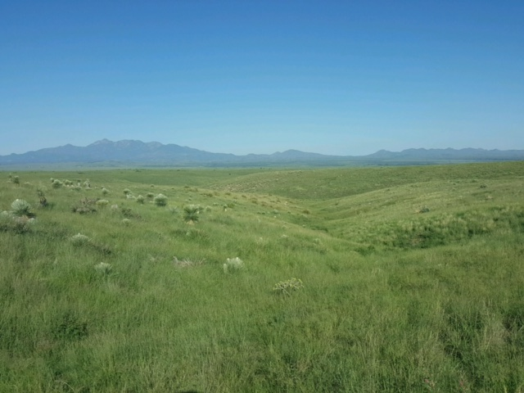
Arizona’s Grasslands
Where are they?
What condition are they in?
Why are they important?
Notes:
If we’re going to talk about brush management, we’d better talk about AZ’s grasslands.

Slide 3
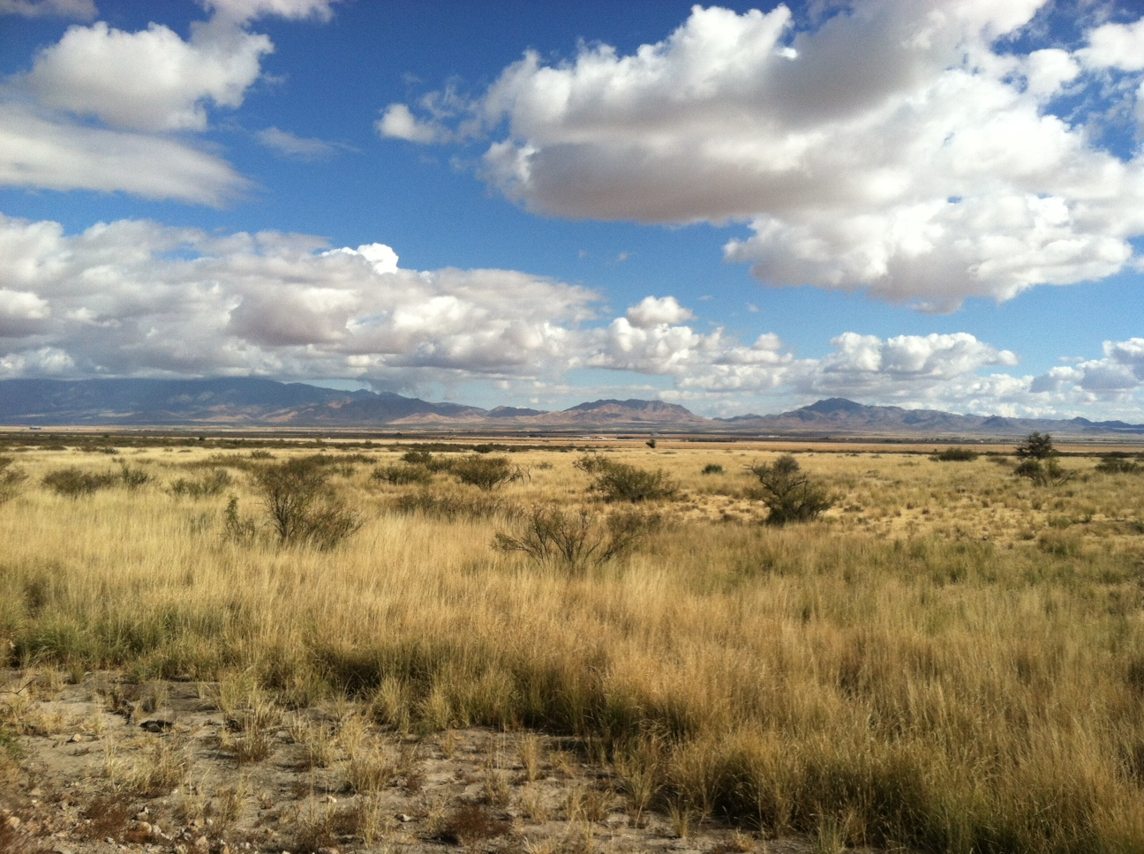
Why grasslands?
Provide important ecological services, such as:
Forage
Cover
Erosion Control
43% of this ecoregion was once grasslands
Reduced to 22% by shrub encroachment
“An ecological analysis of conservation priorities in the Apache Highlands Ecoregion” The Nature Conservancy, 2004

Slide 4
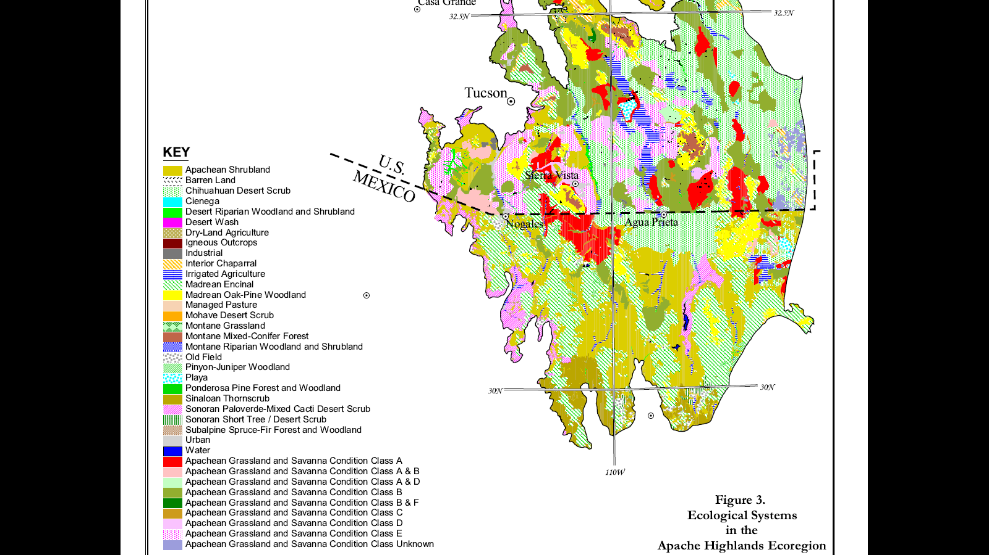
Ecological Systems in the Apache Highlands Ecoregion
Notes:
In this report, “An ecological analysis of conservation priorities in the Apache Highlands Ecoregion”, the looked at all the different ecosystems, including oak-pine woodland, Apachean shrubland, Desert riparian woodland, and last but not least, Apachean Grassland and Savanna, broken into different classes, which they analyzed to prioritize which areas would benefit most from conservation efforts.

Slide 5
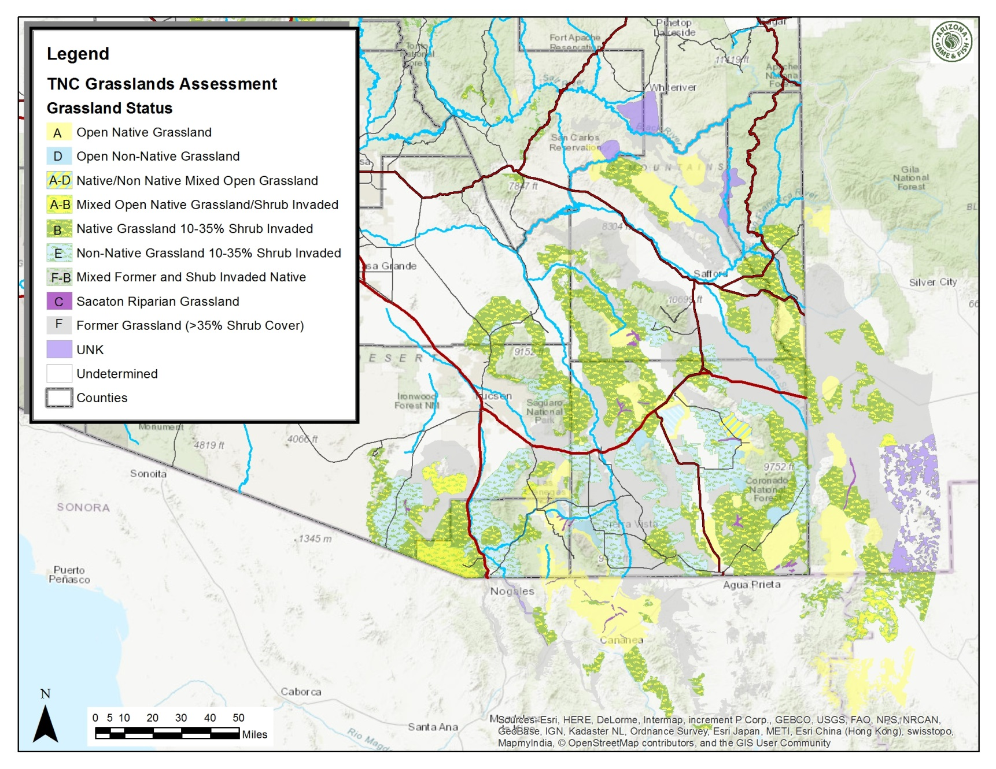
Conservation Priority #1
FOCUS ON GRASSLANDS!
Notes:
THE conservation priority #1 identified in that report was to “Focus on grasslands”.

Slide 6
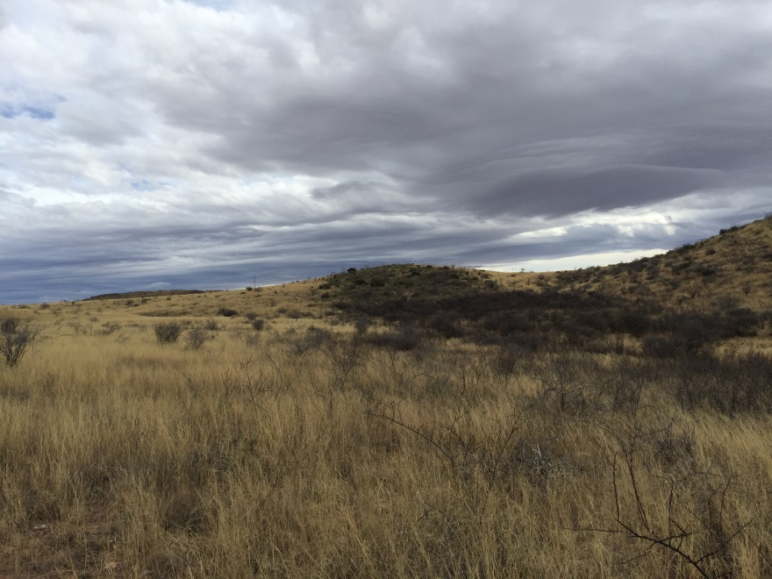
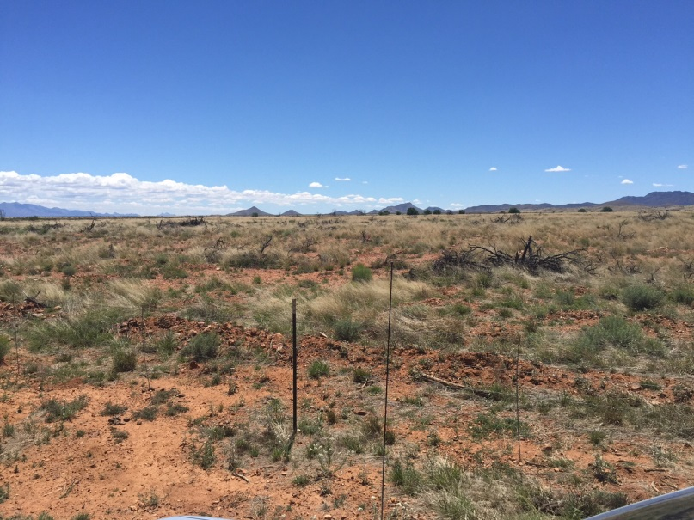
Methods
Mechanical
Chaining
Bulldozer
Backhoe
Excavator
Mastication
Chemical
Aerial – Spike 20P, Sendero,
Hand application – Garlon 4, Velpar L, Remedy/Reclaim
Hand-cut/treat
Cut tree down, treat stump with herbicide
Fire (to maintain treatments)

Slide 7
What does “grassland” mean to you?

Slide 8
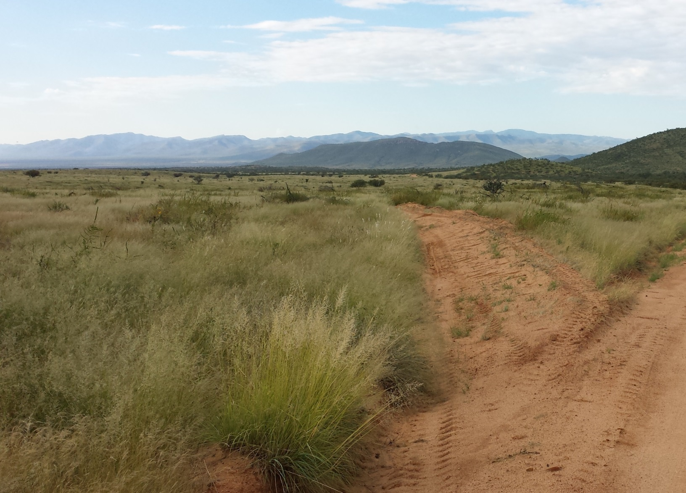
What does “grassland” mean to you?

Slide 9
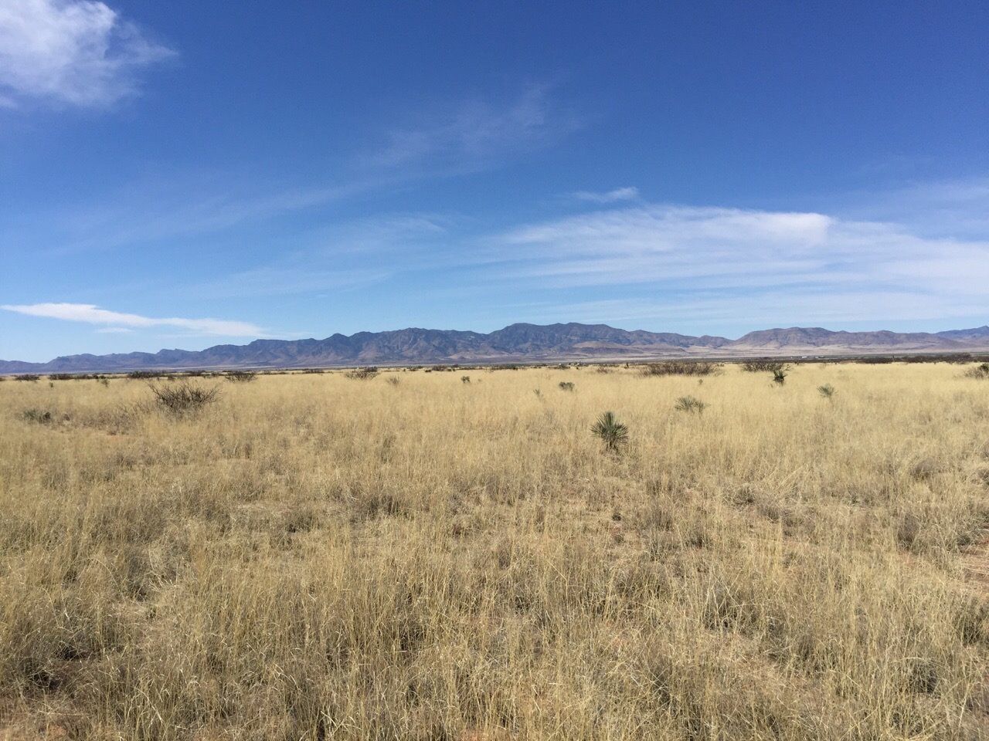
What does “grassland” mean to you?

Slide 10
What does “grassland” mean to you?

Slide 11
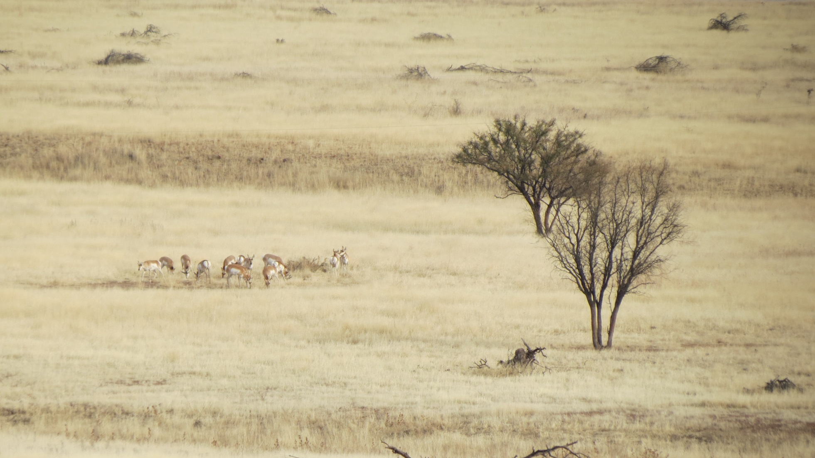
Pronghorn heaven?

Slide 12
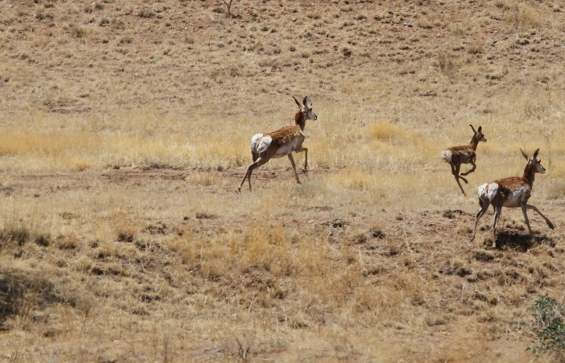
Pronghorn Habitat
Vegetation structure
Forbs/Grass: 30-50% of cover
Small shrubs (<25” tall): 10-35% of cover
Trees: <20% tree canopy (>20% avoided)
Grasses >11” needed to hide fawns
Feeding Habits
Selective feeders, only eat most palatable part of plant, move on
Diet is made up of 80-90% forbs
Have difficulty digesting grass, unless it’s very new growth (same with shrubs—eat when they have to, but only the greenest parts)

Slide 13
Scaled Quail Habitat
Avoid tree cover >20%, but need some shrub cover
Also need >50% tall, bunch-grass cover, but require open ground between grass patches
Rule of thumb: 1 acre of shrubs for every 10 acres of grass; spacing should be 160-240’ apart
Why?
They prefer to run/hide over flying
Nest on the ground under bunch-grasses
Don’t actually eat much grass; prefer forbs, cactus fruit, and the seeds of some shrubs, such as mesquite, sumac, ratany, and wolfberry
Notes:
Similarly, scaled quail, another grassland indicator species, avoids areas with >20% tree cover, rely on tall grasses for hiding, and eat a lot of forbs. However, quail rely on just a little bit of shrub cover to make sure they can hide from predators

Slide 14
Other “Grassland” species?
Mule deer
Commonly associated with grasslands, particularly where drainages run through
Need some trees for shade/cover, preferably <40% of area
Rely on shrubs for food/shelter
Primarily BROWSERS
Grasses and succulents only make up 5% of their diet
Old-growth, decadent tree/shrub stands are avoided
Gambel’s quail
Habitat “generalists”, but are most commonly associated with thorny, diverse shrub cover along drainages
50-70% tree cover
Grass cover can vary from 0-50%

Slide 15
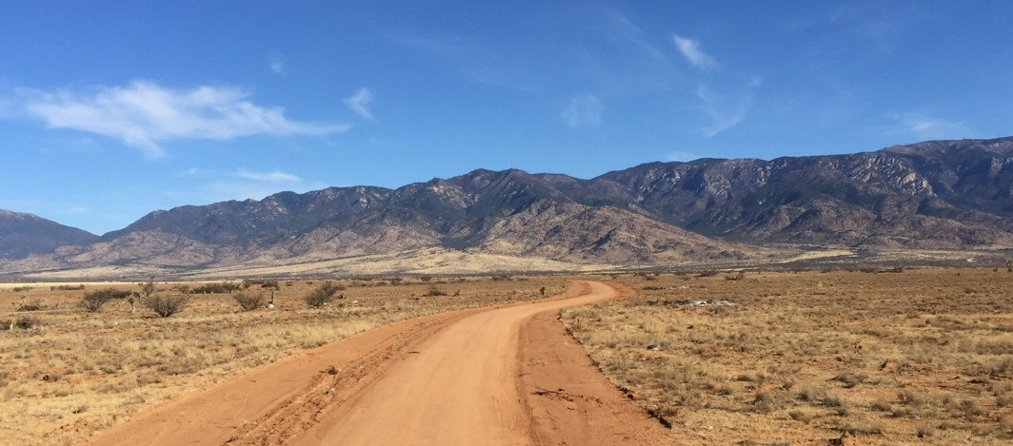
What does this mean?
Diversity is key.
As we “restore” grasslands, keep in mind the similar, but different, habitat needs of wildlife you may find there
Reducing shrub density over-all is good, but some cover needs to be left behind for those species depending on it

Slide 16
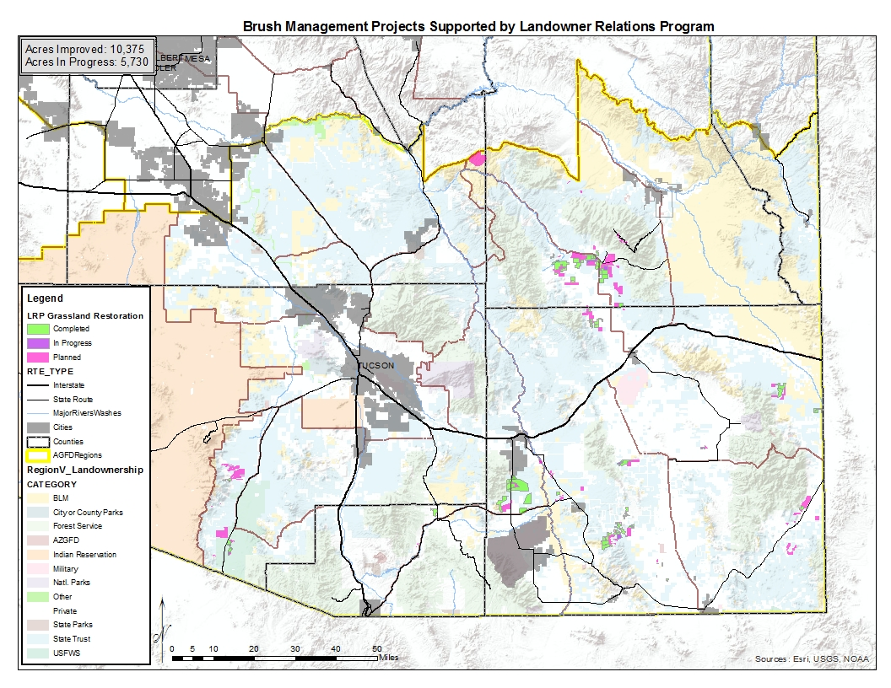
Past/Present Projects with AZGFD-LRP

Slide 17
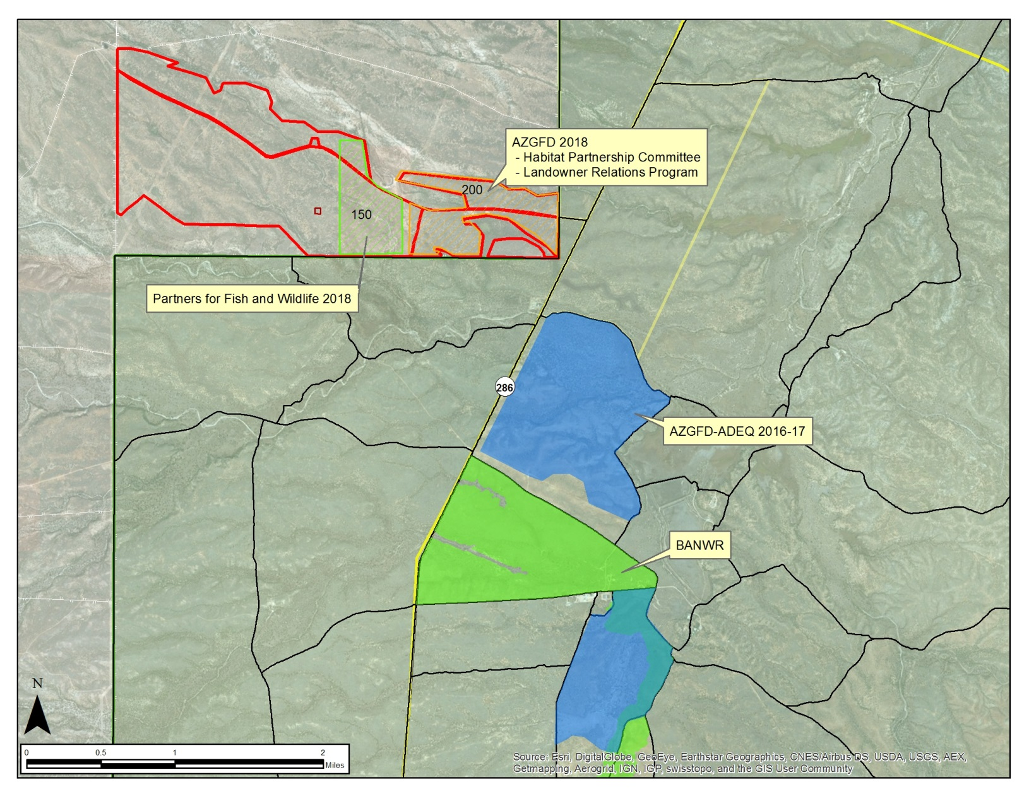
Santa Margarita Project

Slide 23
The End

