Slide 1
Brush management and ecosystem services: a quantification of trade-offs on Western rangelands
Adam T. Naito
School of Natural Resources and the Environment
University of Arizona
Tucson, AZ USA
Thursday 19 April 2018
WSARE Brush Management Workshop
Buenos Aires National Wildlife Refuge

Slide 2
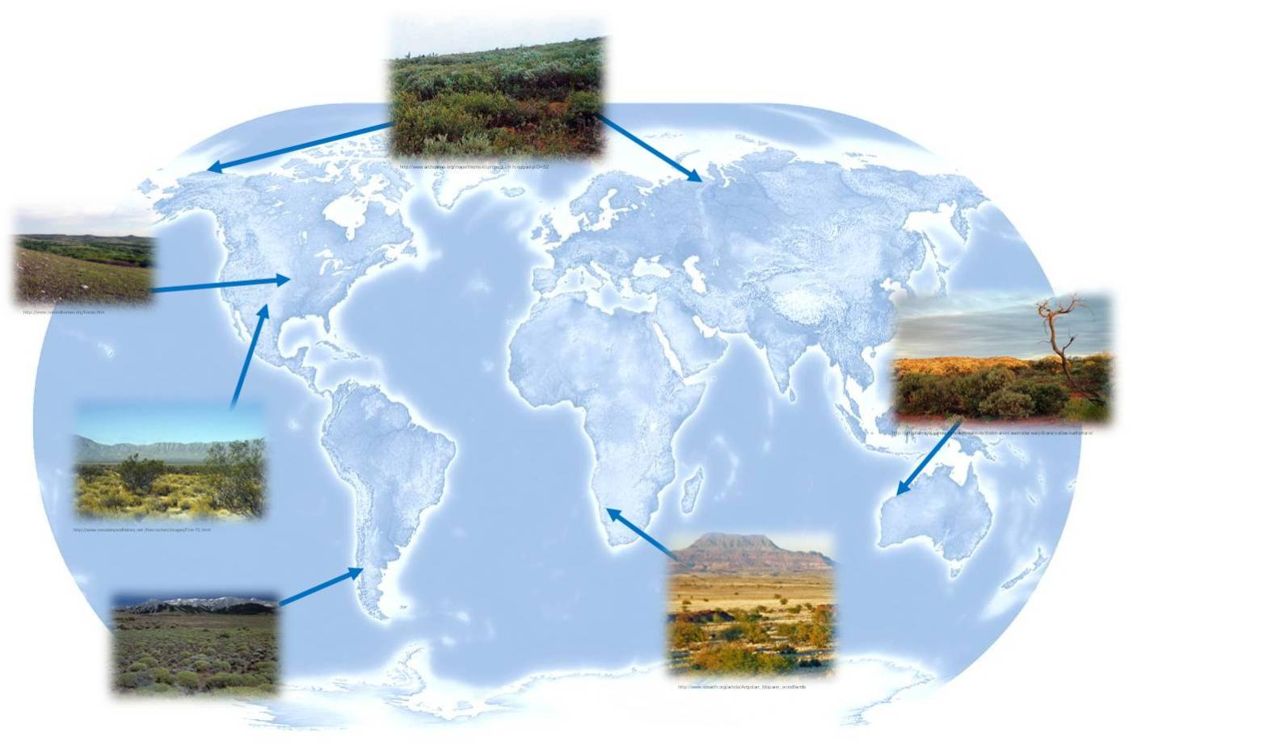
Background ───────
Woody encroachment as a global phenomenon
Background | Objectives | Study area | Methods | Results | Implications

Slide 3
Background ───────
Traditional drivers of woody encroachment
Livestock (over)grazing

Slide 4
Background ───────
Traditional drivers of woody encroachment
Livestock (over)grazing

Slide 5
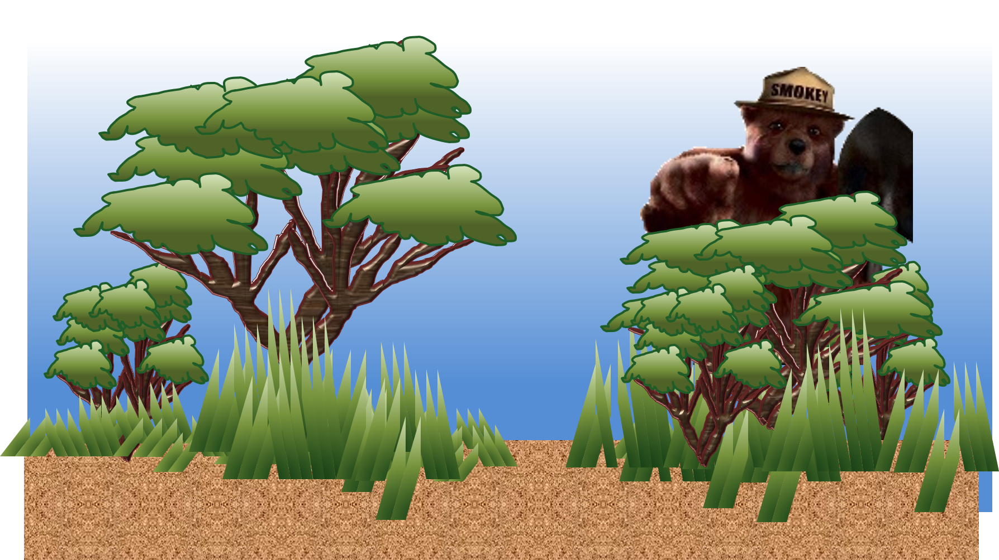
Background ───────
Traditional drivers of woody encroachment
Fire suppression

Slide 6
Background ───────
Woody encroachment on the Santa Rita Experimental Range (SRER)
Photos by Cribbs, Bohning, Buttery, and McClaran
SRER Repeat Photography (http://ag.arizona.edu/SRER/photos.html)
Background | Objectives | Study area | Methods | Results | Implications

Slide 7
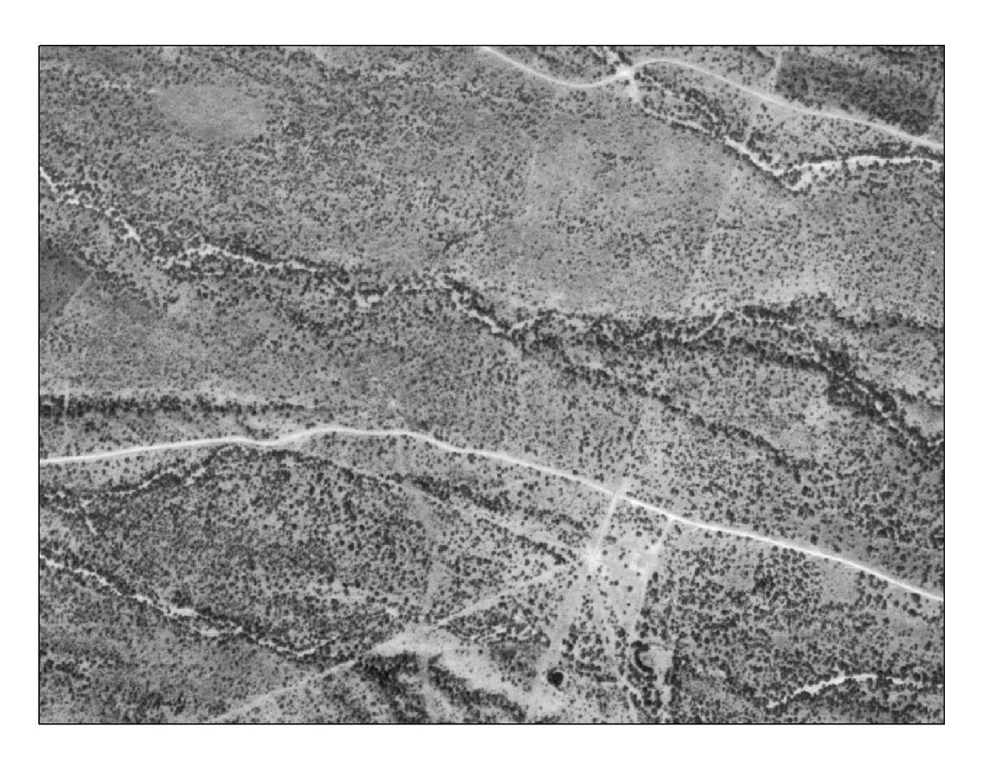
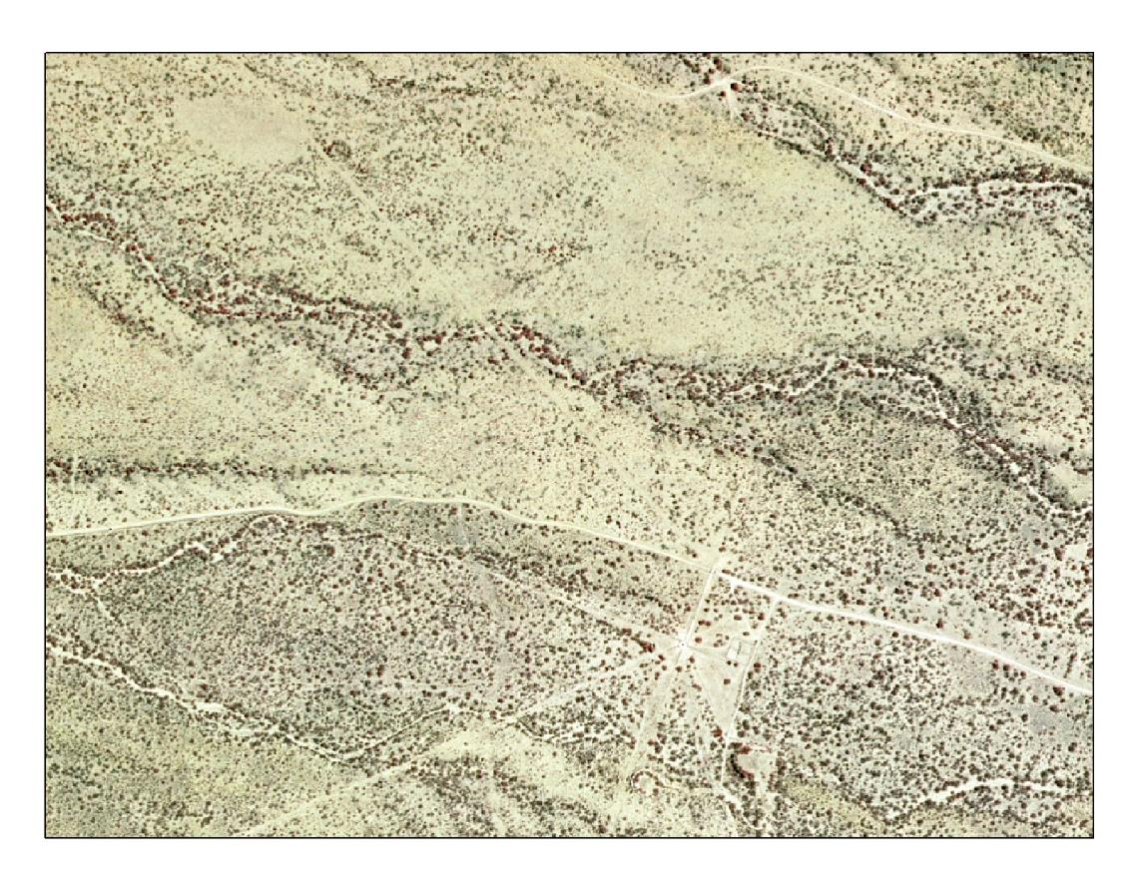
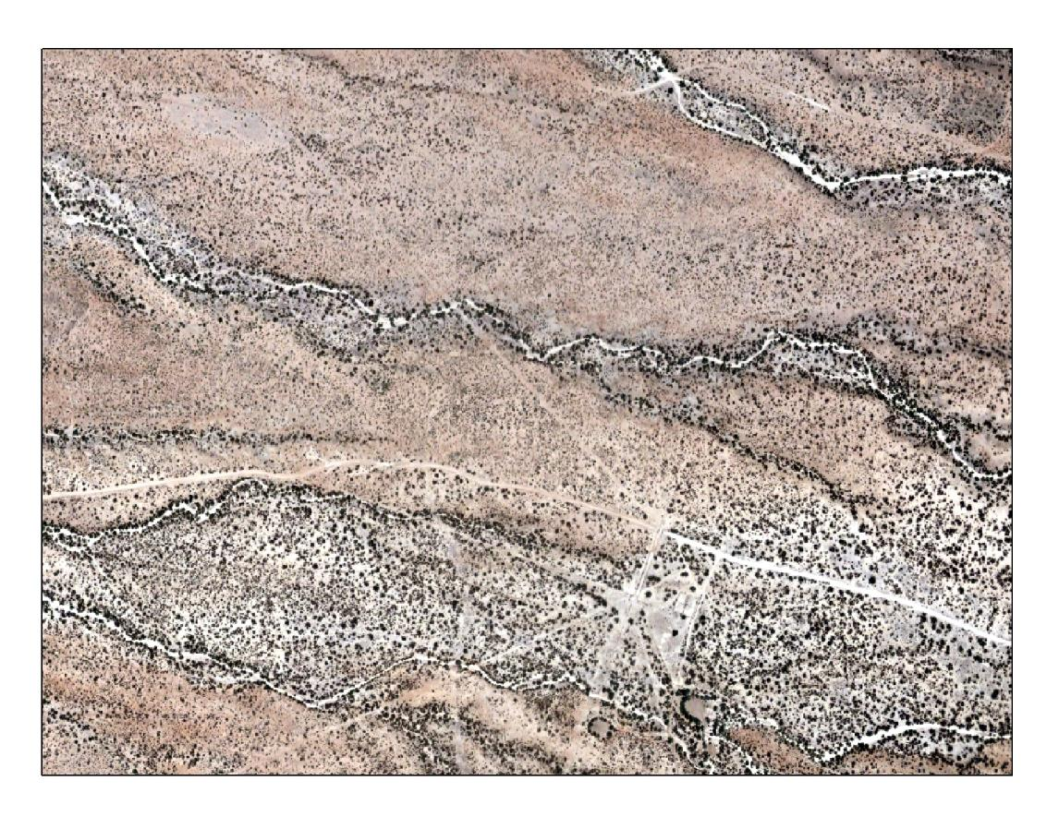
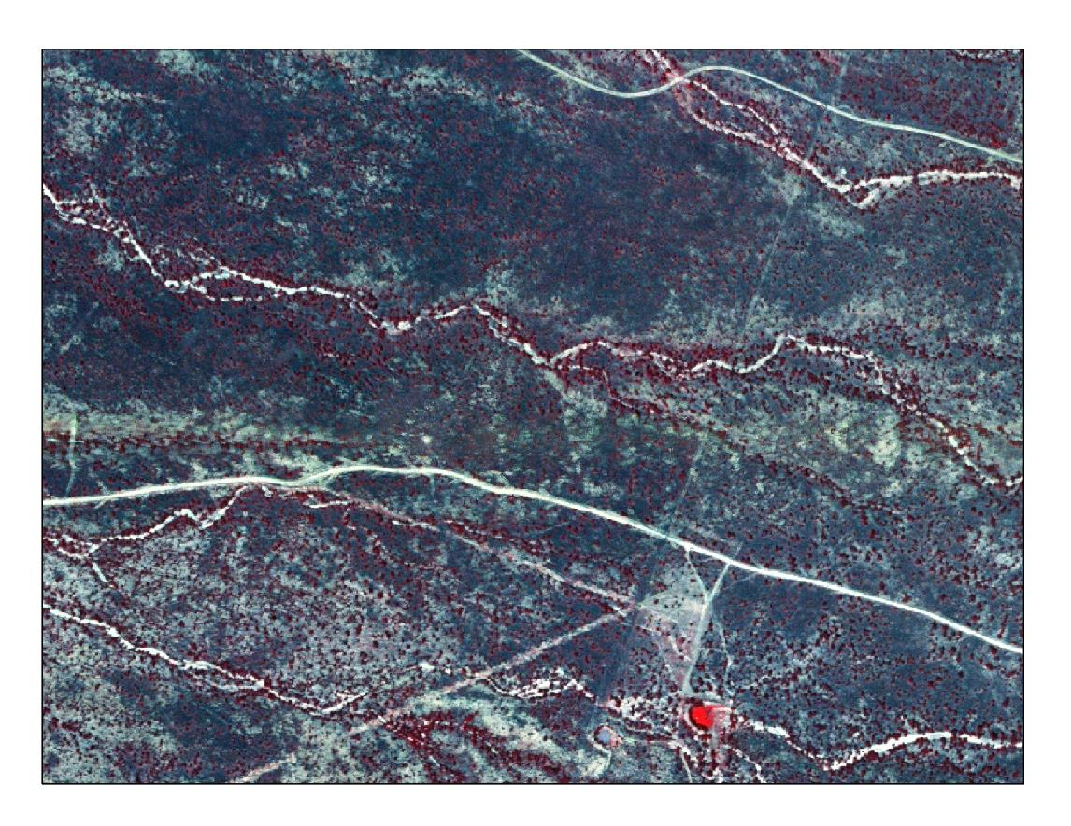
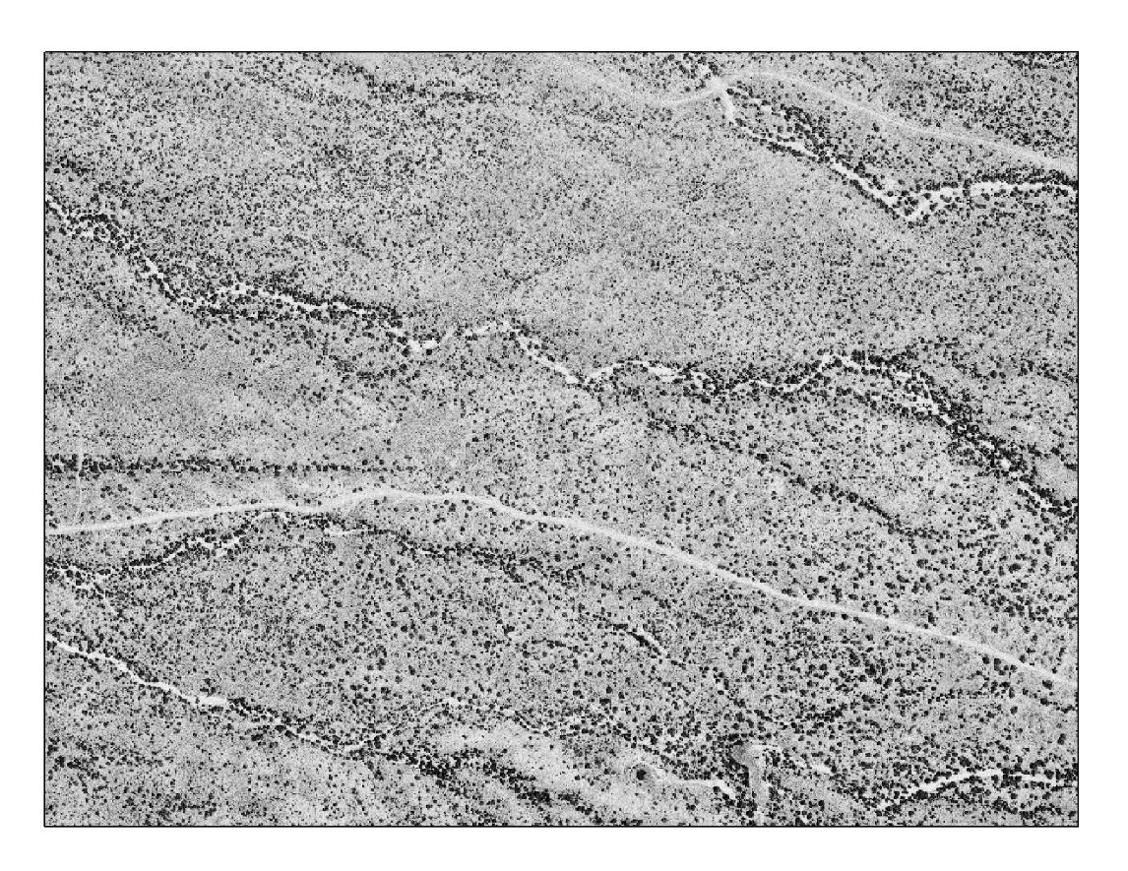
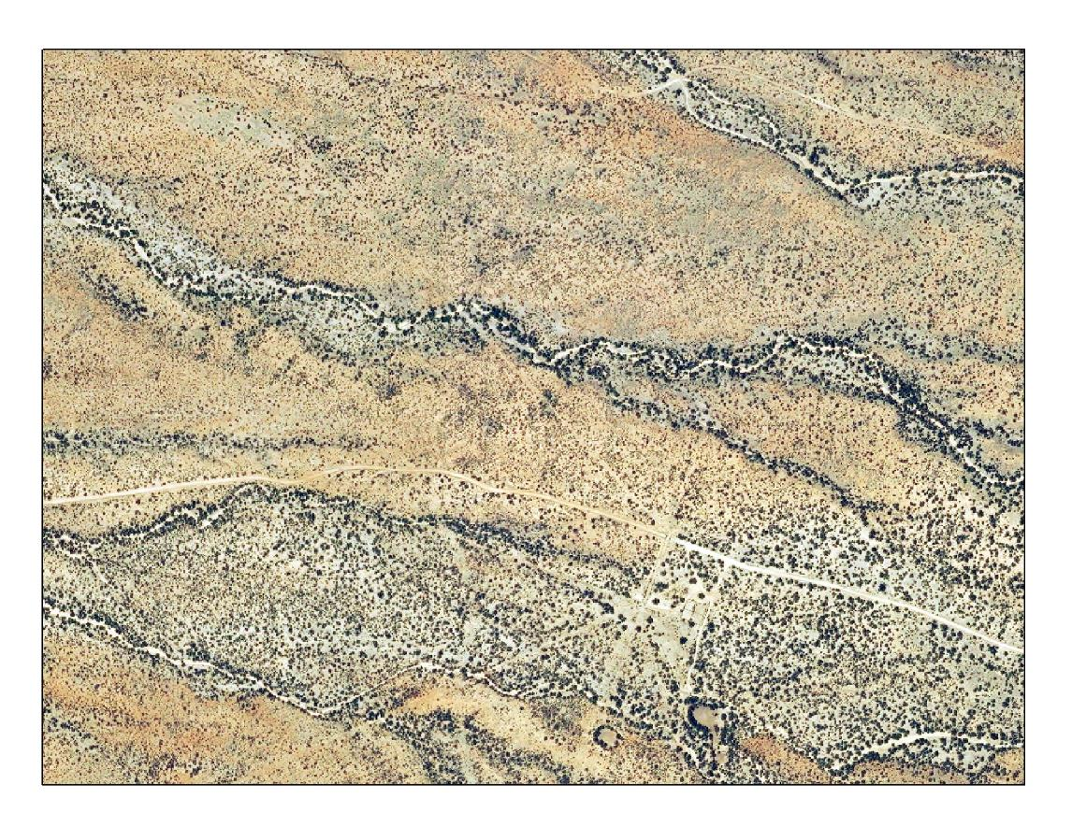
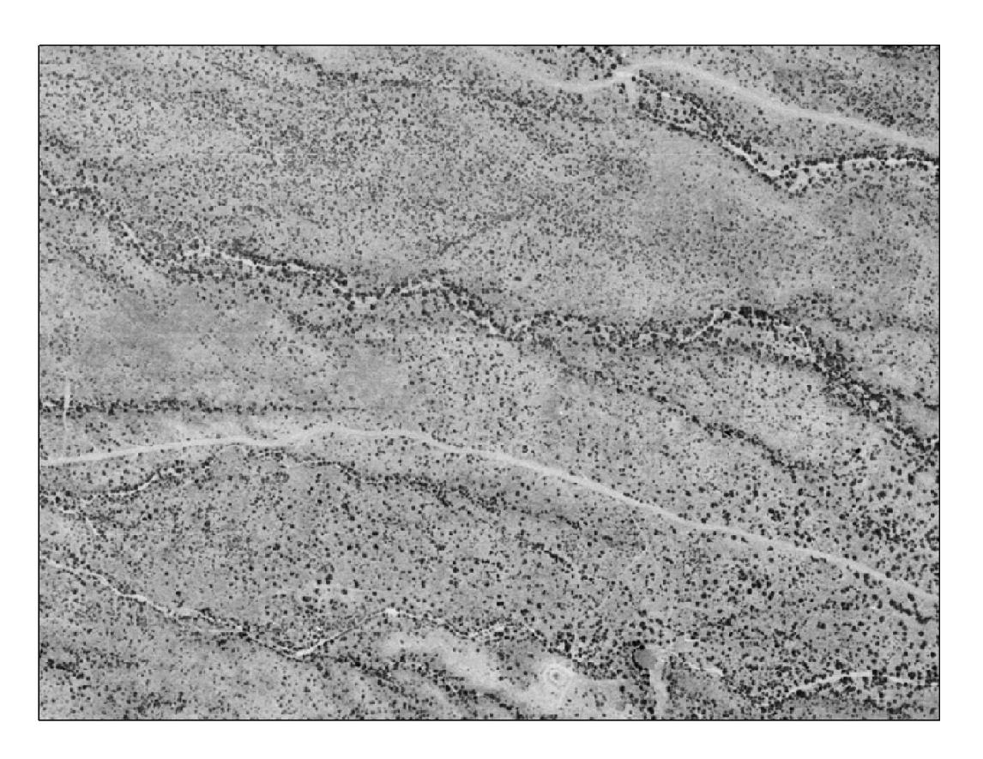
Background ───────
Woody encroachment in SRER
1971
1975
1987
1996
2003
2007
2013
Browning and Archer 2008, Browning et al. 2009, Naito and Benally in prep.
Background | Objectives | Study area | Methods | Results | Implications

Slide 8
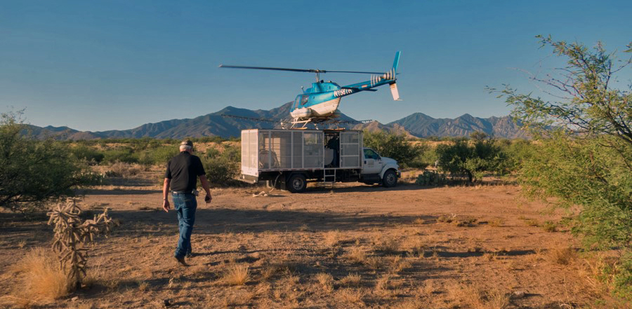
Background ───────
Woody encroachment in Arizona
Photo courtesy of Mark Heitlinger
Background | Objectives | Study area | Methods | Results | Implications

Slide 9
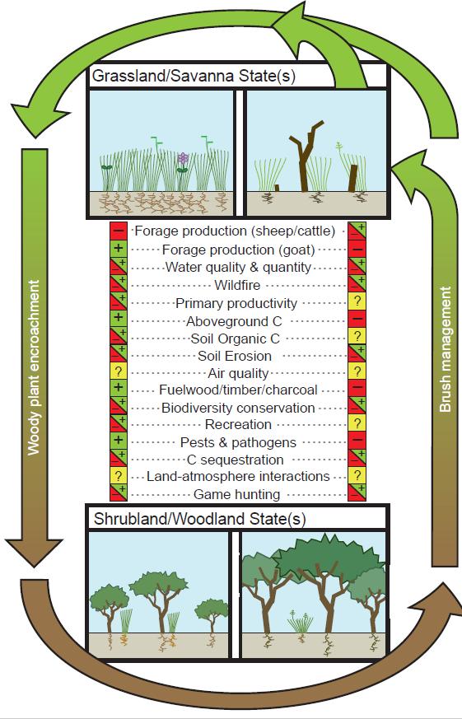
Background ───────
Encroachment & management effects on ecosystem services
Archer and Predick (2014), J. Ecology
Background | Objectives | Study area | Methods | Results | Implications

Slide 10
Background ───────
Encroachment & management effects on ecosystem services
What ecosystem services are affected by brush management, and what are the potential long-terms trade-offs?
Integration of field data with UAV-derived imagery and simulation modeling.
Is it “worth it,” not just financially, but ecologically? If so, we can provide land managers with information to better prioritize the location and timing of management actions and objectively evaluate competing land use scenarios.
Background | Objectives | Study area | Methods | Results | Implications

Slide 11
Objectives ───────
Conceptual model of herbaceous response to brush management
Peak in herbaceous response
Duration of peak herbaceous response
Brush management
Lag in response from herbaceous plants
Amount
Time
Woody cover
Adapted from Archer and Predick (2014), J. Ecology
Herbaceous cover
Background | Objectives | Study area | Methods | Results | Implications

Slide 12
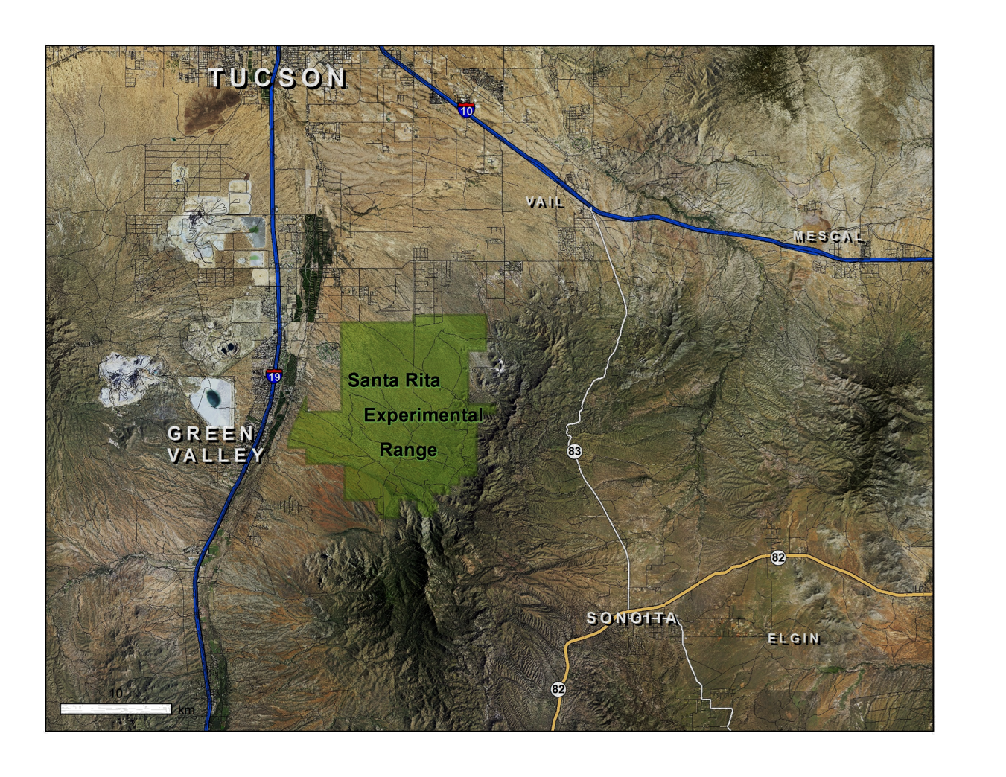
Study area ───────
Santa Rita Experimental Range
Background | Objectives | Study area | Methods | Results | Implications

Slide 13
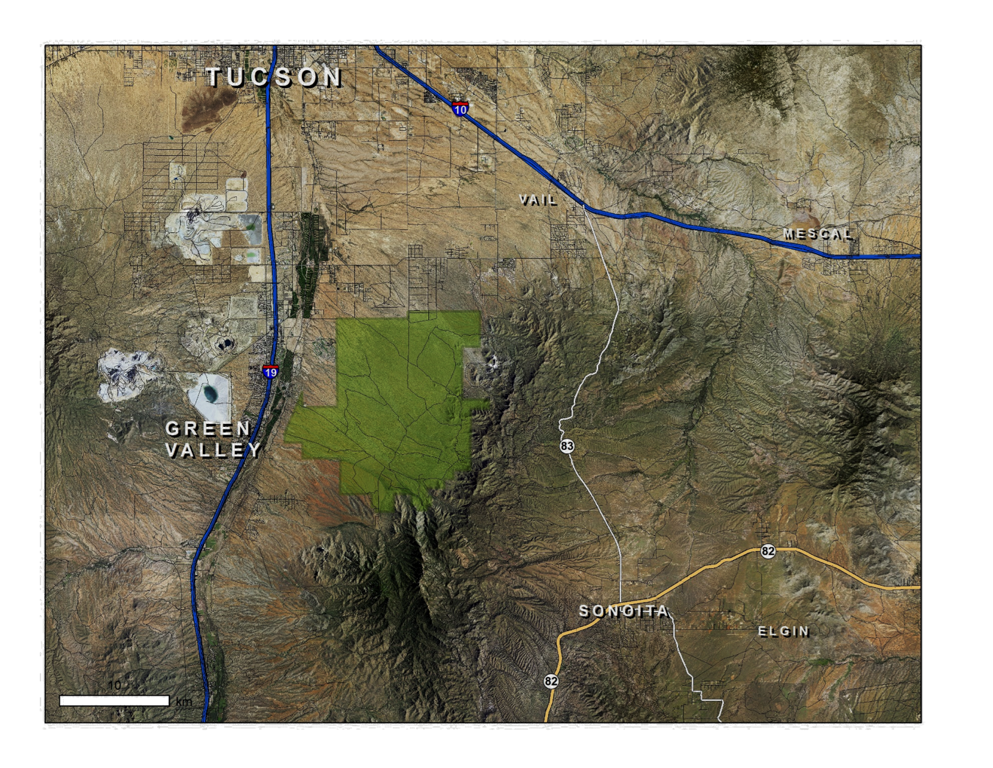
Study area ───────
Santa Rita Experimental Range
Background | Objectives | Study area | Methods | Results | Implications

Slide 14
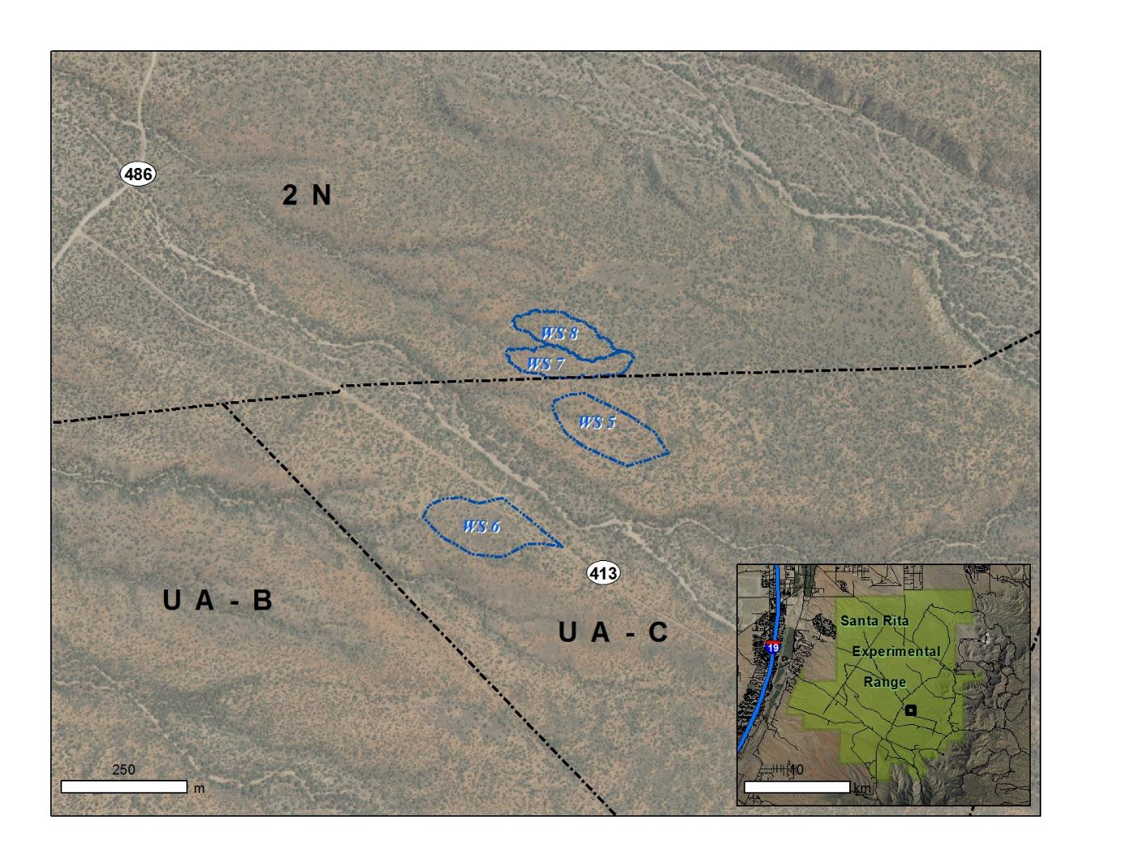
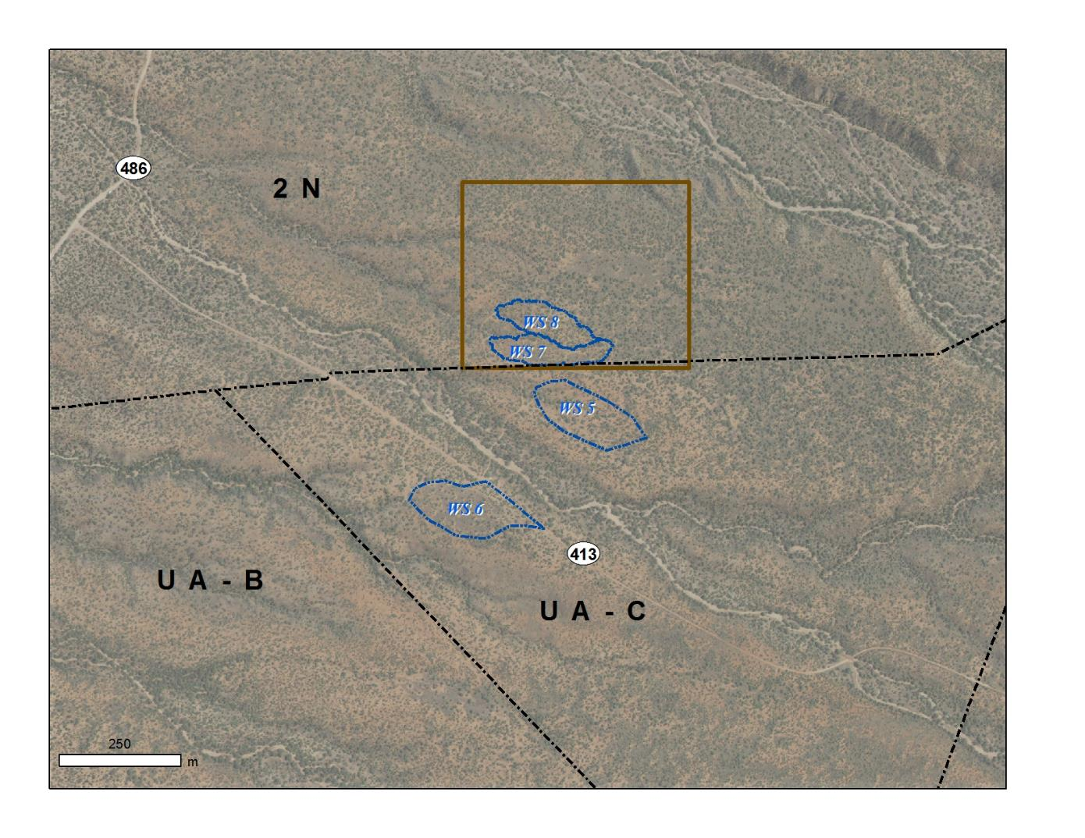
Study area ───────
Santa Rita Experimental Range
Background | Objectives | Study area | Methods | Results | Implications

Slide 15
Study area ───────
Santa Rita Experimental Range
Background | Objectives | Study area | Methods | Results | Implications

Slide 16
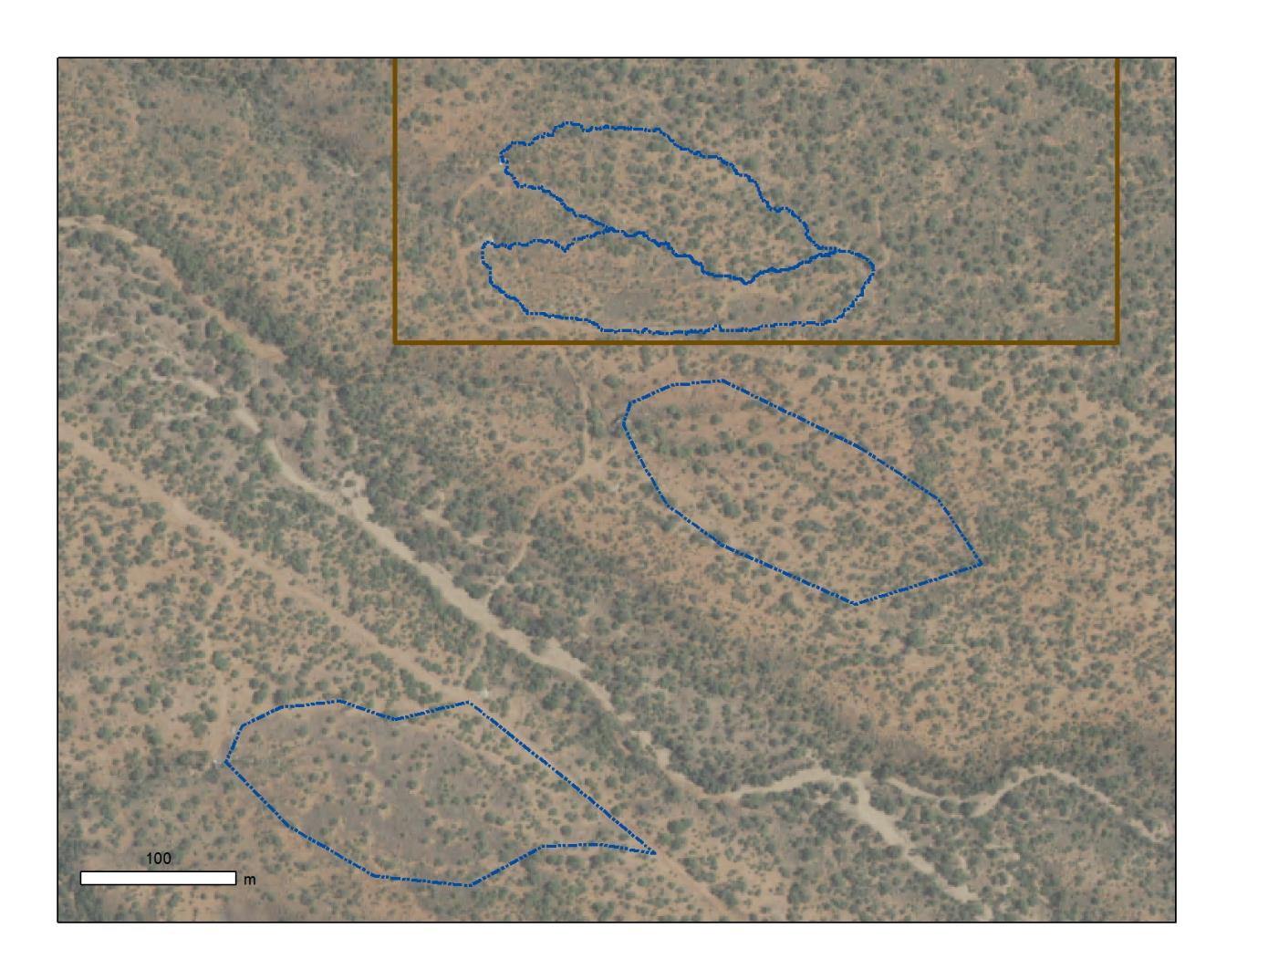
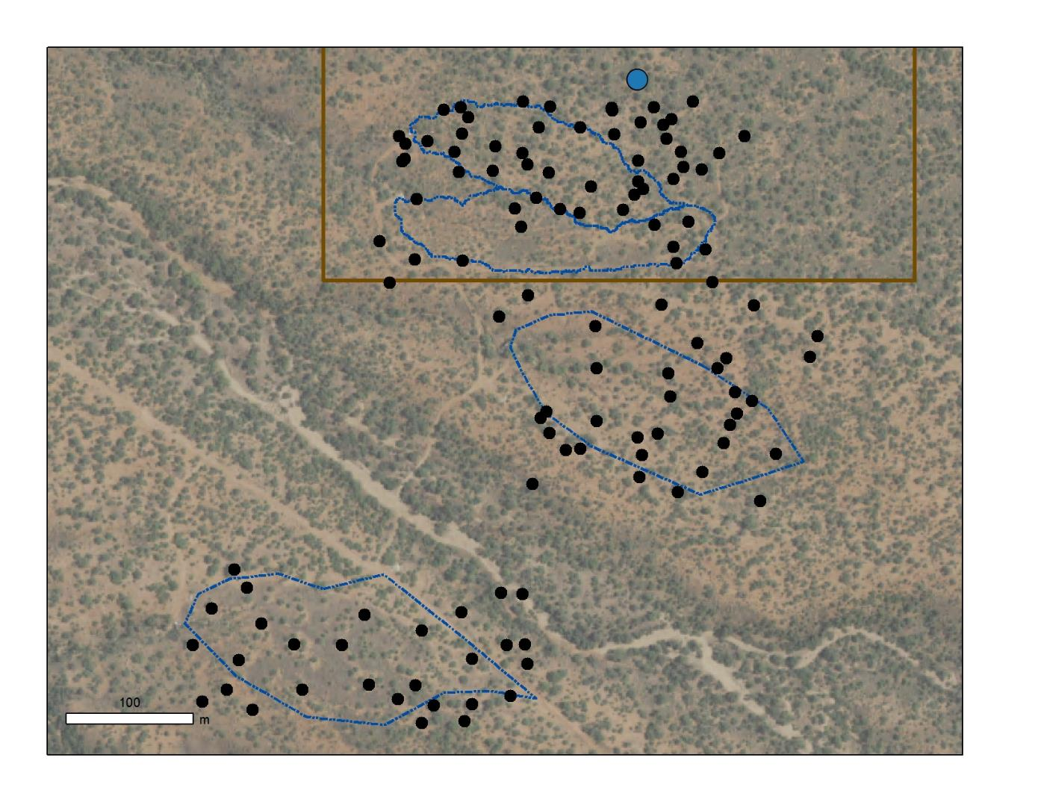
Methods ───────
Sampling mesquite
Background | Objectives | Study area | Methods | Results | Implications

Slide 17
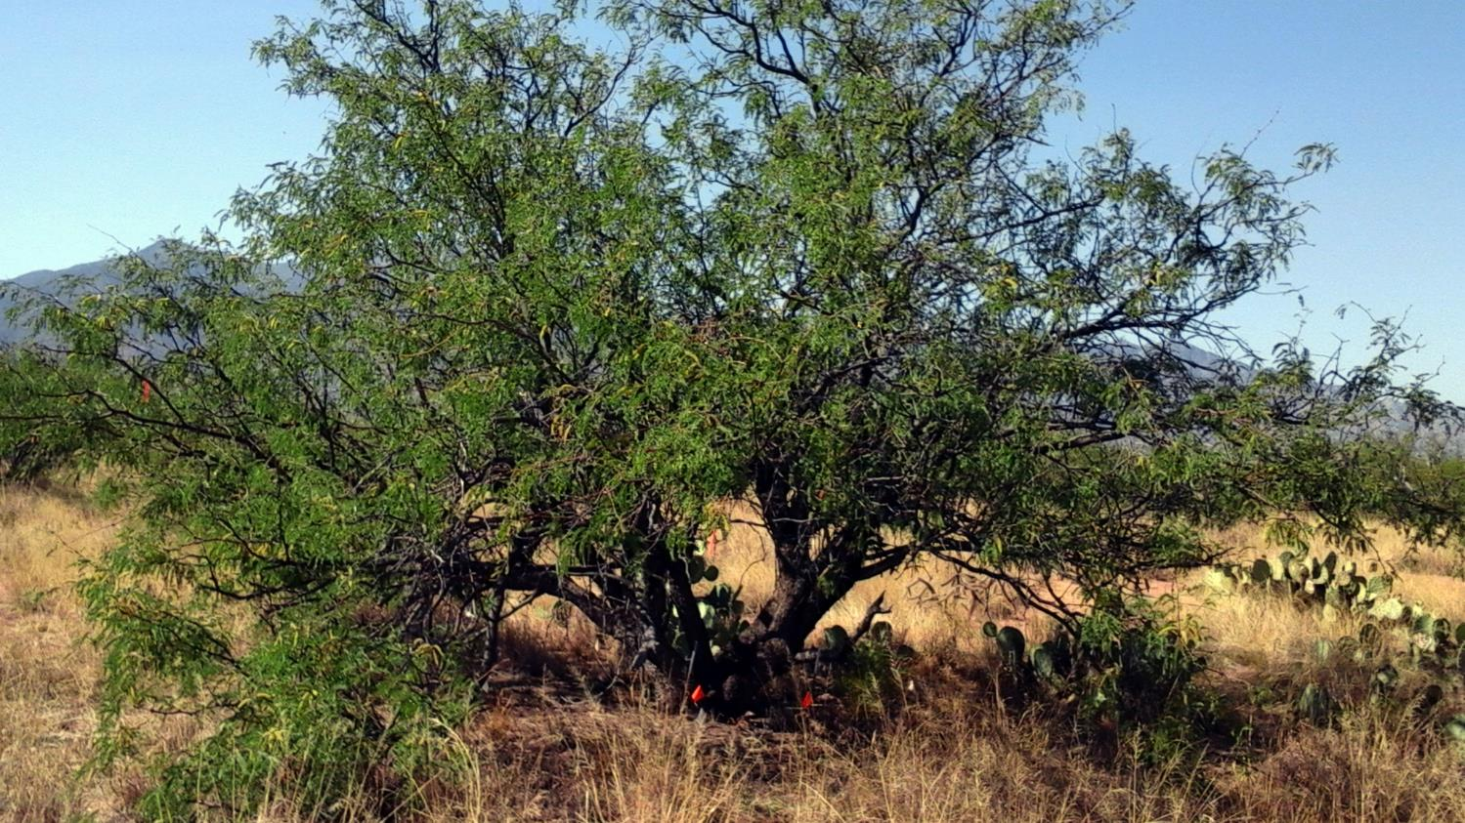
Methods ───────
Diversity and biomass
Background | Objectives | Study area | Methods | Results | Implications

Slide 18
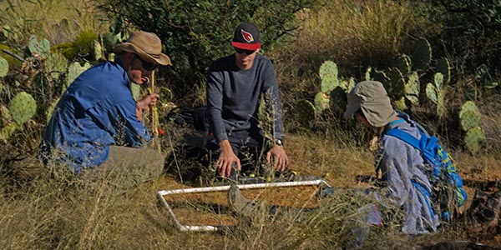
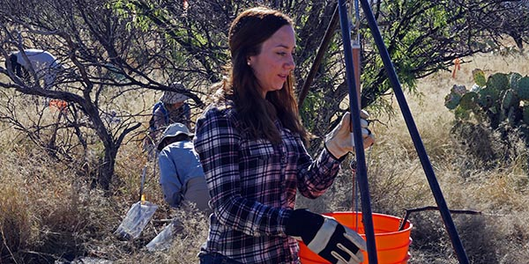
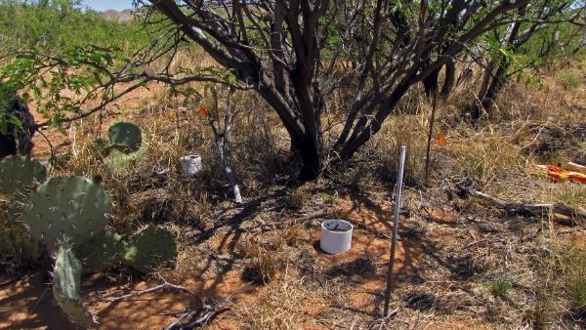
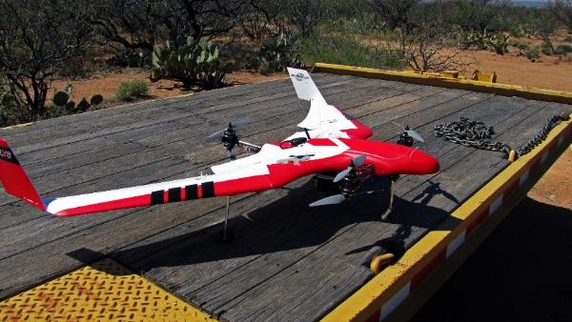
Methods ───────
Data collection
Background | Objectives | Study area | Methods | Results | Implications

Slide 19
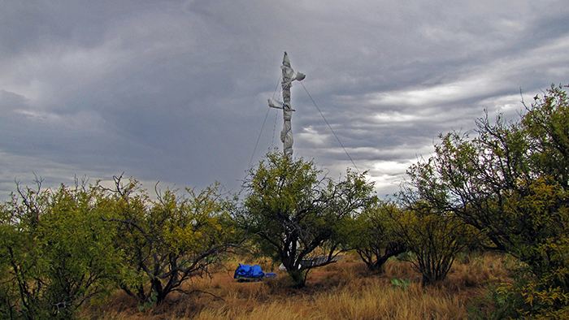
Methods ───────
Preparation for the herbicide application
Background | Objectives | Study area | Methods | Results | Implications

Slide 20
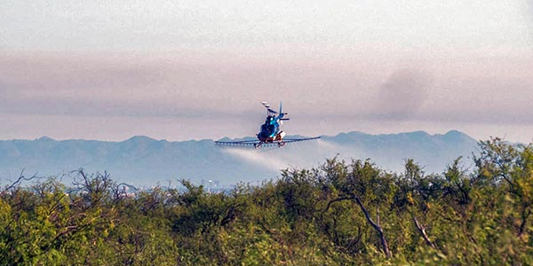
Methods ───────
Herbicide application
Background | Objectives | Study area | Methods | Results | Implications

Slide 21
Methods ───────
Post-herbicide application
Background | Objectives | Study area | Methods | Results | Implications

Slide 22
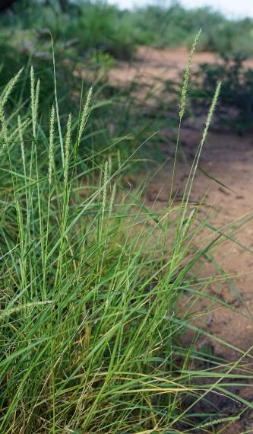
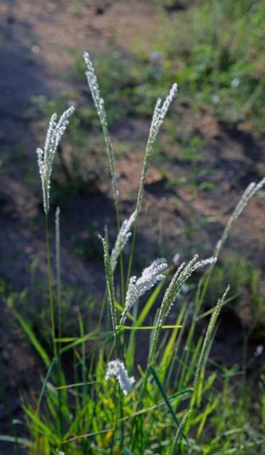
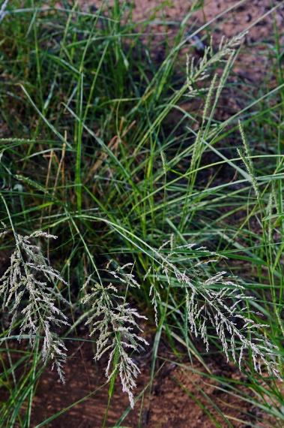
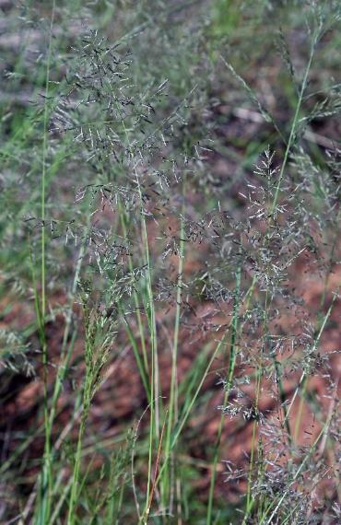
Results ───────
Herbaceous diversity under mesquite canopies
Large-spike bristlegrass
Arizona cottontop
Weeping lovegrass
Lehmann lovegrass
Setaria macrostachya
Digitaria californica
Eragrostis curvula
Eragrostis lehmanniana
Photos courtesy of Adam T. Naito, PhD
Background | Objectives | Study area | Methods | Results | Implications

Slide 23
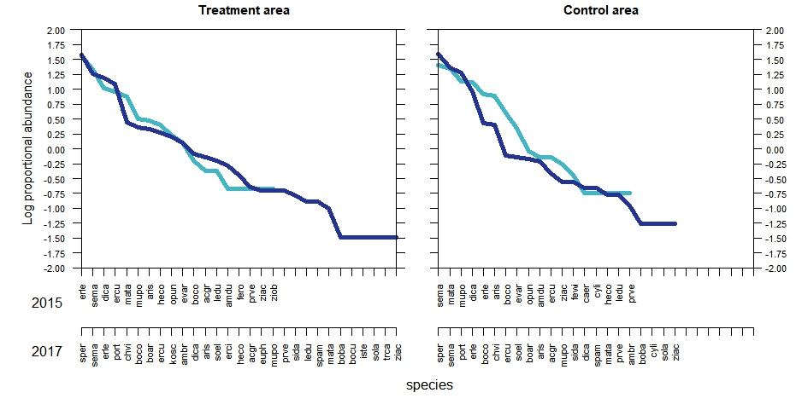
Results ───────
Herbaceous primary production
2015
2017
Background | Objectives | Study area | Methods | Results | Implications

Slide 24
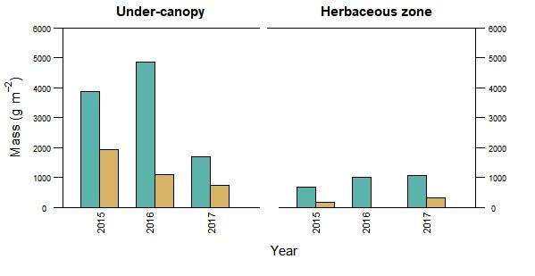
Results ───────
Herbaceous primary production
Treatment
Control
Background | Objectives | Study area | Methods | Results | Implications

Slide 25
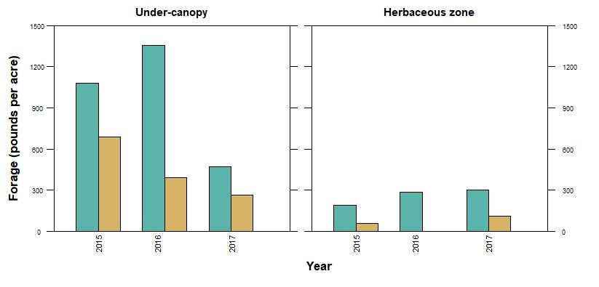
Results ───────
Average forage production
Treatment
Control
Background | Objectives | Study area | Methods | Results | Implications

Slide 26
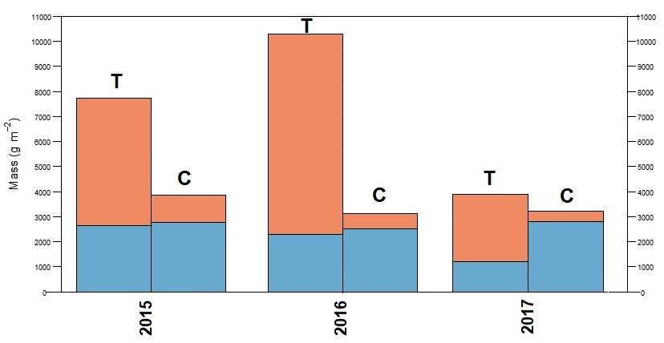
Results ───────
Under-canopy herbaceous primary production
Native
Non-native
Background | Objectives | Study area | Methods | Results | Implications

Slide 27
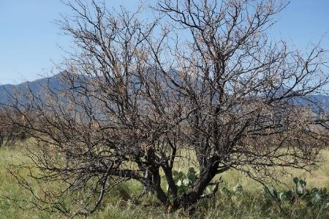
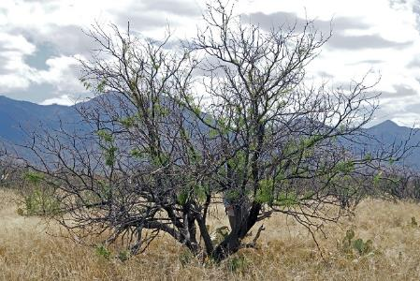
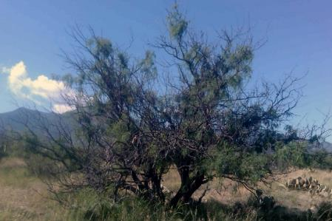
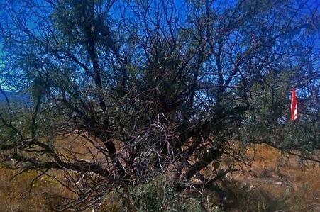
Results ───────
Mesquite recovery
Days before
1 month post
3 months post
9 months post
13 months post
19 months post
Background | Objectives | Study area | Methods | Results | Implications

Slide 28
Implications ───────
BM in this desert grassland may shift the community composition in favor of non-native perennials and annuals over native perennials, perhaps triggered by periods of precipitation shortfall
Unintended adverse consequence for herbaceous diversity and primary production.
Soil data, soil carbon modeling and erosion modeling should provide extra contextual information.
Background | Objectives | Study area | Methods | Results | Implications

Slide 29
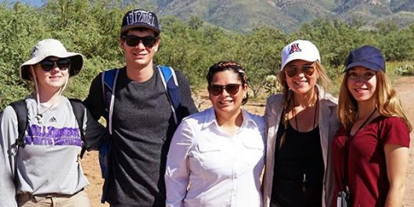
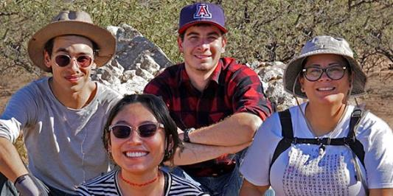
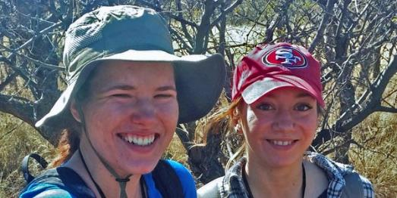
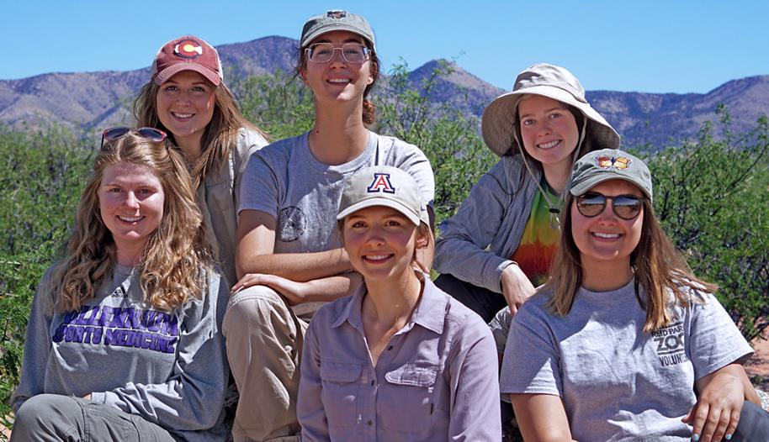
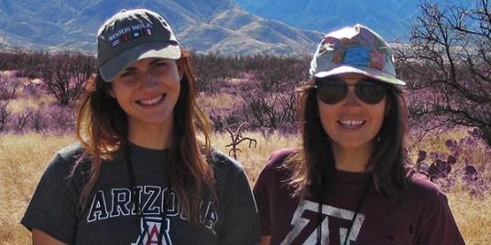
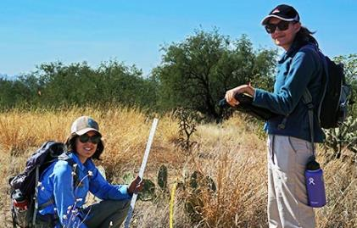
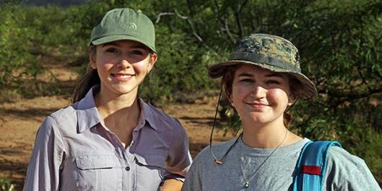

Slide 30
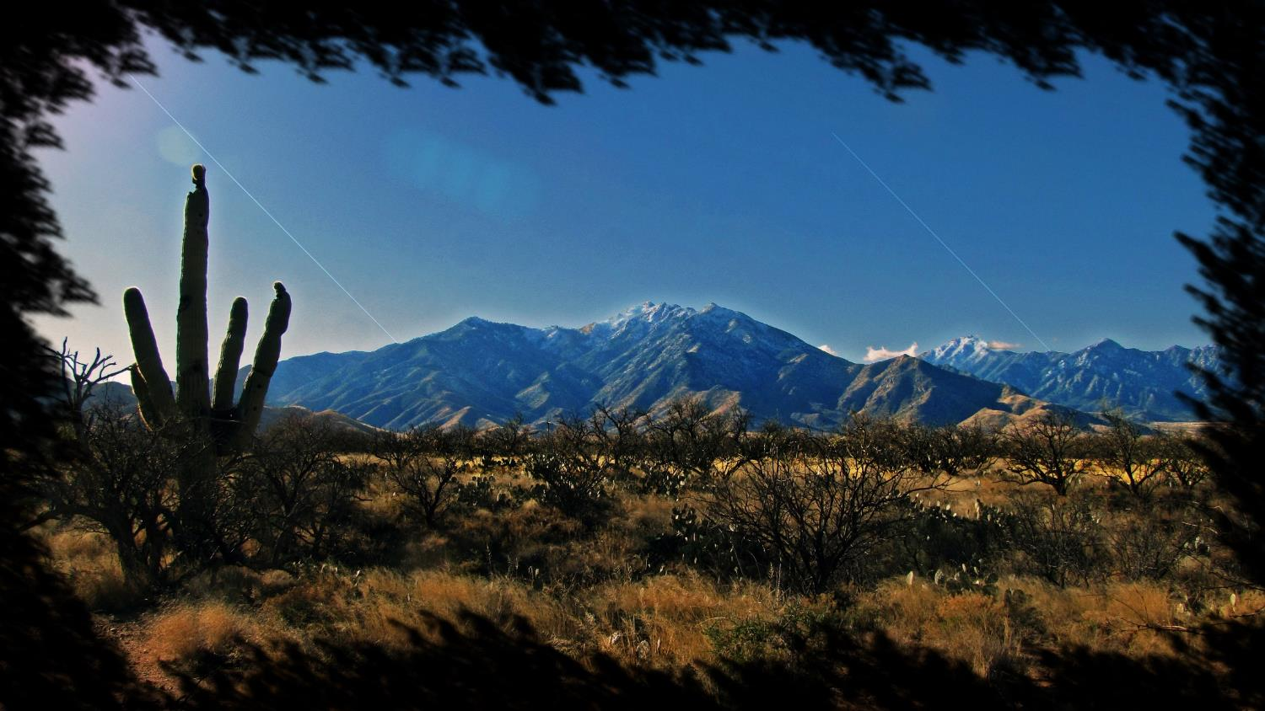
https://cals.arizona.edu/research/archer/bmes

