Slide 1
Drought and Southeast Arizona: Where are we now and where are we headed?
Mike Crimmins
Assoc. Professor/Extension Specialist
Dept. of Soil, Water, & Environmental Science & Arizona Cooperative Extension
The University of Arizona

Slide 2
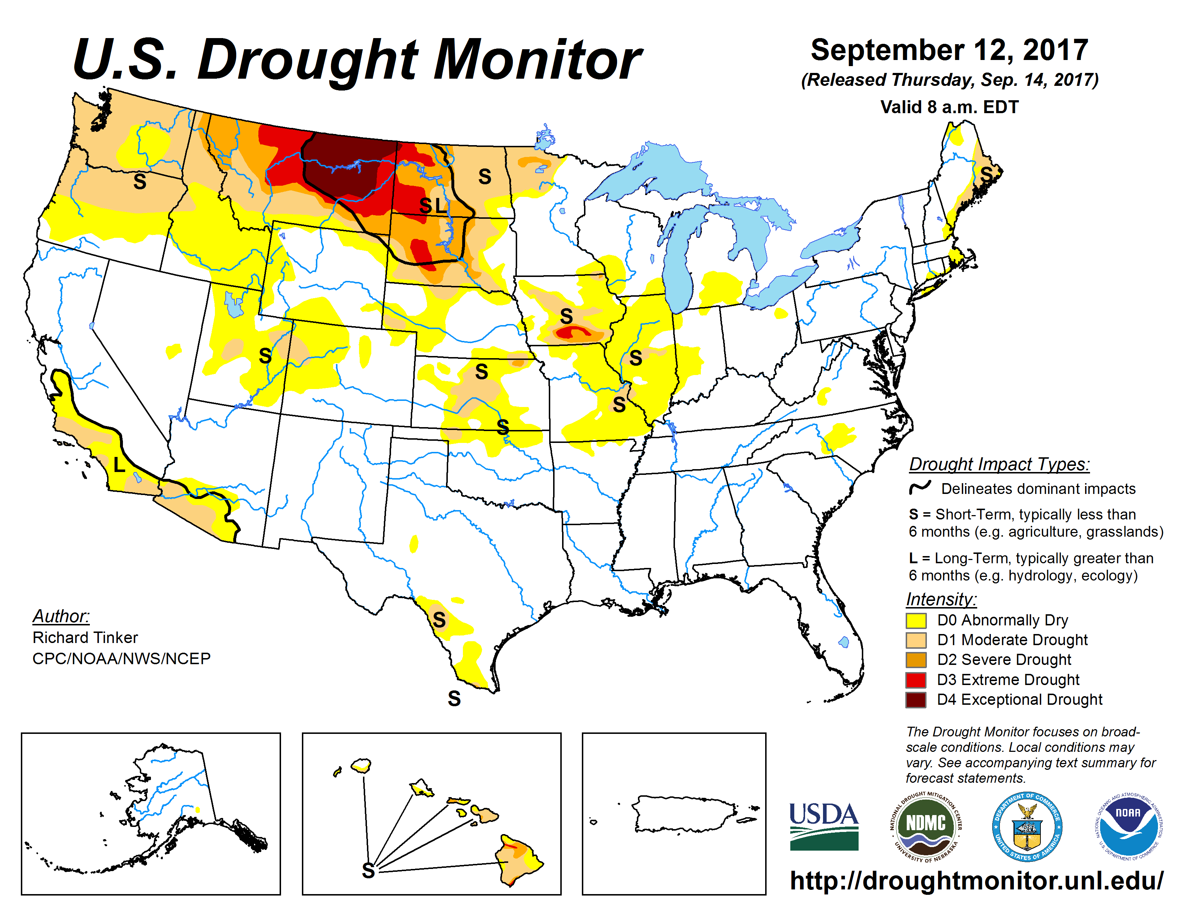

Slide 3
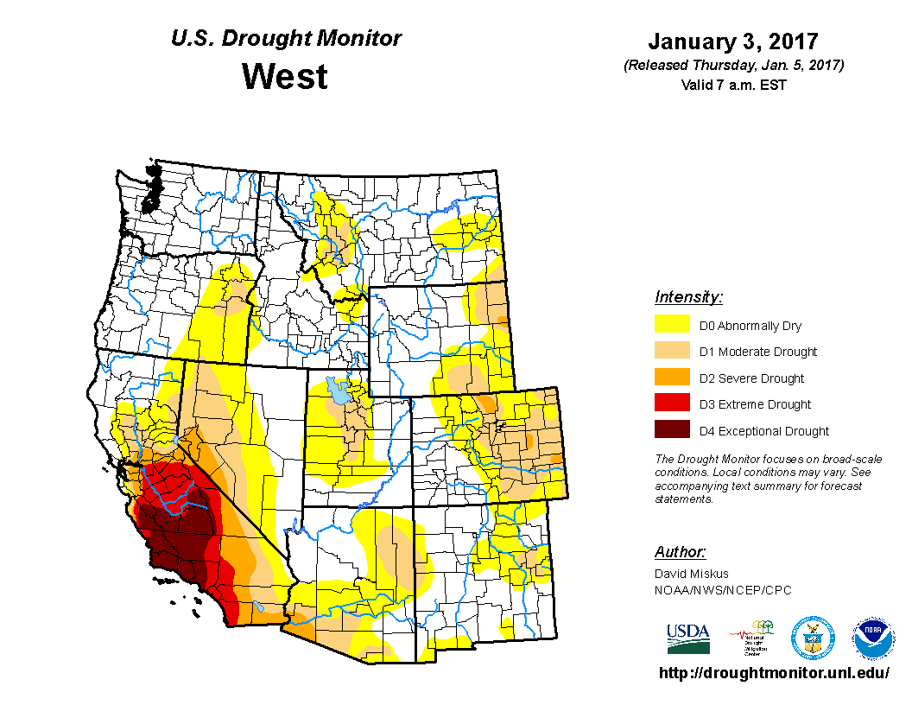
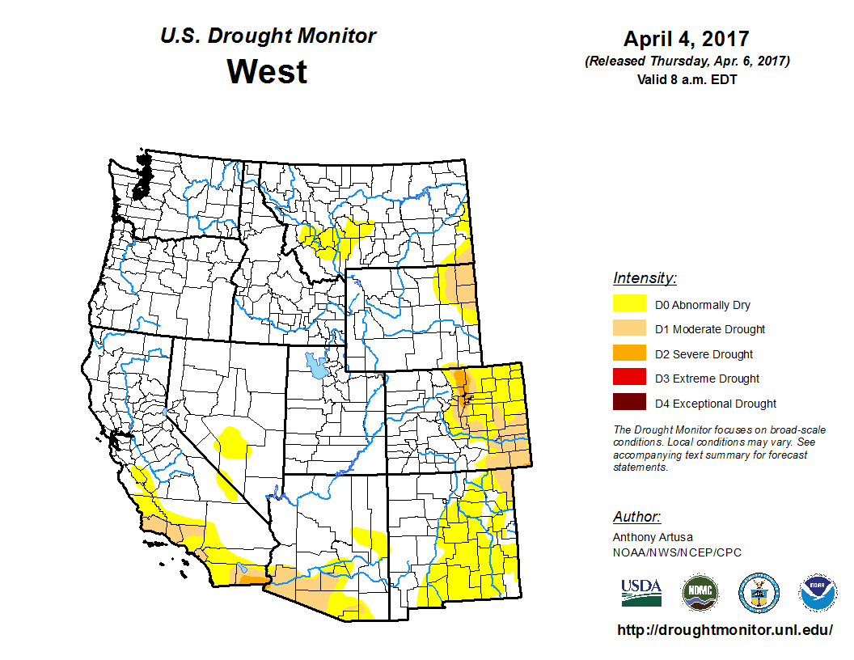
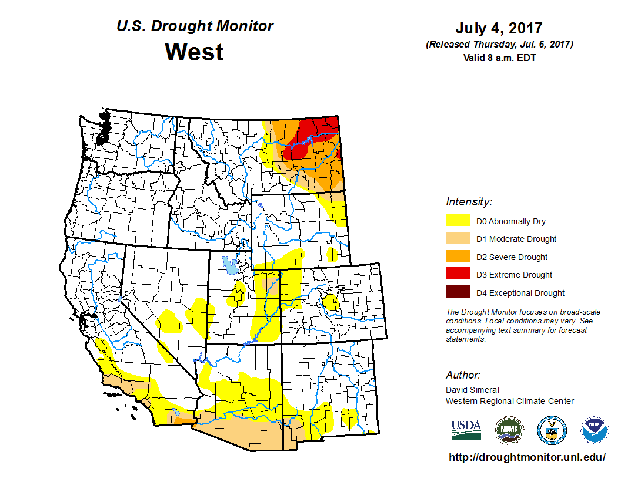
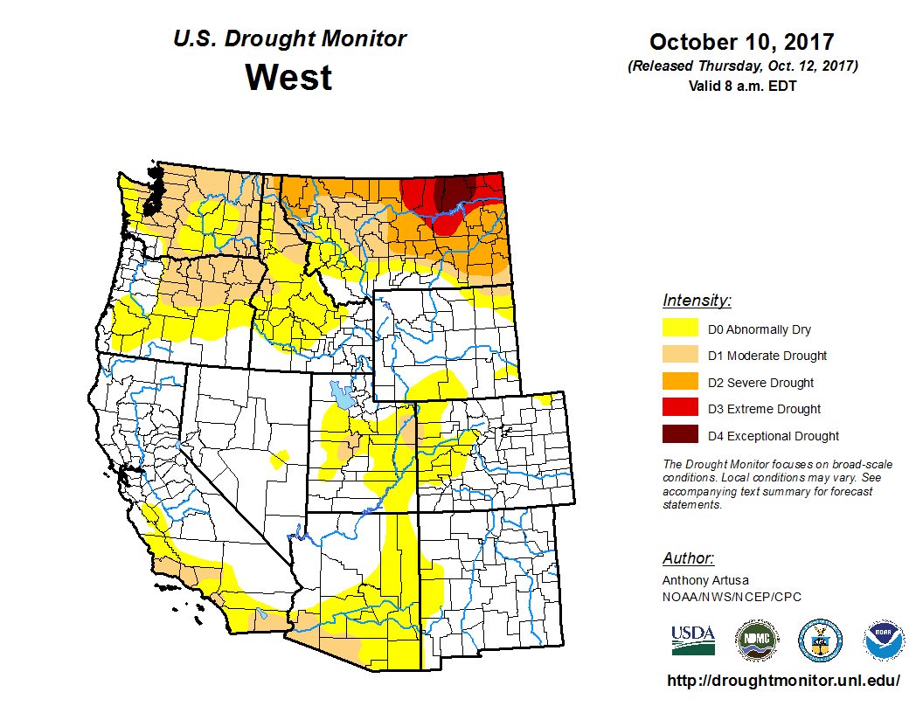

Slide 4
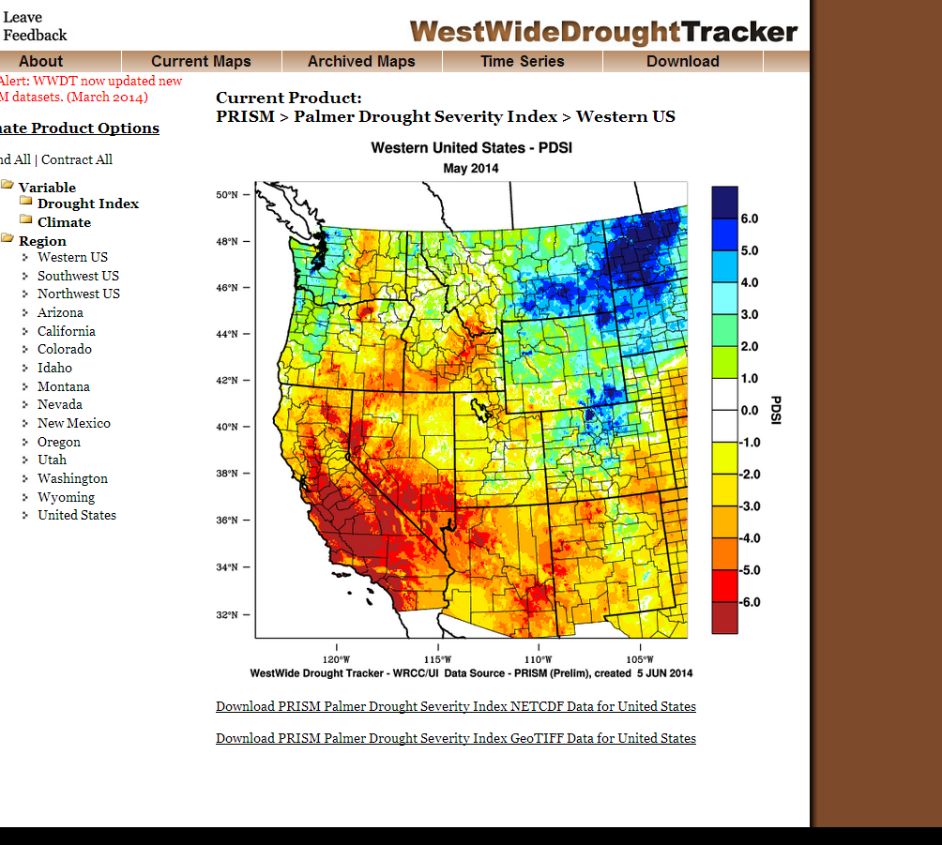
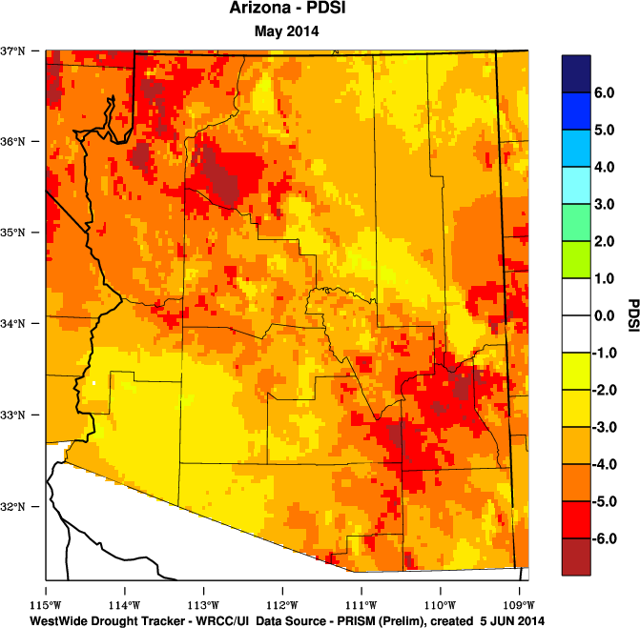
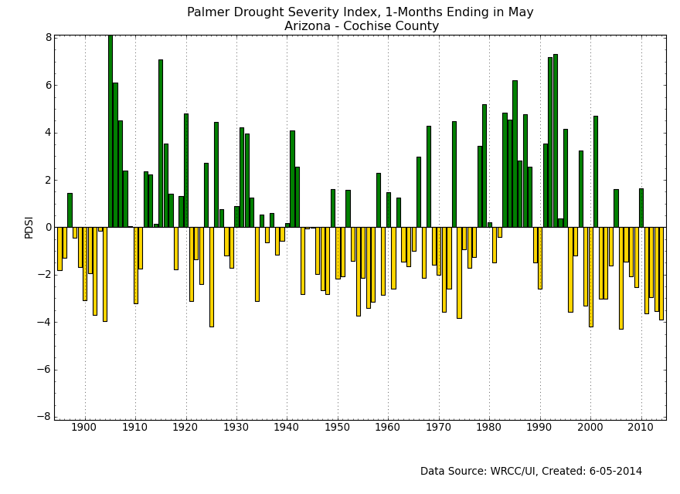
http://www.wrcc.dri.edu/wwdt

Slide 5
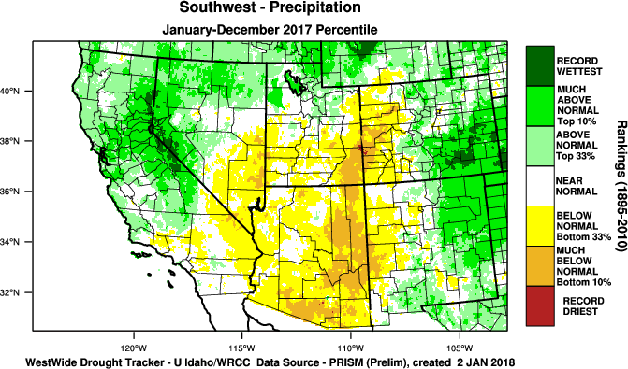
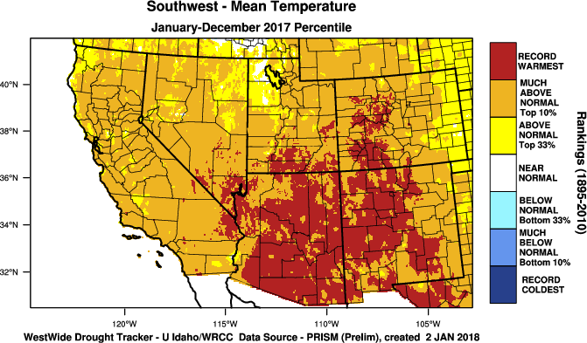
January 2017 – December 2017 Temperature and Precipitation
Notes:
Wet and warm over past 12 months

Slide 6
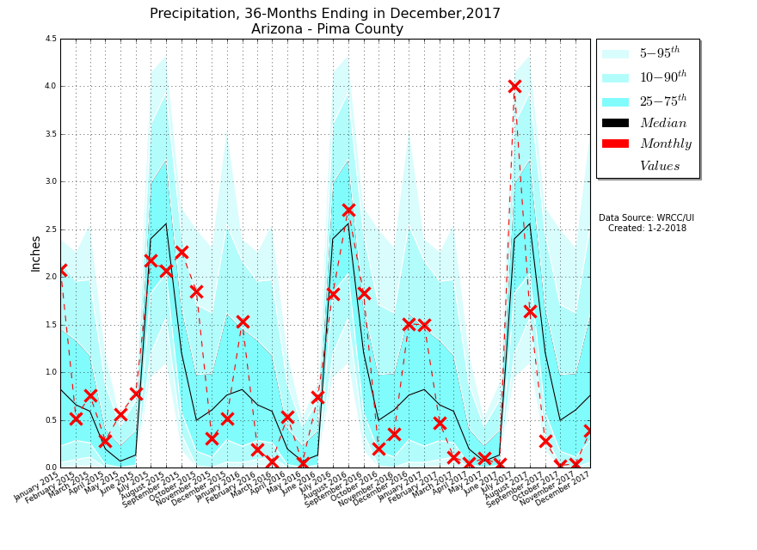
Monthly Total Precip
WET
DRY
https://wrcc.dri.edu/wwdt/time/
Notes:
Evolution of monthly climate over past 30 months, looking for repeat of ‘good’ seasonal precipitation
Figure depicts climatology of seasonal transitional climate, monthly data back to 1895
Point out seasonal-transitional pattern – warm vs cool season precip matters; largely good summers of late
Black line is center line, out bands are guard rails/rumble strips. Red line is past couple of years

Slide 7
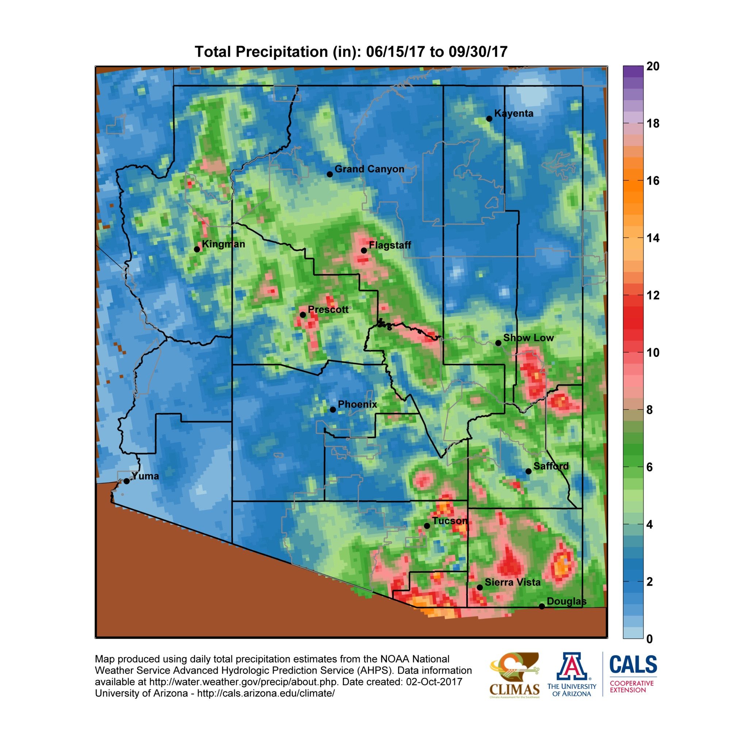
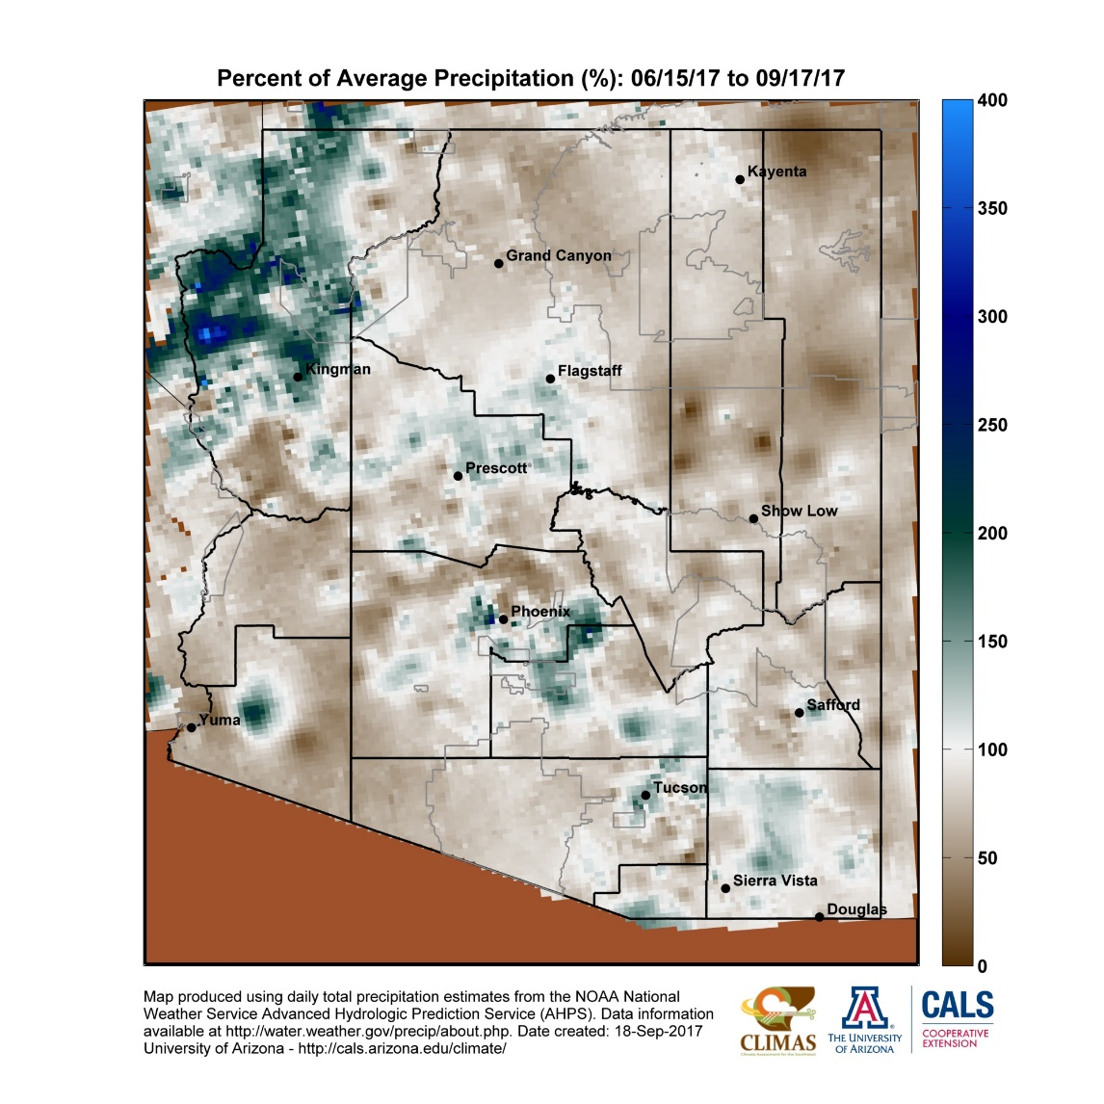
2017 Monsoon Season
https://cals.arizona.edu/climate/misc/monsoon/az_monsoon.html
Notes:
- Most of the precip fell in the in the front half of the season

Slide 8
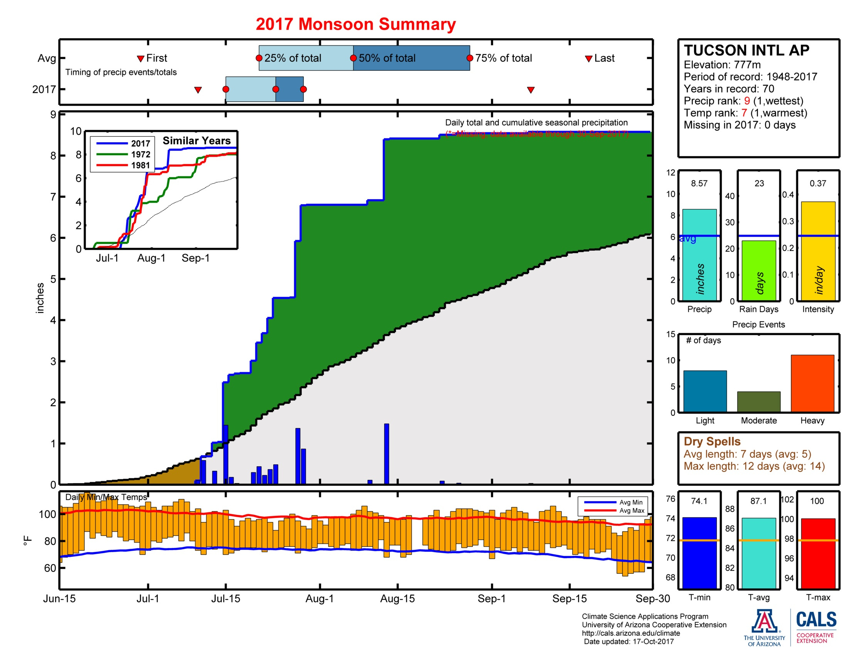
https://cals.arizona.edu/climate/misc/monsoon/monsoon_summaries.html

Slide 9
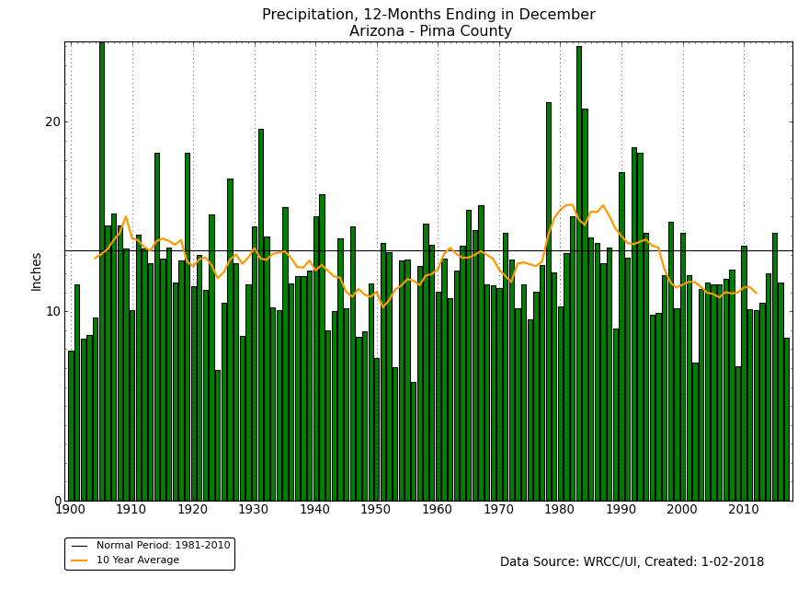
1905
(Jan-Dec Total Precip, 1900-2017)
1983
1978
1984
2017
Upper Gila Avg: ~17 inches
1924
1956
2002
2009
http://www.wrcc.dri.edu/wwdt/time/
Notes:
- Decadal variability, ENSO

Slide 10
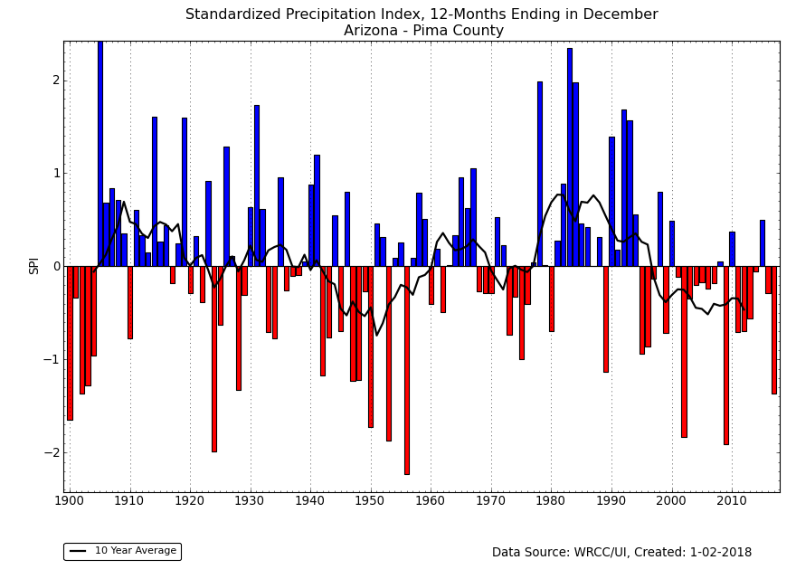
15 of 18 years since 2000 below average precip
Wet
Dry
SPI Drought Index: Jan-Dec Total Precip
http://www.wrcc.dri.edu/wwdt/time/

Slide 11
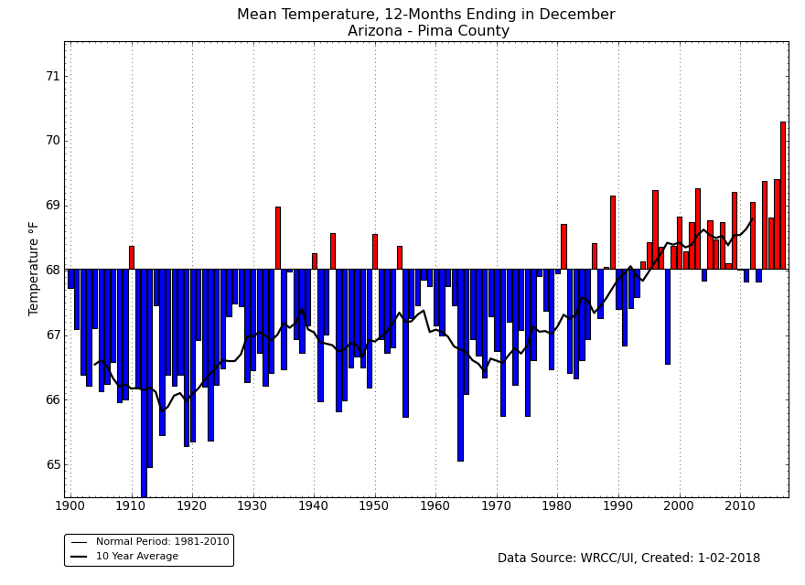
Jan-Dec Avg Temp
14 of 18 years since 2000
above average temps
2017 2nd Warmest year on record
http://www.wrcc.dri.edu/wwdt/time/
Notes:
Consistently warmer now, longer-term warming associated with climate change

Slide 12
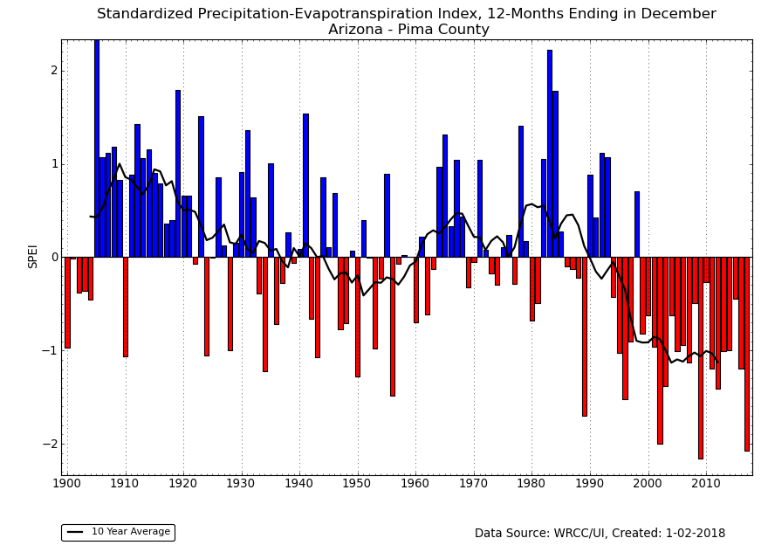
Wet
Dry
SPEI Drought Index: Annual Precipitation and Annual Avg. Temps.
http://www.wrcc.dri.edu/wwdt/time/
Notes:
Clunky albeit useful ways of integrating temp and precip to get at potential water balance

Slide 13
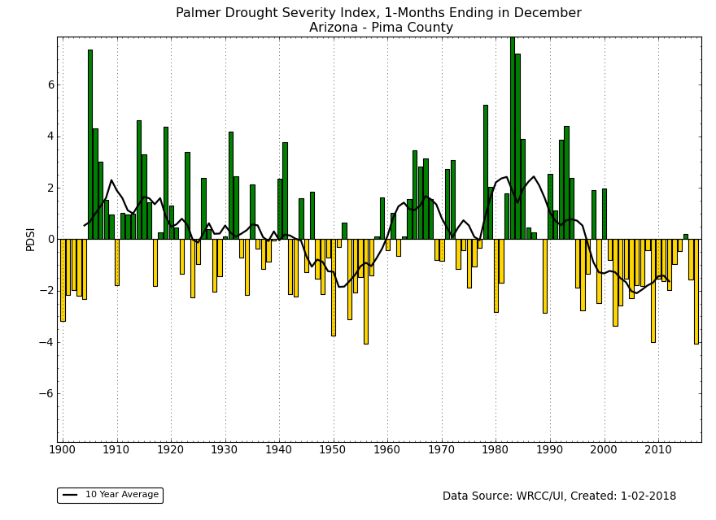
Notes:
PDSI is also pessimistic of recovery with recent precip, integrates temperature

Slide 14
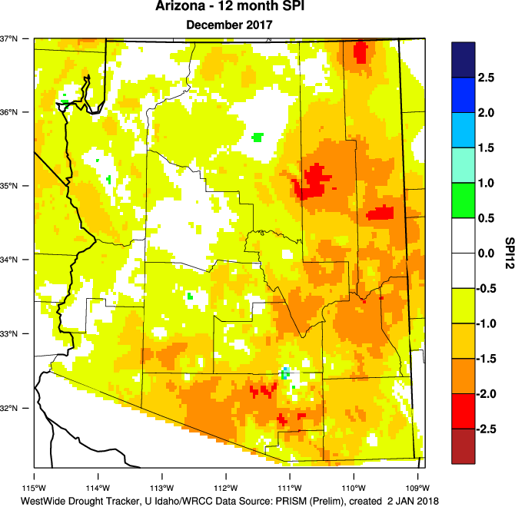
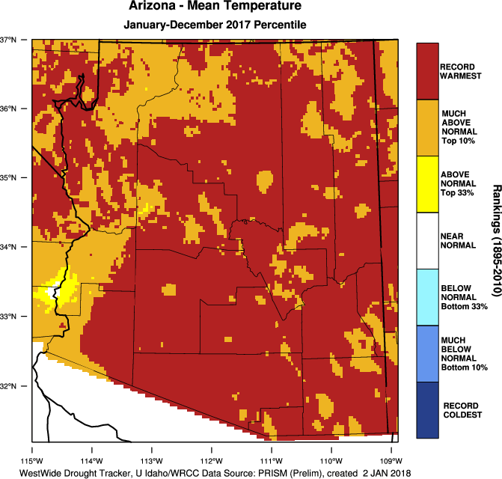
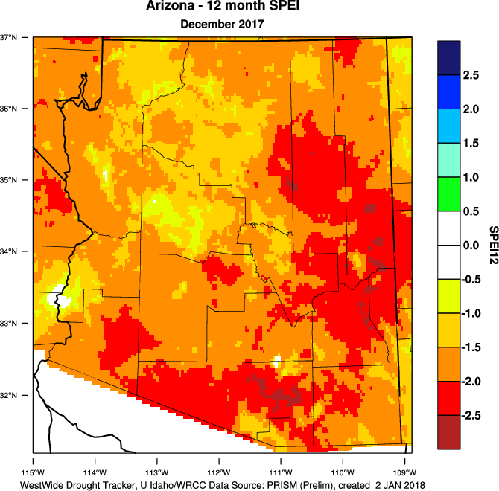
2017 Drought Conditions
Potential Evapotranspiration
(~ temperature)
-
=
Precipitation
SPEI
Increasing temperatures drive increasing levels of evapotranspiration and aridity
Droughts impacts can emerge and persist even with near-average precipitation and above-average temperatures
Need more research to tune up drought monitoring approaches and indices to account for unique Arizona climate variability and temperature effects

Slide 15
Soil Moisture vs. Drought Indices
Soil moisture status is a good indicator of potential drought stress to vegetation, ecosystems…direct link between soil moisture and drought impacts
Soil moisture monitoring is limited…hard to do, expensive, very few stations
Can we model soil moisture and use it as a drought impact dataset? →
Use modeled soil moisture as an objective measure against which to evaluate simple, readily available indices like SPI, SPEI, PDSI…
Notes:
- Not creating a new index, just trying to figure out how to use simple, readily available indices better

Slide 16
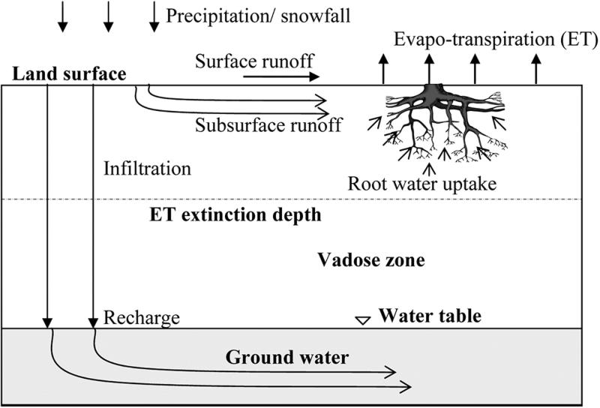
HYDRUS-1D
Numerical soil moisture model that solves the Richards equation for water transport
Only evaporation/transpiration (Hargreaves estimation) and gravity impact water movement
Daily temperature and precipitation data
1950-2015 with 10 year spin up
500 cm loam
4 study sites
Twarakavi et al. 2007

Slide 17
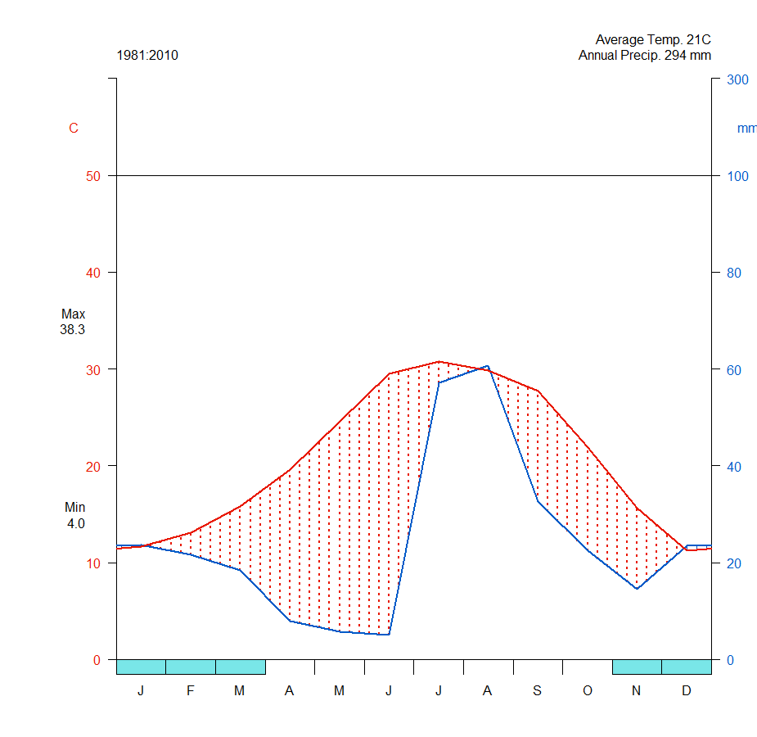
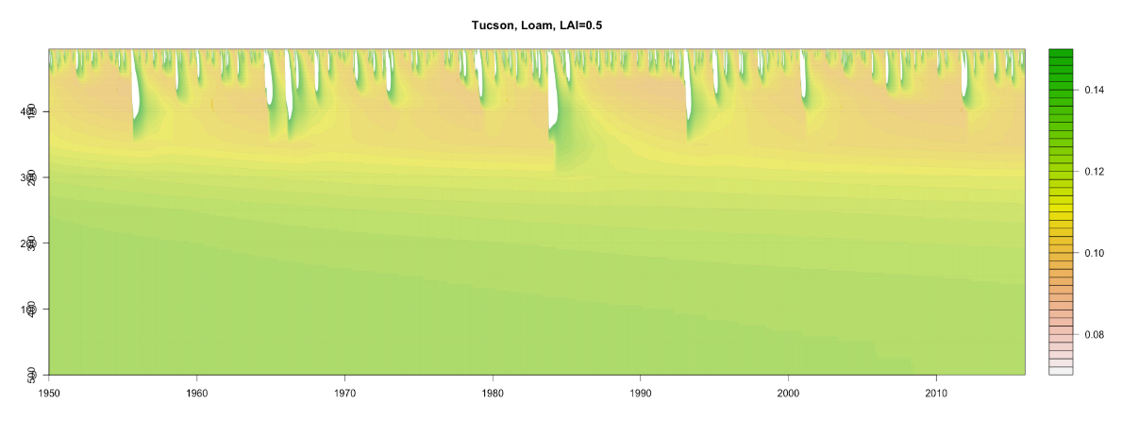
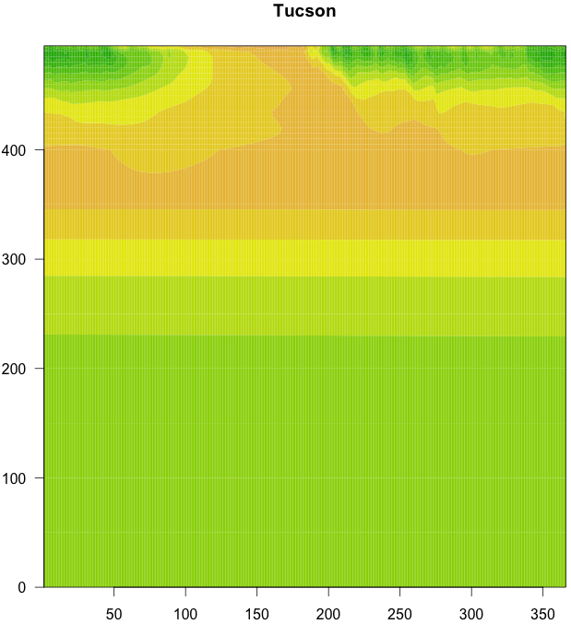
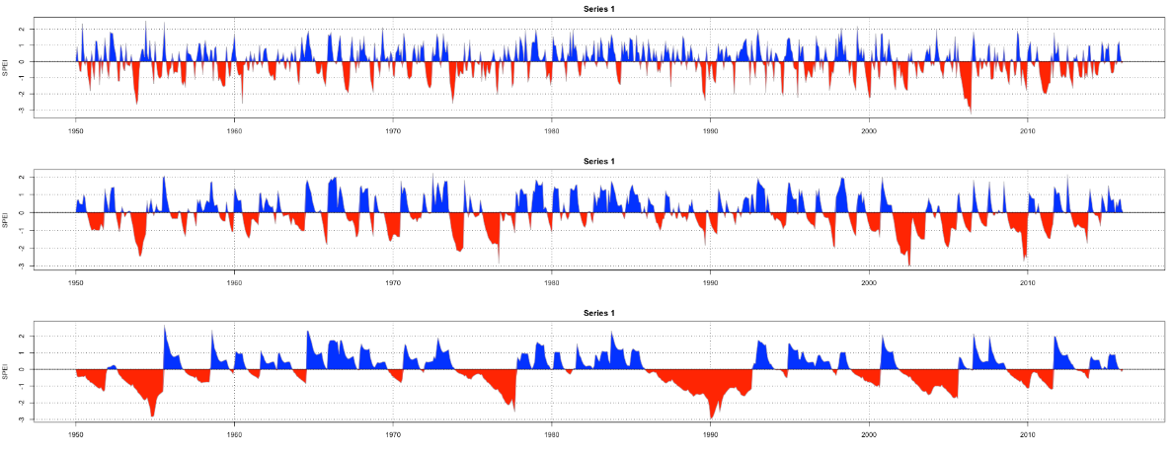
Tucson-AZ
Tucson - Daily Modeled Soil Moisture 1950-2015
Walter-Lieth diagrams
10/30/50 cm
Temp
Precip
0 cm
Wet
Dry
100cm
Monthly Standardized Soil Moisture Index @ 10/30/50 cm
10cm
depth
30cm
VWC
50cm
500 cm
Jan
Day of Year
Dec

Slide 18
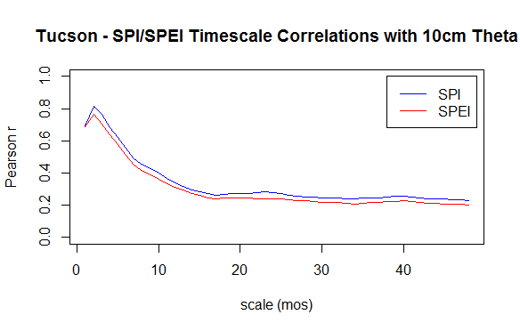
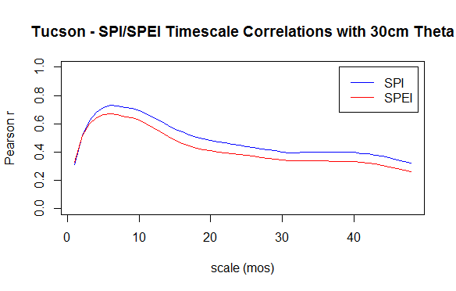

Slide 19
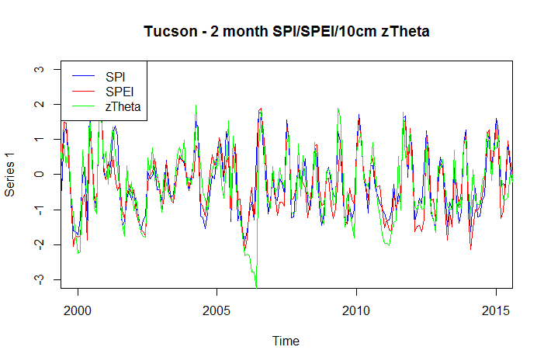
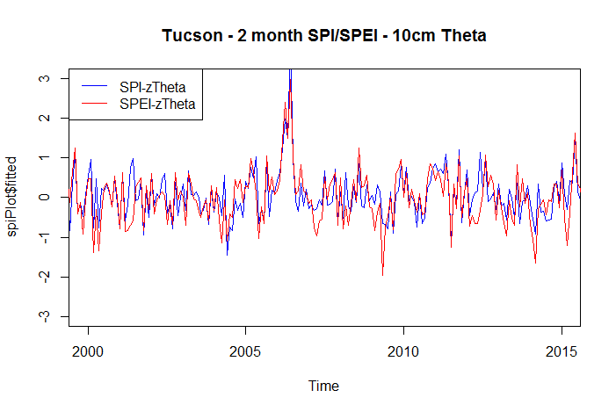
WET
SPI ~ 10cm soil moisture r= 0.81
SPEI ~ 10cm soil moisture r= 0.76
Index
DRY
SPI/SPEI underestimating drought
Index Diff
SPI/SPEI overestimating drought
Notes:
Note how 2002 drought all indices track really well; big departure

Slide 20
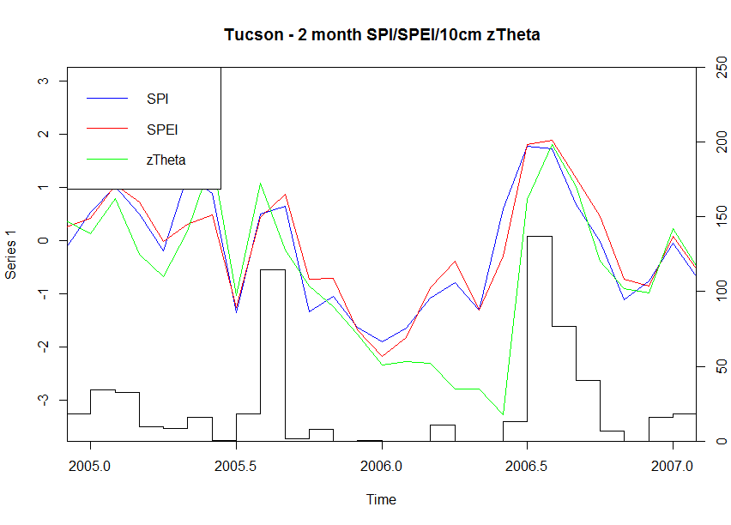
Index
Monthly Total Precip (mm)

Slide 21
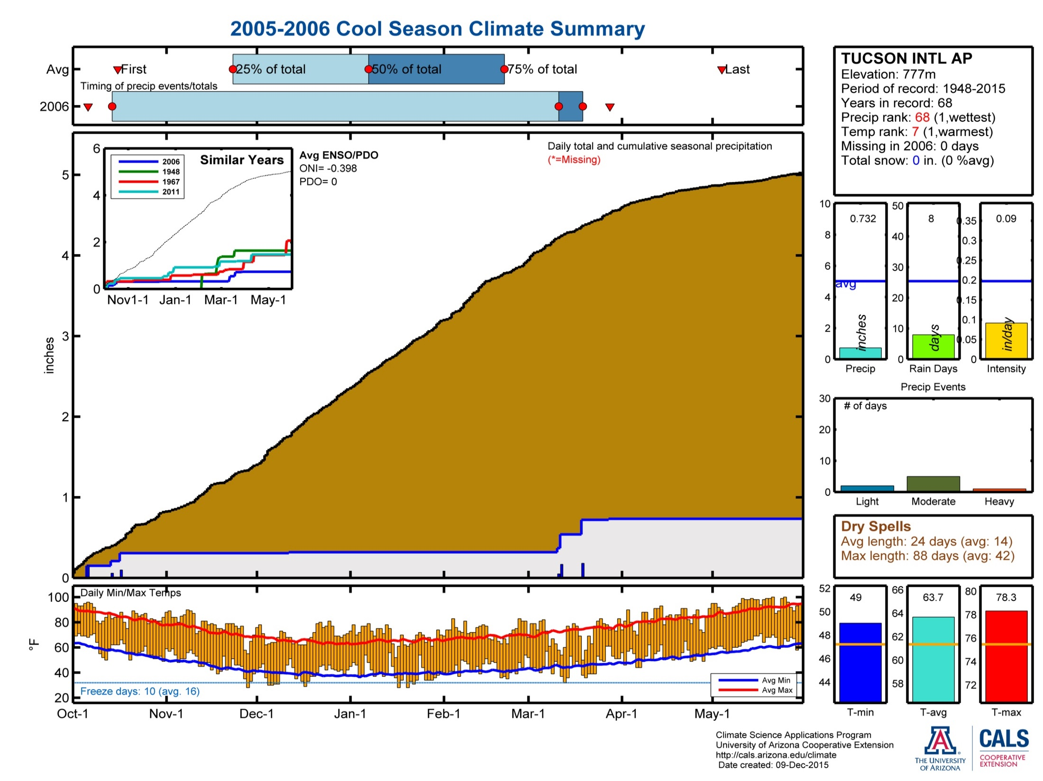
https://cals.arizona.edu/climate/misc/CoolSeason/CoolSeason_summaries.html

Slide 22
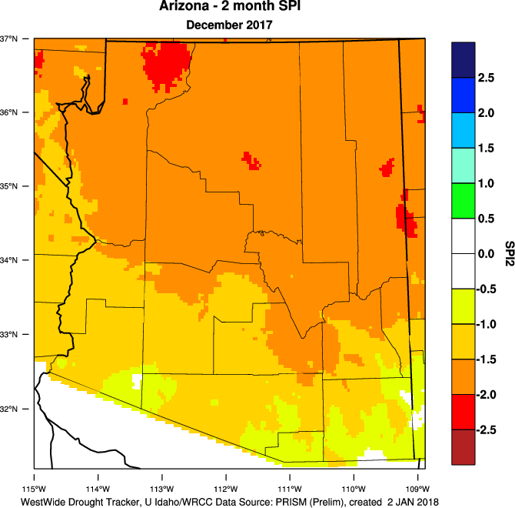
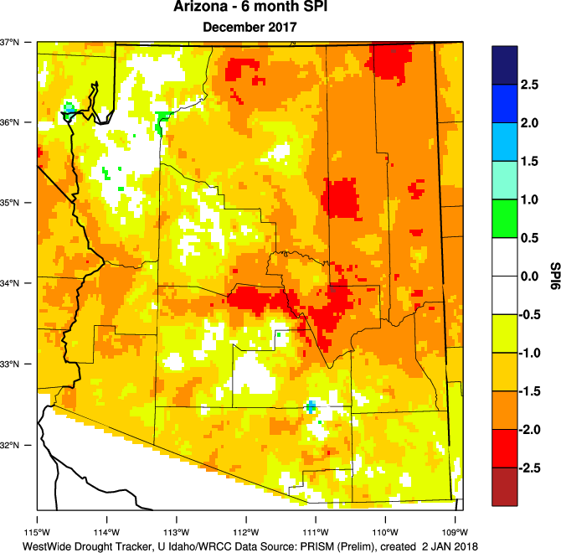
2-month SPI ~ 10cm soil moisture?
6-month SPI ~ 30cm soil moisture?

Slide 23
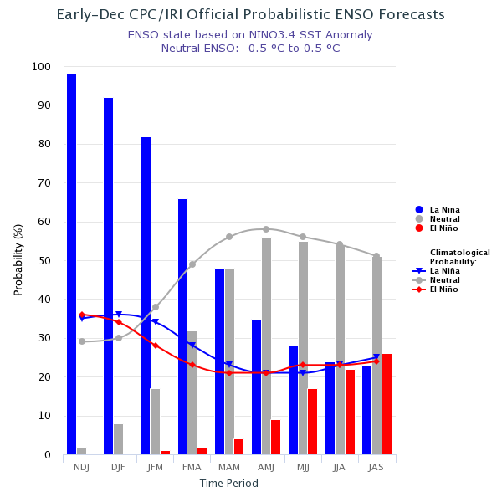
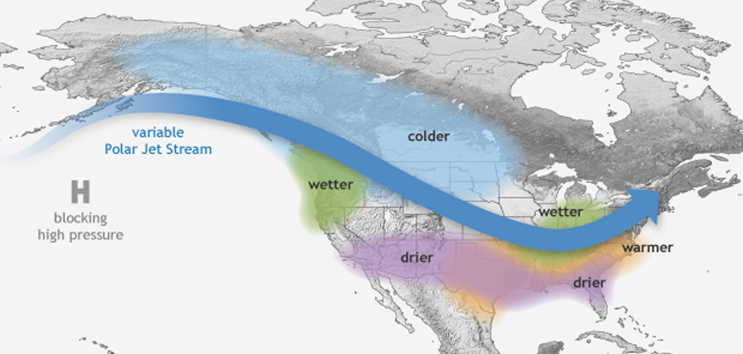
Looking forward…
Typical La Niña Winter Weather Pattern

Slide 24
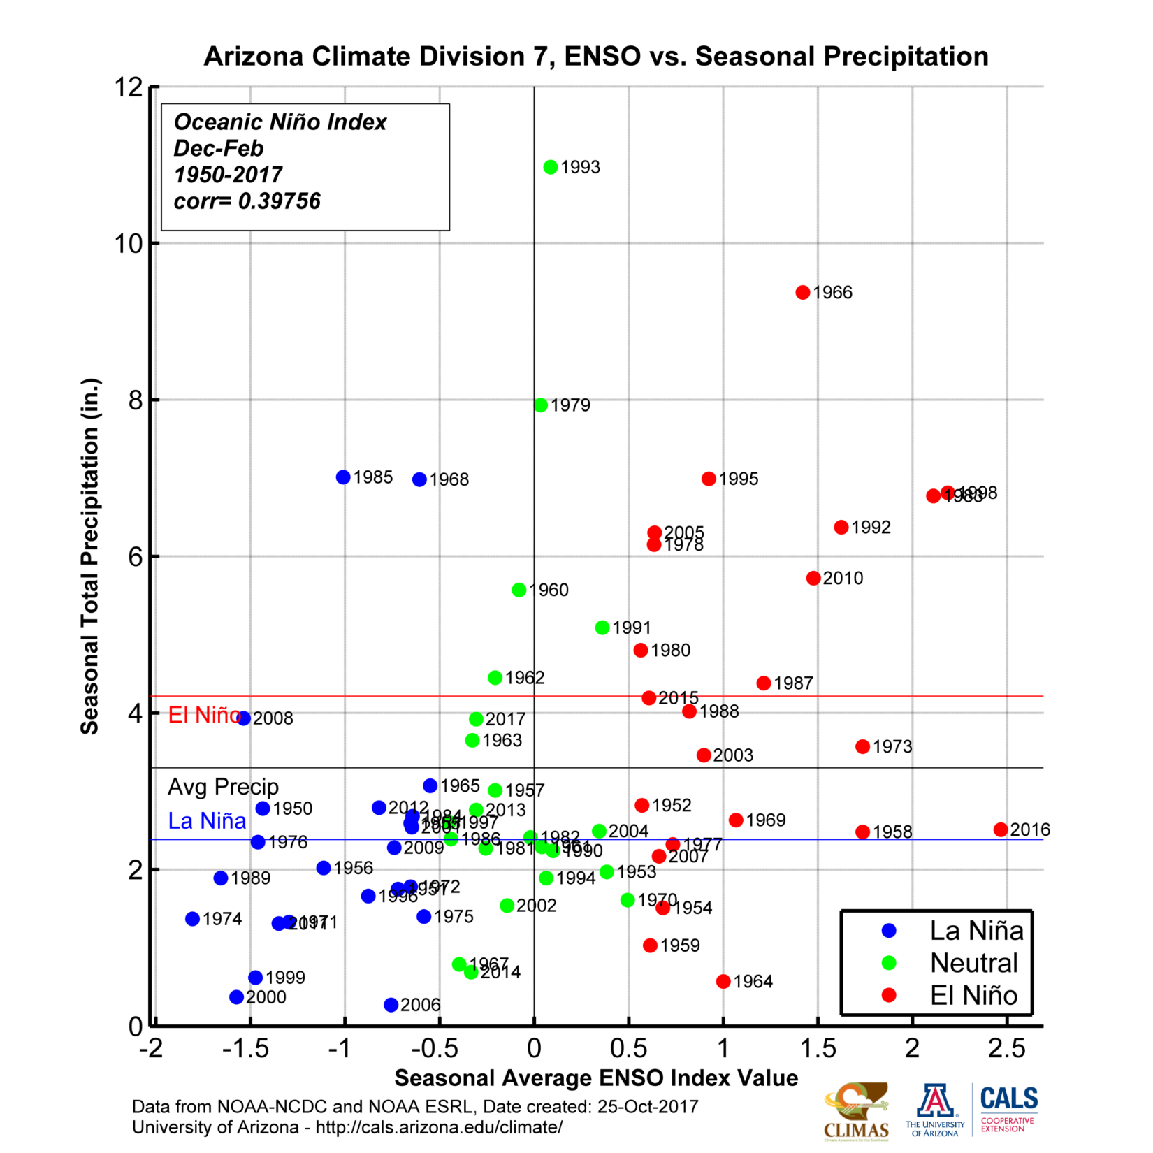
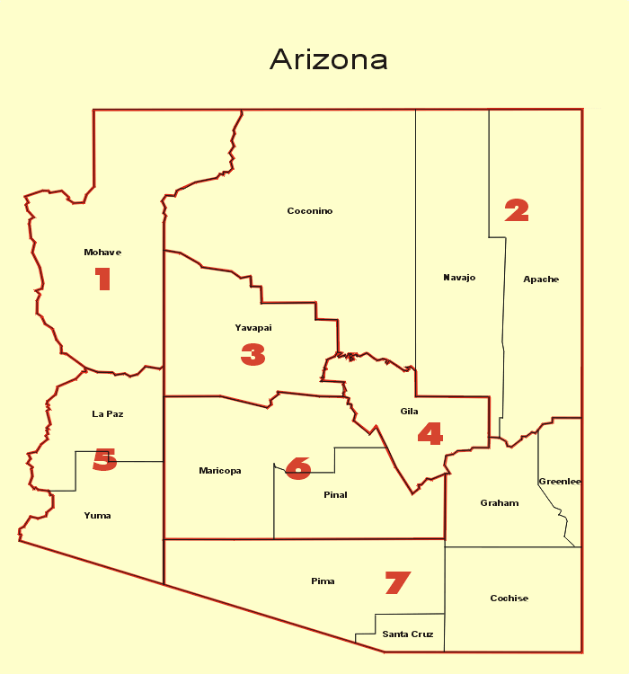
Notes:
La Nina episodes are almost consistently associated with lower winter precipitation amounts. Higher confidence in La Nina/Dry Winter forecast.
Much more spread in precipitation amounts associated with El Nino episodes. Less confidence in El Nino/Wet Winter forecast.

Slide 25
Seasonal Precipitation Outlooks http://www.cpc.ncep.noaa.gov/products/predictions/long_range/

Slide 26
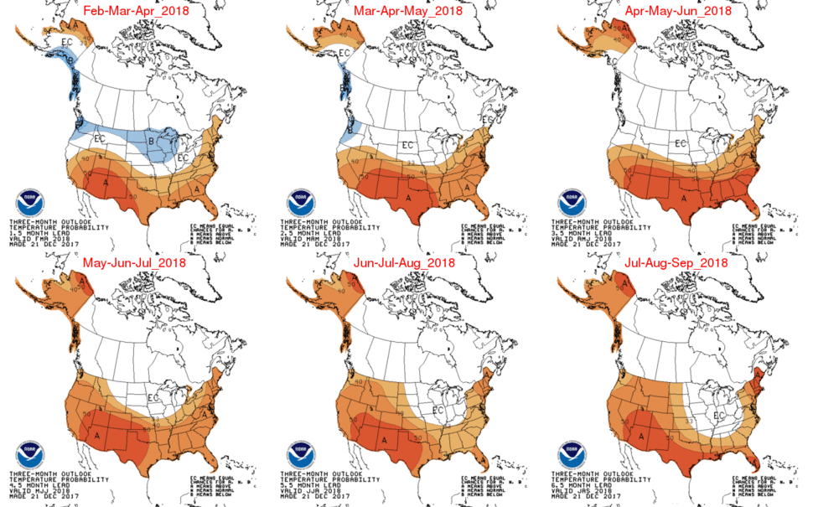
Seasonal Temperature Outlooks http://www.cpc.ncep.noaa.gov/products/predictions/long_range/

Slide 27
Thanks!
crimmins@email.arizona.edu
http://cals.arizona.edu/climate
@mike_crimmins

Slide 28
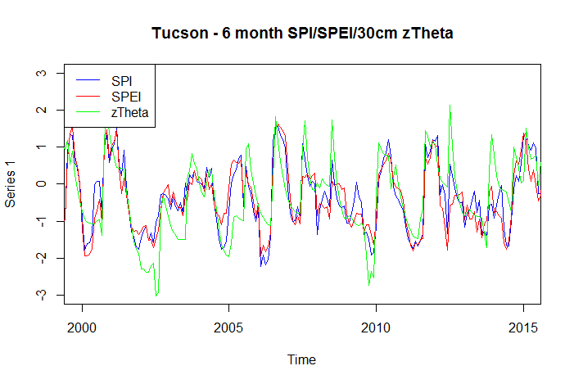
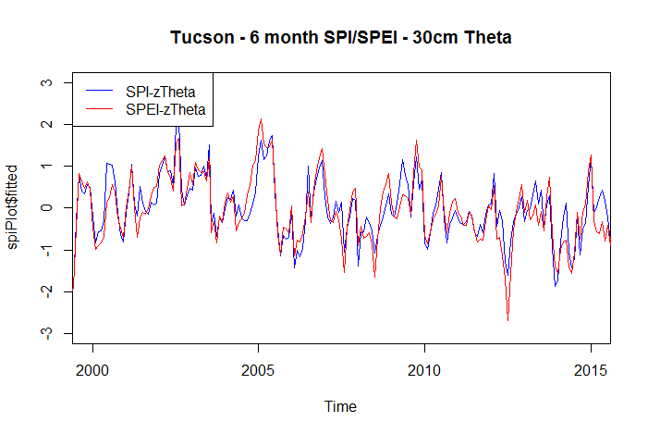
SPI ~ 30cm soil moisture r= 0.73
SPEI ~ 30cm soil moisture r= 0.67
Index
SPI/SPEI underestimating drought
Index Diff
SPI/SPEI overestimating drought

Slide 29
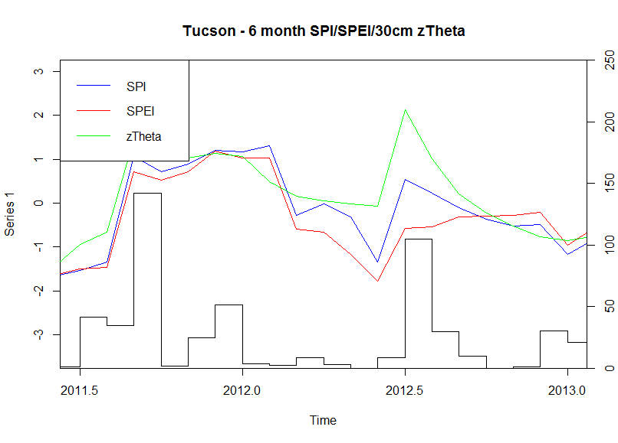
Index
Monthly Total Precip (mm)

Slide 30
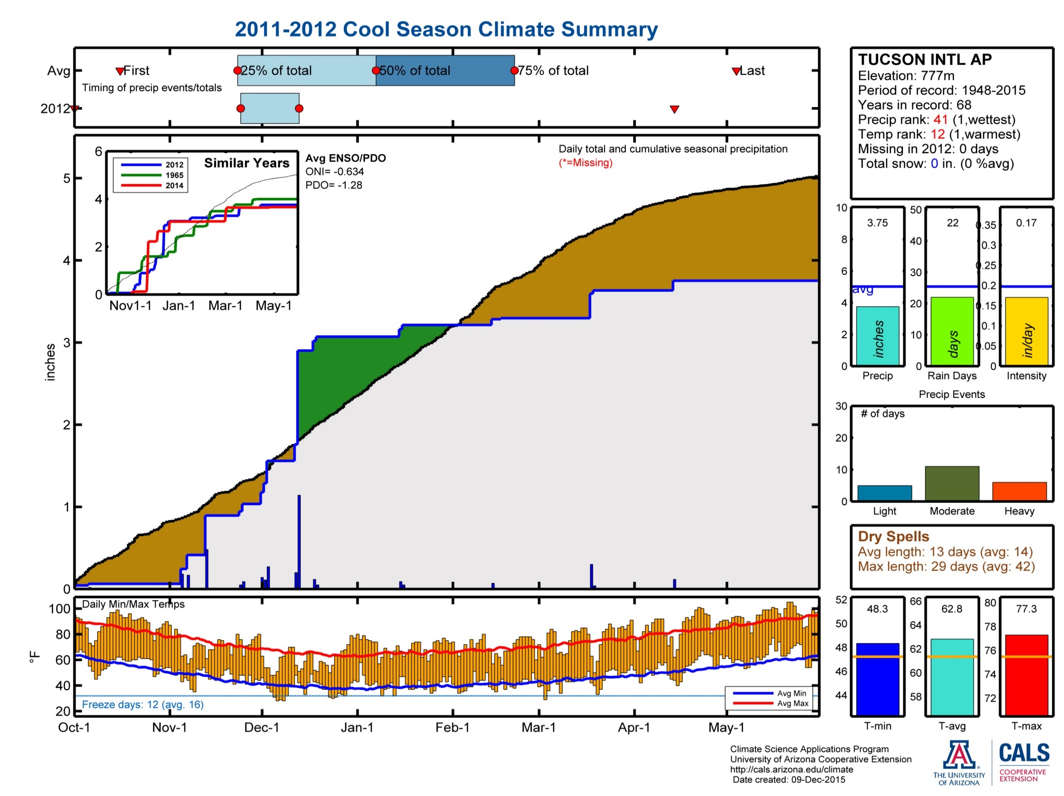
https://cals.arizona.edu/climate/misc/CoolSeason/CoolSeason_summaries.html

Slide 31
SPI ~ 30cm soil moisture r= 0.73
SPEI ~ 30cm soil moisture r= 0.67
Index
SPI/SPEI underestimating drought
Index Diff
SPI/SPEI overestimating drought

