Slide 1
International Year of Rangelands & Pastoralists
Relevance to Pastoral Mobility
Igshaan Samuels

Slide 2
Notes:
KEY FIGURES
1. Rangelands cover 54% of global terrestrial surface (148,326,000 km²) to a total of 79,509,421 km².
2. The largest rangeland biome is deserts and xeric shrublands covering 27,984,645 km² or 19% of global terrestrial surface.
3. Rangelands are made up of seven biomes or rangeland types namely: 35% deserts and xeric shrublands, 1% flooded grasslands and savannas, 4% mediterranean forests, woodlands and scrub, 6% montane grasslands and shrublands, 13% temperate grasslands, savannas and shrublands, 26% tropical and subtropical grasslands, savannas and shrublands, and 15% tundra.

Slide 3
Why an IYRP?
To increase worldwide understanding of importance of rangelands & pastoralists for food security, economy, environment & cultural heritage
Break myths and misunderstandings
To help fill knowledge gaps about rangelands & pastoralists through participatory research & communication
To promote informed, science-based policy & legislation for current & future generations
To increase sustainable and ethical investment in rangelands and pastoral livelihoods
© Wendy Sheehan

Slide 4
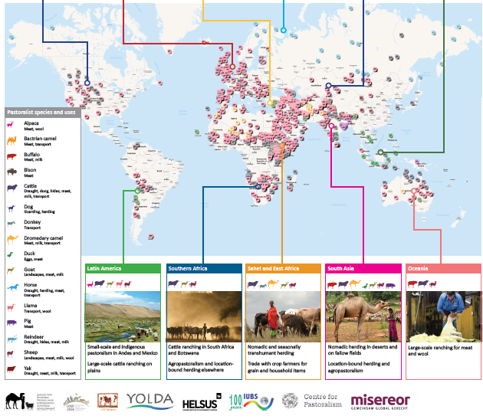
Global Pastoralist MAP

Slide 5
Notes:
Multistakeholder RISGs to generate partnership:
to expand network of supporting organisations and governments in the 11 regions of the world
to work with Government of Mongolia and IYRP International Support Group (ISG) to plan and implement IYRP activities in these regions

Slide 6
IYRP 2026 structure
General IYRP e-list
~740 addresses mostly for info only
International Support Group (ISG)
~415 active partners, including GCG members & 2 co-chairs
Global Coordinating Group (GCG)
~45 members (co-chairs, comms team, RISG & WG chairs & reps from key supporting partners: FAO, Govt of Mongolia, ILRI, IUCN, UNEP, WAMIP)
Working Groups (WGs):
Afforestation
Biodiversity
Gender
Land Degradation Neutrality
Mountains
Water
Youth
Economics
Global Communications Team
Regional IYRP Support Groups (RISGs)

Slide 7
Notes:
What is the LDN process?
We define LDN as “a state whereby the amount and quality of land resources necessary to support ecosystem functions and services to enhance food security remain stable, or increase, within specified temporal and spatial scales and ecosystems.”
The Global Mechanism and the secretariat of the UNCCD established the Land Degradation Neutrality Target Setting Programme (LDN TSP) to assist countries to achieve LDN by 2030. The programme takes countries through a structured process to help leverage, assess, measure and achieve their LDN commitments.

Slide 8
Calls to action
IYRP 2026 calls on the UNCCD Conference of the Parties to adopt eight priority actions to meet the challenges facing rangelands and pastoralists.
#1 Stop indiscriminate conversion of rangelands
#2 Recognize the importance of pastoral mobility
#3 Innovate and implement beneficial economic policies and technologies
#4 Promote integrated, multifunctional land use
#5 Strengthen participatory land governance and equity
#6 Increase rangeland and pastoral projects under the LDN Fund by 30%
#7 Commit LDN targets to rangelands and pastoralism
#8 Earmark 25% of the LDN Fund for knowledge and capacity building
Notes:
#2 Grazing by migratory, wild and domesticated herbivores is an integral component of rangeland ecosystems. Recognize the importance of pastoral mobility as a nature-based solution for sustainably managing and restoring rangeland health. Provide flexible and secure land-tenure systems, well-planned and provisioned animal corridors, and waterpoints for transhumance systems.

Slide 9
Thematic themes
Notes:
The themes take an integrated approach reflecting the SDGs and the 2030 Agenda for Sustainable Development.
Although each country should decide on how they would celebrate the IYRP, the adoption of a global framework of 12 monthly themes would help to a) provide suggestions and ideas, b) highlight urgent and topical issues, and c) show how pastoralism and rangelands across the globe share similar issues and concerns.
Rangelands and the pastoralists who use them around the world are very diverse in characteristics and dynamics, although the same thematic issues often resonate in different countries. Thus one theme alone would be insufficient to capture this diversity and complexity of the systems.

Slide 10
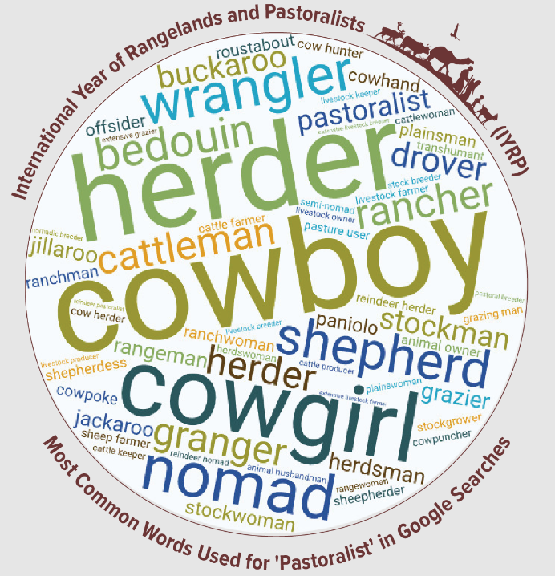
Who is a pastoralist?
January
Pastoralists are people who raise livestock or (semi-)wild animals on rangelands in production systems that depend on some degree of herd mobility. They manage diverse species of grazing and browsing animals such as sheep, goats, camels, cattle, and donkeys.
Notes:
Pastoralism is not a nostalgic return to the past, but a way forward towards future sustainability

Slide 11
Securing mobility and access
February
WG-LDN: Call for action #2:
Livestock mobility needs large and diverse landscapes, i.e. extensive systems.
Pastoralists need flexible land-tenure systems, well-planned and serviced corridors and infrastructure (waterpoints), and lifting market barriers
In agropastoral systems, maintaining corridors for access to postharvest forage and to deposit manure for the next season’s crop.
Many different ecosystems - many types of mobility.
Modern legal systems must accommodate livestock mobility by the protection of land rights, access rights, passage rights and other legislative actions

Slide 12
Social and Economic Services
March
Improve access to education, mobile schools, vocational training, for pastoral peoples
Improve access to health and health clinics in remote areas, and for mobile populations
Do’s and don’ts of water development for livestock; how to address water for mobile livestock

Slide 13
Biodiversity and Ecosystem Services
May
The natural state of world’s rangeland ecosystems depends on herbivory and on frequent movement and rotation of animals.
Periodic livestock grazing is frequently used to promote ecosystem services in protected areas and prevent forest fires
Agropastoralists (and farmers) depend on the fertilization and recycling of organic matter that is provided by livestock grazing.
Mobile pastoralism has been shown to produce 2-10 times more meat output per unit area than commercial sedentary systems in the same arid conditions
Pastoralism and biodiversity can co-exist

Slide 14
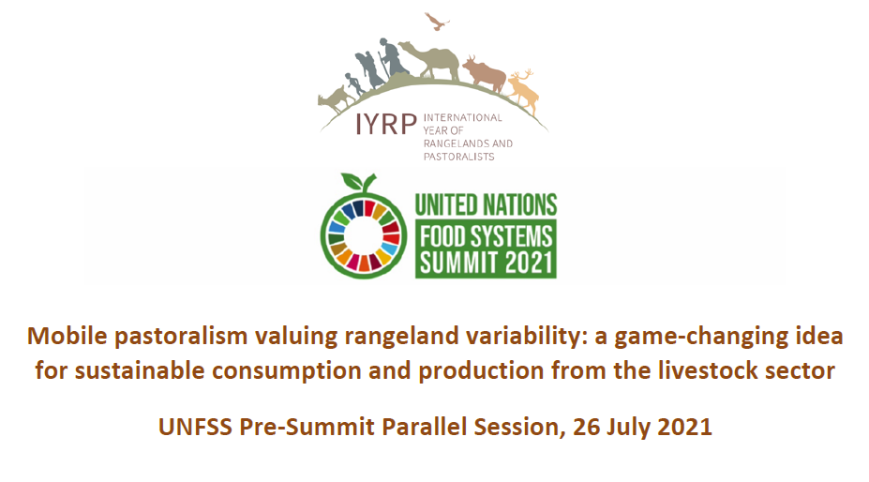
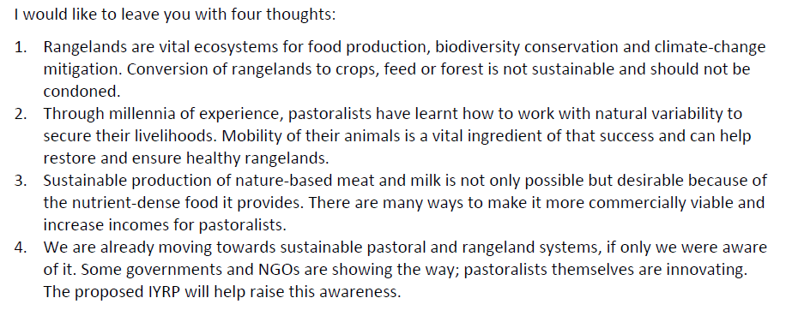
Sustainable livestock consumption
July
Notes:
Enhancing healthy and environmentally friendly consumption of meat and mat products
Celebrating diversity of milk and meat products, examples of pastoral foods and regional diversity
Knowing specialty or novelty foods (e.g. camel’s milk and its role in helping diabetics)

Slide 15
Indigenous Knowledge and Culture
August
Recognize indigenous knowledge and ways of managing land
Pastoralist grazing planning is their core tool
Scheduling grazing itineraries at a variety of scales allow livestock to gain a better diet than they would without management.
Pastoralists extract the appropriate resources from each piece of land at a given time, moving and leaving the grazed land to rest.
New ideas building on traditional knowledge
Notes:
Pastoralists are key actors in rangeland management, and grazing planning is their core tool. They thus control vegetation and fuel, redistribute fertility, balance woody and herbaceous composition, and maintain their infrastructure. By arranging factors like herd composition, grazing pressure, water

Slide 16
Pastoral Youth
November
Young herder’s associations encouraged and recognized
Vocational training, specialized training for pastoral youth
Challenges: inhibited and/or reverse migration; abandonment of rangelands; lack of opportunities for youth
Bright spots: professionalization of herding (training and certification schools), rodeos and other related festivals; pastoralist youth innovation / entrepreneurship
Safeguard the next generation of pastoralists

Slide 17
LDN_WG: Pastoralism and animal mobility can be enabled by Member States through policy decisions for:
Legal recognition and enforcement of pastoral mobility both in-county and across national borders
Legal status made available for land users and communities that wish to manage rangelands through common property tenure, including ownership of buffer zones and the notion of flexible boundaries
Effective integration of pastoralists’ mobility itineraries in the sustainable development strategies of the regions hosting this activity
Increased investment in pastoral mobility-infrastructure such as transhumance corridors, water points, decentralized electrical supply using renewable energy, etc.
Investing in mobility-friendly infrastructure, including 100% coverage of rural areas with mobile phone and broadband networks, marketing options, providing weather forecast data for day-to-day
Adapting administrative, social, health and educational services to the reality of mobile pastoralists and their communities

