Slide 1
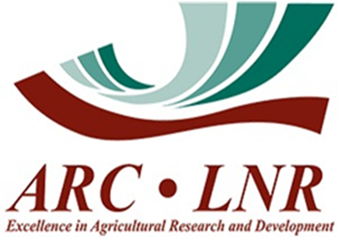
International Year of Rangelands & Pastoralists
Insights into this unprecedented journey
Igshaan Samuels

Slide 2
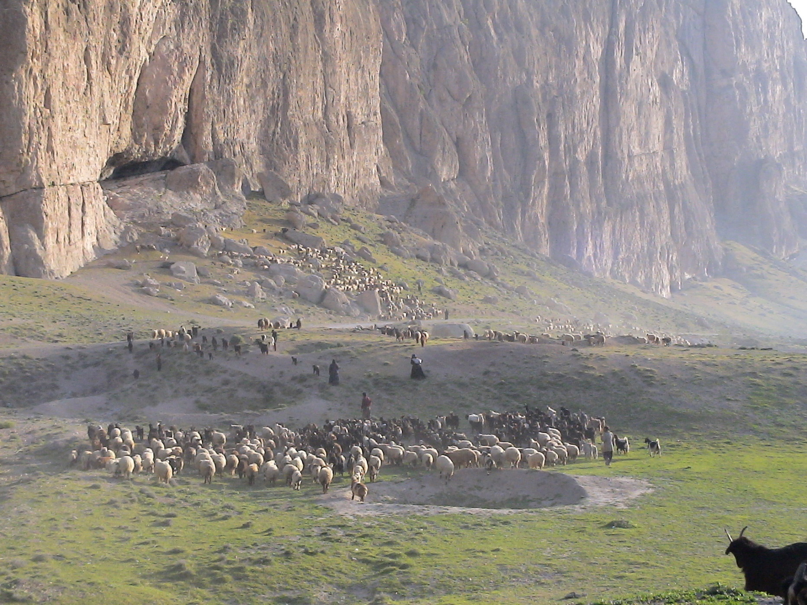
Presentation Outline
IYRP Declaration
Significance of the IYRP
Goals of the IYRP
Threats to Rangelands and Pastoralists
IYRP Structure
IYRP activities and achievements
Key messages
Opportunities for South Africa

Slide 3
Notes:
KEY FIGURES
1. Rangelands cover 54% of global terrestrial surface (148,326,000 km²) to a total of 79,509,421 km².
2. The largest rangeland biome is deserts and xeric shrublands covering 27,984,645 km² or 19% of global terrestrial surface.
3. Rangelands are made up of seven biomes or rangeland types namely: 35% deserts and xeric shrublands, 1% flooded grasslands and savannas, 4% mediterranean forests, woodlands and scrub, 6% montane grasslands and shrublands, 13% temperate grasslands, savannas and shrublands, 26% tropical and subtropical grasslands, savannas and shrublands, and 15% tundra.

Slide 4
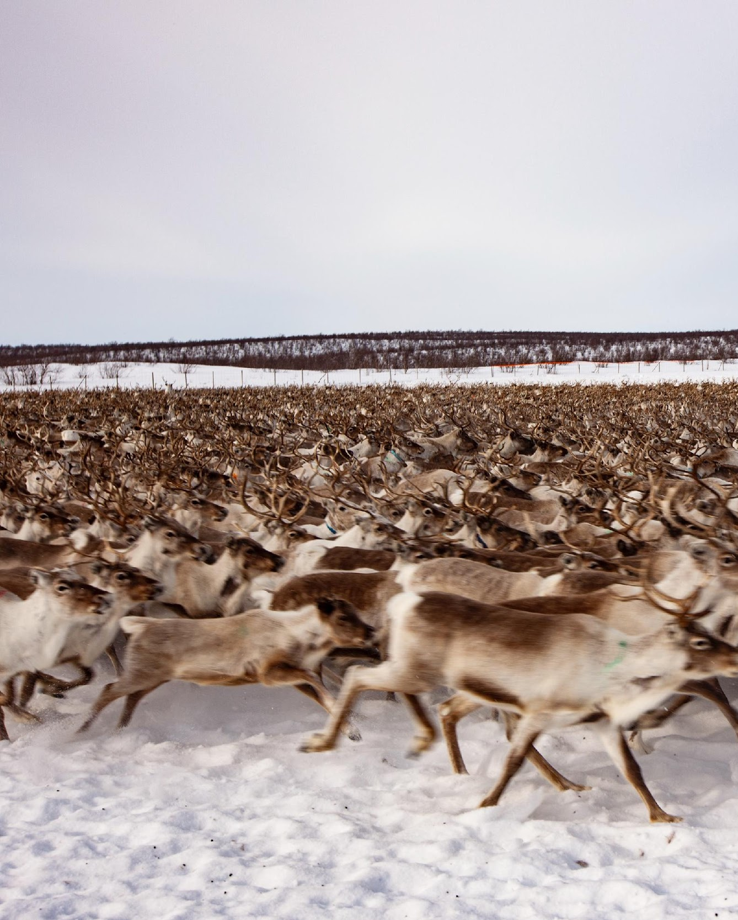
On 22 March 2022, The UNGA declared 2026, the International year of Rangelands and Pastoralists
Process started in 2008, at IRC/IGC in Inner Mongolia
Proposal passed through several UN bodies before discussed at UNGA
Resolution approved unanimously
Currently 104 governments support the resolution by govt. of Mongolia
Movement supported by 415 pastoralist and supporting organizations
FAO to facilitate the implementation of the IYRP
Notes:
KEY FIGURES
1. Rangelands cover 54% of global terrestrial surface (148,326,000 km²) to a total of 79,509,421 km².
2. The largest rangeland biome is deserts and xeric shrublands covering 27,984,645 km² or 19% of global terrestrial surface.
3. Rangelands are made up of seven biomes or rangeland types namely: 35% deserts and xeric shrublands, 1% flooded grasslands and savannas, 4% mediterranean forests, woodlands and scrub, 6% montane grasslands and shrublands, 13% temperate grasslands, savannas and shrublands, 26% tropical and subtropical grasslands, savannas and shrublands, and 15% tundra.

Slide 5
Why an IYRP?
To increase worldwide understanding of importance of rangelands & pastoralists for food security, economy, environment & cultural heritage
Break myths and misunderstandings
To help fill knowledge gaps about rangelands & pastoralists through participatory research & communication
To promote informed, science-based policy & legislation for current & future generations
To increase sustainable and ethical investment in rangelands and pastoral livelihoods
© Wendy Sheehan

Slide 6
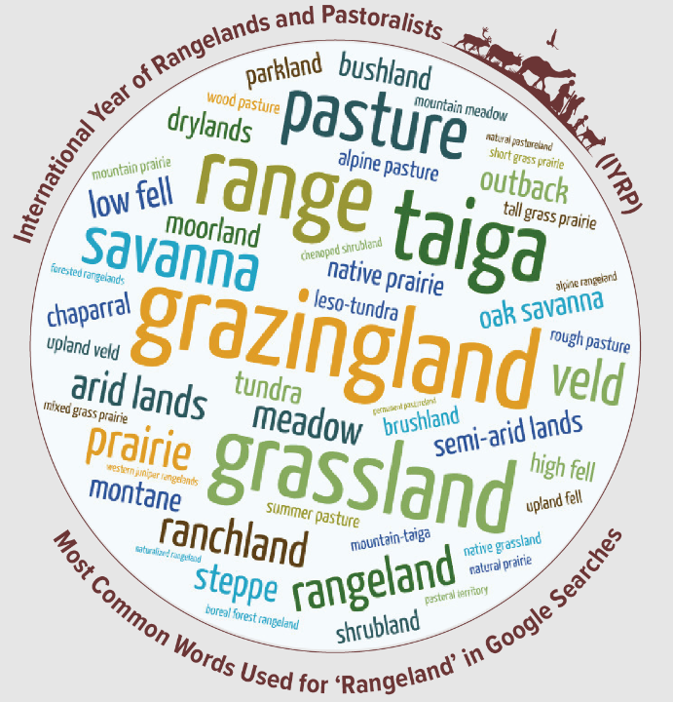
What are Rangelands?
“Rangelands are areas of grasses, grass-like plants, forbs, shrubs and sometimes trees that are grazed or have the potential to be grazed by livestock and wildlife. They are diverse in their vegetation highly influenced by rainfall, temperature and other climate phenomena, and habitat for a wide range of wildlife, many species of which are found nowhere else.”
Notes:
KEY FIGURES
1. Rangelands cover 54% of global terrestrial surface (148,326,000 km²) to a total of 79,509,421 km².
2. The largest rangeland biome is deserts and xeric shrublands covering 27,984,645 km² or 19% of global terrestrial surface.
3. Rangelands are made up of seven biomes or rangeland types namely: 35% deserts and xeric shrublands, 1% flooded grasslands and savannas, 4% mediterranean forests, woodlands and scrub, 6% montane grasslands and shrublands, 13% temperate grasslands, savannas and shrublands, 26% tropical and subtropical grasslands, savannas and shrublands, and 15% tundra.

Slide 7
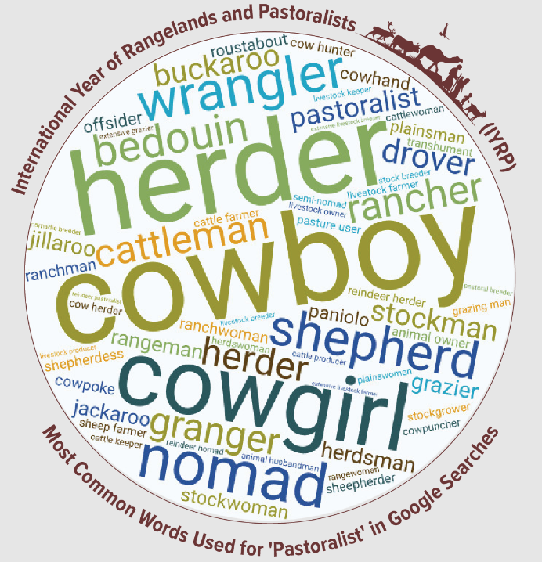
Who is a pastoralist?
Pastoralists are people who raise livestock or (semi-)wild animals on rangelands in production systems that depend on some degree of herd mobility. They manage diverse species of grazing and browsing animals such as sheep, goats, camels, cattle, and donkeys.
Notes:
The SES framework a conceptual framework designed to keep both the social and ecological components of a system in focus so that the interactions between them can be scrutinized for drivers of change and causes of specific outcomes. Resilience, adaptability, and transformability have been identified as the three related attributes of SESs that determine their future trajectories.
The primary benefit of the SES framework is the improved ability to prevent or correct social policies that cause negative ecological outcomes, and to achieve ecological objectives in ways that support, rather than hurt, rangeland users.
Environmental problems arise from failures in social processes as much as from ecological processes, and recognizing this, a common framework is needed for understanding and analyzing the drivers that lead to improvement or deterioration of natural resources (Ostrom 2009). The “social–ecological system” (SES) concept provides a framework for analyzing complex rangeland dynamics and identifying interventions that can increase rangeland sustainability and support the production of desired goods and services.
This vein of SES scholarship is dominated by systems theory and treats SESs as complex adaptive systems that self-organize (e.g., Folke et al. 2005) and operate with feedbacks and thresholds (e.g., Walker et al. 2004).

Slide 8
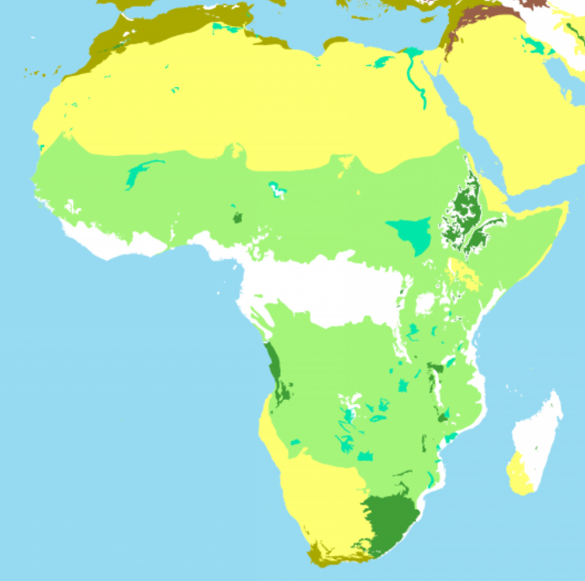
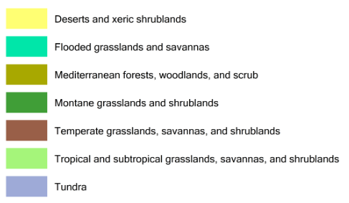
Rangeland distribution in Africa
www.rangelandsdata.org/atlas

Slide 9
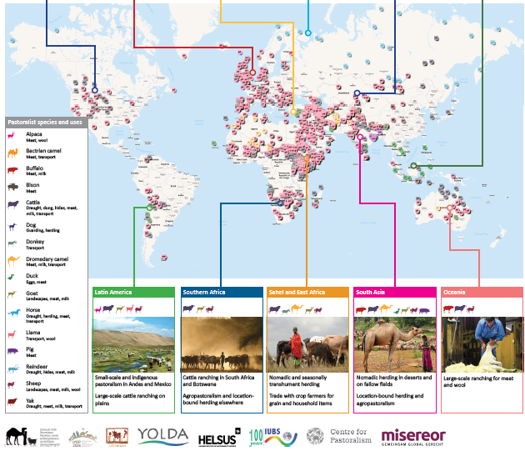

Slide 10
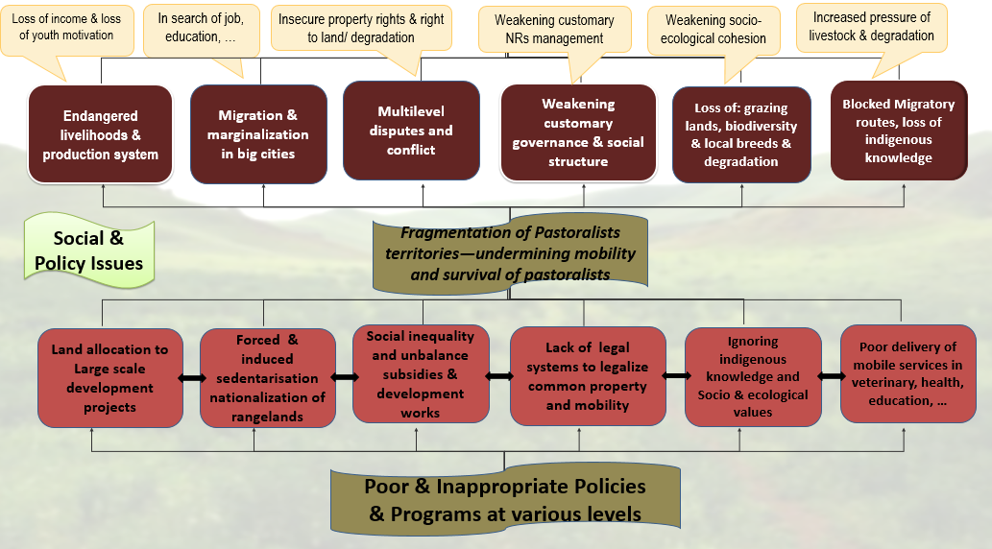
Underlying challenges in Rangelands
Notes:
Nahideh Naghizadeh

Slide 11
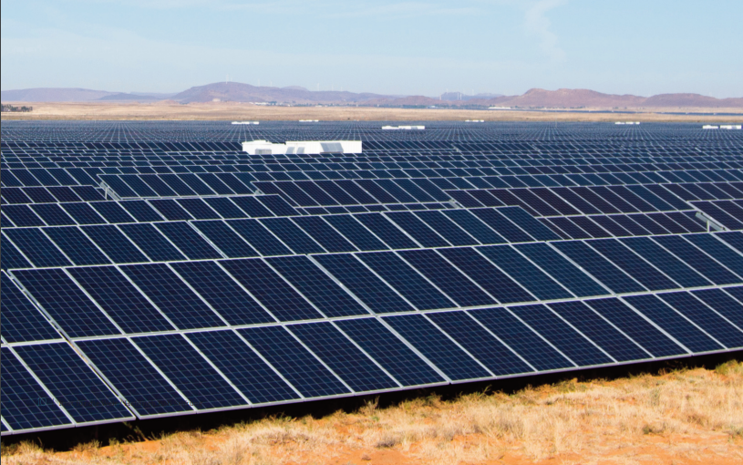
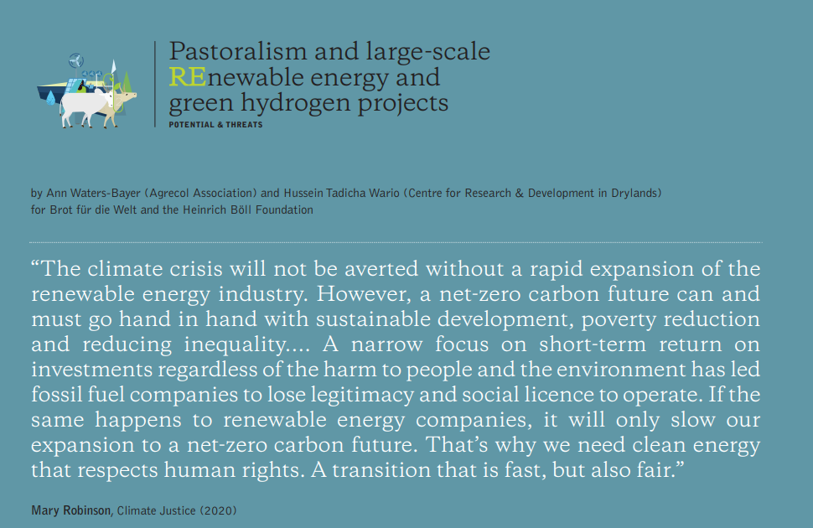
Challenges facing rangelands
Notes:
Insufficient solutions to persistent rangeland challenges may partially be a consequence of a powerful rangeland marginalization narrative. The extent to which rangelands are marginalized is inherent in the terms used to describe their limited capacity to provide forage, food and fiber; i.e., unpredictability, resource scarcity, sparse human populations, and remoteness—collectively termed the drylands syndrome (Reynolds et al. 2007).

Slide 12
Conversion of rangelands

Slide 13
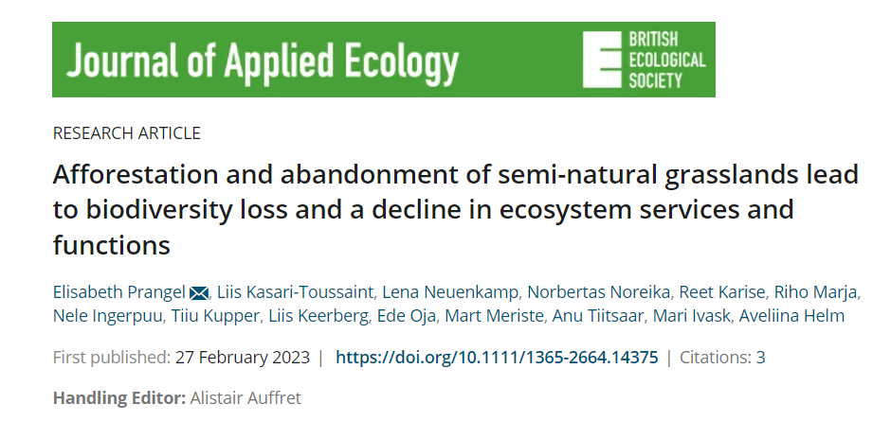
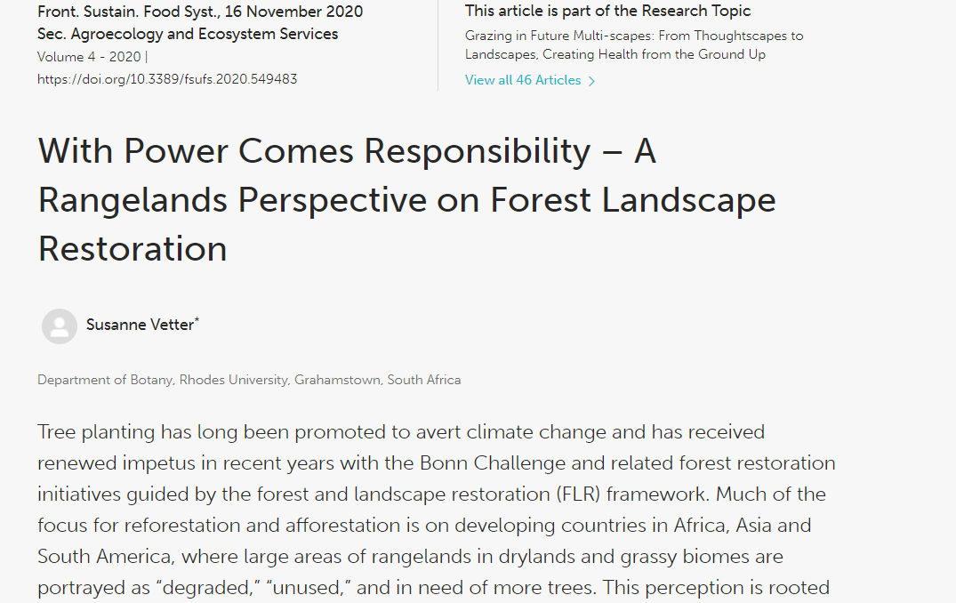
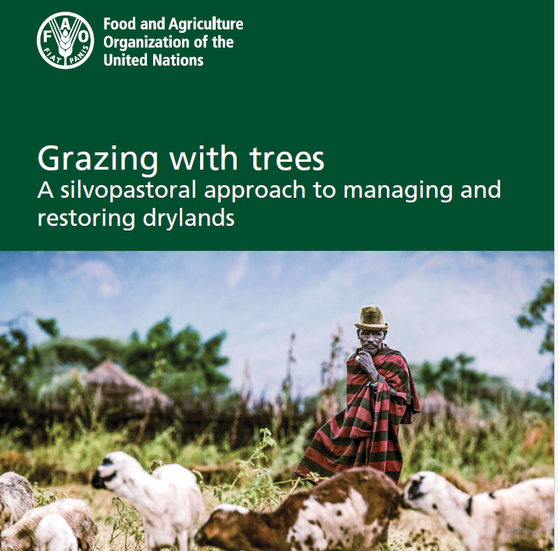
Afforestation in rangelands

Slide 14
IYRP 2026 structure
General IYRP e-list
~740 addresses mostly for info only
International Support Group (ISG)
~415 active partners, including GCG members & 2 co-chairs
Global Coordinating Group (GCG)
~45 members (co-chairs, comms team, RISG & WG chairs & reps from key supporting partners: FAO, Govt of Mongolia, ILRI, IUCN, UNEP, WAMIP)
Working Groups (WGs):
Afforestation
Biodiversity
Gender
Land Degradation Neutrality
Mountains
Water
Youth
Economics
Global Communications Team
Regional IYRP Support Groups (RISGs)

Slide 15
Thematic themes
Notes:
The themes take an integrated approach reflecting the SDGs and the 2030 Agenda for Sustainable Development

Slide 16
Regional IYRP Support Groups (RISGs)
Multistakeholder RISGs to generate partnership:
to expand network of supporting organisations and governments in the 11 regions of the world
to work with Government of Mongolia and IYRP International Support Group (ISG) to plan and implement IYRP activities in these regions
Arctic
East Asia
South Asia
Central Asia & Mongolia
Australasia
North Africa & Middle East
Eastern & Southern Africa
West & Central Africa
Europe
North America
South America
Central role for pastoralist organizations in the RISGs & their activities
Photo: J.Dillan/MercyCorps
Notes:
RISGs are comprised of Pastoralist organisations and communities, supporting organisations, researchers

Slide 18
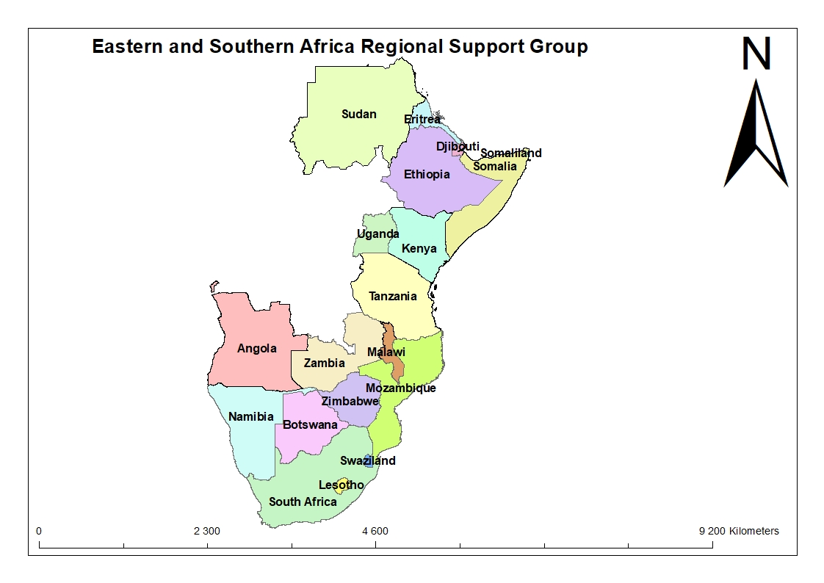
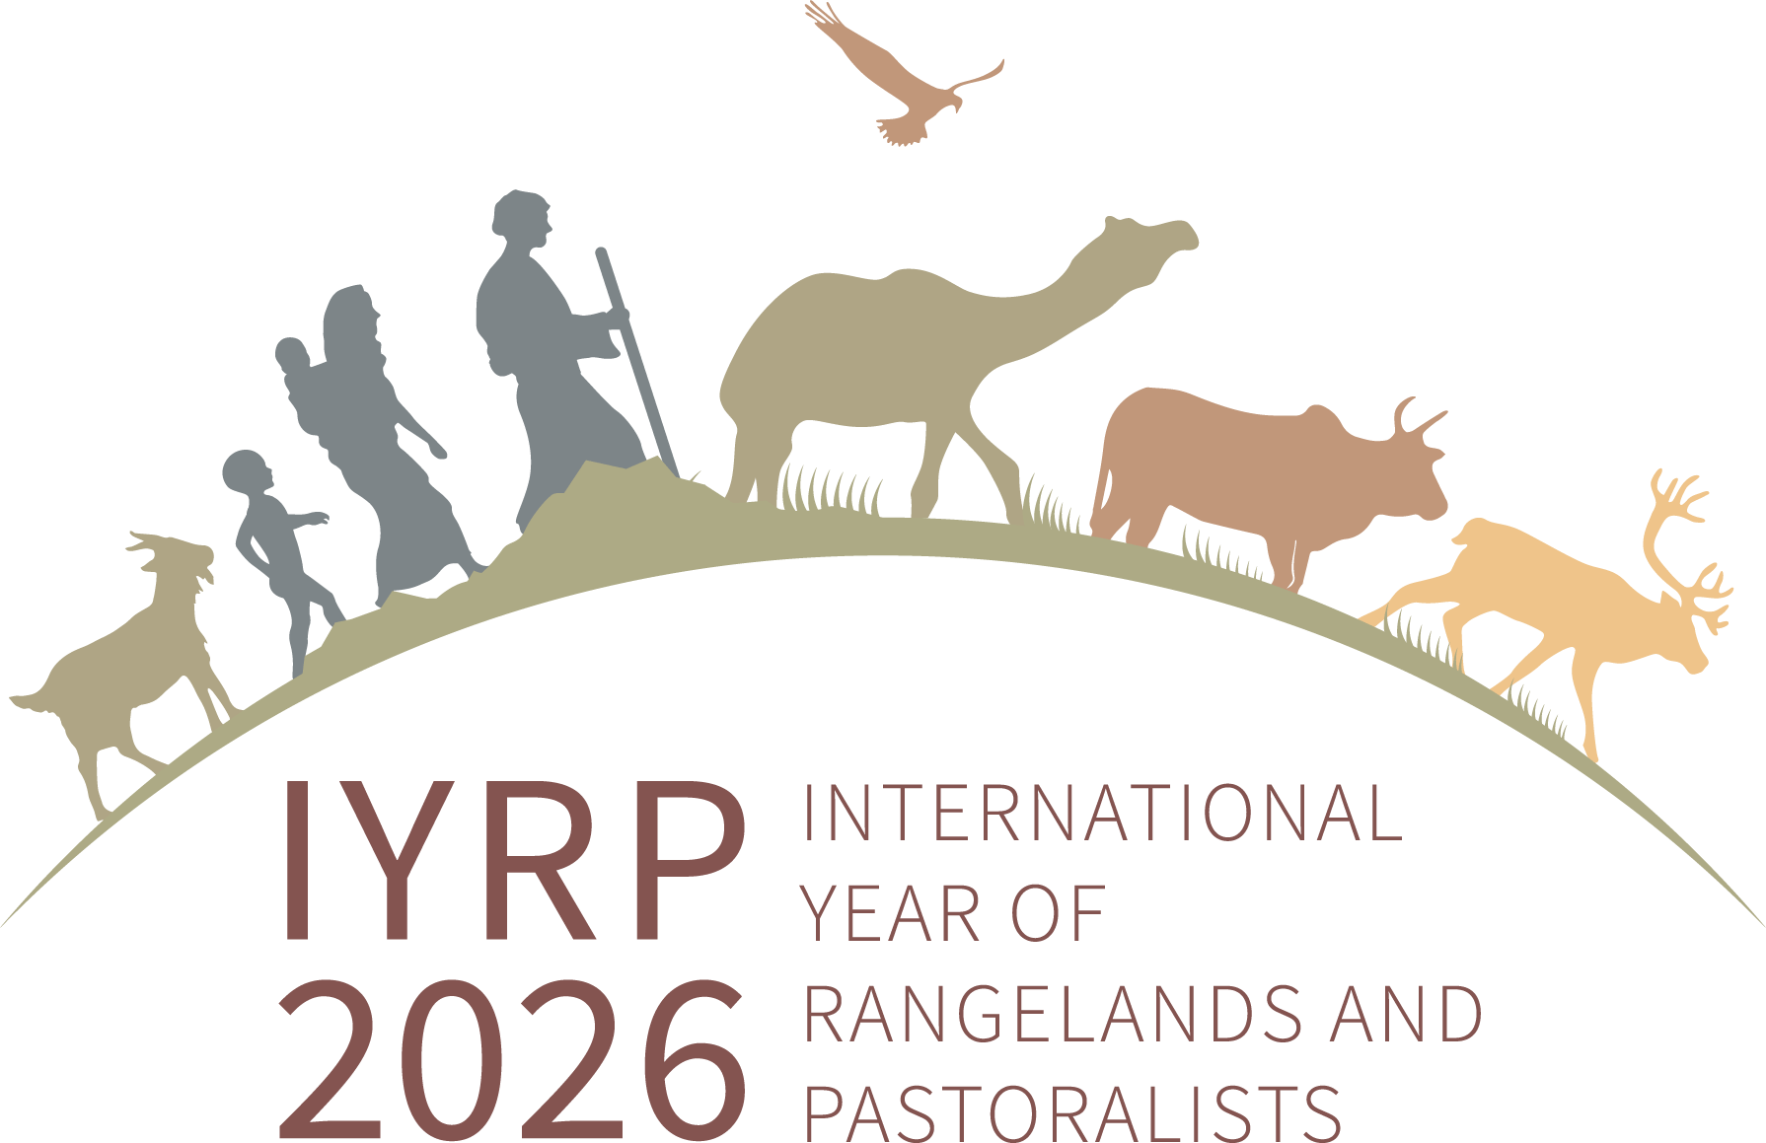
Eastern and Southern Africa Regional IYRP Support Group

Slide 19
What does the IYRP initiative seek to achieve through the Working Groups?
Greater awareness in science & society about how rangelands & pastoralists contribute to food security, economy, environment & cultural heritage
Resolutions taken by UN and other international entities in support of rangelands & pastoralists
Changes in national, regional & global policies in favour of sustainable management of rangeland resources by pastoralists & other stakeholders

Slide 20
Tasks of Working Groups :
Collate and analyse existing research results (science review)
Identify knowledge & information gaps – and new opportunities
Stimulate and engage in participatory research to fill gaps and explore opportunities
Analyse existing international policy related to the theme
Identify “targets” (international bodies, conventions, events etc) for science- and experience-based advocacy
Strategise on appropriate messages for these targets, including identification of spokespersons or “ambassadors” to bring them across
Engage with pastoralists and others in IYRP network (including other WGs) in disseminating these messages, also for public awareness

Slide 21
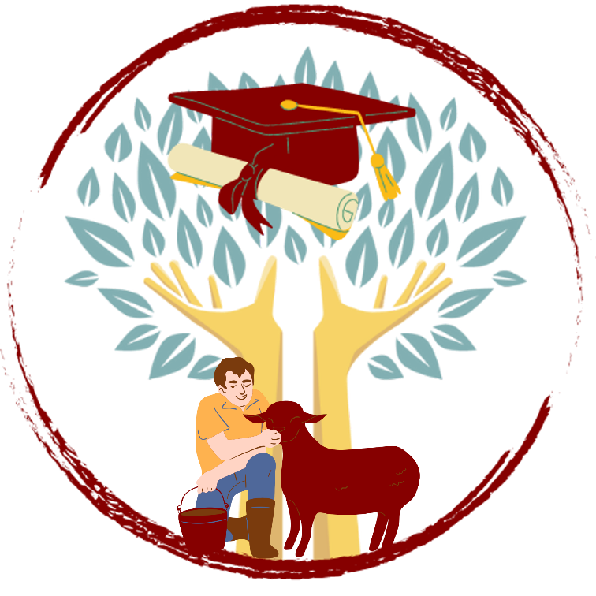
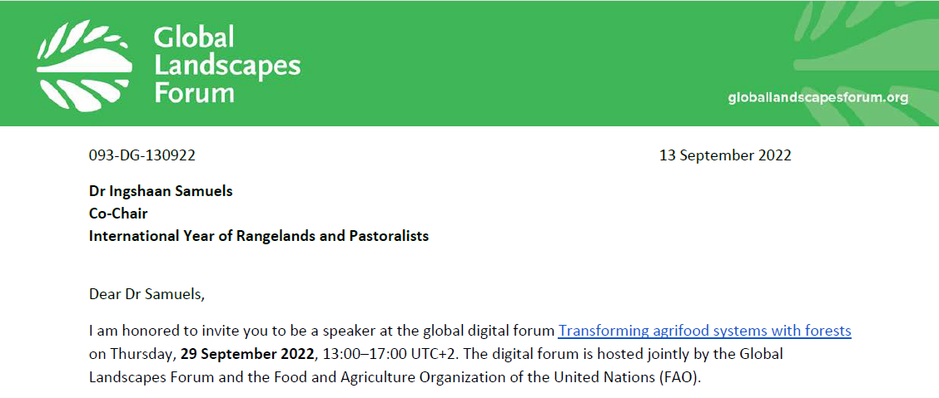
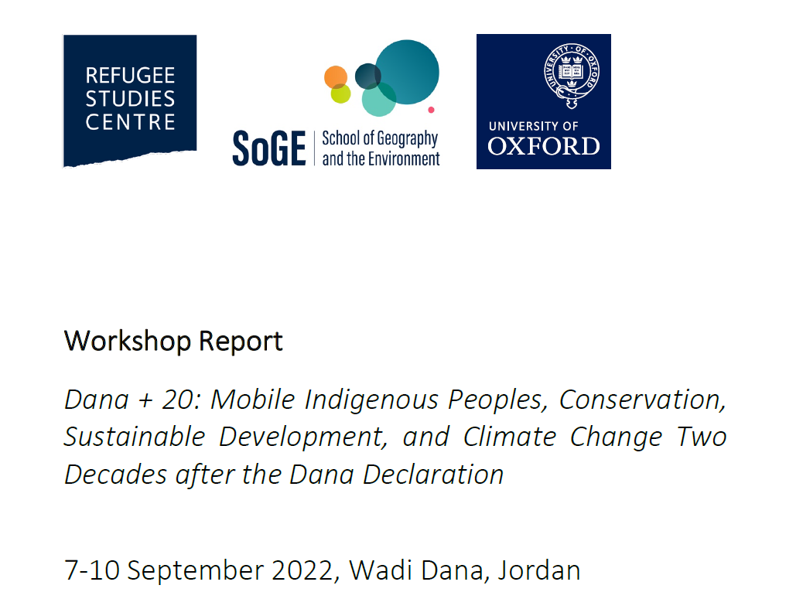
Global RSC
IMC 2022
UNESCO
SRM annual IYRP session
IRC- IYRP Sessions and TKF
Humboldt Forum
DRYLANDS SUMMER
SCHOOL
PRESENTATION TITLE HERE
Notes:
Launch of the Rangeland Stewardship Council (RSC) - Batkhishig Baival
The RSC was launched at the Natural Fibre Connect Conference on 9 Sept 2022 and is led by the SFA. RSC is inviting collaboration from the IYRP GCG and ISG to build its structures and aims to be fully participatory as all growers, herders, and farmers will be involved in preparing the standards. Its vision is to prepare certification standards similar to the Forest Stewardship Council that would be global, covering all animal products, and connecting livelihoods, land degradation, biodiversity and climate issues into the product supply chain. Its focus will be on non-perishable animal products at this time and the RSC intends to build a traceability and assessment system.
The RSC was welcomed by the GCG. A certification of effective management and improved stewardship will impact positively on rangelands and animal product supply chains.
The Council of Europe has certified transhumance routes as cultural heritage in Spain, France, Italy, Greece, Albania and cross-border.

Slide 22
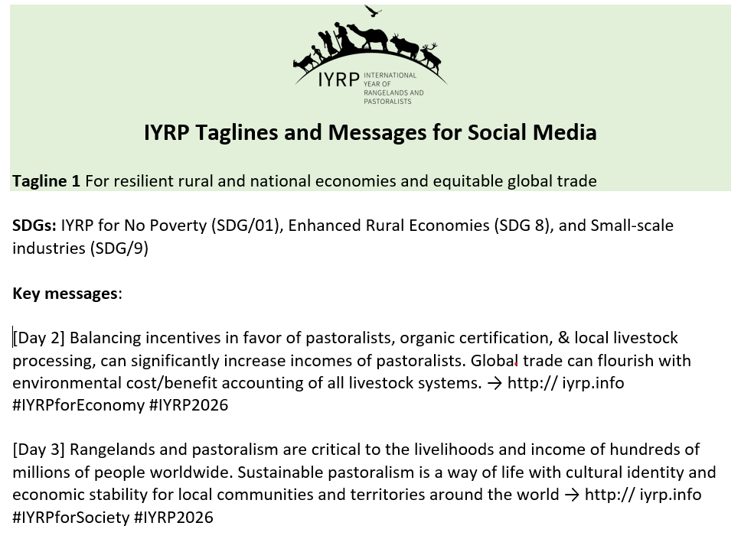
Notes:
The Declaration of the United Nations Conference on the Human Environment, or Stockholm Declaration, adopted on 16 June 1972 by the United Nations Conference on the Human Environment, was the first document to recognize the interconnections between development, poverty and the environment. 1 Fifty years after the Stockholm conference, with increasing environmental challenges and growing inequality affecting development and well-being, the global community comes together to reflect on the urgent need for action to address these interconnections

Slide 23
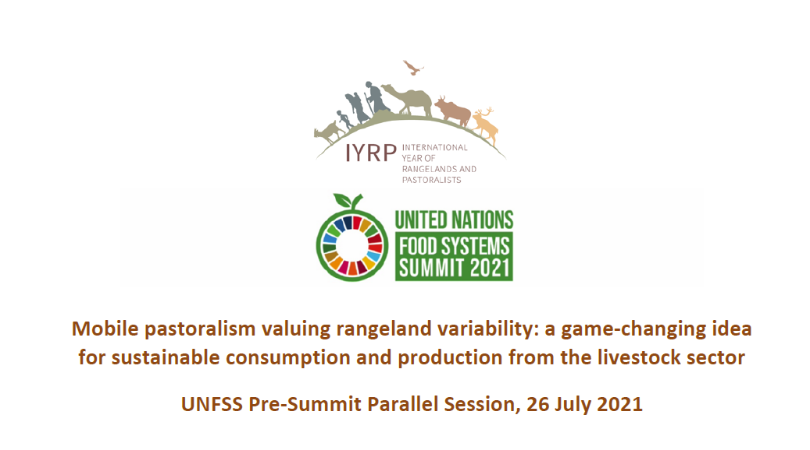

Slide 24
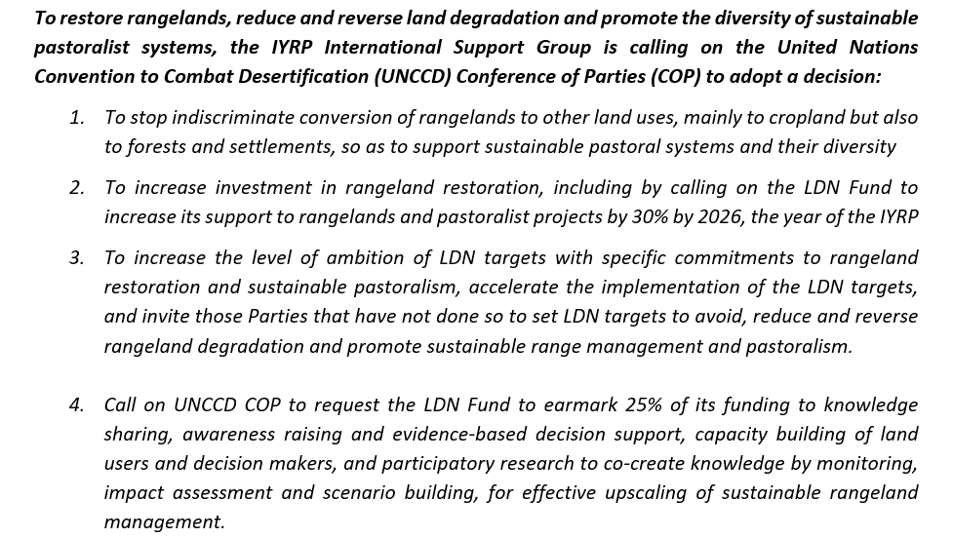
Key messages from Working Groups
“Rangeland afforestation is not a natural climate solution”
Key message: Rangelands are valuable ecosystems and afforestation efforts, driven by a climate change mitigation agenda, present a serious risk.

Slide 26
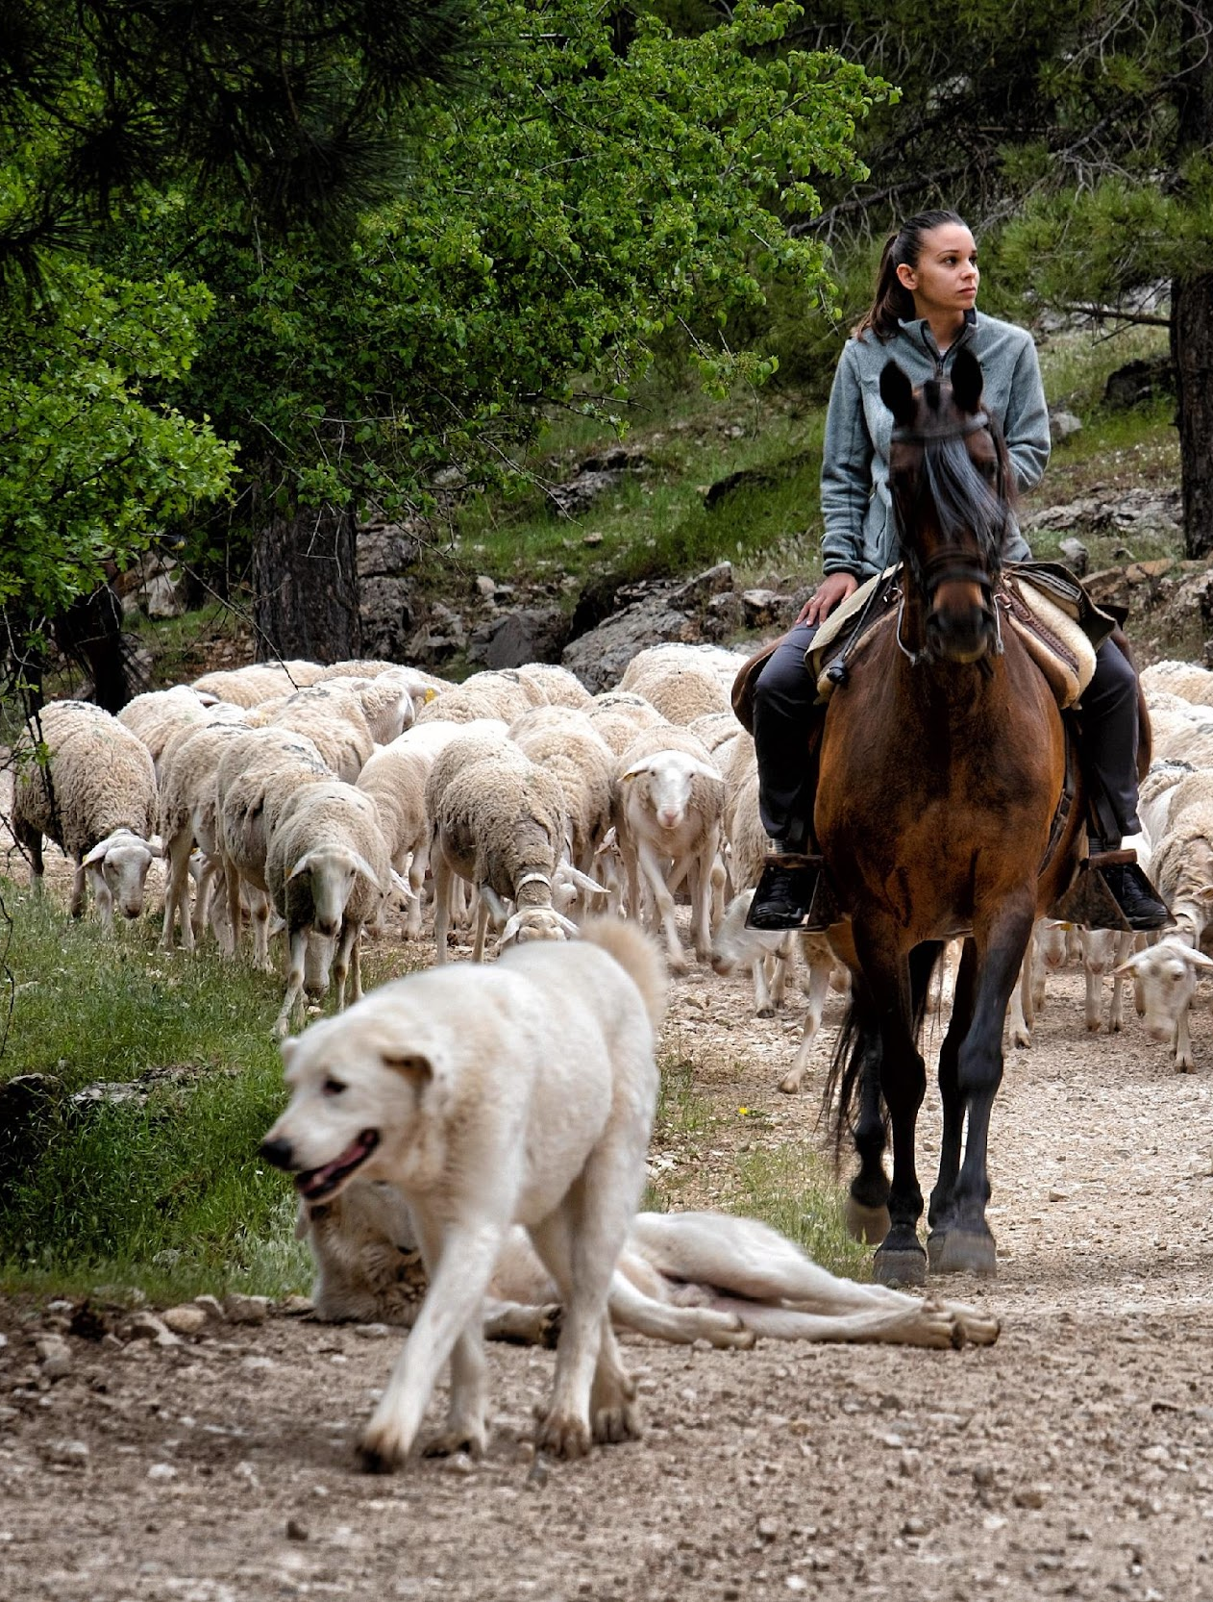
Grazing Land, Grazing land – Children Song Johnny Johnny Yes Papa )
Grazing land, Grazing land
Grazing animals, in the land
Forcing nomads off the land
Facing crisis Yes Yes Yes.
Keeping grass, in the land
Carbon storing, bottom land
Coping drought, common land
Caring herd, Care Care Care.
Calling nation, everywhere
Curtail carbon, over air
Climate Action here and there
Grazing range, Come Come Come.

Slide 27
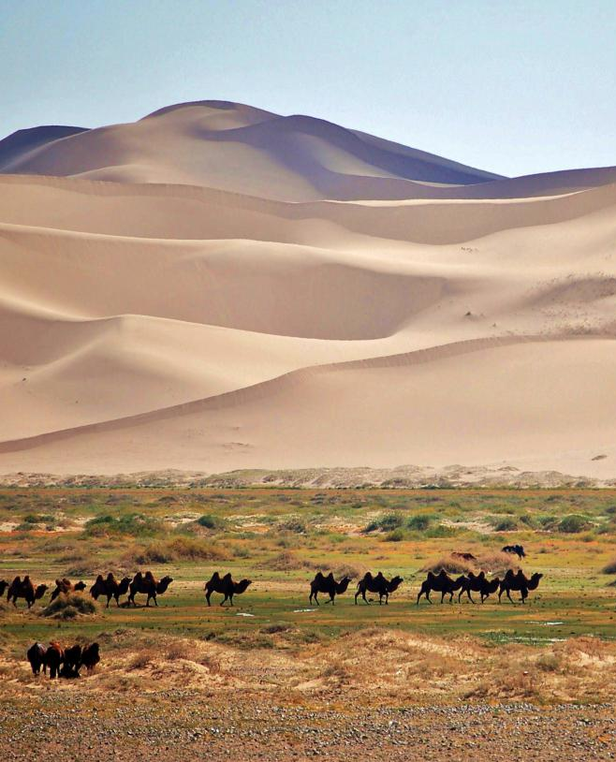
Regional action plans
To spearhead regional/multi-country activities for highlighting IYRP and achieving its objectives
To reach out and inform pastoralists
To help coordinate national activities across the region
To contribute to global activities
© Marc Foggin

Slide 28
Regional/National Action Plans
Preparatory phase (2021–2025): activities to be done in 2026 require prior planning and preparation, research, etc.; moreover, many awareness-raising, learning and policy-influencing activities related to rangelands and pastoralists would need to take place already before 2026
The International Year (IY) (2026)
Post IY follow-up (2026 and beyond): some activities (particularly research and evaluation) may be done after 2026.
© Wendy Sheehan

Slide 29
Action Plan for South Africa
We need to establish a national action plan to support the IYRP which could be led by GSSA and discussions with DALRRD have started to fund IYRP activities.
Activities could include:
Special sessions at conference
Hosting a regional conference on IYRP
Public Seminars
Short Films
Grass day in South Africa
Farmer days highlighting IYRP messages
Social media campaigns
Commissioned research to fill knowledge gaps and formulating policy briefs.
Special issue in AJRFS

Slide 30
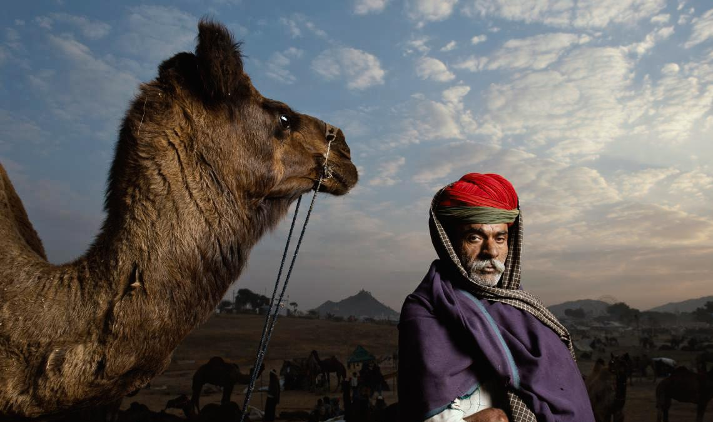
Thank You
© Kalyan Varma

