Slide 1
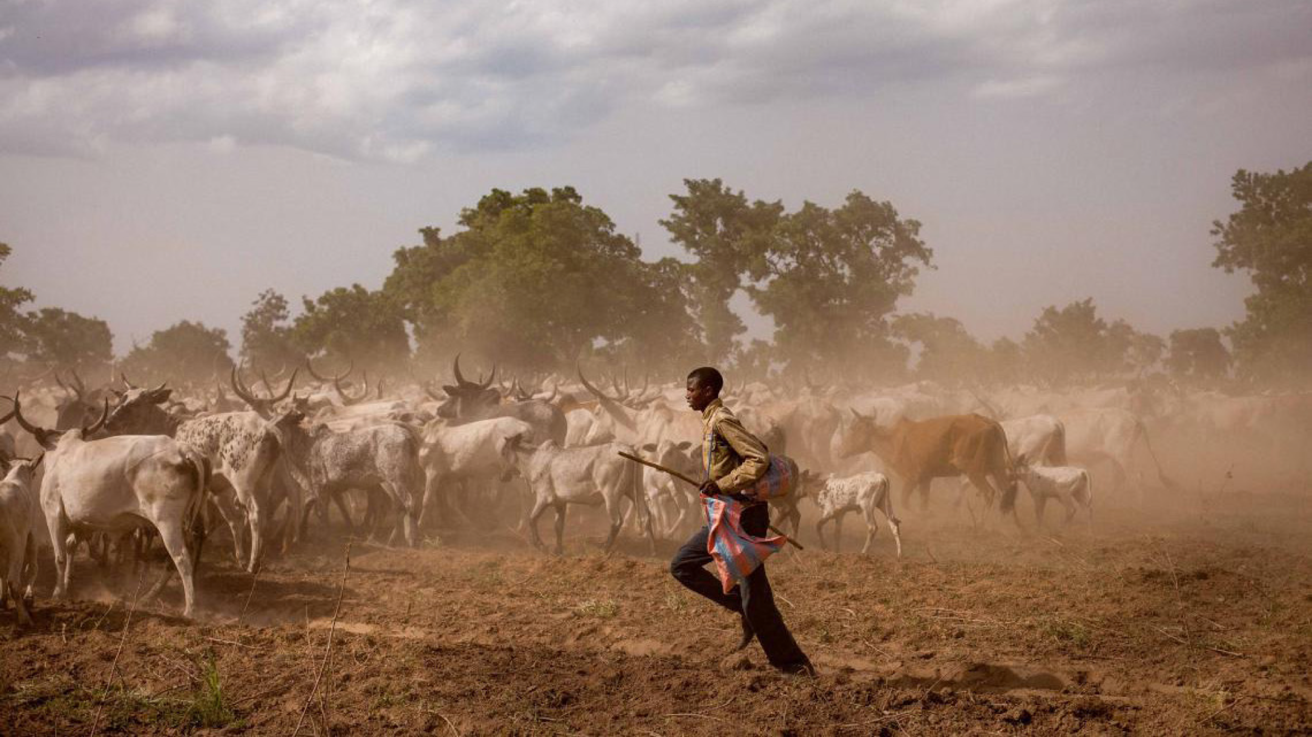
International Year of
Rangelands and Pastoralists
2026
Engin Yılmaz
Co-chair of European RISG
Director of Yolda Initiative & Coordinator of AMNC

Slide 2
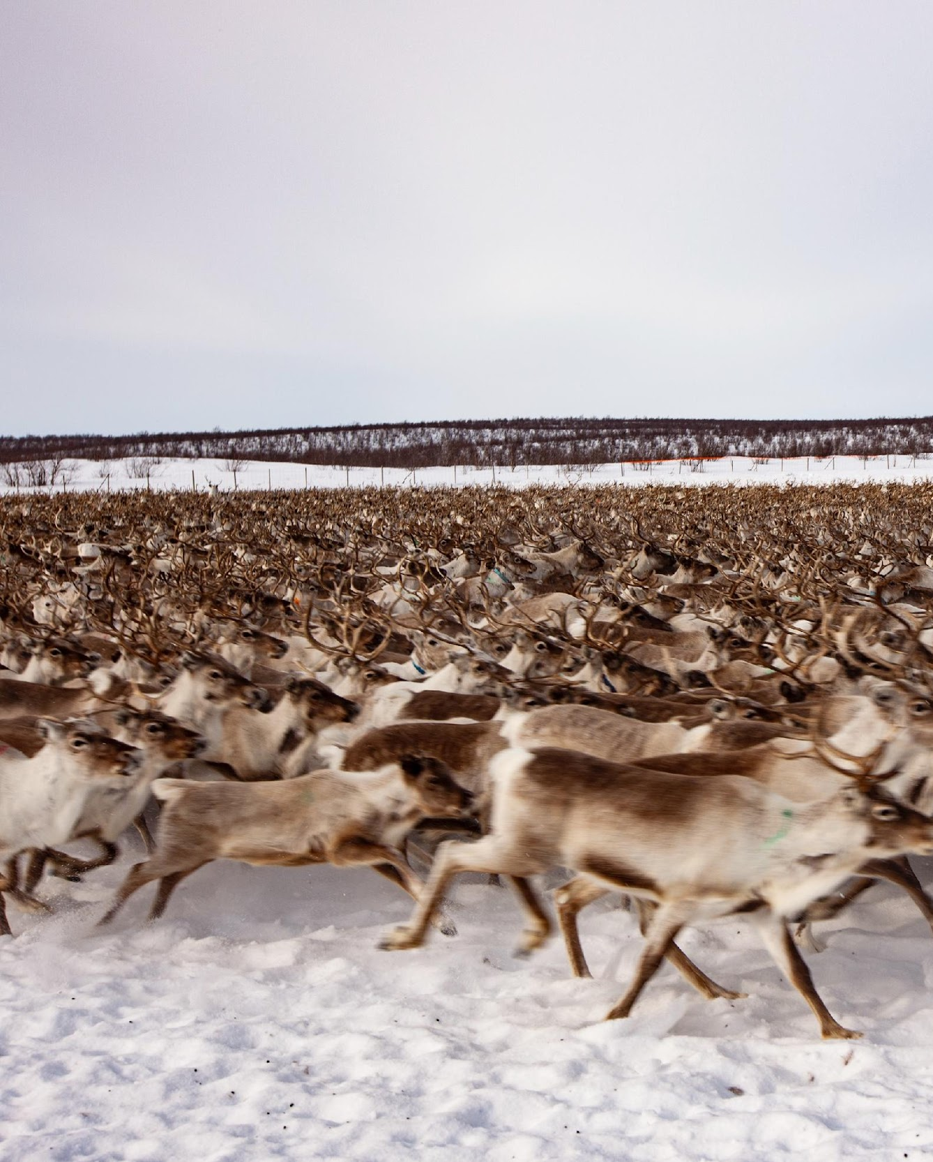
WHY AN IYRP?
increase worldwide understanding of importance of rangelands & pastoralists for food security, biodiversity and climate crises, economic resilience and culture
Break myths and misunderstandings
Fill knowledge gaps with more participatory research
Promote informed, science-based policies and legislation throughout the world recognizing and respecting the rights of the communities
Increase sustainable and ethical investment in rangelands and for pastoralists
mobilise people worldwide to address today’s challenges and to grasp new opportunities in rangelands & pastoralism
IYRP draft global action plan
UNEP GAP Analysis Report

Slide 4
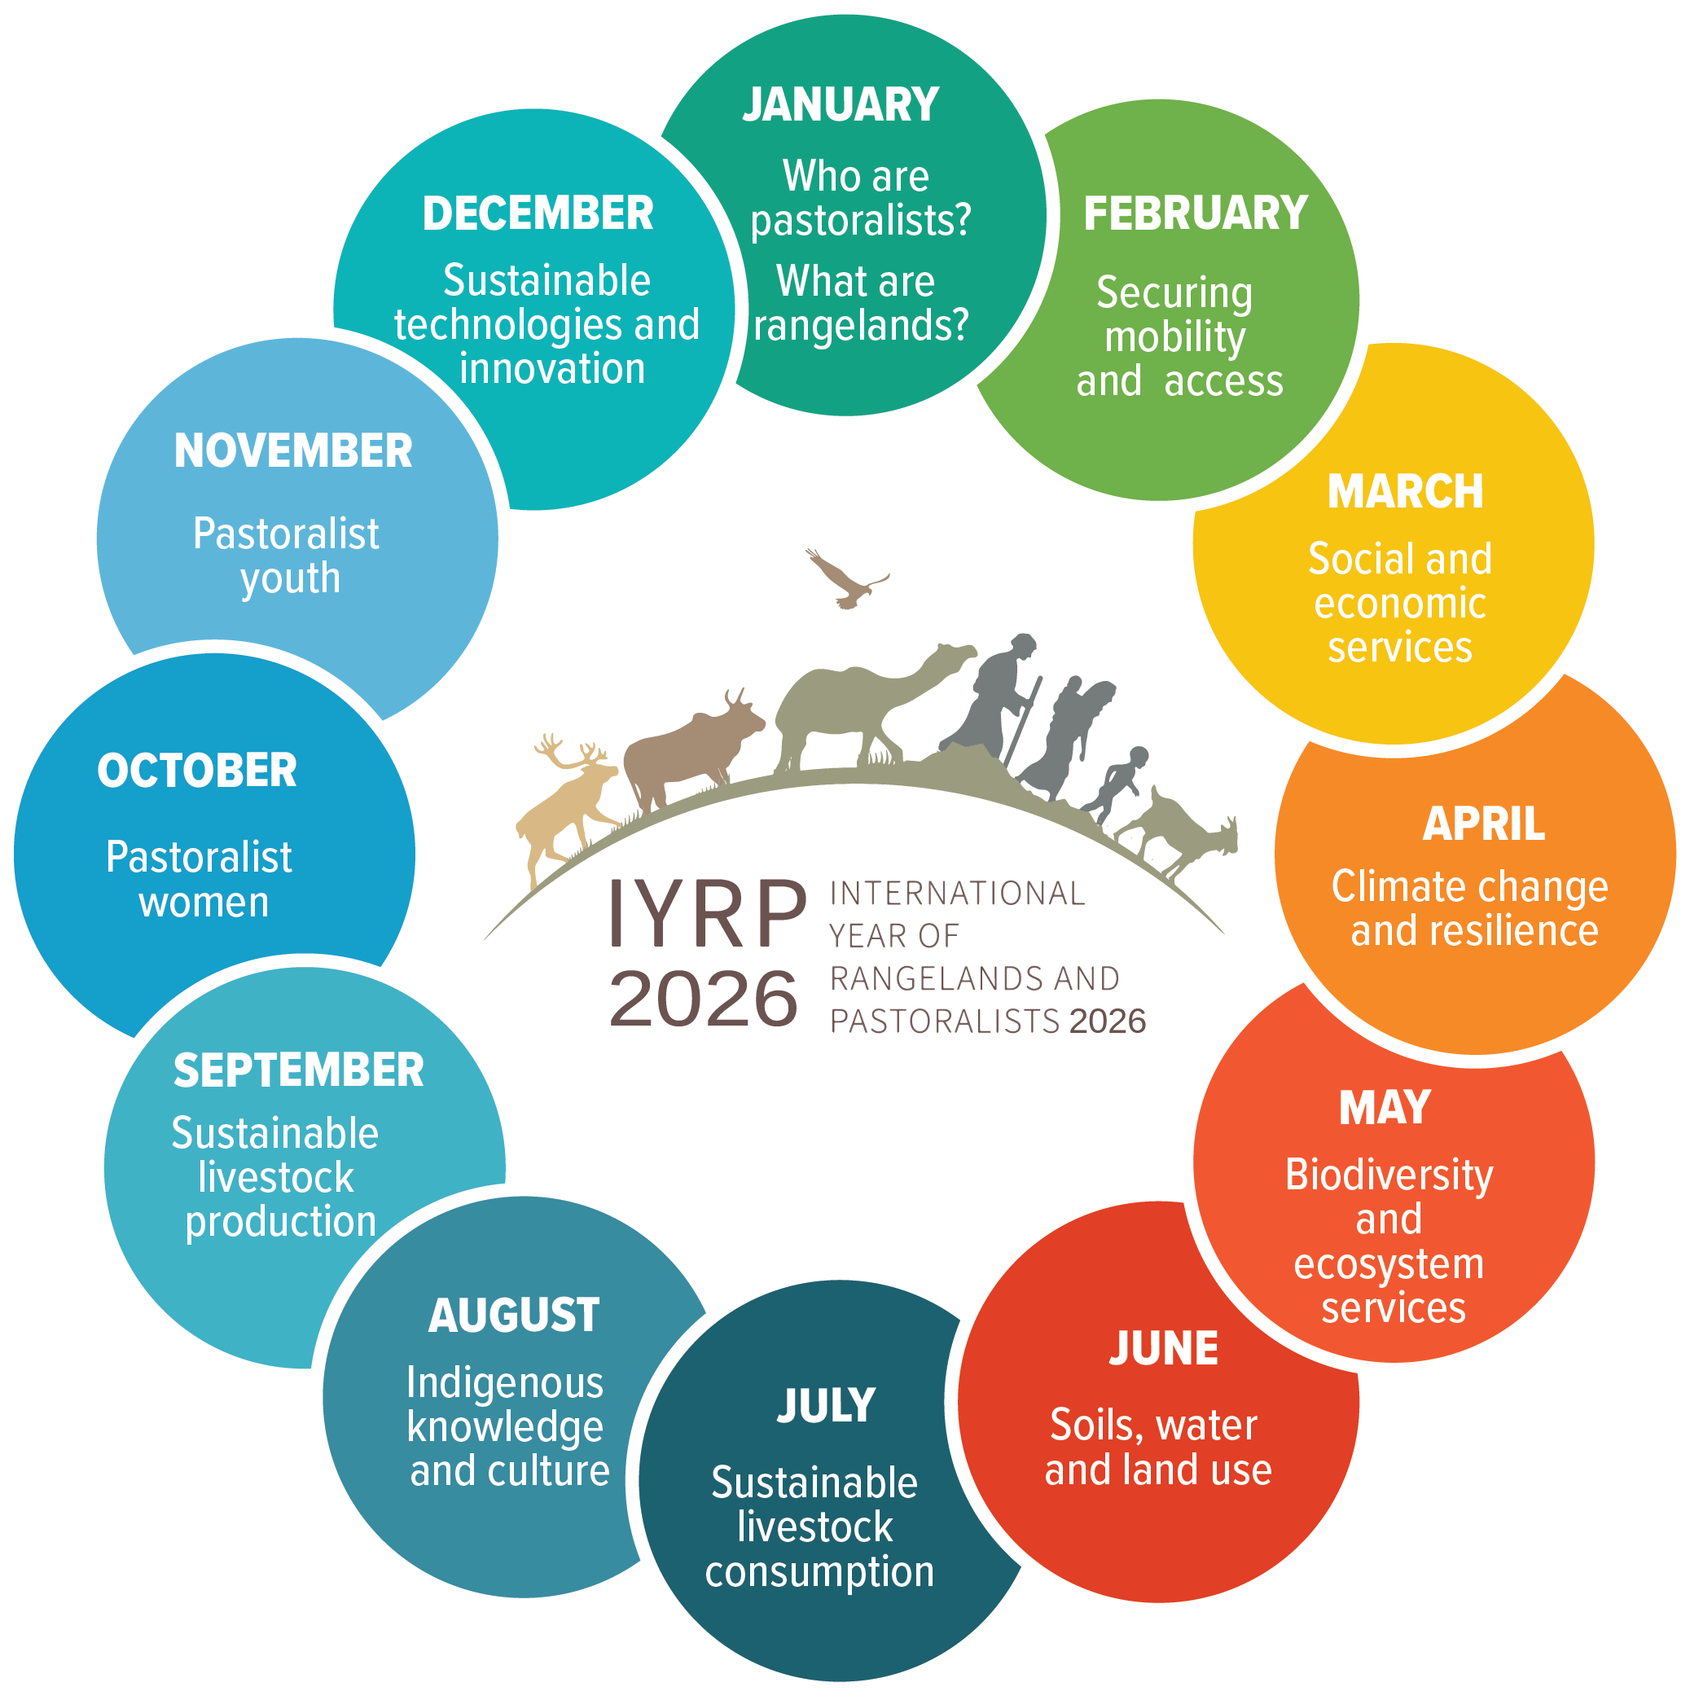
12 Global Themes of IYRP
IYRP is centered around 12 themes, one for each month of 2026
The themes take an integrated approach reflecting the SDGs and the 2030 Agenda for Sustainable Development
IYRP 2026 global monthly themes
© Antolin Avuzela

Slide 5
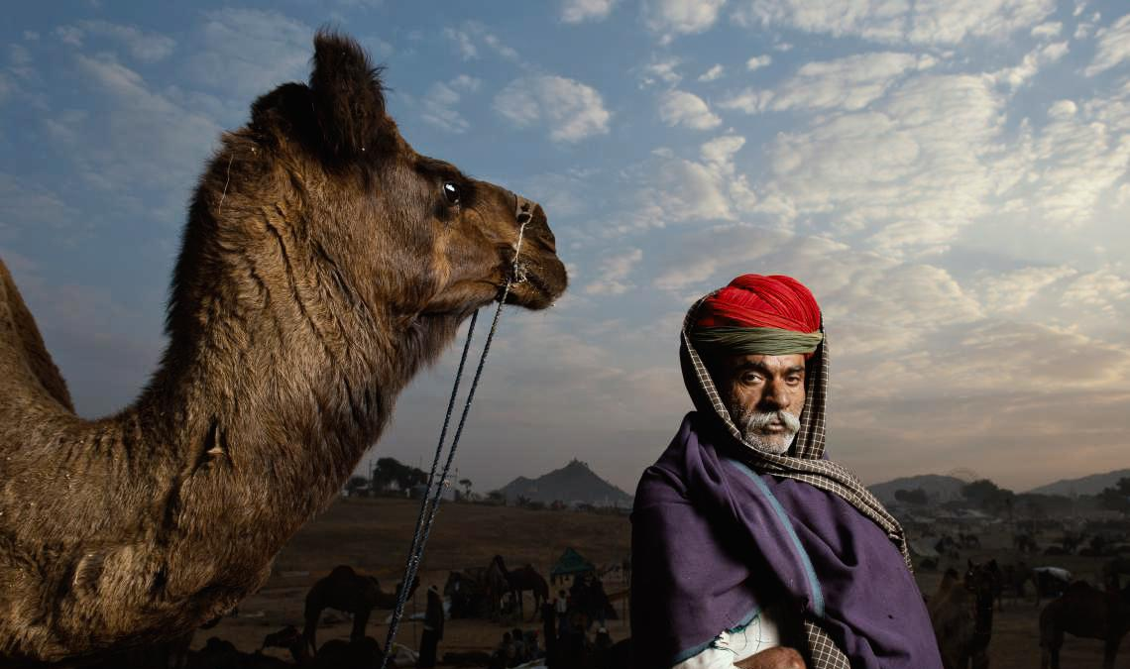
IYRP GLOBAL COALITION ACTORS
© Kalyan Varma

Slide 6
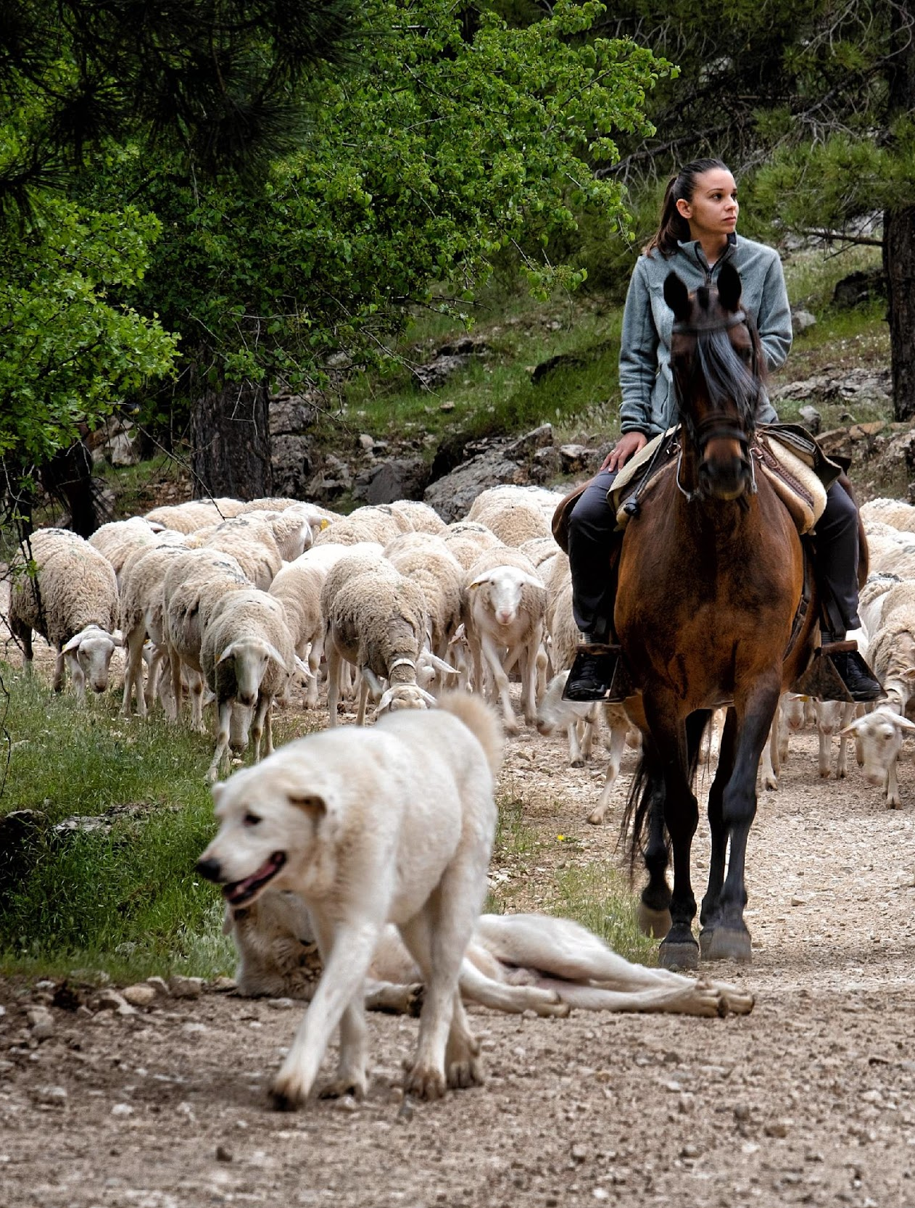
General Member List
International Support Group (ISG):
Global Coordination Group
Global Communications Team
Global Events Sub-group
Regional IYRP Support Groups
Food and Agriculture Organization of the United Nations (FAO) is facilitating the implementation of the International Year;
© Katy Gomez Catalina

Slide 7
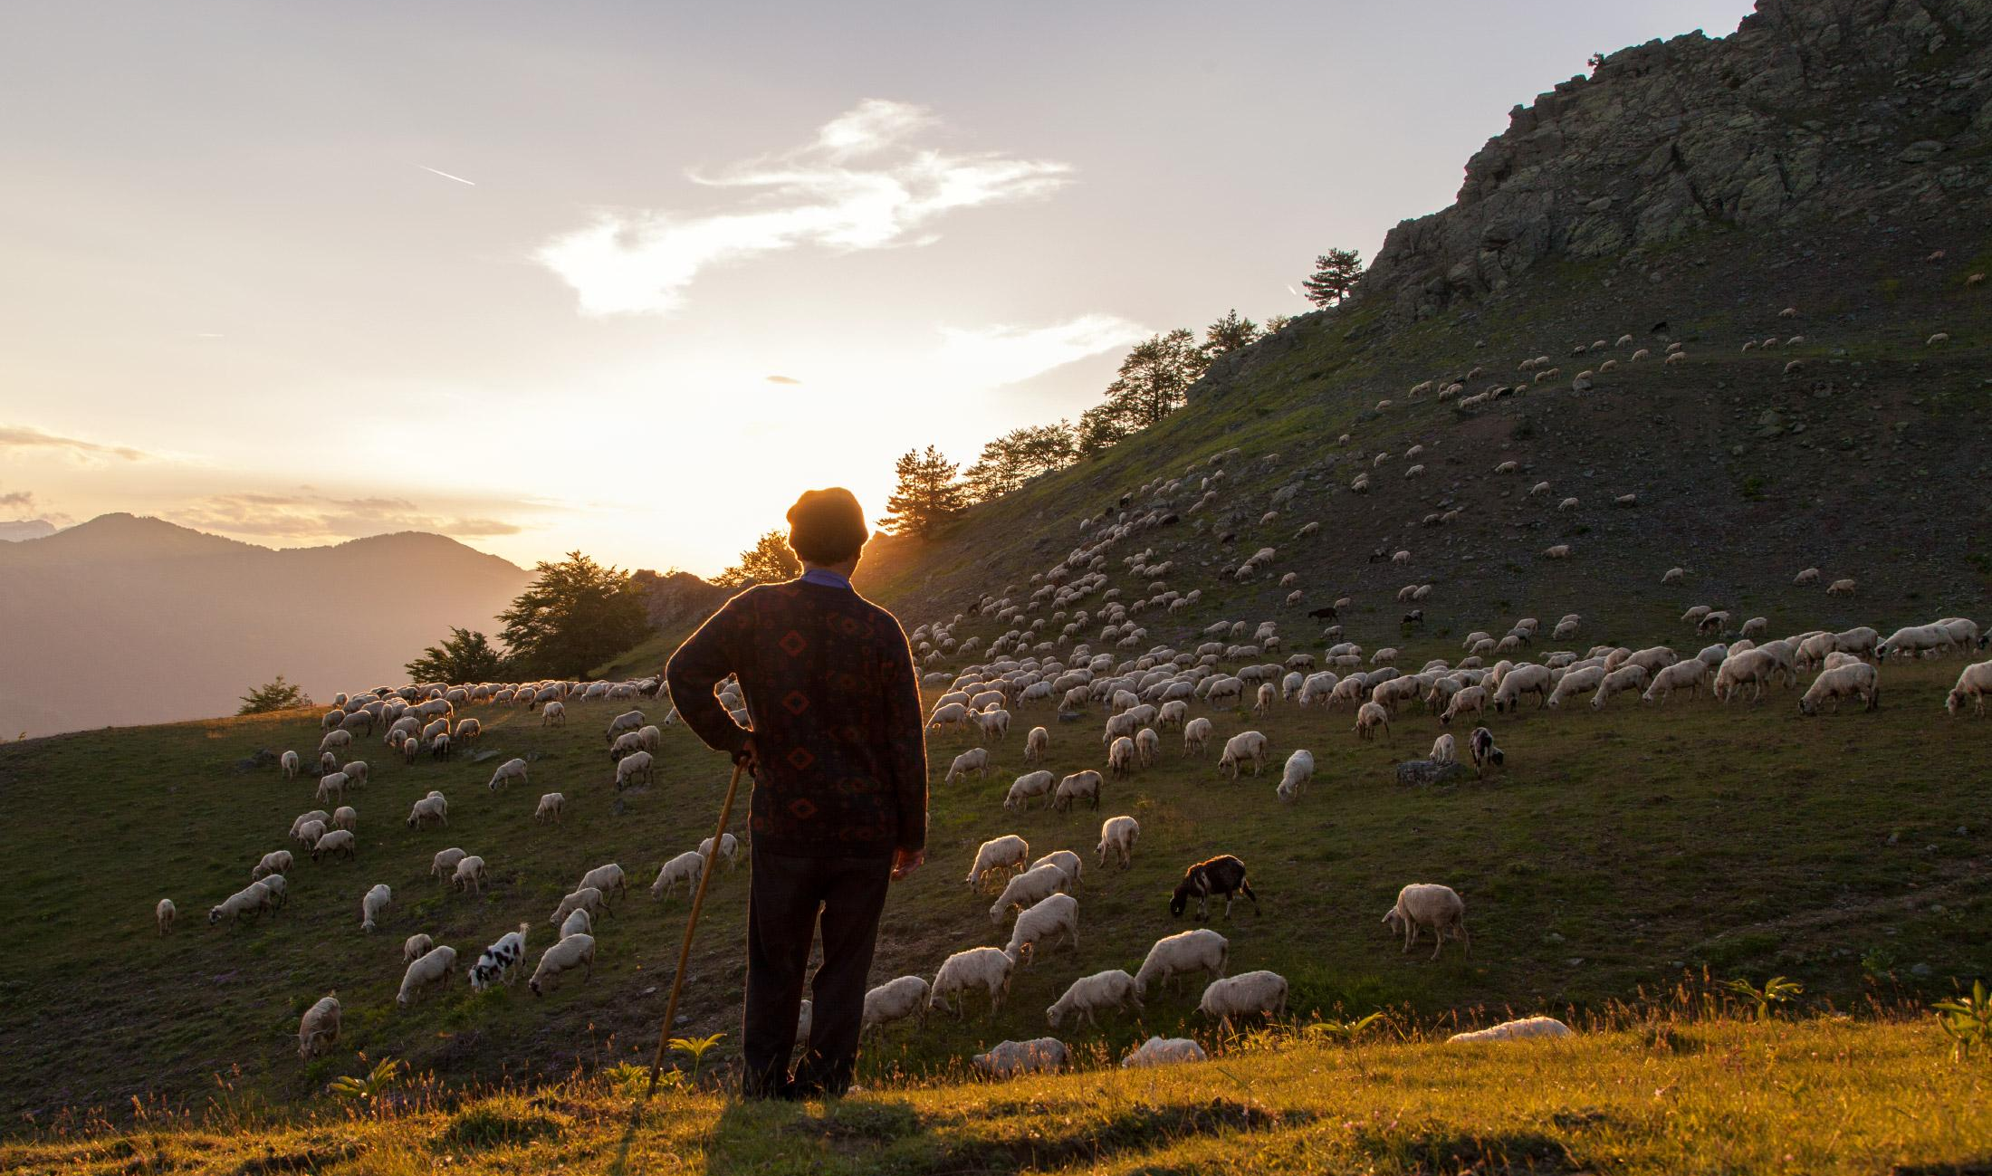
REGIONAL IYRP SUPPORT GROUPS (RISGS)
© Stamos Abatis

Slide 8
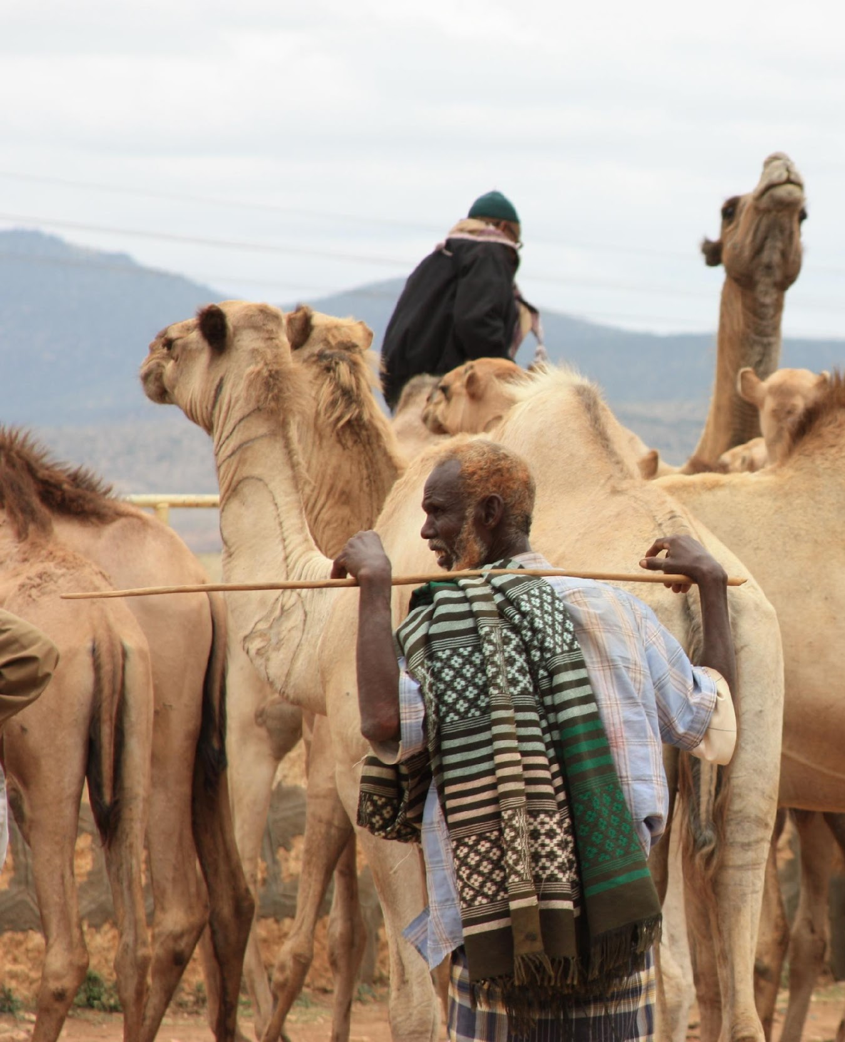
Regional IYRP Support Groups
Arctic, Australasia, Central Asia, East Asia, Eastern & Southern Africa, Europe, North Africa & Middle East, North America, South America, South Asia, West and Central Asia
RISGs are comprised of Pastoralist organisations and communities, supporting organisations, researchers
© Nena Terrell

Slide 9
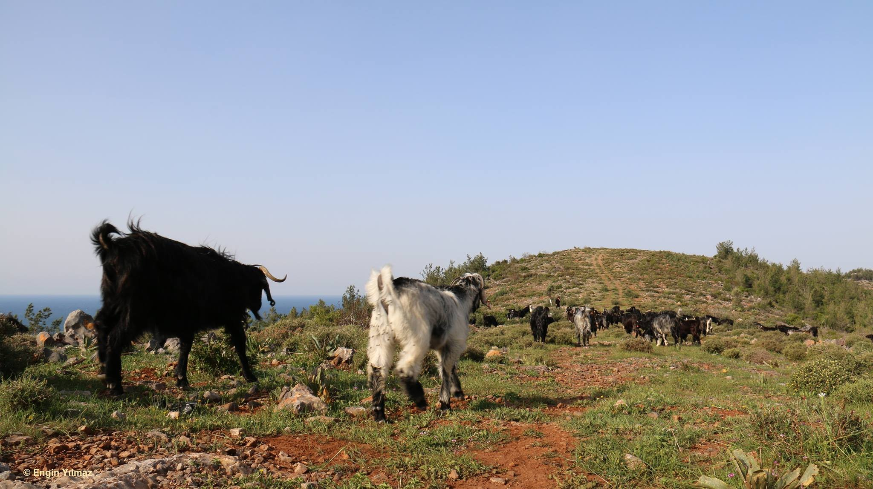
REGIONAL ACTION PLANS

Slide 10
Regional Action Plans
Preparatory phase (2021–2025): activities to be done in 2026 require prior planning and preparation, research, etc.; moreover, many awareness-raising, learning and policy-influencing activities related to rangelands and pastoralists would need to take place already before 2026
The International Year (IY) (2026)
Post IY follow-up (2026 and beyond): some activities (particularly research and evaluation) may be done after 2026.
© Wendy Sheehan

Slide 11
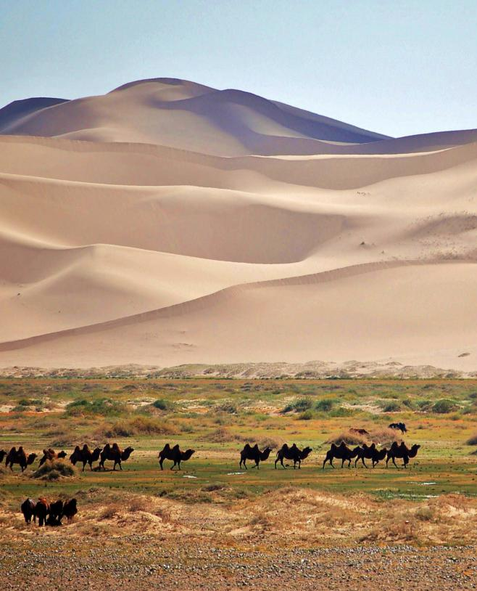
Purpose of regional action plans
To spearhead regional/multi-country activities for highlighting IYRP and achieving its objectives
To reach out and inform pastoralists
To help coordinate national activities across the region
To contribute to global activities
© Marc Foggin

Slide 12
THANK YOU!
Engin Yılmaz
engin@yolda.org.tr
© Engin Yılmaz

