Slide 1
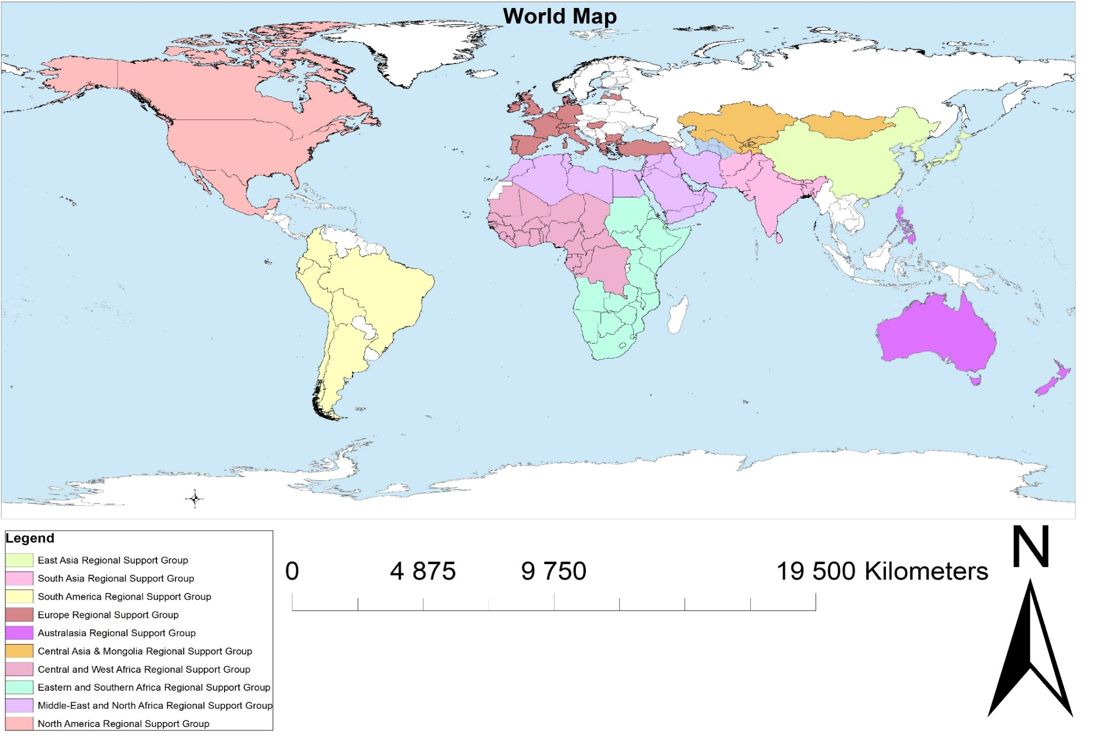
Legend
Arctic Regional Support Group
Regional Support Groups of the International Year of Rangelands and Pastoralists

Slide 2
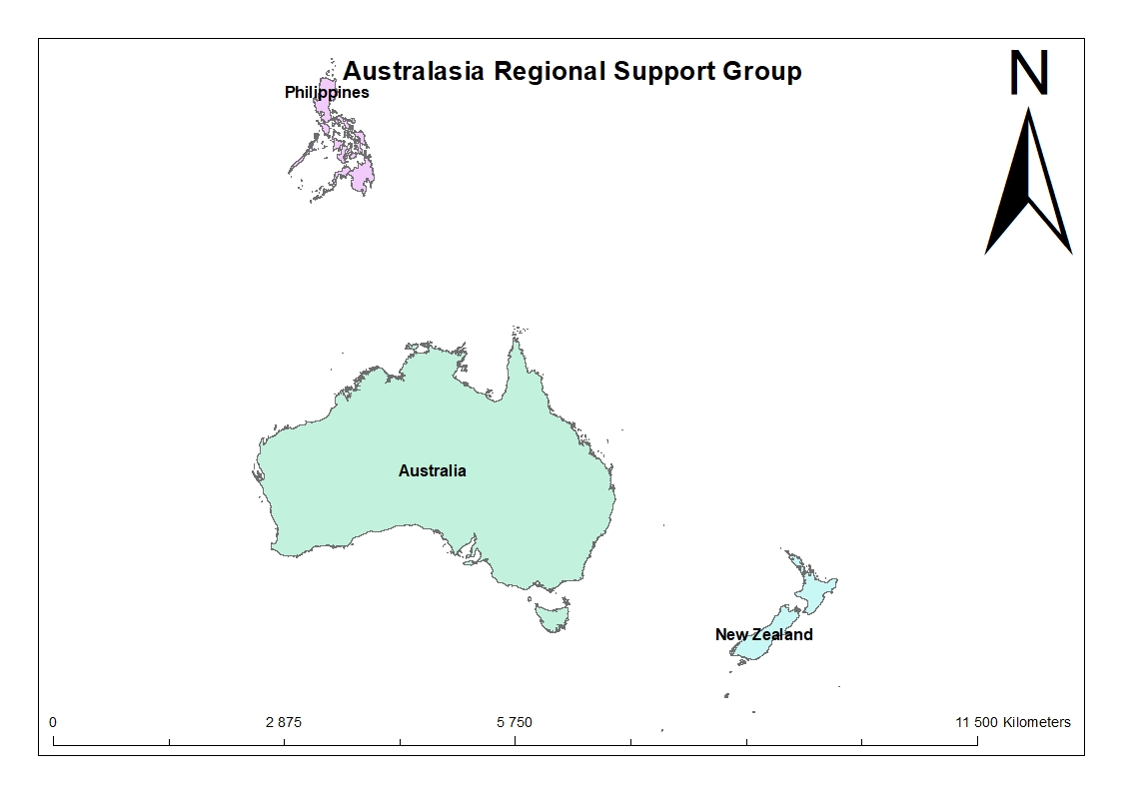
Australasia Regional IYRP Support Group

Slide 3
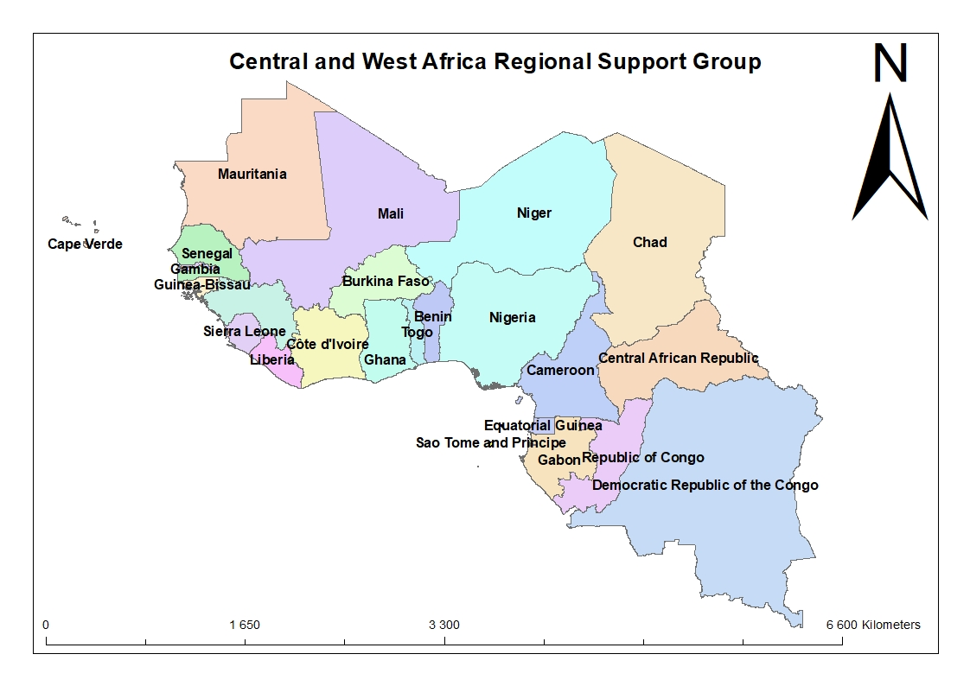
Central and West Africa Regional IYRP Support Group

Slide 4
Central Asia and Mongolia Regional IYRP Support Group

Slide 5
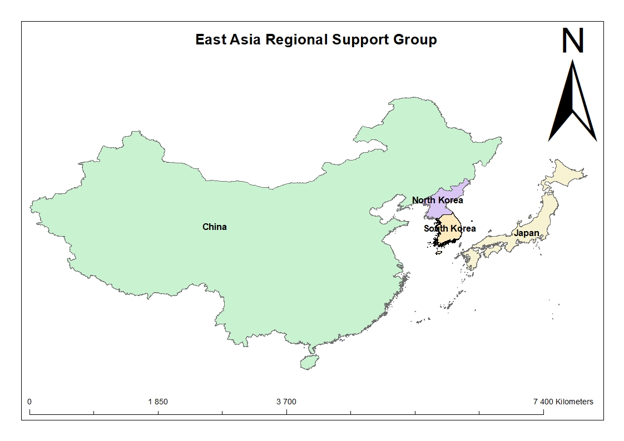
East Asia Regional IYRP Support Group

Slide 6
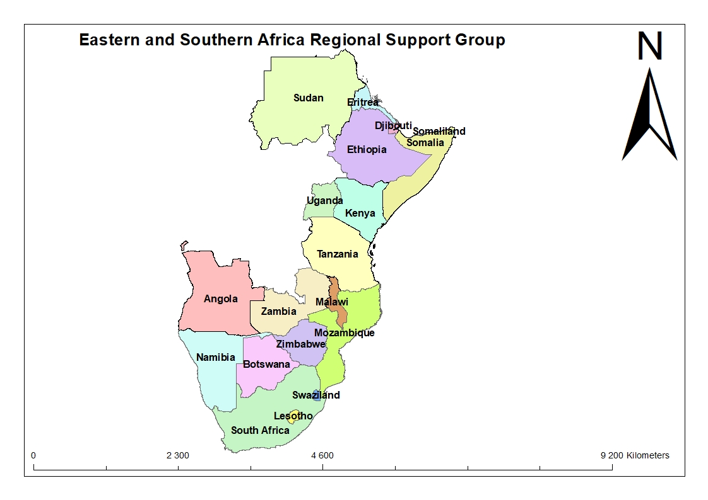
Eastern and Southern Africa Regional IYRP Support Group

Slide 7
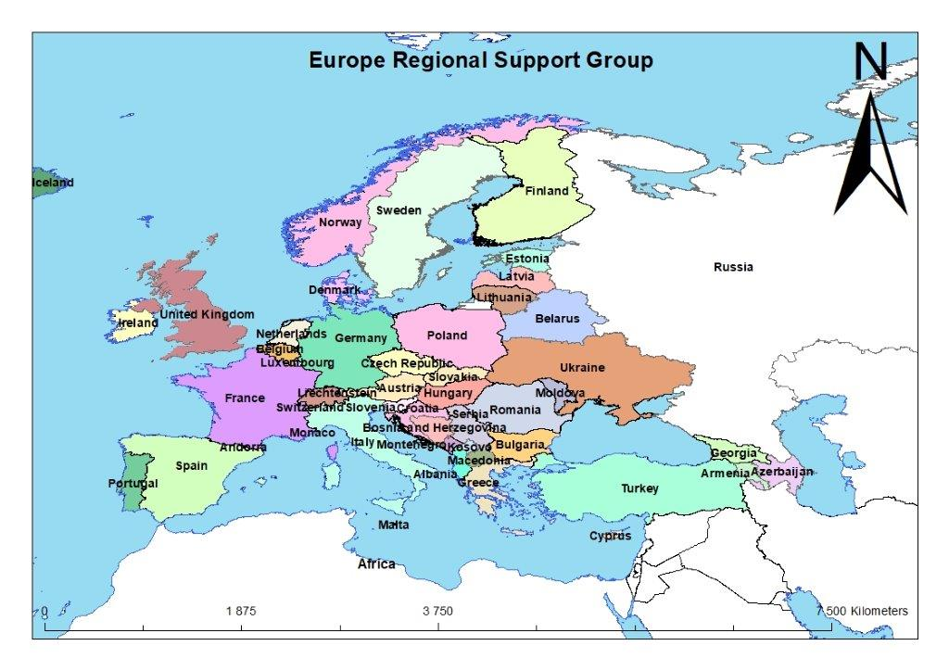
Europe Regional IYRP Support Group

Slide 8
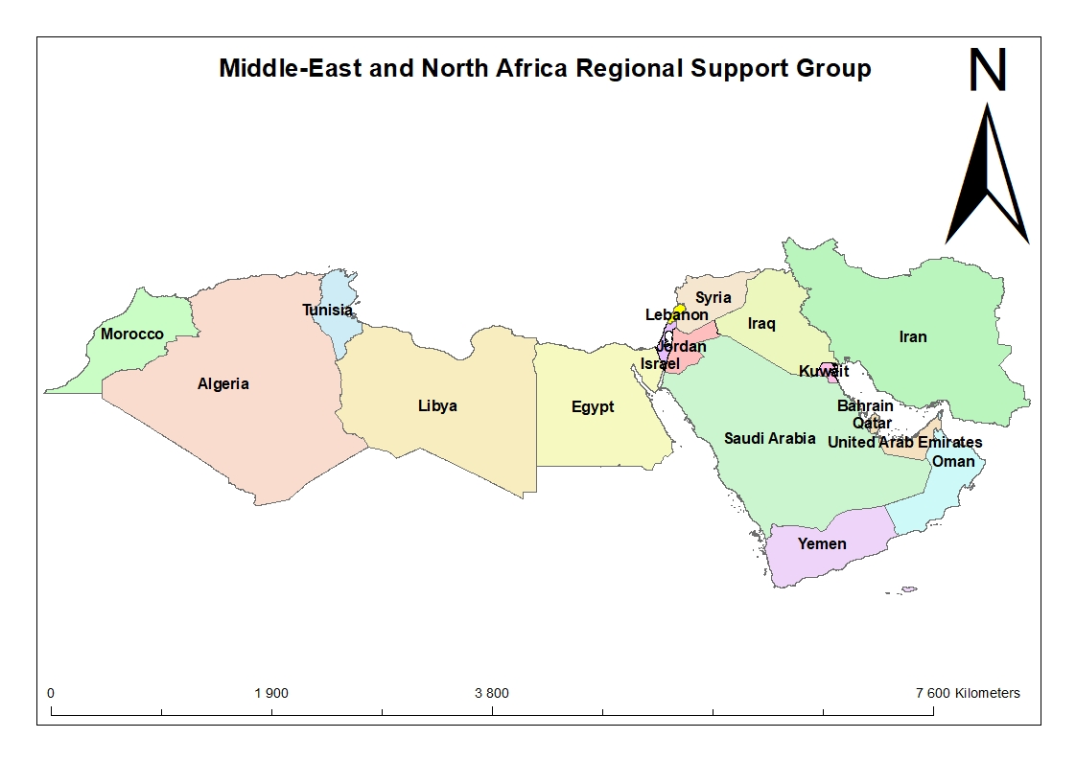
Middle East and North Africa Regional IYRP Support Group

Slide 9
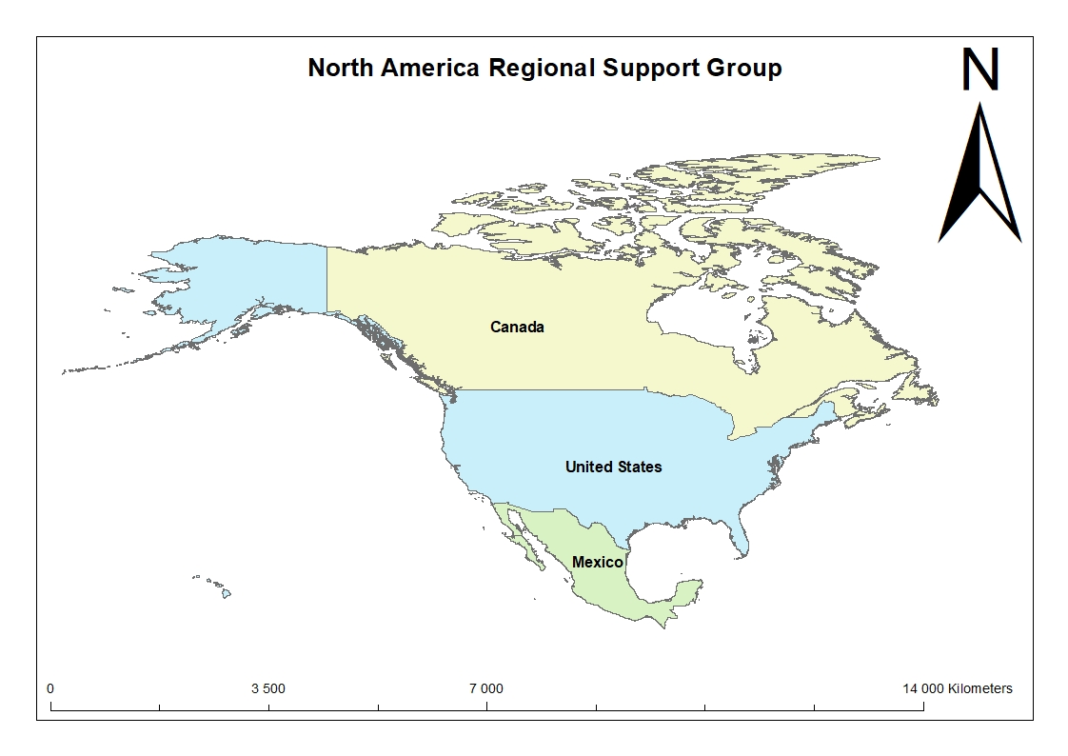
North America Regional IYRP Support Group

Slide 10
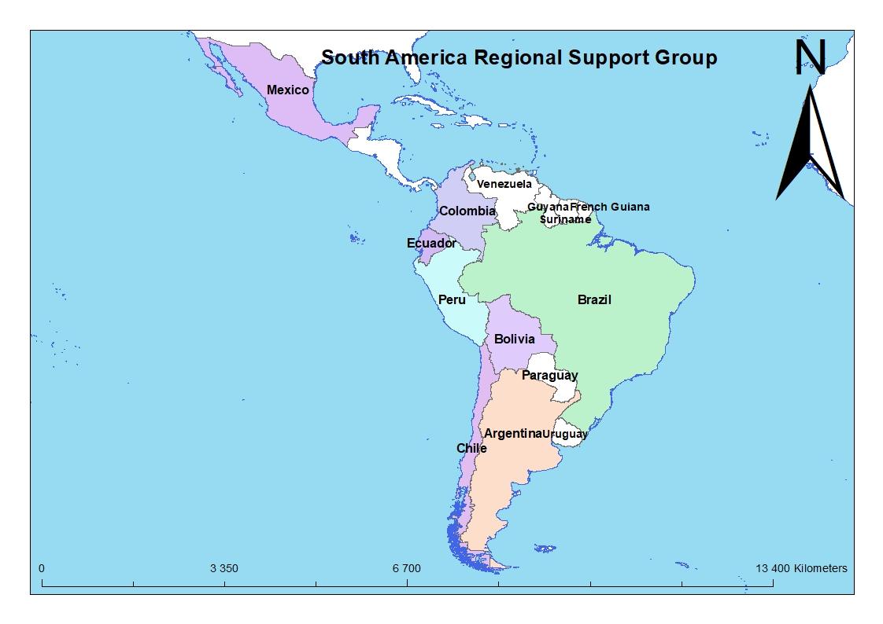
South America Regional IYRP Support Group

Slide 11
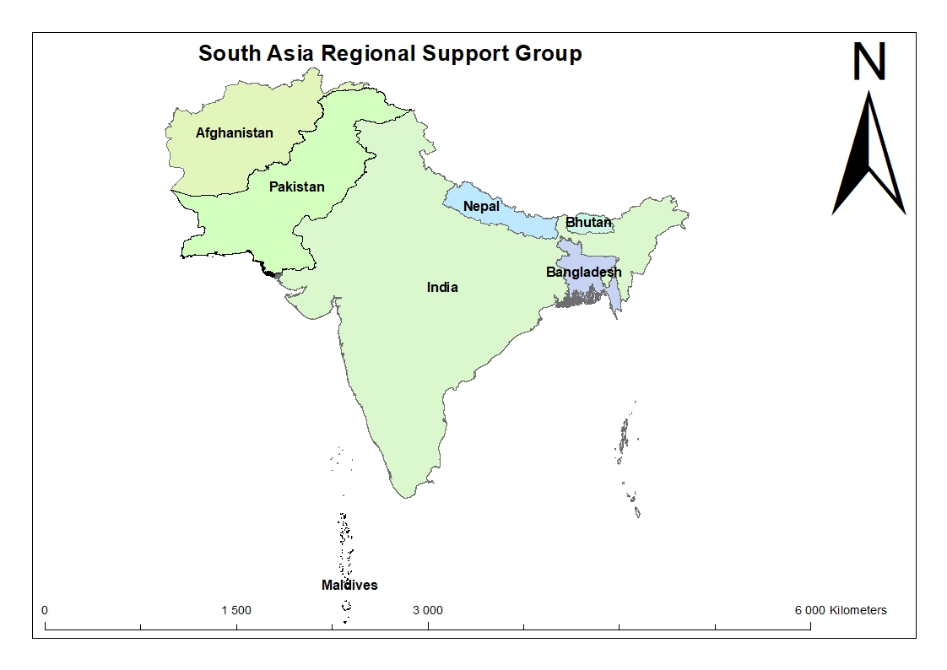
South Asia Regional IYRP Support Group

