Slide 1
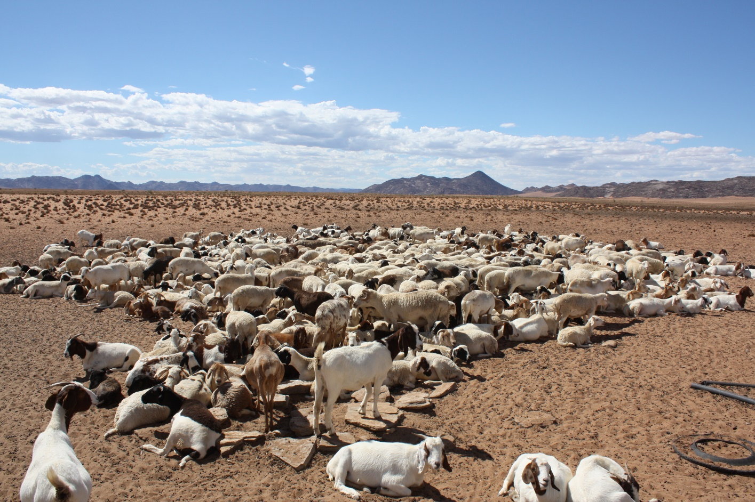
IYRP Regional Support Groups
Action Planning
SRM- IYRP Symposium, 07 February 2023

Slide 3
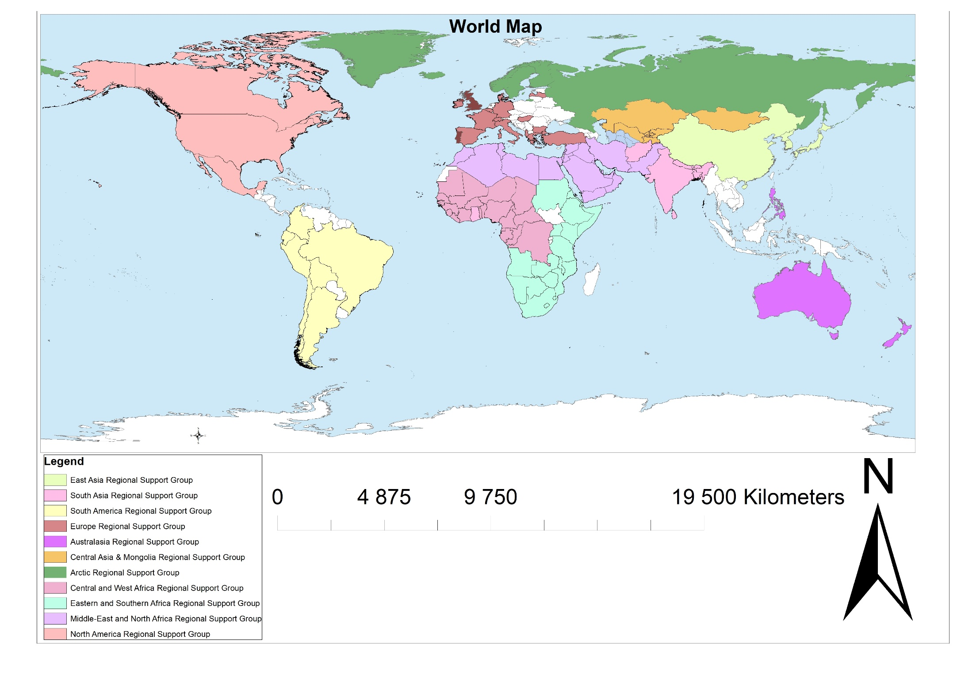
IYRP Regional Support Groups

Slide 4
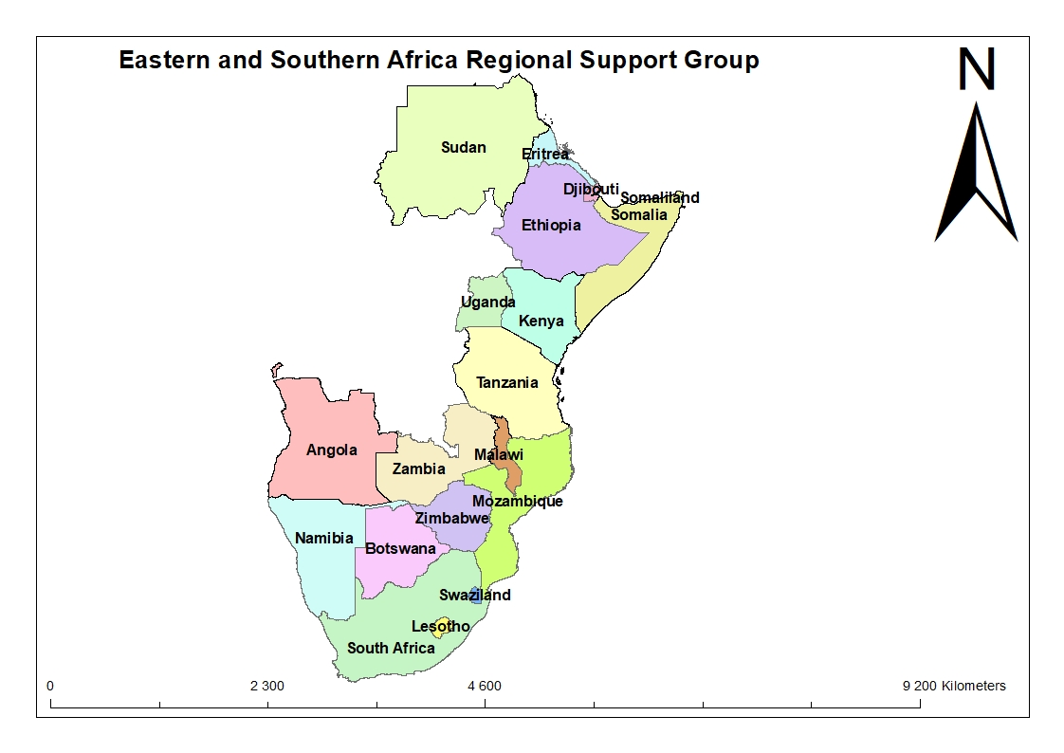
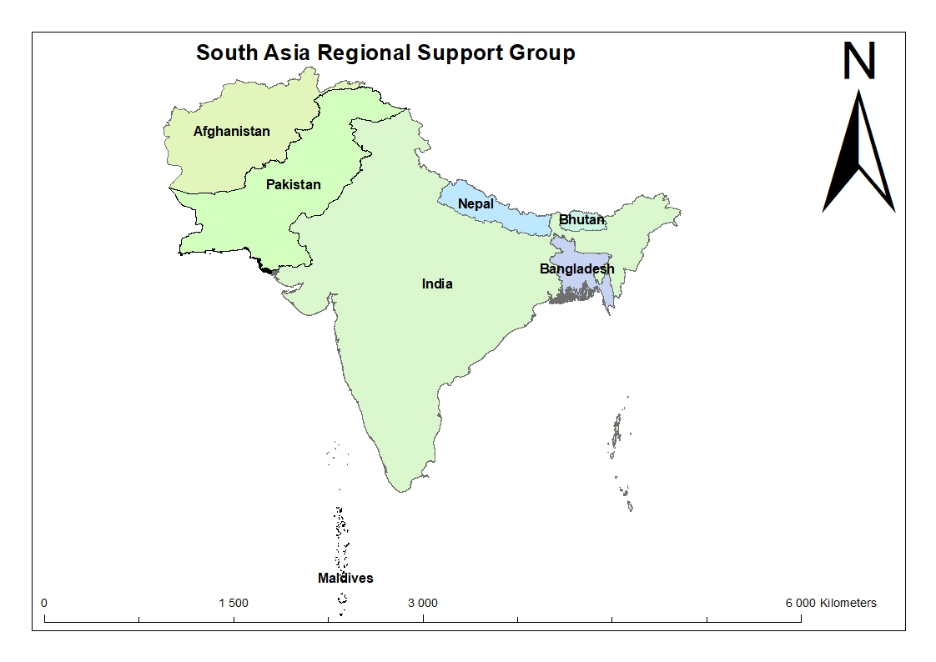
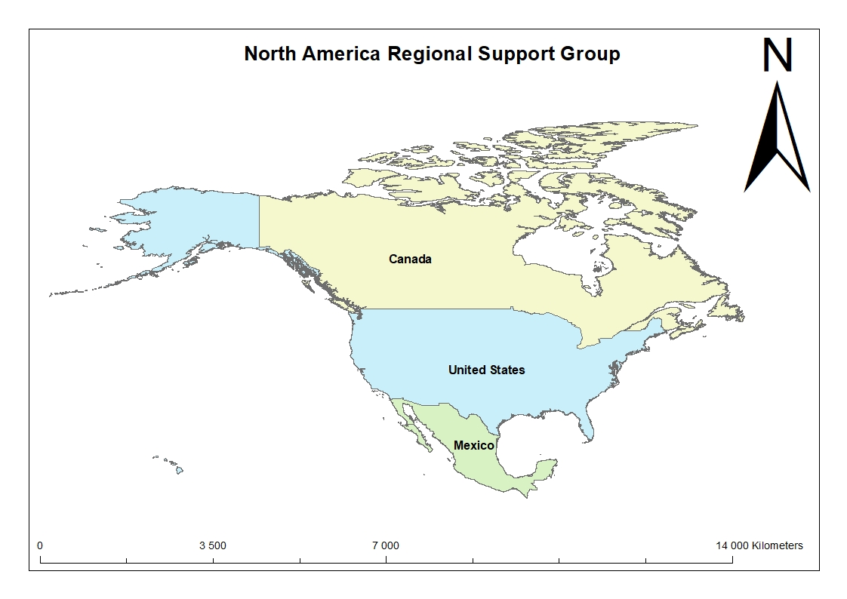
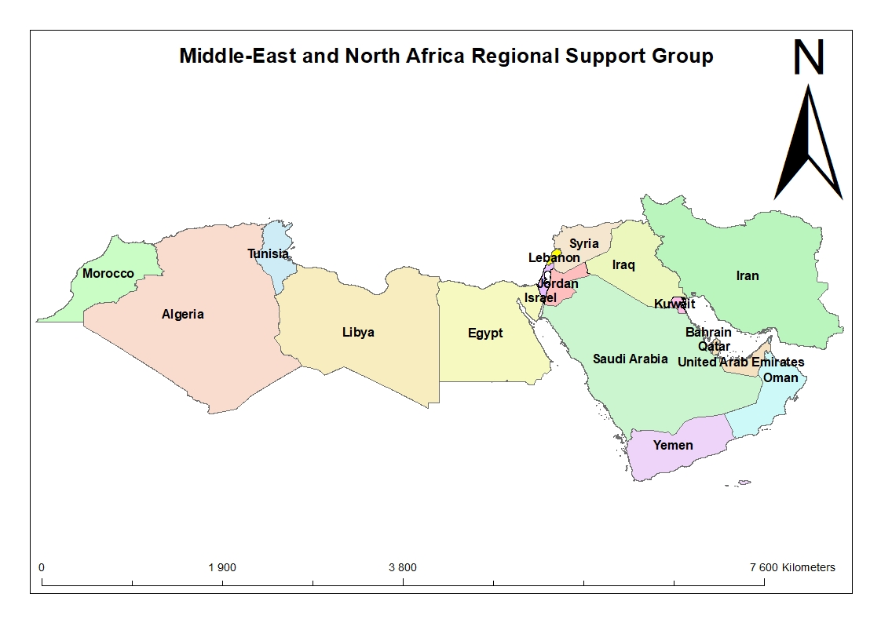
Notes:
fill knowledge gaps about rangelands and pastoralism,
translate English documents into other languages (
coordinate media engagement and distribution in their regions
develop and distribute a manual on pasture management and enhancing the resilience of local communities to the climate change

Slide 5
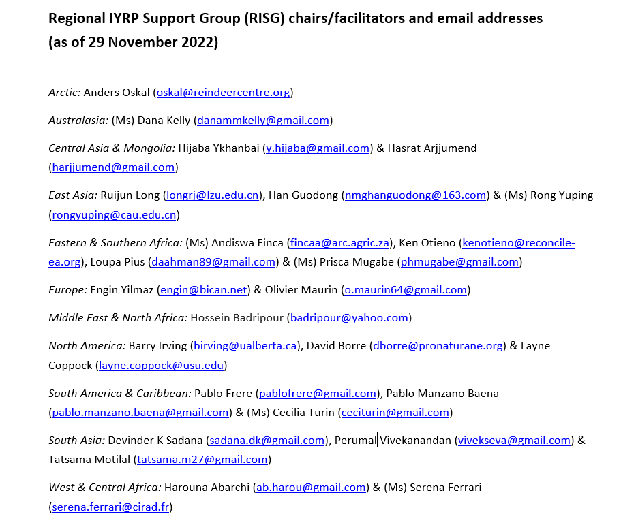

Slide 6
Purpose of regional action plans
To create awareness and help coordinate national activities across the region
To spearhead regional/multi-country activities
To contribute to global activities
To encourage government involvement and financial support.
National action planning. Countries to establish a multi-stakeholder National Support Group to design, execute and implement actions before and during 2026 to celebrate the IYRP.
Notes:
RISG (co-)chairs should take the leadership in this process and involve as many other RISG members as possible, including additionally recruited members. It is particularly important to include people from pastoralist organizations.

Slide 7
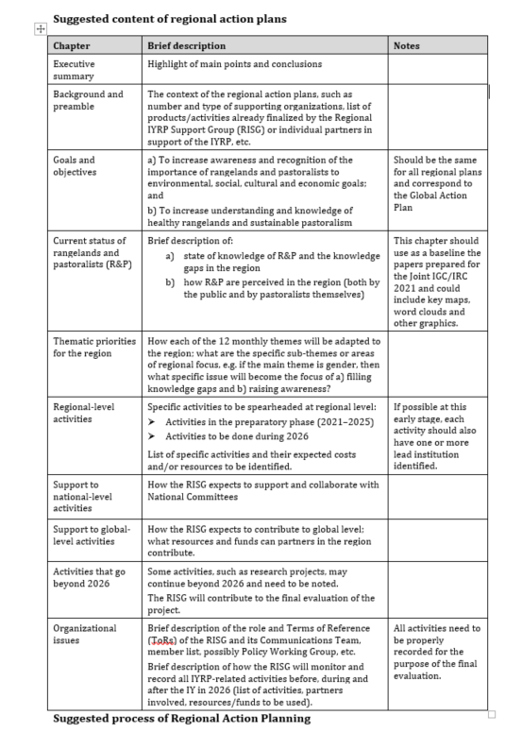

Slide 8
Thank You

