Slide 1
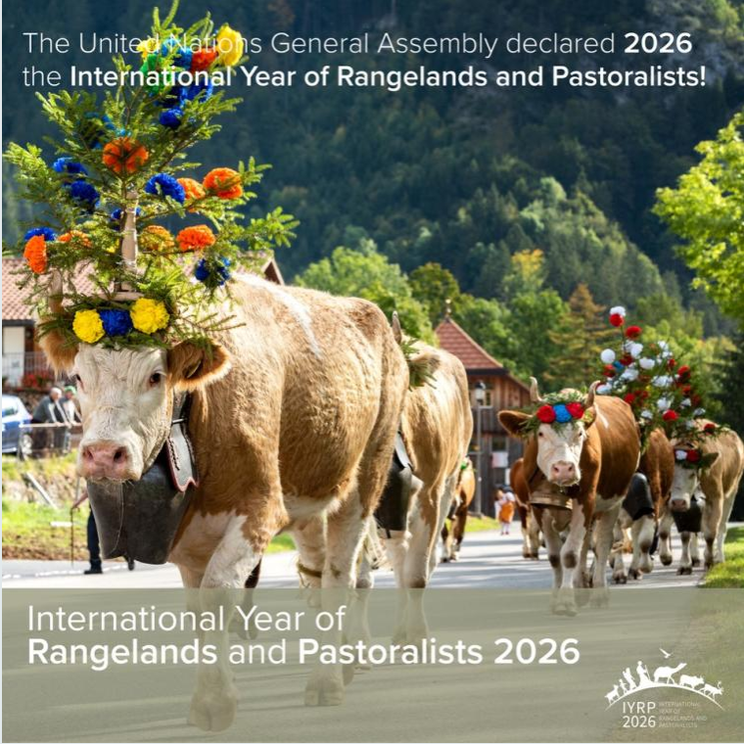
Introducing the International Year of Rangelands and Pastoralists
Igshaan Samuels
Co-chair of the IYRP ISP
Learning and Exchange program to sustain pastoralism, 11 Apr 2023

Slide 2
What does the IYRP seek to achieve?
Create awareness on the critical contributions of rangelands & pastoralists for food security, the economy and the environment
Break myths and misunderstandings of rangelands and pastoralism
Fill knowledge gaps with more participatory research and engagements
Promote evidence-based policies and legislation throughout the world in support of sustainable rangelands and pastoralism
Increase sustainable and ethical investment in rangelands

Slide 3
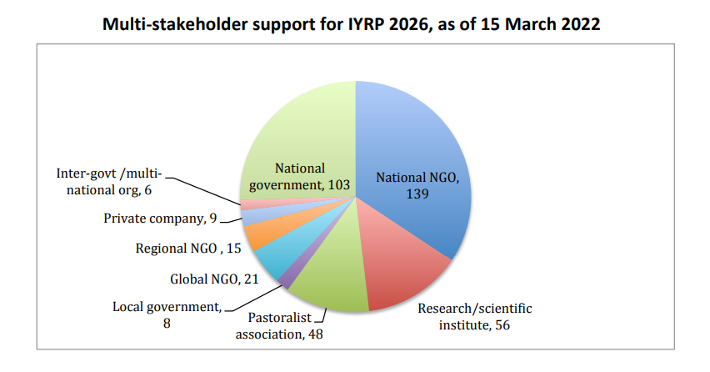
Who is the IYRP?
Coalition of 330 organizations from around the world representing pastoralists, NGOs, academia, media, private sector, multinational organizations, etc. )

Slide 4
How will we achieve our goals?
Involvement of diverse stakeholders
Stakeholders will be involved in different processes, action plans, IYRP structures, events.
Institutional partnerships e.g. IYC, MPS, FAO COFO
IYRP representation on different platforms e.g. global events

Slide 5
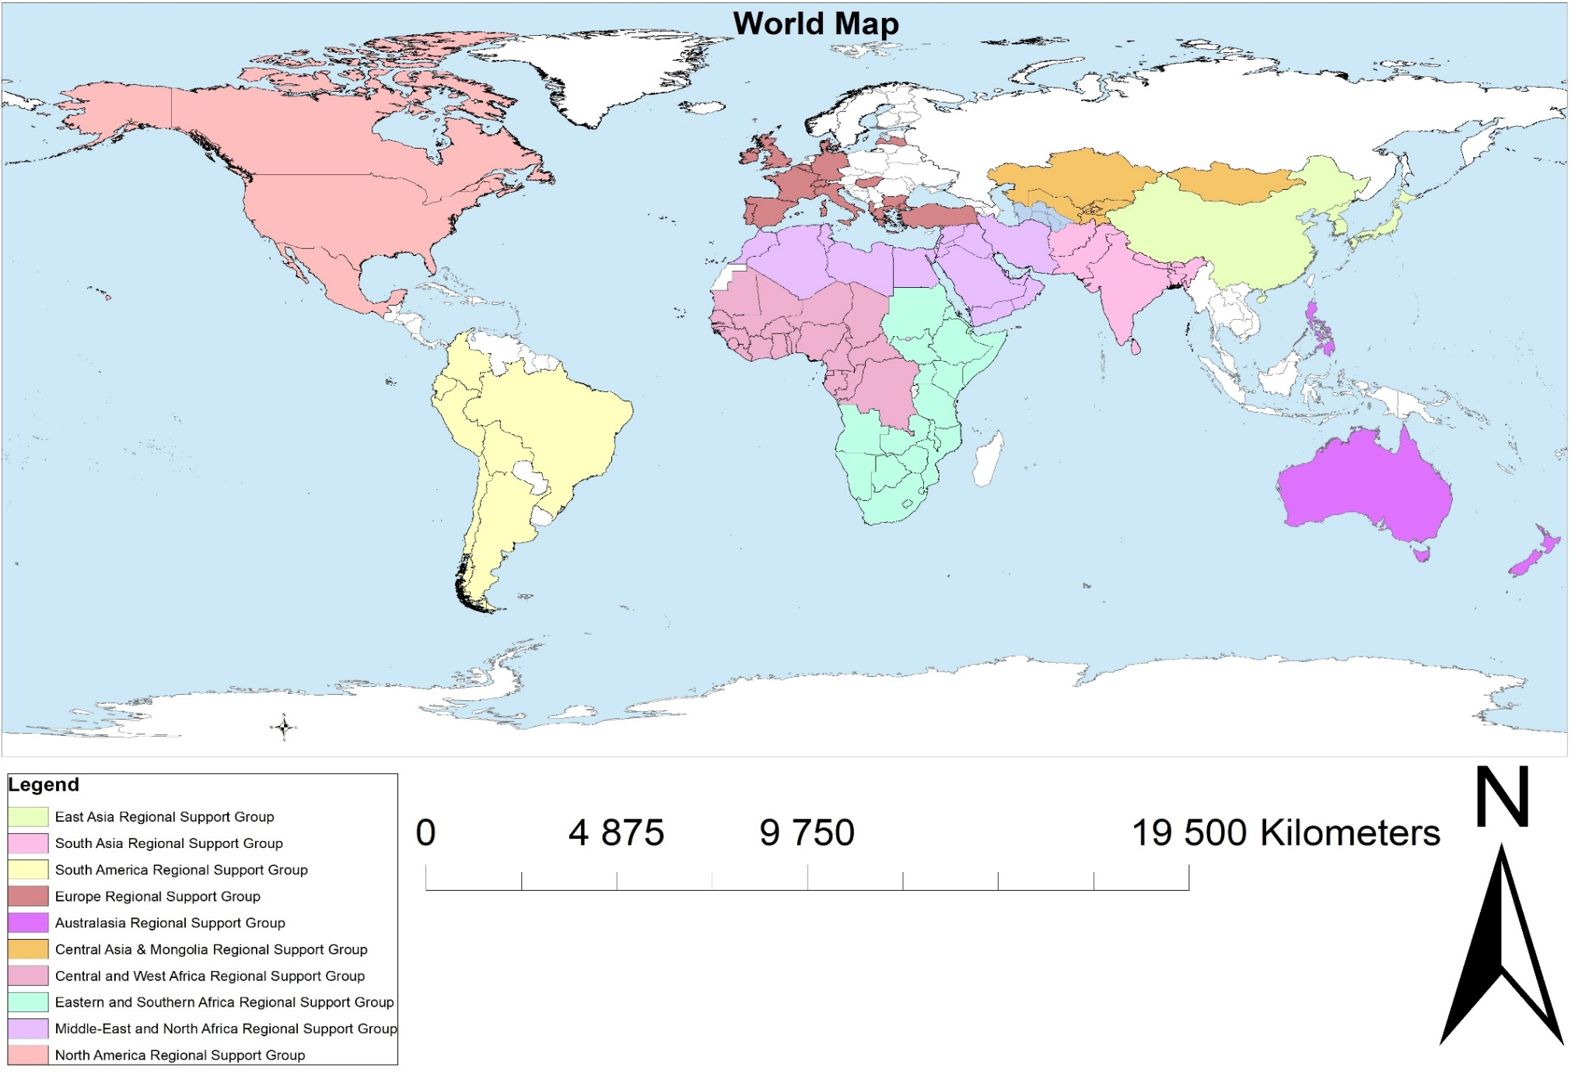
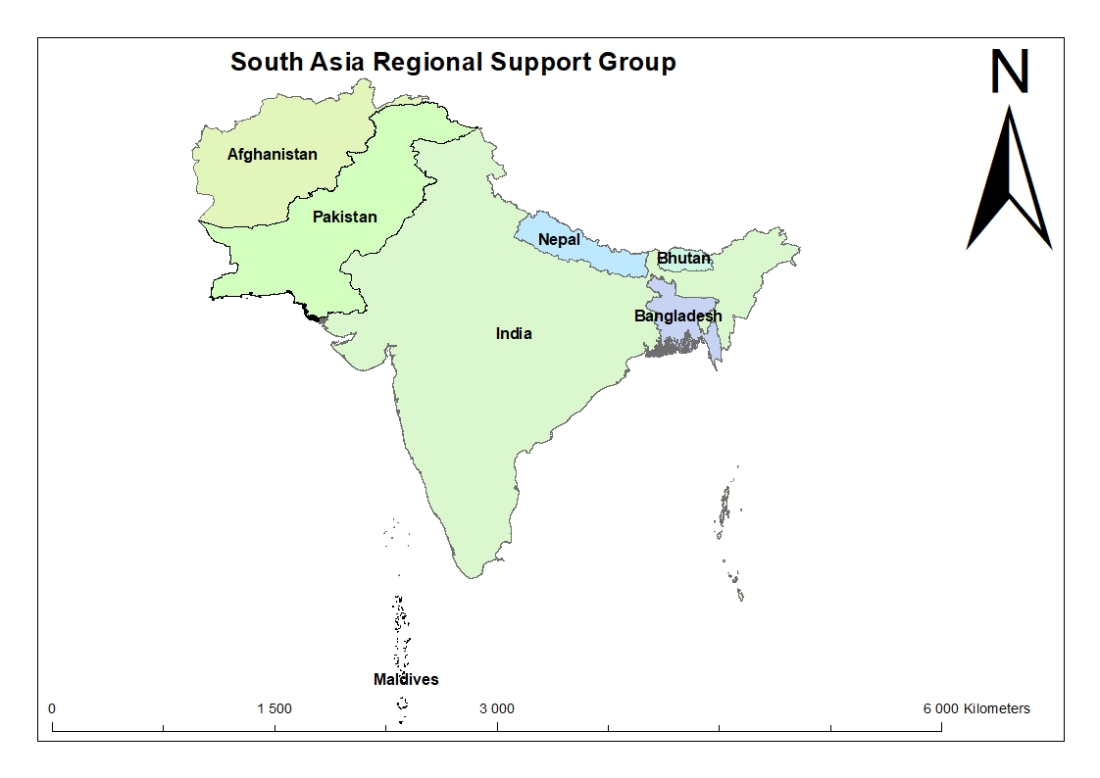
Legend
Arctic Regional Support Group
Regional Support Groups of the International Year of Rangelands and Pastoralists

Slide 6
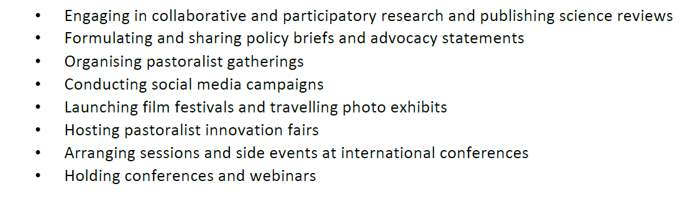
Type of Activities planned

Slide 8
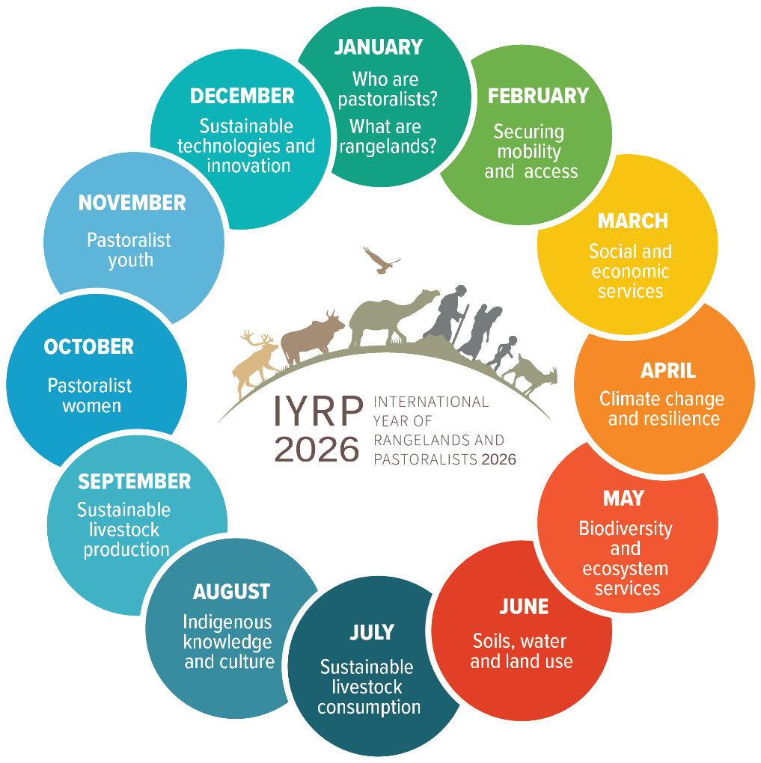
12 themes

Slide 9
Purpose of regional action plans
To create awareness and help coordinate national activities across the region
To spearhead regional/multi-country activities
To contribute to global activities
To encourage government involvement and financial support.
National action planning. Countries to establish a multi-stakeholder National Support Group to design, execute and implement actions before and during 2026 to celebrate the IYRP.
Notes:
RISG (co-)chairs should take the leadership in this process and involve as many other RISG members as possible, including additionally recruited members. It is particularly important to include people from pastoralist organizations.

Slide 10
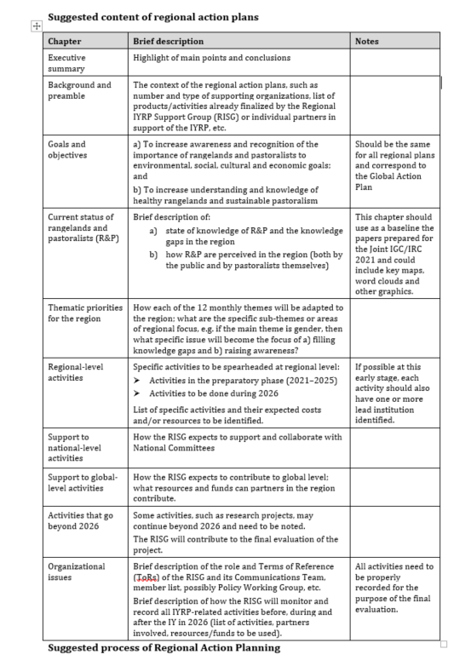

Slide 11
What would we consider success?
FAO Rangelands Partnership Secretariat, to continue to raise awareness for governments
Pastoralists are looking for platforms for pastoralists to speak and have their voice heard, at national, regional and global levels
Resolutions taken by UN Entities in support of rangelands and pastoralism, including UNFCCC and the Post-2030 SDGs
Global data base of rangelands and pastoralists
Changes in national, regional, global policies promoting the protection and sustainability of rangelands and pastoralists, fair and equitable benefits and upliftment
A fully funded and representative global gathering of pastoralists in 2026
More projects and programs dedicated to rangelands and pastoralists through global funds such as GEF, GCF, LDN, VCM – and growing portfolio of rangeland friendly certified products

