Slide 1
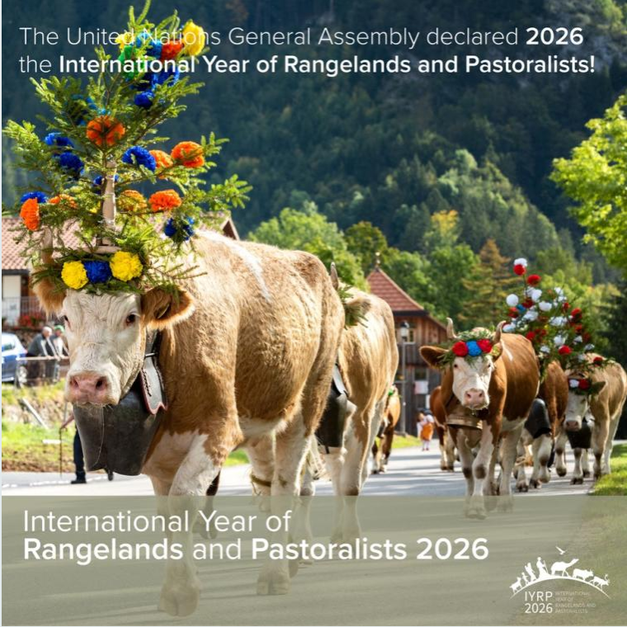
Igshaan Samuels
Co-chair of the IYRP ISP

Slide 2
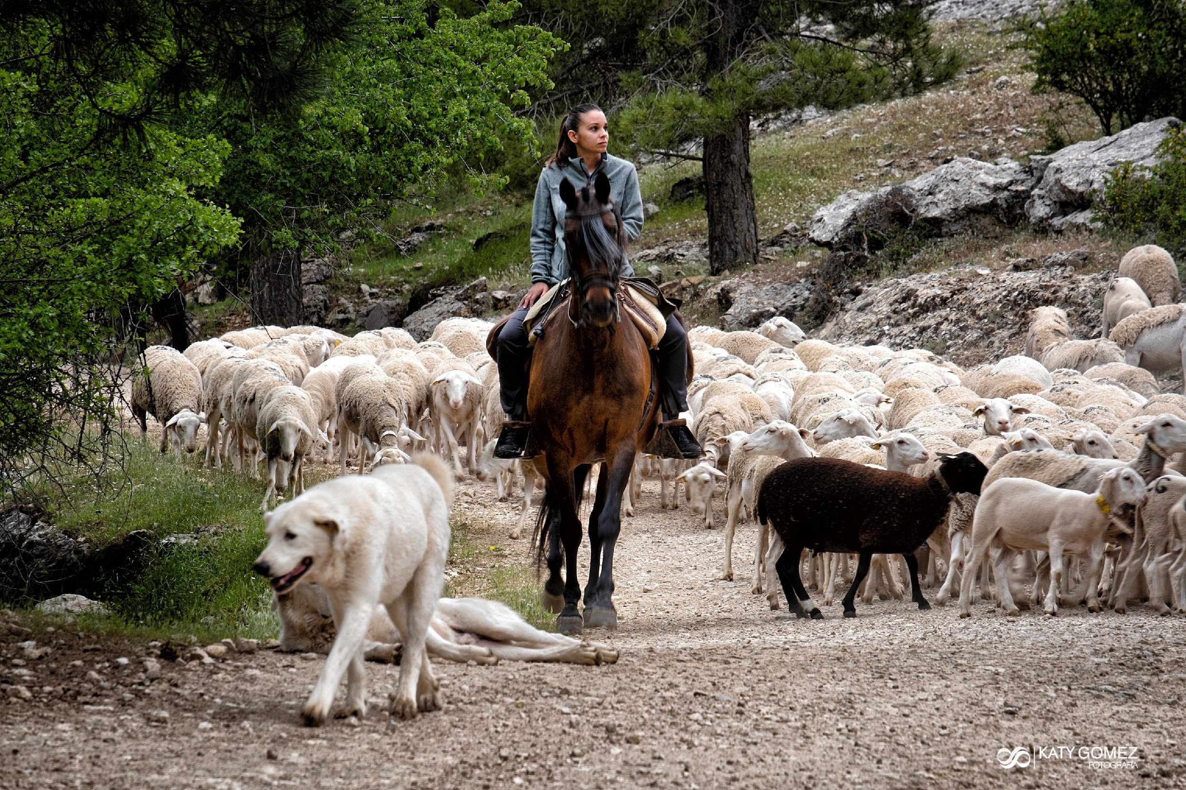
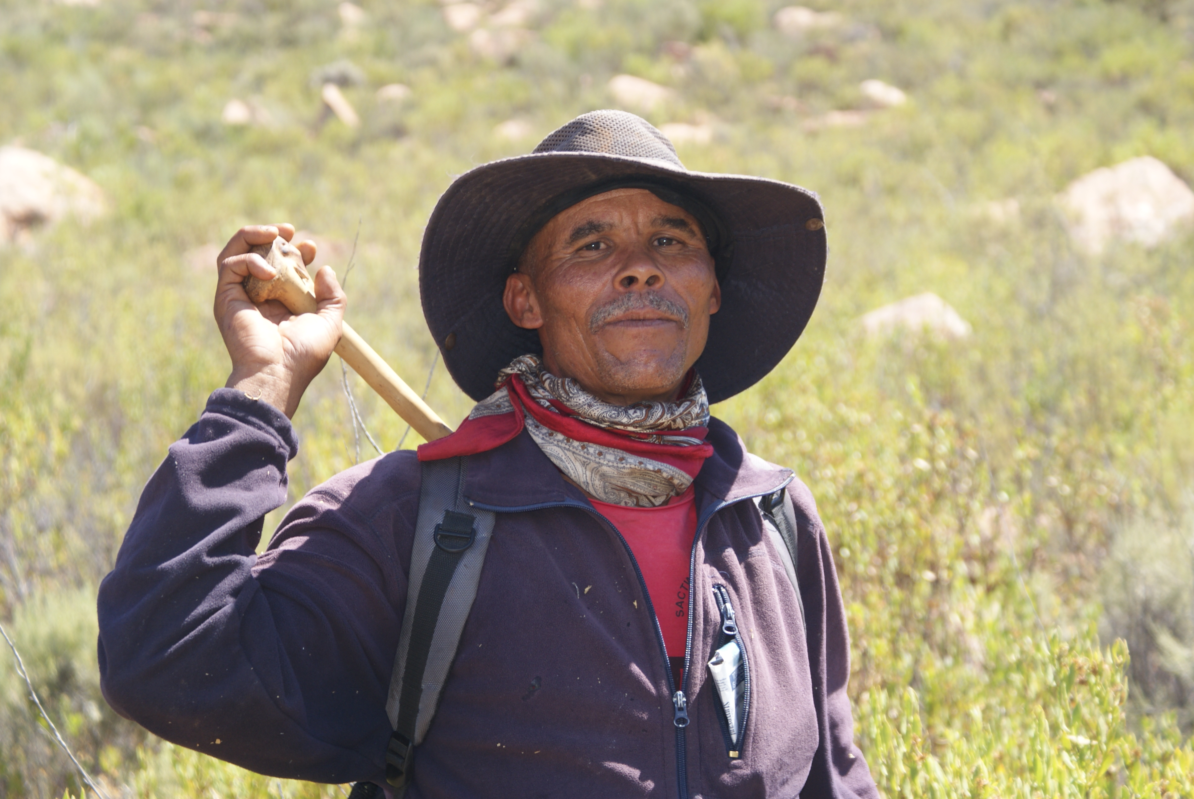
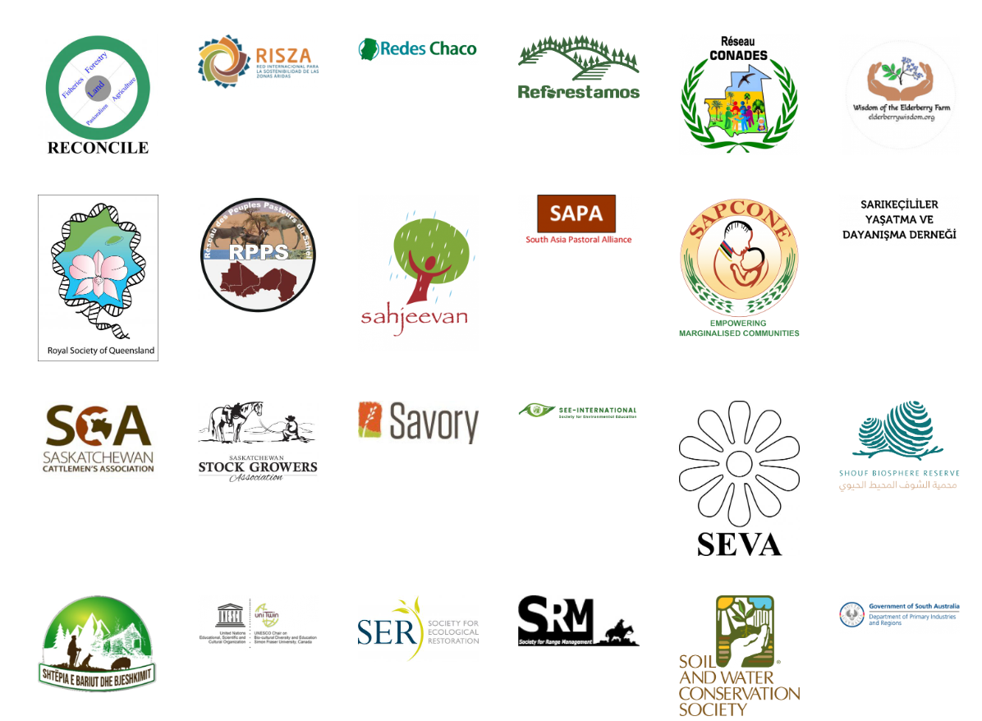
Who is the IYRP?
Coalition of about 415 organizations from around the world representing pastoralists, NGOs, academia, media, private sector, multinational organizations, etc. )

Slide 3
IYRP 2026 structure
General IYRP e-list
~740 addresses mostly for info only
International Support Group (ISG)
~415 active partners, including GCG members & 2 co-chairs
Global Coordinating Group (GCG)
~45 members (co-chairs, comms team, RISG & WG chairs & reps from key supporting partners: FAO, Govt of Mongolia, ILRI, IUCN, UNEP, WAMIP)
Working Groups (WGs):
Afforestation
Biodiversity
Gender
Land Degradation Neutrality
Mountains
Water
Youth
Economics
Global Communications Team
Regional IYRP Support Groups (RISGs)
Notes:
RISGs: Multistakeholder RISGs to generate partnership:
to expand network of supporting organisations and governments in the 11 regions of the world
to work with Government of Mongolia and IYRP International Support Group (ISG) to plan and implement IYRP activities in these regions
WGs
Greater awareness in science & society about how rangelands & pastoralists contribute to food security, economy, environment & cultural heritage
Resolutions taken by UN and other international entities in support of rangelands & pastoralists
Changes in national, regional & global policies in favour of sustainable management of rangeland resources by pastoralists & other stakeholders
Increase sustainable & ethical investment in rangelands & pastoralist livelihoods

Slide 4
Notes:
Multistakeholder RISGs to generate partnership:
to expand network of supporting organisations and governments in the 11 regions of the world
to work with Government of Mongolia and IYRP International Support Group (ISG) to plan and implement IYRP activities in these regions

Slide 5
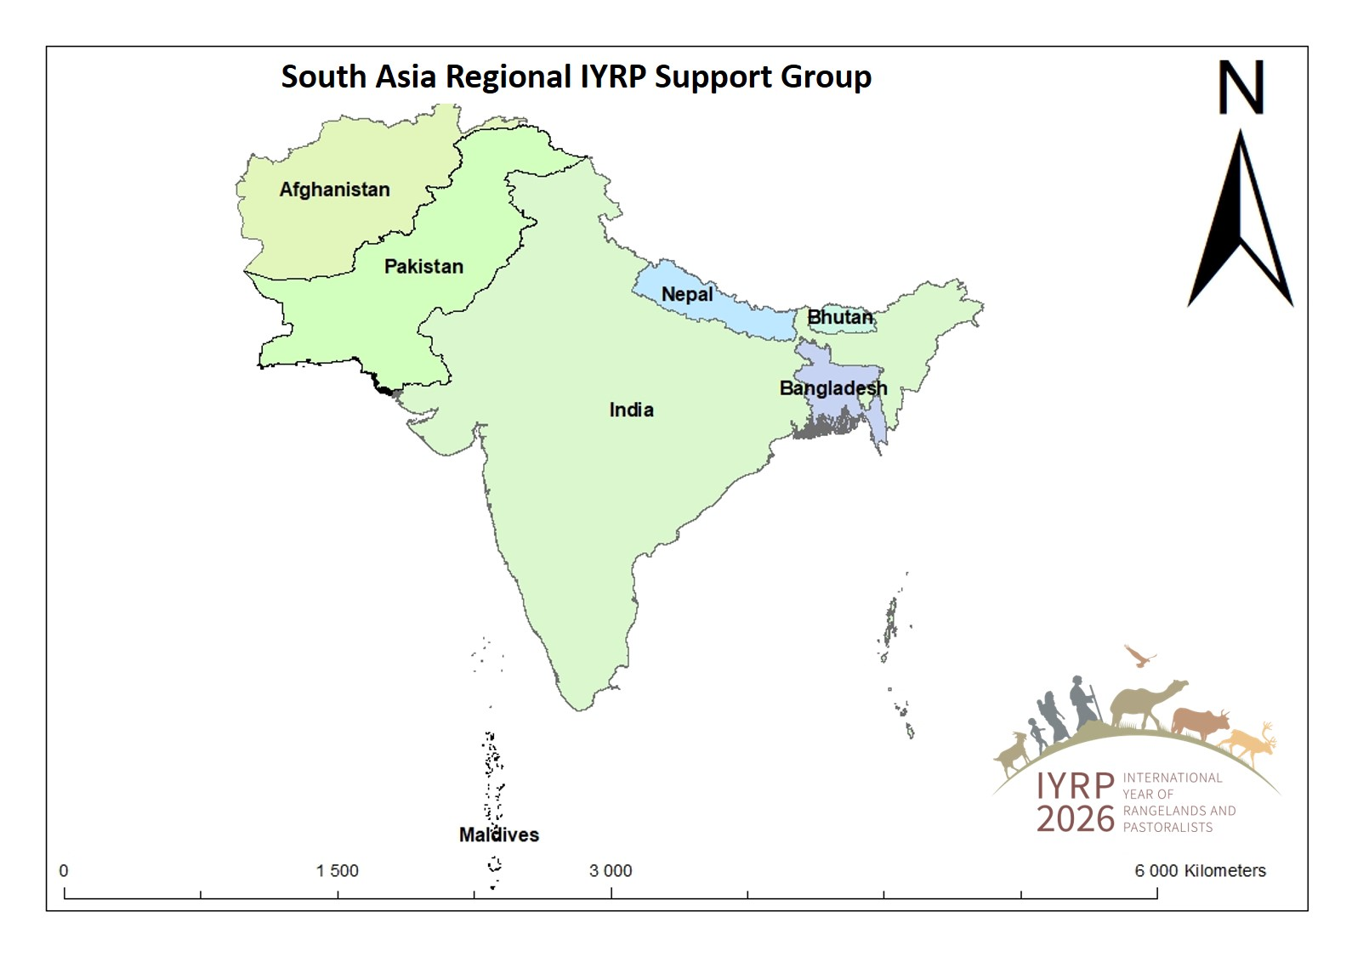

Slide 7
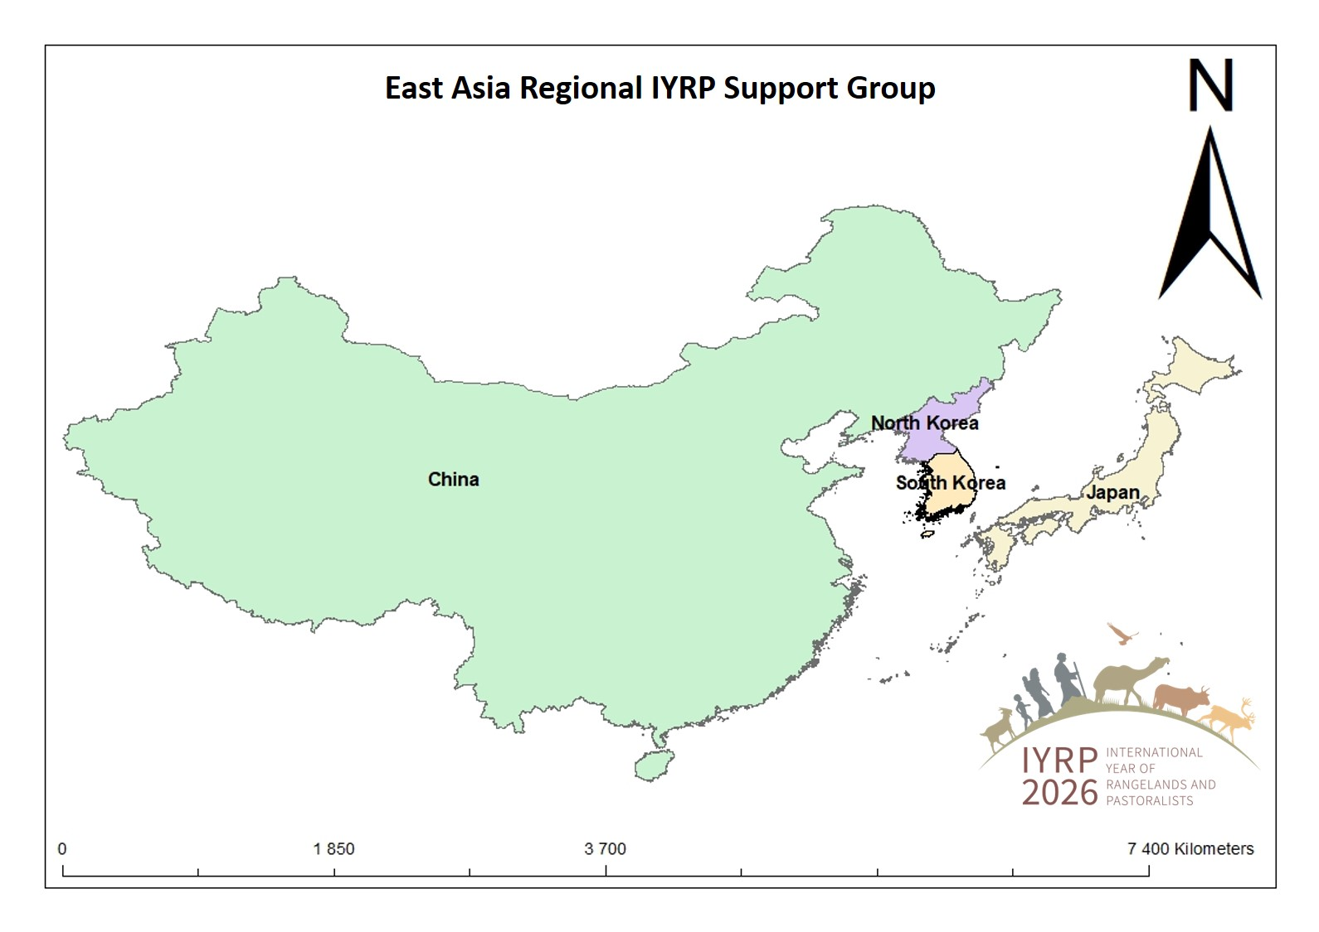

Slide 8
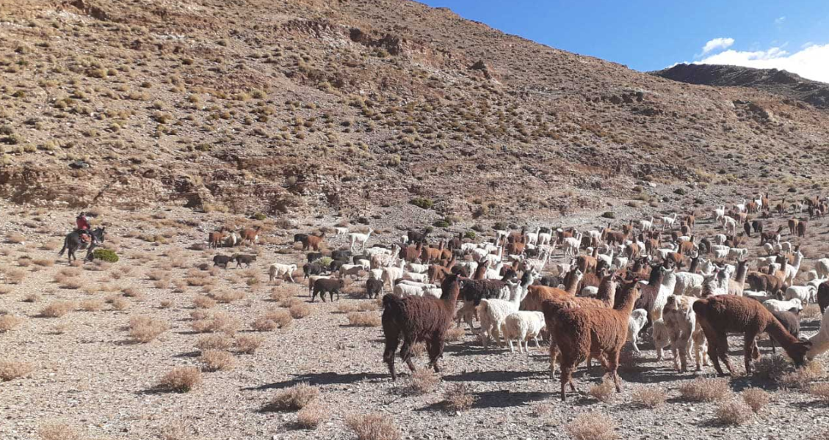
What does the IYRP seek to achieve?
Create awareness on the contributions of rangelands & pastoralists for food security, the economy and the environment
Break myths and misunderstandings of rangelands and pastoralism
Fill knowledge gaps with more participatory research and engagements
Promote evidence-based policies and legislation throughout the world in support of sustainable rangelands and pastoralism
Increase sustainable and ethical investment in rangelands

Slide 9
Drivers of change in pastoral areas at a global level
Land conversion (mining, cultivation, renewable energy, conservation, urbanization, etc.,
Climate change
Land degradation
Weakening tenure security
Inappropriate policies
Poor service delivery
Disease
Conflict
Eroding cultures
Etc.
To tackle these, MSP are crucial

Slide 10
MSP can…
MSP can collaborate on strategies for adapting livestock farming practices and policies to a changing climate and socio-economic conditions.
MSPs can work to develop sustainable resource management practices and conflict resolution mechanisms.
MSPs can develop vaccination programsand policies to control and prevent the spread of diseases.
MSPs can facilitate cooperation between partners to develop value-added products and improve market access.
In areas where livestock activities intersect with wildlife conservation, MSPs can help balance the needs of both sectors.

Slide 11
Potential benefit of MSP such as with IYRP
Global
IYRP
GASL
Regional
e.g. ICIMOD
Voices of resilience, sustainability but also challenges
Resources
Policy Support and investment
Recommendations
Opportunities
National
State Dept.
NGOs
Farmers
Local
Local Government
Pastoralists
Youth
Pastoral organizations
Women
Grassroots institutions

Slide 12
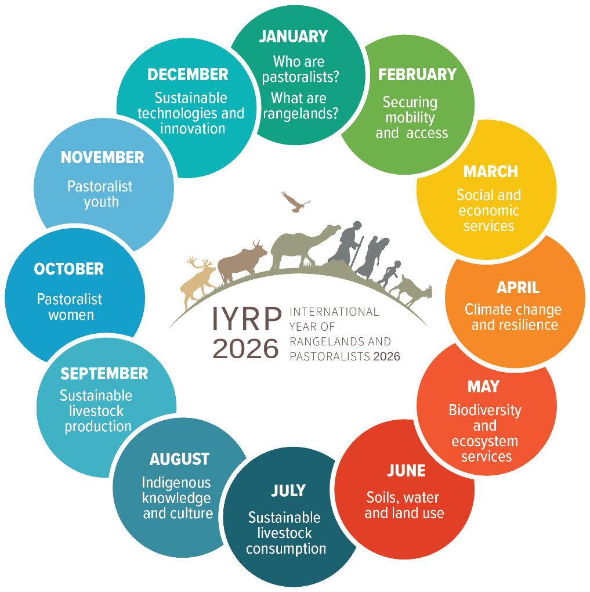
IYRP will address 12 themes during 2026

Slide 13
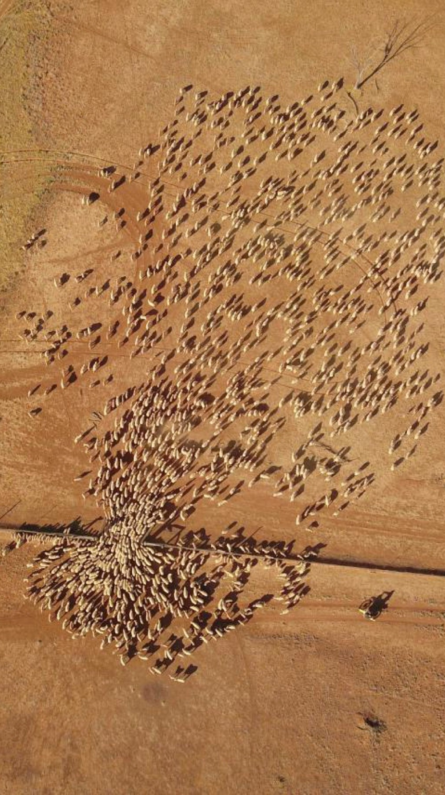
What would we consider success?
FAO Rangelands Partnership Secretariat, to continue to raise awareness for governments
Platforms for pastoralists to speak and have their voice heard
Changes in national, global policies promoting the protection and sustainability of rangelands
More projects and programs dedicated to rangelands and pastoralists through global funds such as GEF, GCF, LDN, VCM
Growing portfolio of rangeland friendly certified products (RSC)
@Wendy Sheehan
Notes:
FAO Rangelands Partnership Secretariat, to continue to raise awareness for governments
Pastoralists platforms for pastoralists to speak and have their voice heard, at national, regional and global levels
Resolutions taken by UN Entities in support of rangelands and pastoralism, including UNFCCC and the Post-2030 SDGs
Global data base of rangelands and pastoralists
Changes in national, regional, global policies promoting the protection and sustainability of rangelands and pastoralists, fair and equitable benefits and upliftment
A fully funded and representative global gathering of pastoralists in 2026
More projects and programs dedicated to rangelands and pastoralists through global funds such as GEF, GCF, LDN, VCM – and growing portfolio of rangeland friendly certified products (RSC)

Slide 14
Thank You

