Slide 1
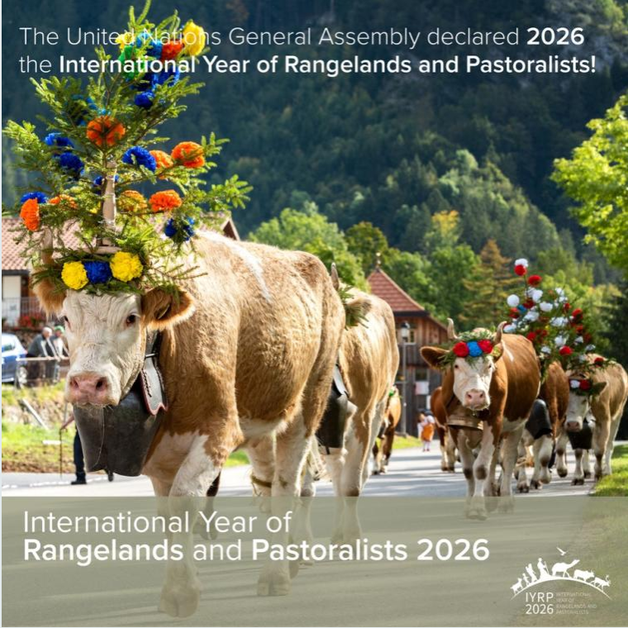
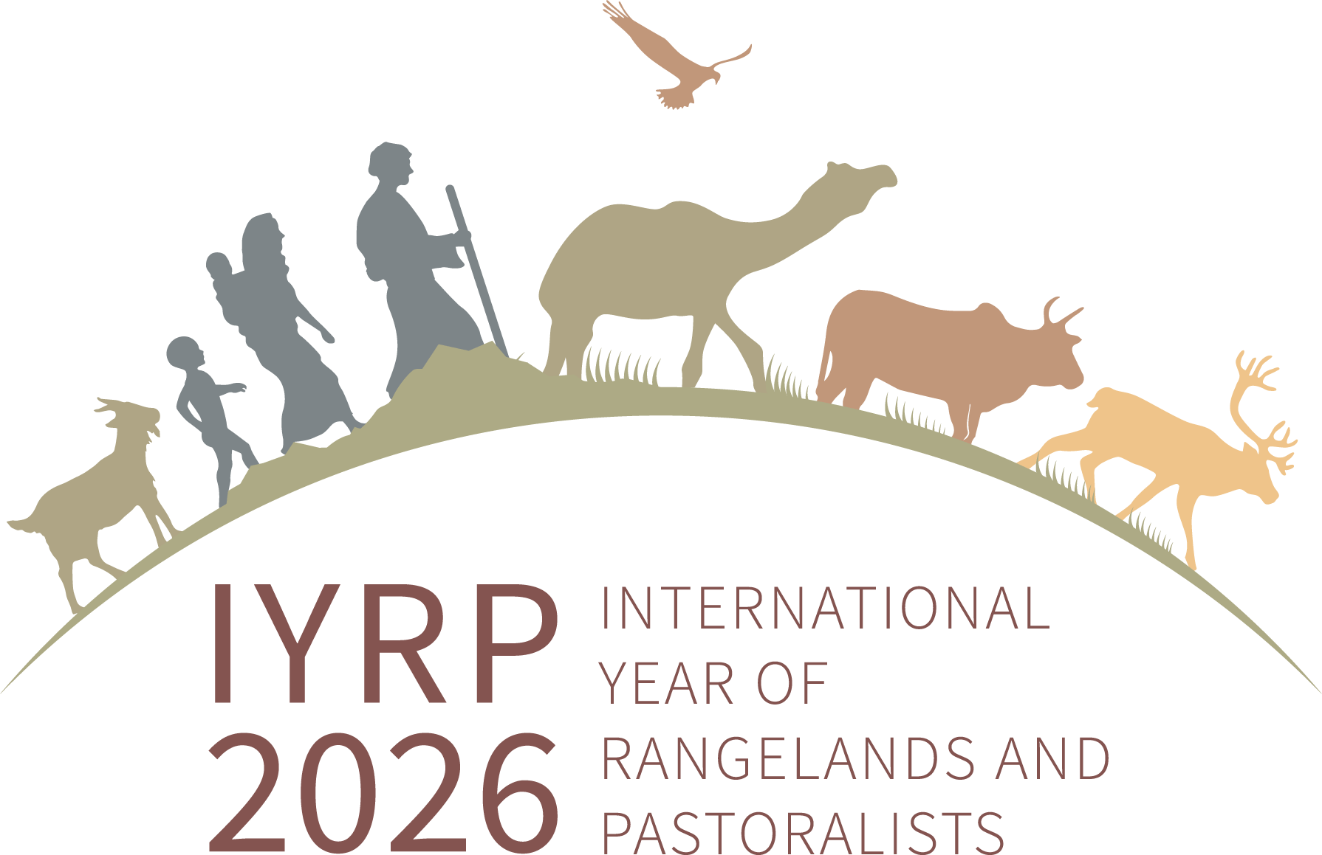
Introducing the International Year of Rangelands and Pastoralists

Slide 2
What does the IYRP seek to achieve?
Create awareness on the critical contributions of rangelands & pastoralists for food security, the economy and the environment
Break myths and misunderstandings of rangelands and pastoralism
Fill knowledge gaps with more participatory research and engagements
Promote evidence-based policies and legislation throughout the world in support of sustainable rangelands and pastoralism
Increase sustainable and ethical investment in rangelands

Slide 3
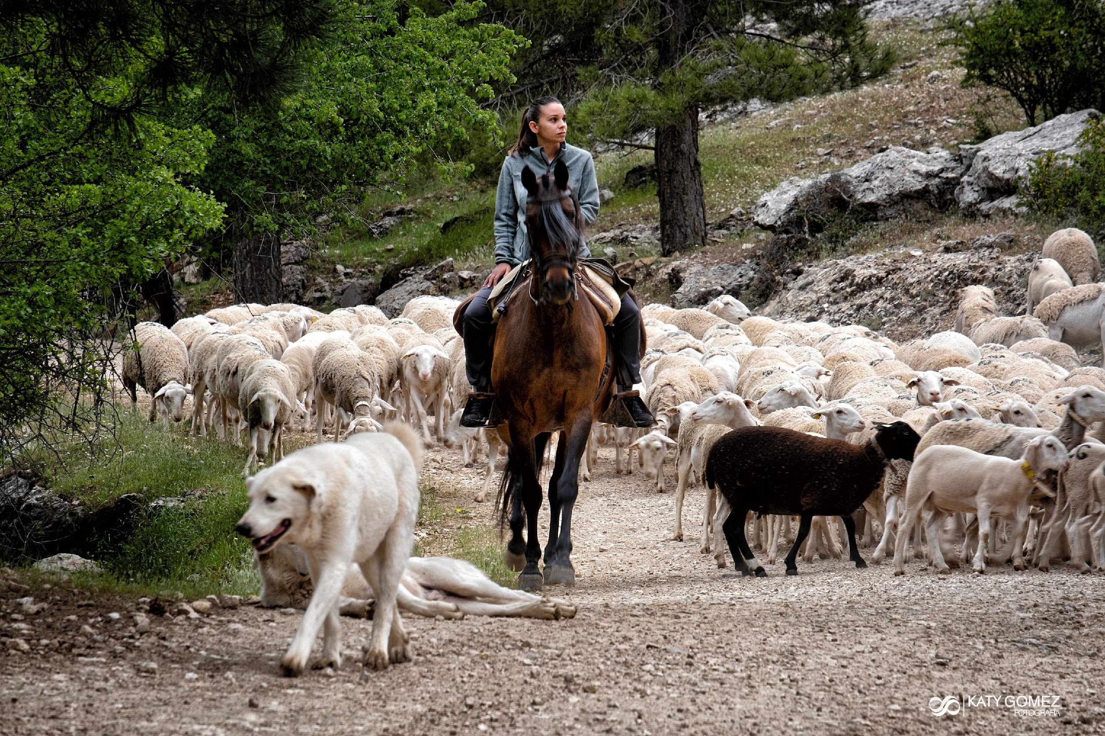
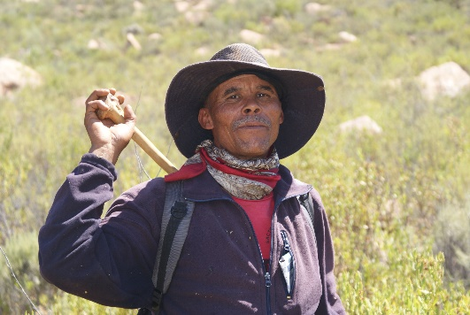
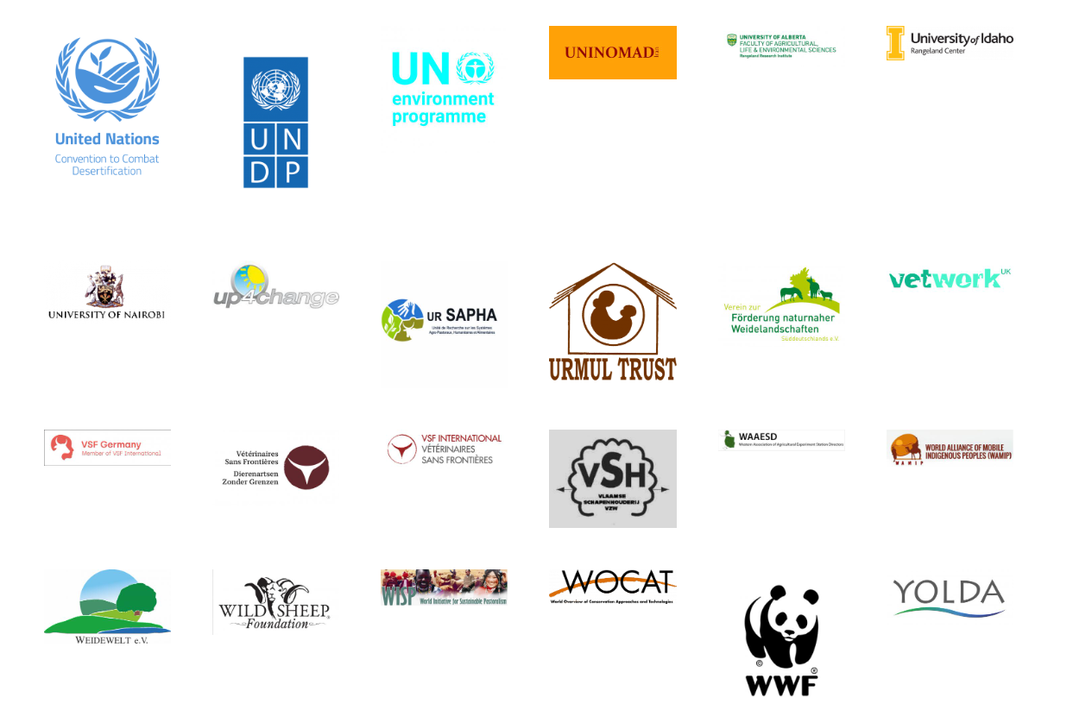
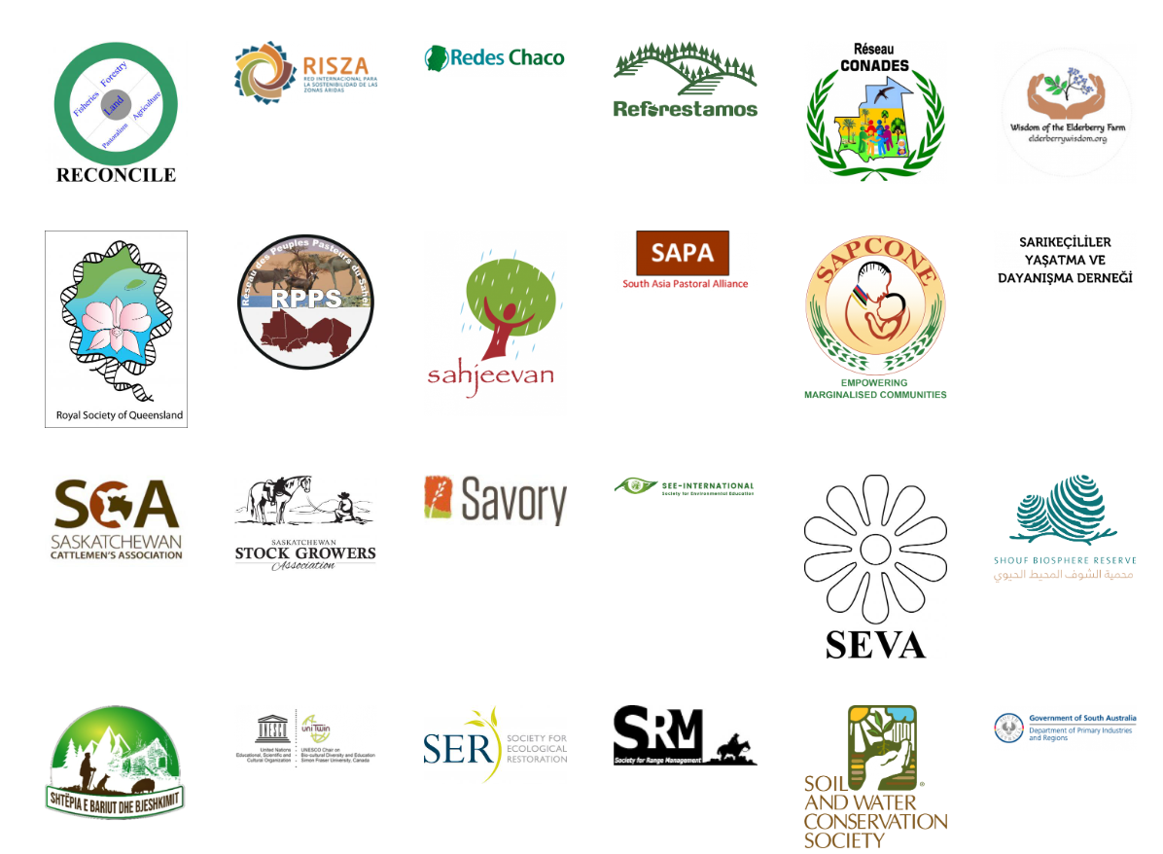
Who is the IYRP?
Coalition of about 415 organizations from around the world representing pastoralists, NGOs, academia, media, private sector, multinational organizations, etc. )

Slide 4
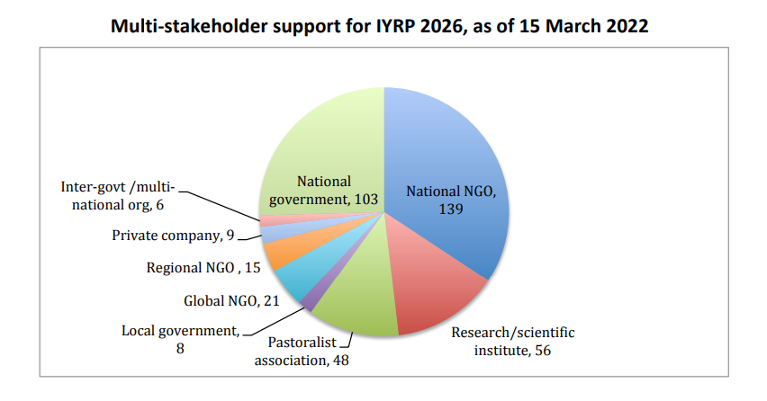

Slide 5
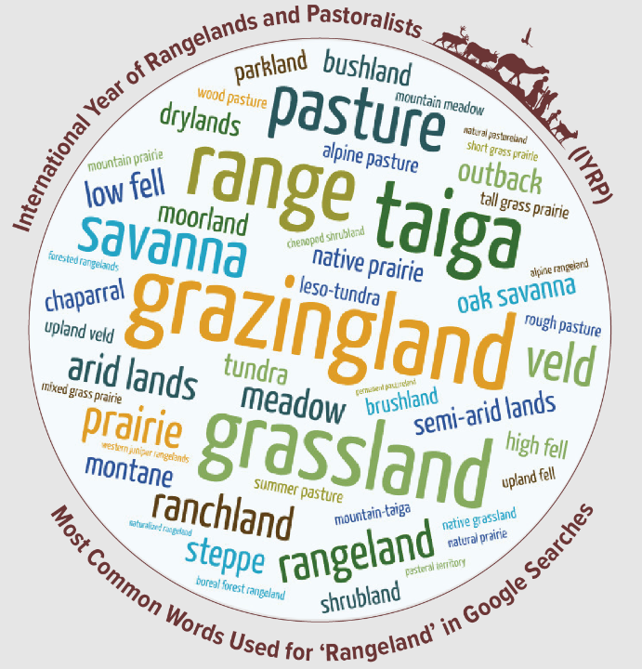
What are Rangelands?
“Rangelands are areas of grasses, grass-like plants, forbs, shrubs and sometimes trees that are grazed or have the potential to be grazed by livestock and wildlife. They are diverse in their vegetation highly influenced by rainfall, temperature and other climate phenomena, and habitat for a wide range of wildlife, many species of which are found nowhere else.”
Notes:
KEY FIGURES
1. Rangelands cover 54% of global terrestrial surface (148,326,000 km²) to a total of 79,509,421 km².
2. The largest rangeland biome is deserts and xeric shrublands covering 27,984,645 km² or 19% of global terrestrial surface.
3. Rangelands are made up of seven biomes or rangeland types namely: 35% deserts and xeric shrublands, 1% flooded grasslands and savannas, 4% mediterranean forests, woodlands and scrub, 6% montane grasslands and shrublands, 13% temperate grasslands, savannas and shrublands, 26% tropical and subtropical grasslands, savannas and shrublands, and 15% tundra.

Slide 6
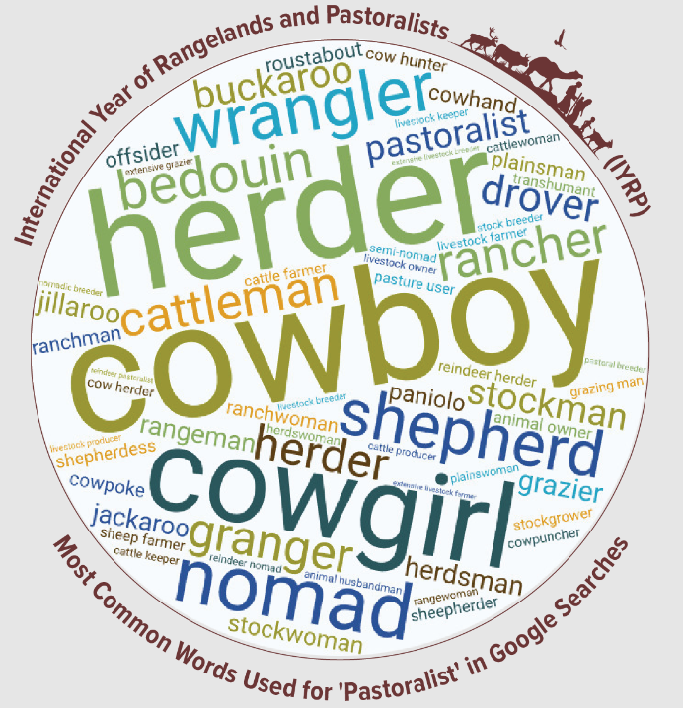
Who is a pastoralist?
Pastoralists are people who raise livestock or (semi-)wild animals on rangelands in production systems that depend on some degree of herd mobility. They manage diverse species of grazing and browsing animals such as sheep, goats, camels, cattle, and donkeys.
Notes:
The SES framework a conceptual framework designed to keep both the social and ecological components of a system in focus so that the interactions between them can be scrutinized for drivers of change and causes of specific outcomes. Resilience, adaptability, and transformability have been identified as the three related attributes of SESs that determine their future trajectories.
The primary benefit of the SES framework is the improved ability to prevent or correct social policies that cause negative ecological outcomes, and to achieve ecological objectives in ways that support, rather than hurt, rangeland users.
Environmental problems arise from failures in social processes as much as from ecological processes, and recognizing this, a common framework is needed for understanding and analyzing the drivers that lead to improvement or deterioration of natural resources (Ostrom 2009). The “social–ecological system” (SES) concept provides a framework for analyzing complex rangeland dynamics and identifying interventions that can increase rangeland sustainability and support the production of desired goods and services.
This vein of SES scholarship is dominated by systems theory and treats SESs as complex adaptive systems that self-organize (e.g., Folke et al. 2005) and operate with feedbacks and thresholds (e.g., Walker et al. 2004).

Slide 7
What does the IYRP initiative seek to achieve through the Working Groups?
Greater awareness in science & society about how rangelands & pastoralists contribute to food security, economy, environment & cultural heritage
Resolutions taken by UN and other international entities in support of rangelands & pastoralists
Changes in national, regional & global policies in favour of sustainable management of rangeland resources by pastoralists & other stakeholders

Slide 8
Tasks of Working Groups :
Collate and analyse existing research results (science review)
Identify knowledge & information gaps – and new opportunities
Stimulate and engage in participatory research to fill gaps and explore opportunities
Analyse existing international policy related to the theme
Identify “targets” (international bodies, conventions, events etc) for science- and experience-based advocacy
Strategise on appropriate messages for these targets, including identification of spokespersons or “ambassadors” to bring them across
Engage with pastoralists and others in IYRP network (including other WGs) in disseminating these messages, also for public awareness

Slide 9
IYRP 2026 structure
General IYRP e-list
~740 addresses mostly for info only
International Support Group (ISG)
~415 active partners, including GCG members & 2 co-chairs
Global Coordinating Group (GCG)
~45 members (co-chairs, comms team, RISG & WG chairs & reps from key supporting partners: FAO, Govt of Mongolia, ILRI, IUCN, UNEP, WAMIP)
Working Groups (WGs):
Afforestation
Biodiversity
Gender
Land Degradation Neutrality
Mountains
Water
Youth
Economics
Global Communications Team
Regional IYRP Support Groups (RISGs)
Notes:
RISGs: Multistakeholder RISGs to generate partnership:
to expand network of supporting organisations and governments in the 11 regions of the world
to work with Government of Mongolia and IYRP International Support Group (ISG) to plan and implement IYRP activities in these regions
WGs
Greater awareness in science & society about how rangelands & pastoralists contribute to food security, economy, environment & cultural heritage
Resolutions taken by UN and other international entities in support of rangelands & pastoralists
Changes in national, regional & global policies in favour of sustainable management of rangeland resources by pastoralists & other stakeholders
Increase sustainable & ethical investment in rangelands & pastoralist livelihoods

Slide 10
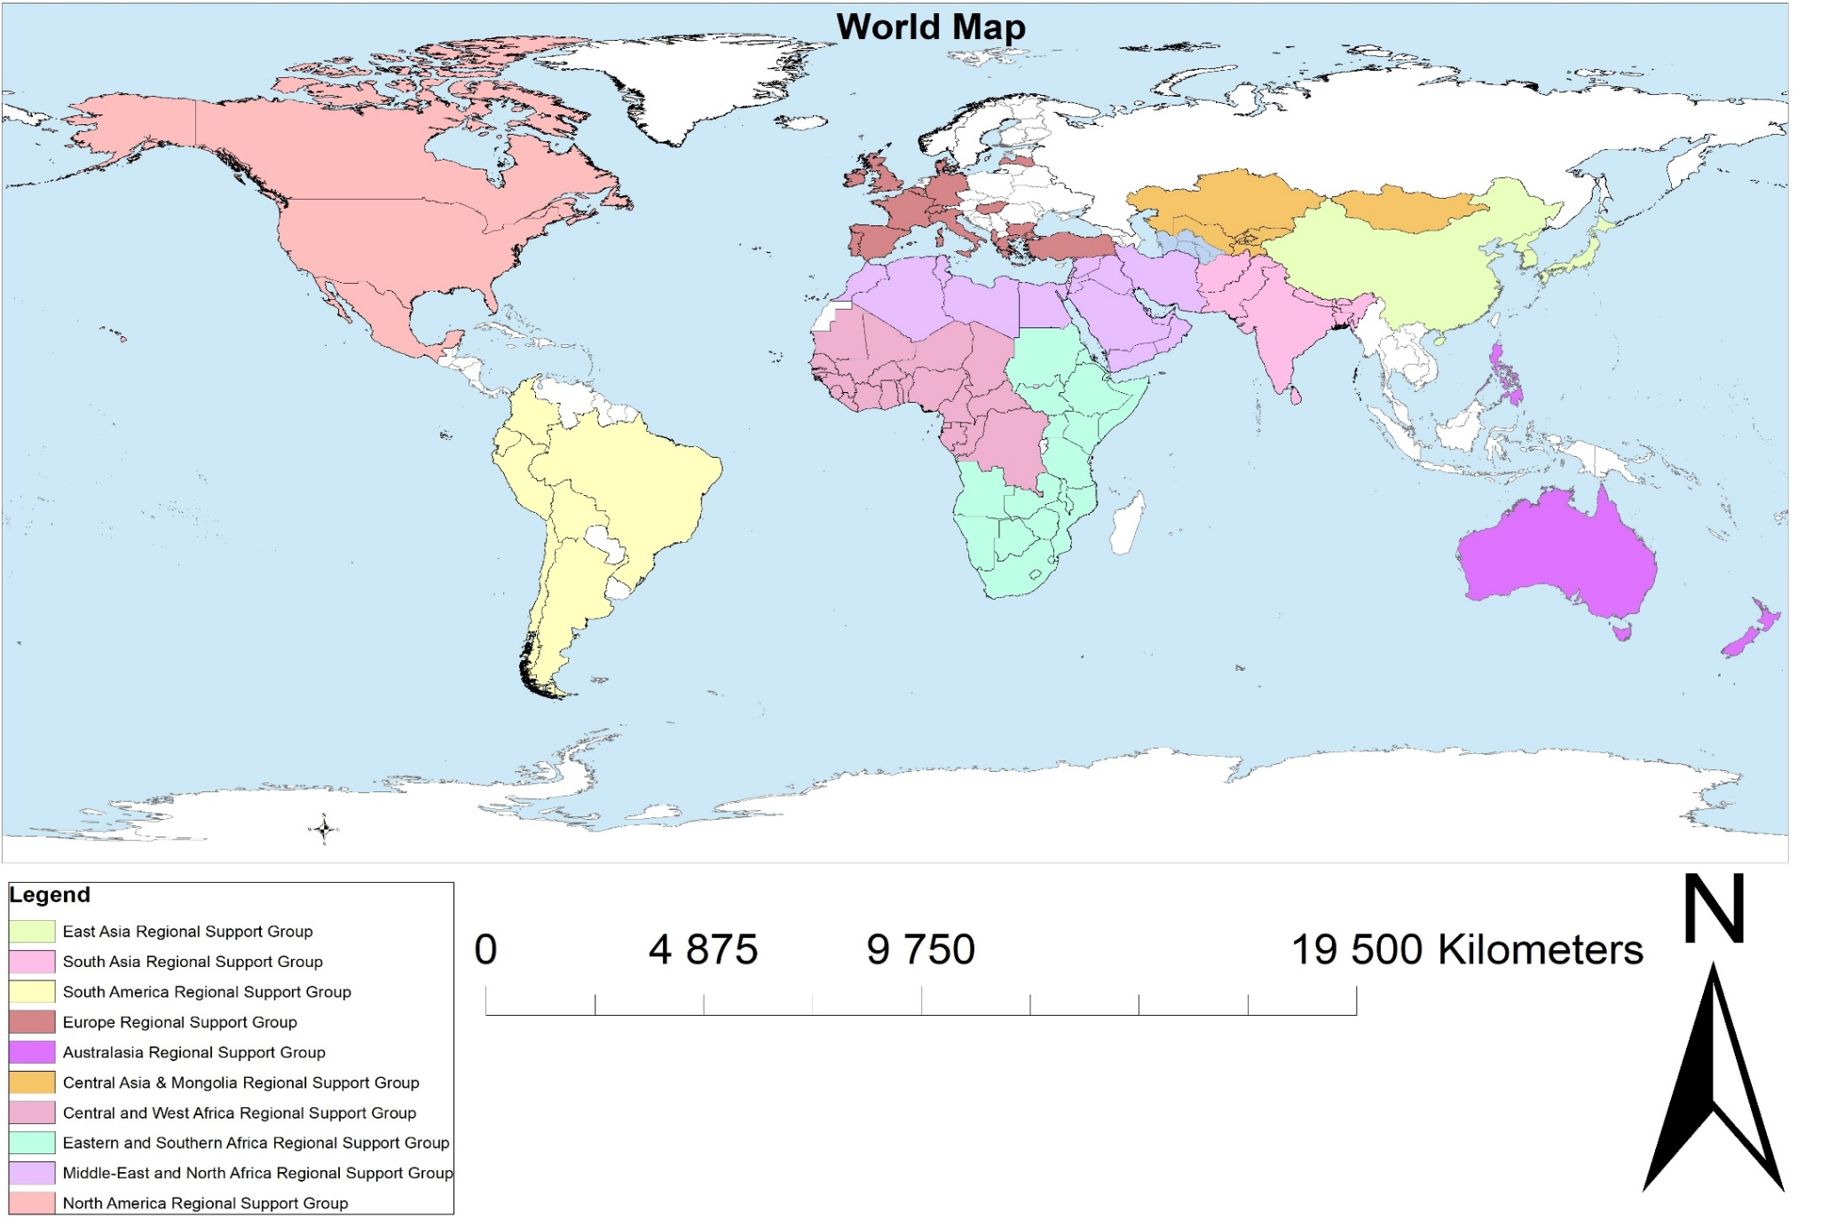
Legend
Arctic Regional Support Group
Regional Support Groups of the International Year of Rangelands and Pastoralists

Slide 12
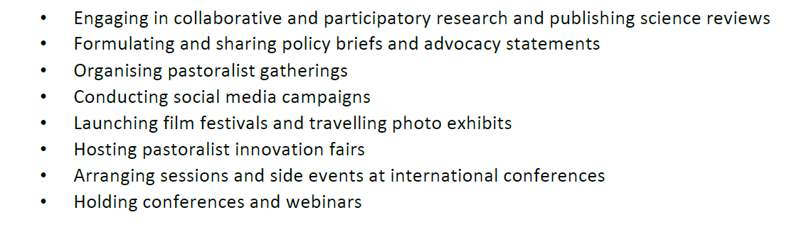
Type of Activities planned

Slide 14
BRIEF PROGRESS REPORT OF THE RISG “CENTRAL ASIA & MONGOLIA” FOR IYRP
September 2023
Chair of CAM RISG for IYRP, Dr. Hijaba Ykhanbai, conducted field work on 05-10 July for a participatory study with local community members in Batsumber soum, steppe and forest ecosystem of Mongolia with the aims of monitoring pasture capacity and participatory mapping of the territory.
An online meeting of Central Asia Regional on Transboundary Mobility and IYRP Objectives on 27 Aug 2023 was organized by CAPA Focal Point (Kyrgyz Jayity). In the meeting, members of RISG CAM informed about the activities of IYRP and action plans and priorities.
JASIL in line with CAM RISG conducted a Webinar on 04 Sept 2023 focusing Rangelands and ICCA on “Mapeo Application” with Mongolian herder communities and representatives from UNEP-WCMC.
Several Mongolian herders’ communities registered on the Global ICCA Registry in Aug-Sept. It will support pastoralist communities as custodians of Territories Life.
Chair of CAM RISG for IYRP, Dr. Hijaba Ykhanbai, participated in the UN FAO Dryland Summer School held in Amman, Jordan on 12-16 September.
Between 10 and 20 September 2023, the Co-Chair of CAM RISG for IYRP, Dr. Hasrat Arjjumend, conducted a global training program “Summer Field School on Mountain Ecosystems & Resource Management” in which it was an exclusive Day.4 addressing “Mountain Transhumance, Pastoralism and Rangeland Governance”. Members of IYRP RISG-CAM, Rural Development Fund and JASIL delivered lectures on this Day.4. The program was attended by over 300 participants and hundreds of professors/experts contributed with their lectures and presentations.

Slide 15
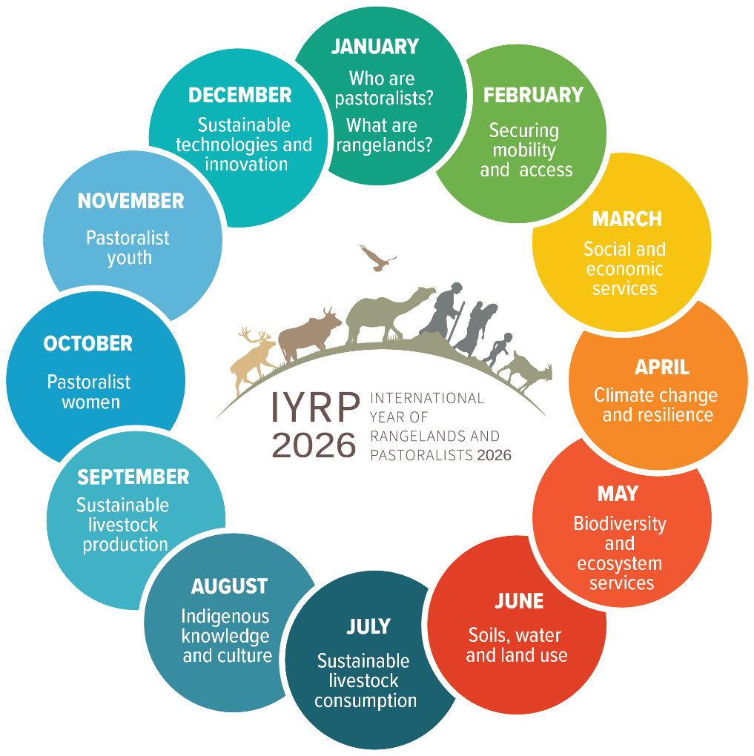
12 themes

Slide 16
Purpose of regional action plans
To create awareness and help coordinate national activities across the region
To spearhead regional/multi-country activities
To contribute to global activities
To encourage government involvement and financial support.
National action planning. Countries to establish a multi-stakeholder National Support Group to design, execute and implement actions before and during 2026 to celebrate the IYRP.
Notes:
RISG (co-)chairs should take the leadership in this process and involve as many other RISG members as possible, including additionally recruited members. It is particularly important to include people from pastoralist organizations.

Slide 17
Action Plan for South Africa
We need to establish a national action plan to support the IYRP which could be led by GSSA and discussions with DALRRD have started to fund IYRP activities.
Activities could include:
Special sessions at conference
Hosting a regional conference on IYRP
Public Seminars
Short Films
Grass day in South Africa
Farmer days highlighting IYRP messages
Social media campaigns
Commissioned research to fill knowledge gaps and formulating policy briefs.
Special issue in AJRFS

Slide 18
What would we consider success?
FAO Rangelands Partnership Secretariat, to continue to raise awareness for governments
Pastoralists are looking for platforms for pastoralists to speak and have their voice heard, at national, regional and global levels
Resolutions taken by UN Entities in support of rangelands and pastoralism, including UNFCCC and the Post-2030 SDGs
Global data base of rangelands and pastoralists
Changes in national, regional, global policies promoting the protection and sustainability of rangelands and pastoralists, fair and equitable benefits and upliftment
A fully funded and representative global gathering of pastoralists in 2026
More projects and programs dedicated to rangelands and pastoralists through global funds such as GEF, GCF, LDN, VCM – and growing portfolio of rangeland friendly certified products

