Slide 1
UN International Year of Rangelands & Pastoralists (IYRP) 2026
Introduction for IYRP Working Groups
www.iyrp.info 15 March 2023

Slide 2
Why an IYRP?
To increase worldwide understanding of importance of rangelands & pastoralists for food security, economy, environment & cultural heritage
To help fill knowledge gaps about rangelands & pastoralists through participatory research & communication
To promote informed, science-based policy & legislation for current & future generations
To mobilise people worldwide to grasp new opportunities in rangelands & pastoralism
© Wendy Sheehan

Slide 3
Regional IYRP Support Groups (RISGs)
Arctic
East Asia
South Asia
Central Asia & Mongolia
Australasia
North Africa & Middle East
Eastern & Southern Africa
West & Central Africa
Europe
North America
South America
Multistakeholder RISGs to generate partnership:
to expand network of supporting organisations and governments in the 11 regions of the world
to work with Government of Mongolia and IYRP International Support Group (ISG) to plan and implement IYRP activities in these regions
Central role for pastoralist organisations
in the RISGs & their activities
Photo: J.Dillan/MercyCorps

Slide 4
Activities up to & during IYRP 2026 on various themes
Joint research & publishing
Policy briefs / statements
Pastoralist gatherings
Social media campaigns
Films / Photo exhibits
Pastoralist innovation fairs
Side events
Conferences / Webinars … etc

Slide 5
What does the IYRP initiative seek to achieve through the Working Groups?
Greater awareness in science & society about how rangelands & pastoralists contribute to food security, economy, environment & cultural heritage
Resolutions taken by UN and other international entities in support of rangelands & pastoralists
Changes in national, regional & global policies in favour of sustainable management of rangeland resources by pastoralists & other stakeholders
Increase sustainable & ethical investment in rangelands & pastoralist livelihoods

Slide 6
Possible tasks of Working Groups related to their respective themes:
Collate and analyse existing research results (science review)
Identify knowledge & information gaps – and new opportunities
Stimulate and engage in participatory research to fill gaps and explore opportunities
Analyse existing international policy related to the theme
Identify “targets” (international bodies, conventions, events etc) for science- and experience-based advocacy
Strategise on appropriate messages for these targets, including identification of spokespersons or “ambassadors” to bring them across
Engage with pastoralists and others in IYRP network (including other WGs) in disseminating these messages, also for public awareness

Slide 7
Collaborating in IYRP 2026 initiative
General IYRP e-list
~740 addresses mostly for info only
International Support Group (ISG)
~415 active partners, including GCG members & 2 co-chairs
Global Coordinating Group (GCG)
~45 members (co-chairs, comms team, RISG & WG chairs & reps from key supporting partners: FAO, Govt of Mongolia, ILRI, IUCN, UNEP, WAMIP)
Working Groups (WGs):
Afforestation
Biodiversity
Gender
Land Degradation Neutrality (LDN)
Mountains
Water
Youth
Global Communications Team
Regional IYRP Support Groups (RISGs)

Slide 8
THANKS FOR CONTRIBUTING TO THE WORKING GROUPS, ESSENTIAL FOR UNDERPINNING & SHARING MAIN MESSAGES FOR THE IYRP 2026 !
www.iyrp.info

Slide 9
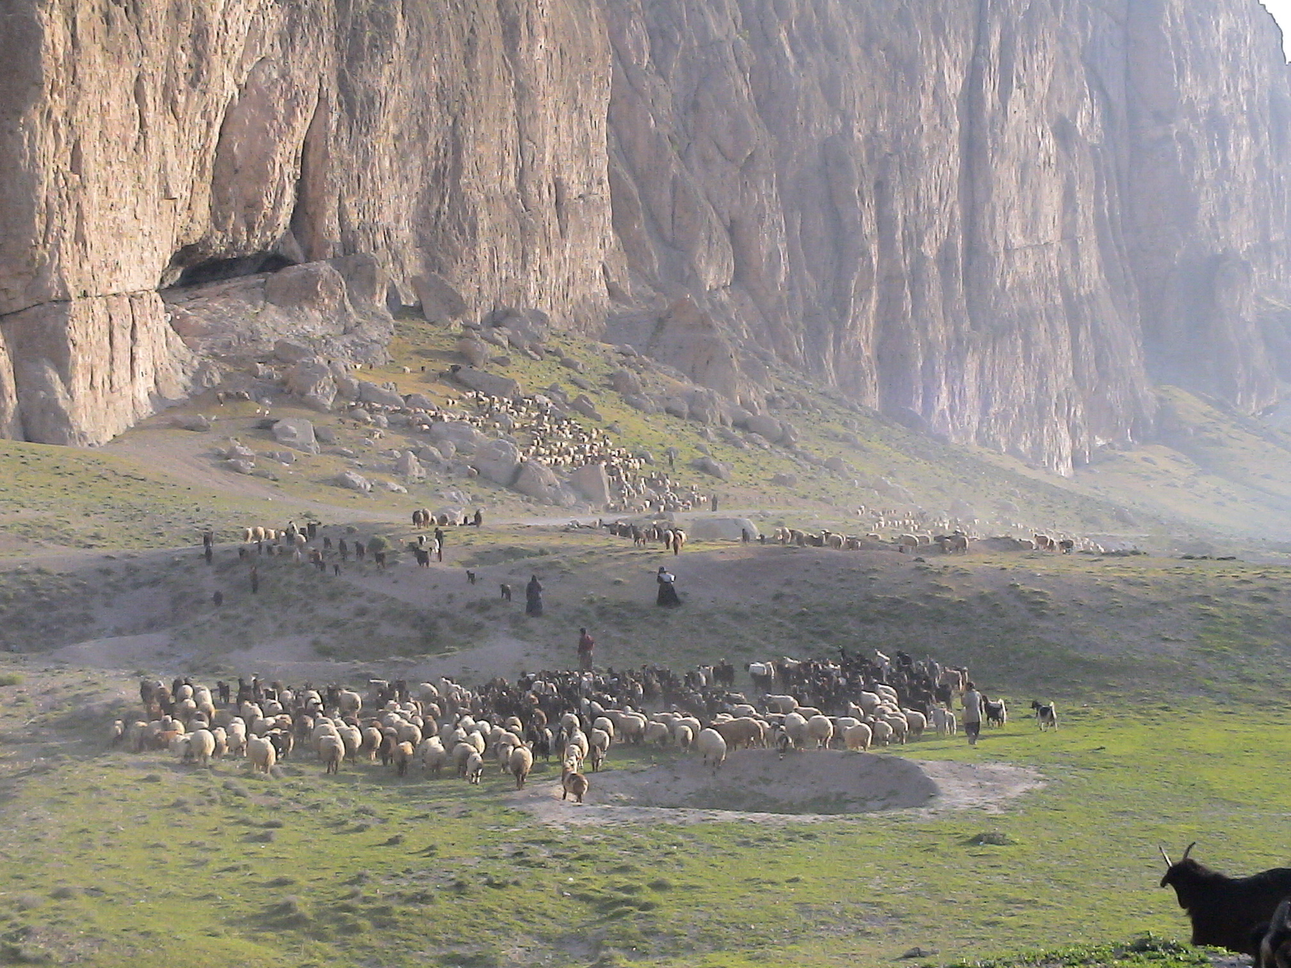
Pastoralism, the Backbone and Invisible Assets of the World’s Drylands

Slide 10
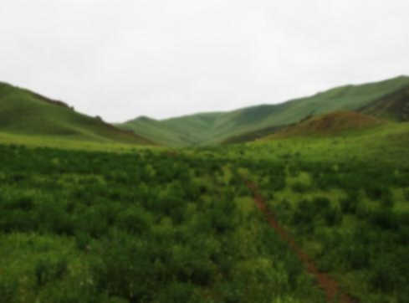
Loss of income & loss of youth motivation
Insecure property rights & right to land/ degradation
Weakening customary NRs management
Weakening socio-ecological cohesion
Increased pressure of livestock & degradation
Endangered livelihoods & production system
Migration & marginalization in big cities
Multilevel disputes and conflict
Weakening customary governance & social structure
Loss of: grazing lands, biodiversity & local breeds & degradation
Blocked Migratory routes, loss of indigenous knowledge
Social & Policy Issues
Fragmentation of Pastoralists territories—undermining mobility and survival of pastoralists
In search of job, education, …
Land allocation to Large scale development projects
Forced & induced sedentarisation
nationalization of rangelands
Social inequality and unbalance subsidies & development works
Lack of legal systems to legalize common property and mobility
Ignoring indigenous knowledge and Socio & ecological values
Poor delivery of mobile services in veterinary, health, education, …
Poor & Inappropriate Policies
& Programs at various levels

