Slide 1
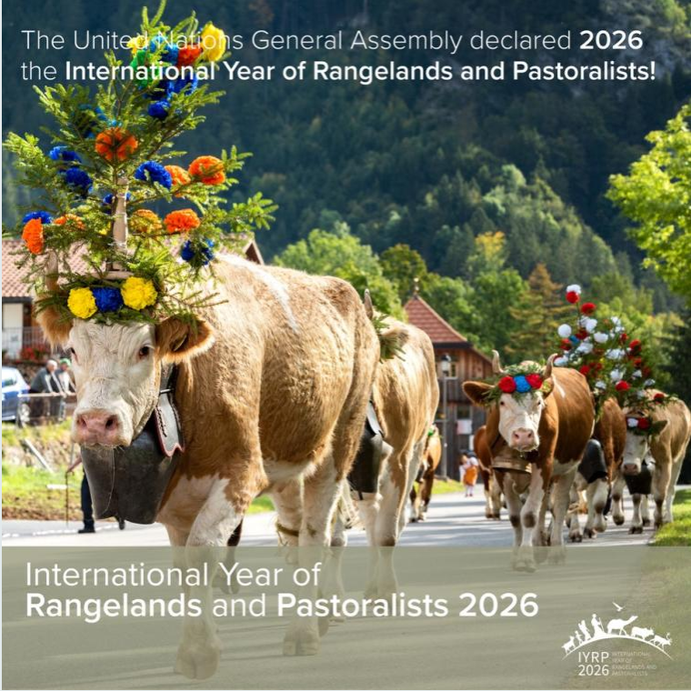
A catalyst for change, empowerment and impact – the International Year of Rangelands and Pastoralists
Igshaan Samuels
Co-chair of the IYRP ISP

Slide 2
Presentation Approach
Rangeland Stewardship Council
Pastoralism
IYRP
Regenerative Agriculture
IYRP at the nexus for healthy rangelands and sustainable and resilient pastoralism

Slide 3
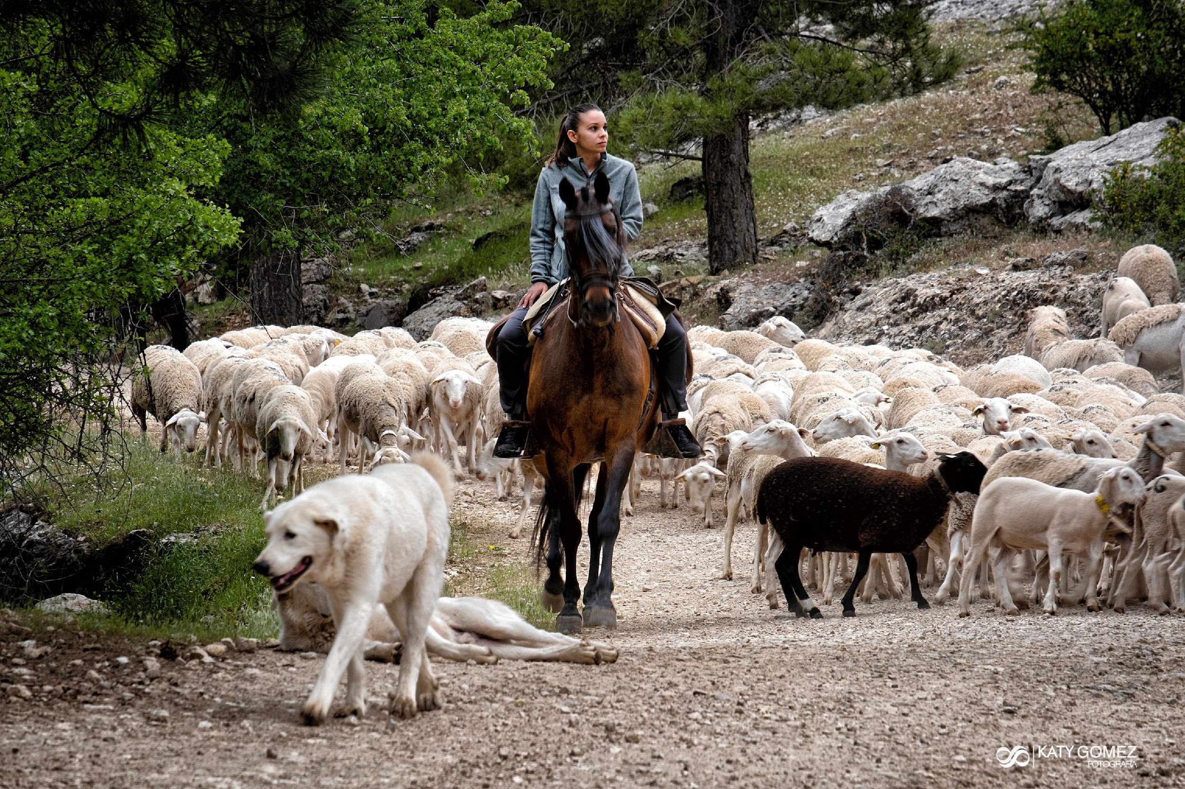
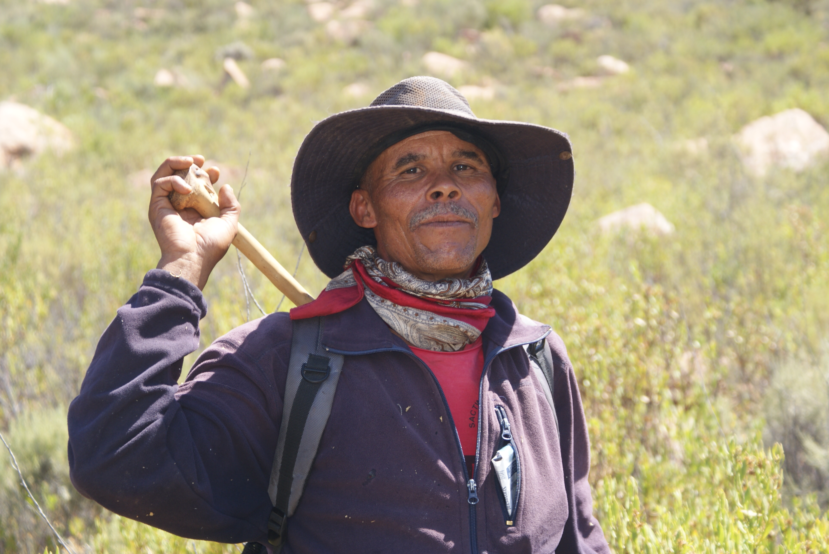
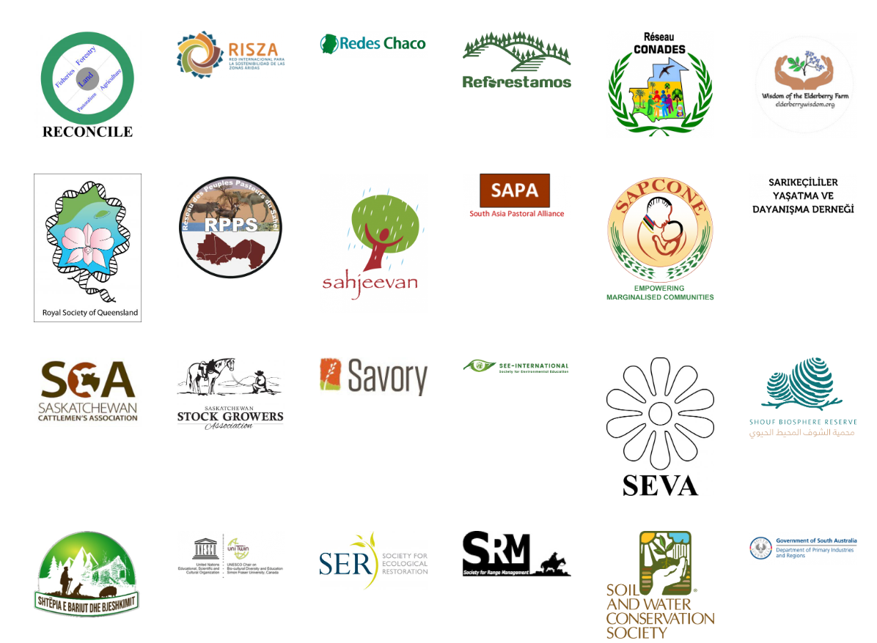
Who is the IYRP?
Coalition of about 415 organizations from around the world representing pastoralists, NGOs, academia, media, private sector, multinational organizations, etc. )

Slide 4
IYRP 2026 structure
General IYRP e-list
~740 addresses mostly for info only
International Support Group (ISG)
~415 active partners, including GCG members & 2 co-chairs
Global Coordinating Group (GCG)
~45 members (co-chairs, comms team, RISG & WG chairs & reps from key supporting partners: FAO, Govt of Mongolia, ILRI, IUCN, UNEP, WAMIP)
Working Groups (WGs):
Afforestation
Biodiversity
Gender
Land Degradation Neutrality
Mountains
Water
Youth
Economics
Global Communications Team
Regional IYRP Support Groups (RISGs)
Notes:
RISGs: Multistakeholder RISGs to generate partnership:
to expand network of supporting organisations and governments in the 11 regions of the world
to work with Government of Mongolia and IYRP International Support Group (ISG) to plan and implement IYRP activities in these regions
WGs
Greater awareness in science & society about how rangelands & pastoralists contribute to food security, economy, environment & cultural heritage
Resolutions taken by UN and other international entities in support of rangelands & pastoralists
Changes in national, regional & global policies in favour of sustainable management of rangeland resources by pastoralists & other stakeholders
Increase sustainable & ethical investment in rangelands & pastoralist livelihoods

Slide 5
Notes:
Multistakeholder RISGs to generate partnership:
to expand network of supporting organisations and governments in the 11 regions of the world
to work with Government of Mongolia and IYRP International Support Group (ISG) to plan and implement IYRP activities in these regions

Slide 6
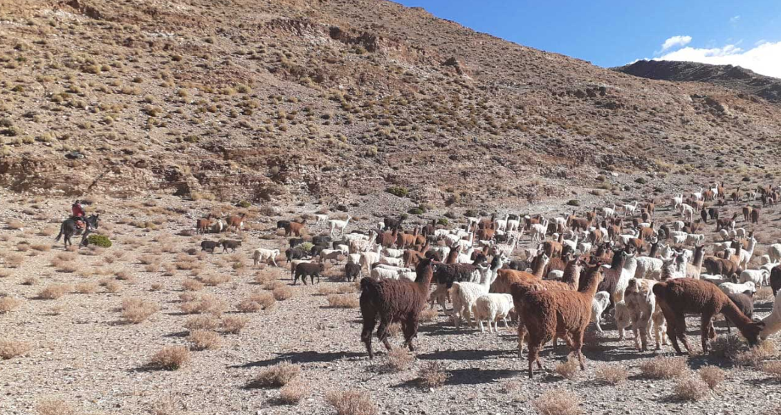
What does the IYRP seek to achieve?
Create awareness on the contributions of rangelands & pastoralists for food security, the economy and the environment
Break myths and misunderstandings of rangelands and pastoralism
Fill knowledge gaps with more participatory research and engagements
Promote evidence-based policies and legislation throughout the world in support of sustainable rangelands and pastoralism
Increase sustainable and ethical investment in rangelands

Slide 7
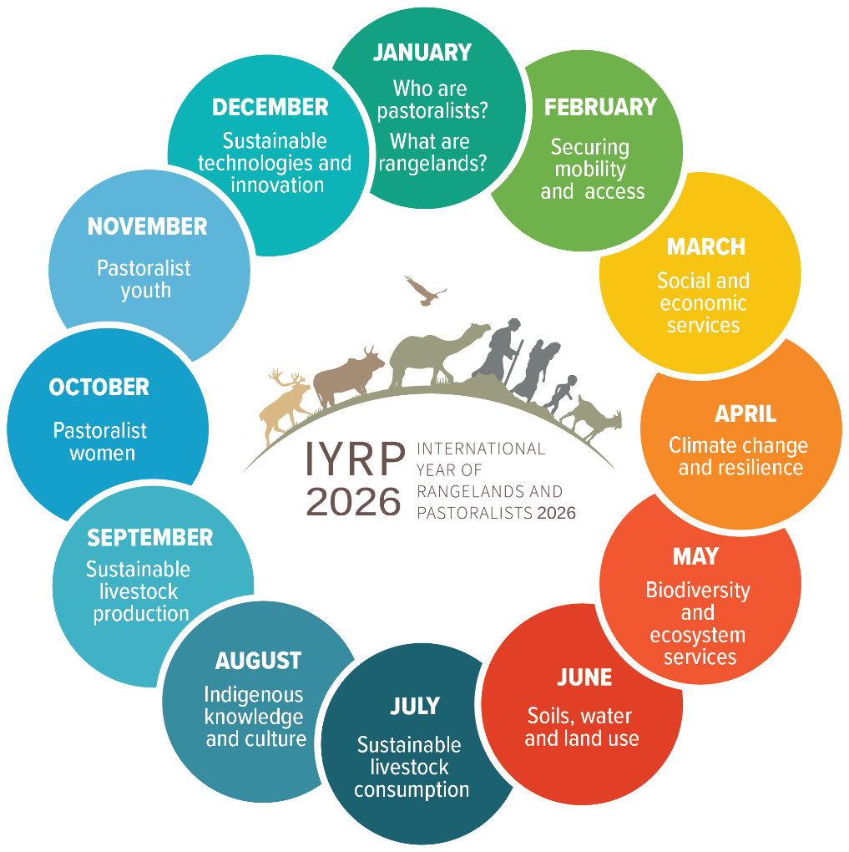
IYRP will address 12 themes during 2026

Slide 8
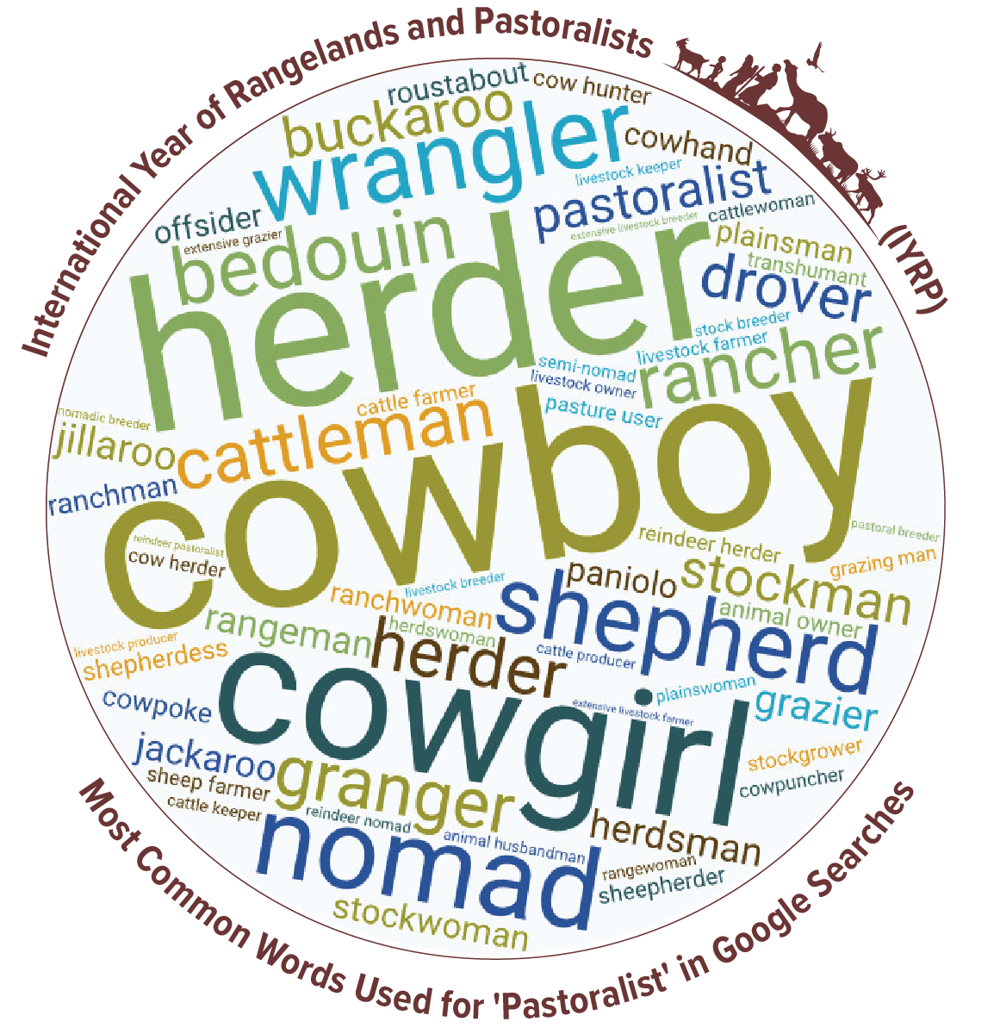
Who are pastoralists?
Pastoralism is a way of life and a form of animal husbandry on large extensive rangelands.
Pastoral system plays a key role in the supply of milk and meat and in agricultural production.
It helps to generate currency through the export of live cattle and products, such as fibres, leather and hides.
Notes:
Pastoralists are people who raise livestock or (semi-)wild animals on rangelands in production systems that depend on some degree of herd mobility. They manage diverse species of grazing and browsing animals such as sheep, goats, camels, cattle, and donkeys.
Pastoralism is a way of life and a form of animal husbandry where domesticated and semi-wild animals are released onto large extensive rangelands for grazing, by nomadic people who moved around with their herds or ranchers who move between their grazing paddocks.
Pastoral system also plays a key role in the supply of milk and meat and in agricultural production through the provision of manure and animal traction. It helps to generate currency through the export of live cattle and products, such as fibres, leather and hides.

Slide 9
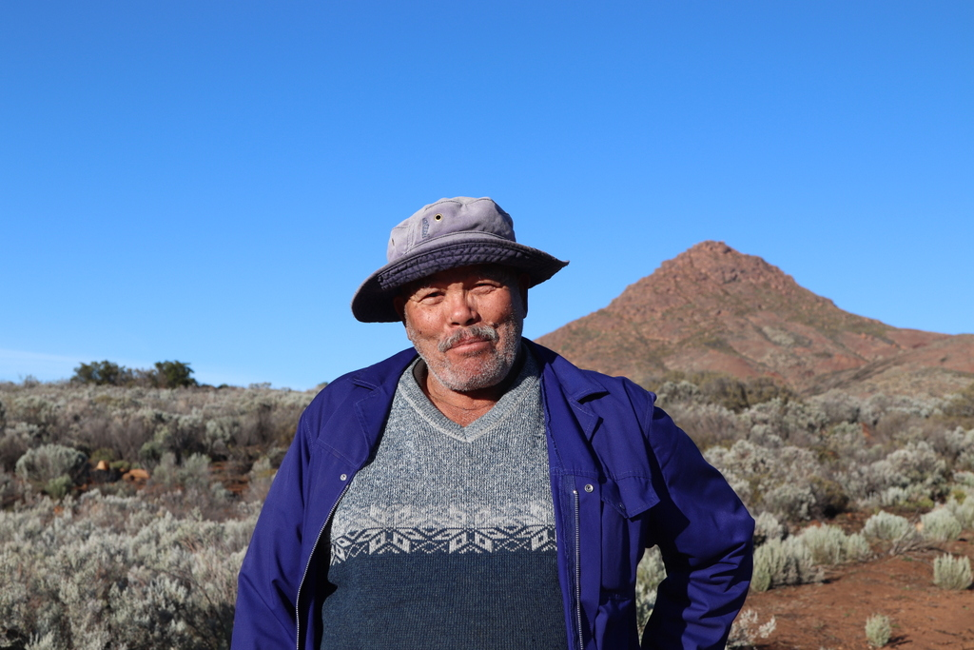
Pastoralism and Regenerative Agriculture
Biodiversity
Pastoralism promotes biodiversity
Grazing animals mimic natural herbivore behaviors
Soil Health
Pastoralism contributes to soil health and reduce erosion
Grazing animals help cycle nutrients
Carbon Sequestration
Rangelands capture and store significant amounts of carbon
When managed sustainably, pastoralism mitigates climate
change
Notes:
Pastoralism, when practiced sustainably, aligns with regenerative agriculture principles.
Embracing pastoralism as a regenerative approach can benefit both ecosystems and human livelihoods.
Biodiversity
Pastoralism promotes biodiversity by maintaining diverse landscapes through mobility and rotational grazing.
Grazing animals mimic natural herbivore behaviors, which can enhance plant and wildlife diversity.
Soil Health
Pastoralism contributes to soil health through minimal disturbance.
Grazing animals help cycle nutrients and stimulate microbial activity.
Reduced soil erosion and improved soil structure are outcomes of well-managed pastoral systems.
Carbon Sequestration
Grasslands and forests in pastoral areas capture and store significant amounts of carbon.
When managed sustainably, pastoralism mitigates climate change by preserving these carbon sinks.

Slide 10
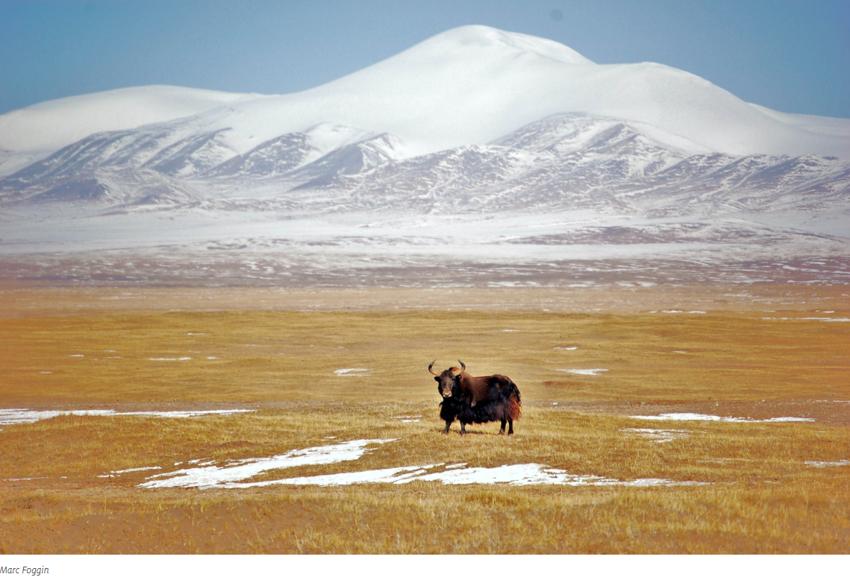
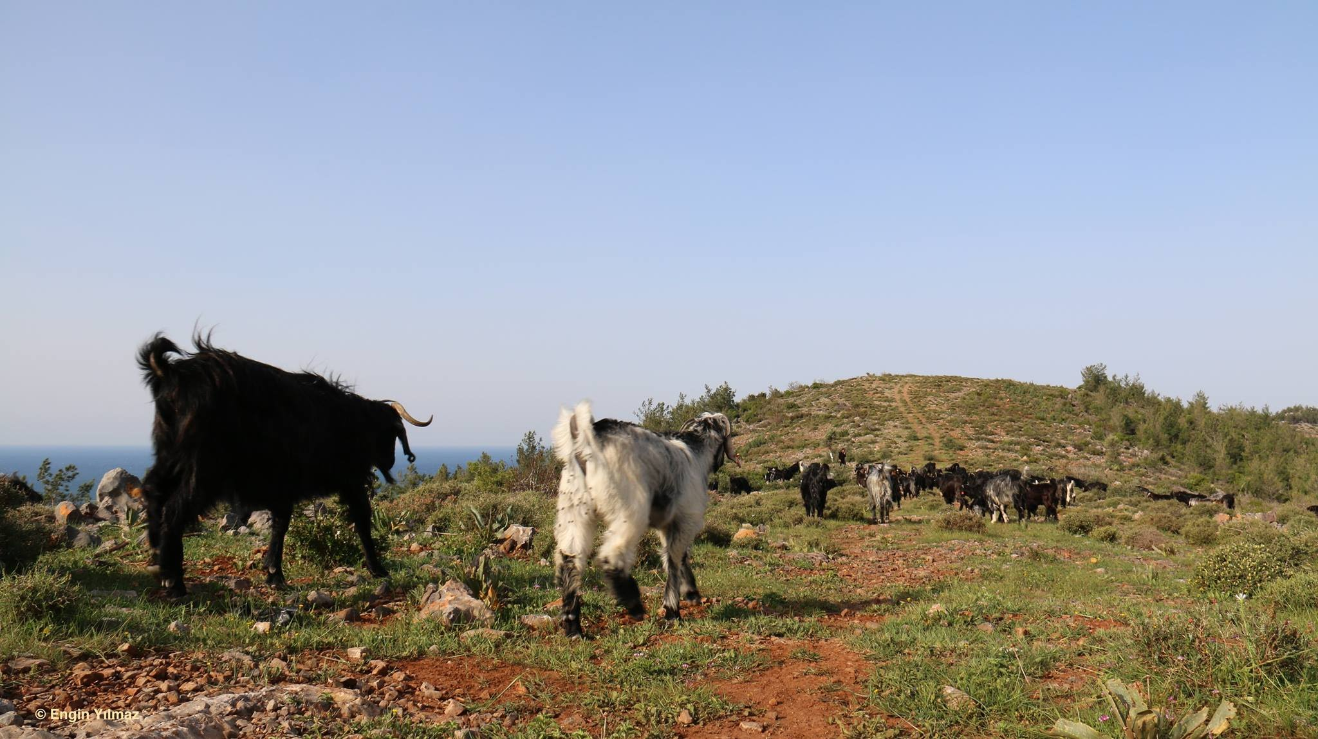
Benefits of a Rangeland Stewardship Council to Pastoralists
Existing standards do not cover all issues of relevance to a pastoral society
A certification system would potentially increase incomes for pastoralists
Give the legitimacy to extensive pastoral production
Provide the incentive for pastoralists to protect rangelands
Notes:
RSC is a critical step towards achieving an effective, equitable and impactful certification system for all rangelands of the world. I thank Sustainable Fibre Alliance , Eurofins and all the organizers for creating this important dialogue for us.
A new certification system should address issues critical for a mobile system not a sedentary one. For example, land rights and customary local regulations are very different for an extensive system than they are for a sedentary system. Keeping rangelands healthy is very different from keeping croplands healthy.
Existing standards are piecemeal and do not cover all issues of relevance to a pastoral society –they have been developed for a sedentary production system.
A new certification system should address issues critical for a mobile system not a sedentary one. Keeping rangelands healthy is very different from keeping croplands healthy.
A certification system would potentially increase incomes for pastoralists and also make it a predictable stream of revenue that would help increase pastoralists’ resilience to climate change
A certification system would give the legitimacy to extensive pastoral production that would raise its profile, visibility and value on the market
RSC should encourage governments to pass appropriate policies and balanced subsidy programs that enable pastoral stewardship of rangelands
A well-tuned certification system would provide the incentive for pastoralists and other land managers to invest in protecting rangelands from conversion to unsustainable uses

Slide 11
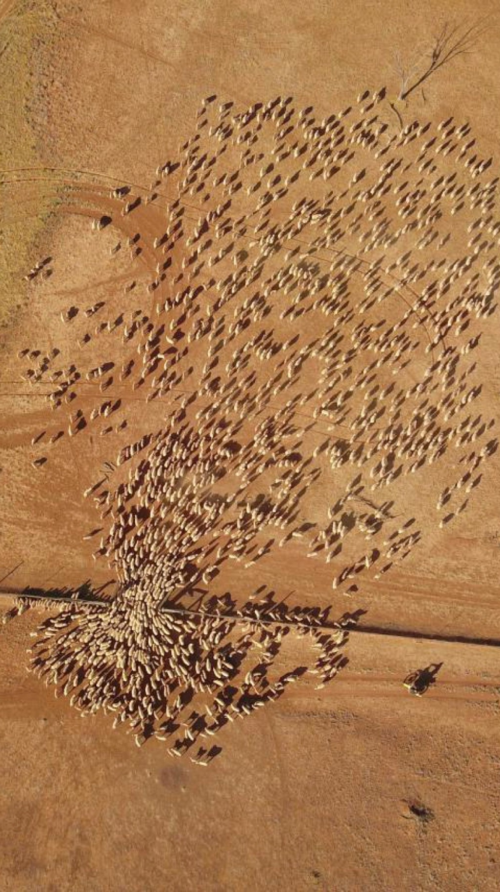
What would we consider success?
FAO Rangelands Partnership Secretariat, to continue to raise awareness for governments
Platforms for pastoralists to speak and have their voice heard
Changes in national, global policies promoting the protection and sustainability of rangelands
More projects and programs dedicated to rangelands and pastoralists through global funds such as GEF, GCF, LDN, VCM
Growing portfolio of rangeland friendly certified products (RSC)
@Wendy Sheehan
Notes:
FAO Rangelands Partnership Secretariat, to continue to raise awareness for governments
Pastoralists platforms for pastoralists to speak and have their voice heard, at national, regional and global levels
Resolutions taken by UN Entities in support of rangelands and pastoralism, including UNFCCC and the Post-2030 SDGs
Global data base of rangelands and pastoralists
Changes in national, regional, global policies promoting the protection and sustainability of rangelands and pastoralists, fair and equitable benefits and upliftment
A fully funded and representative global gathering of pastoralists in 2026
More projects and programs dedicated to rangelands and pastoralists through global funds such as GEF, GCF, LDN, VCM – and growing portfolio of rangeland friendly certified products (RSC)

Slide 12
Thank You

