Slide 1
UN International Year of Rangelands & Pastoralists (IYRP) 2026
Overview of IYRP Working Groups
www.iyrp.info

Slide 2
International Year of Rangelands & Pastoralists 2026
Resolution adopted by the United Nations General Assembly on 15 March 2022
Formally supported by 102 countries and 338 organisations
Aims:
To increase worldwide understanding of importance of rangelands & pastoralists for food security, economy, environment & cultural heritage
To help fill knowledge gaps about rangelands & pastoralists through participatory research & communication
To promote informed, science-based policy & legislation for current & future generations
To mobilise people worldwide to grasp new opportunities in rangelands & pastoralism
Global Coordinating Group, 11 Regional Support Groups, 8 Working Groups

Slide 3
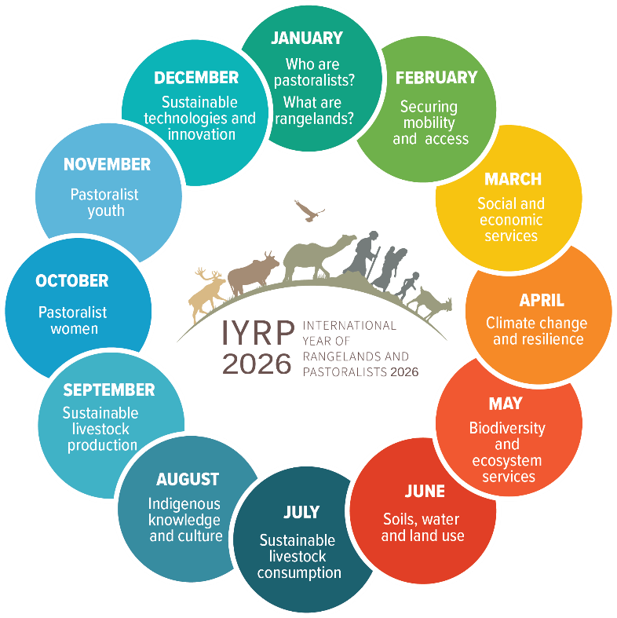
Outputs of the Working Groups will feed into the 12 themes that actors shall engage with during the IYRP (one theme per month)

Slide 4
What does the IYRP initiative seek to achieve through the Working Groups?
Greater awareness in science & society about how rangelands & pastoralists contribute to food security, economy, environment & cultural heritage
Resolutions taken by UN and other international entities in support of rangelands & pastoralists
Changes in national, regional & global policies in favour of sustainable management of rangeland resources by pastoralists & other stakeholders
Increase sustainable & ethical investment in rangelands & pastoralist livelihoods

Slide 5
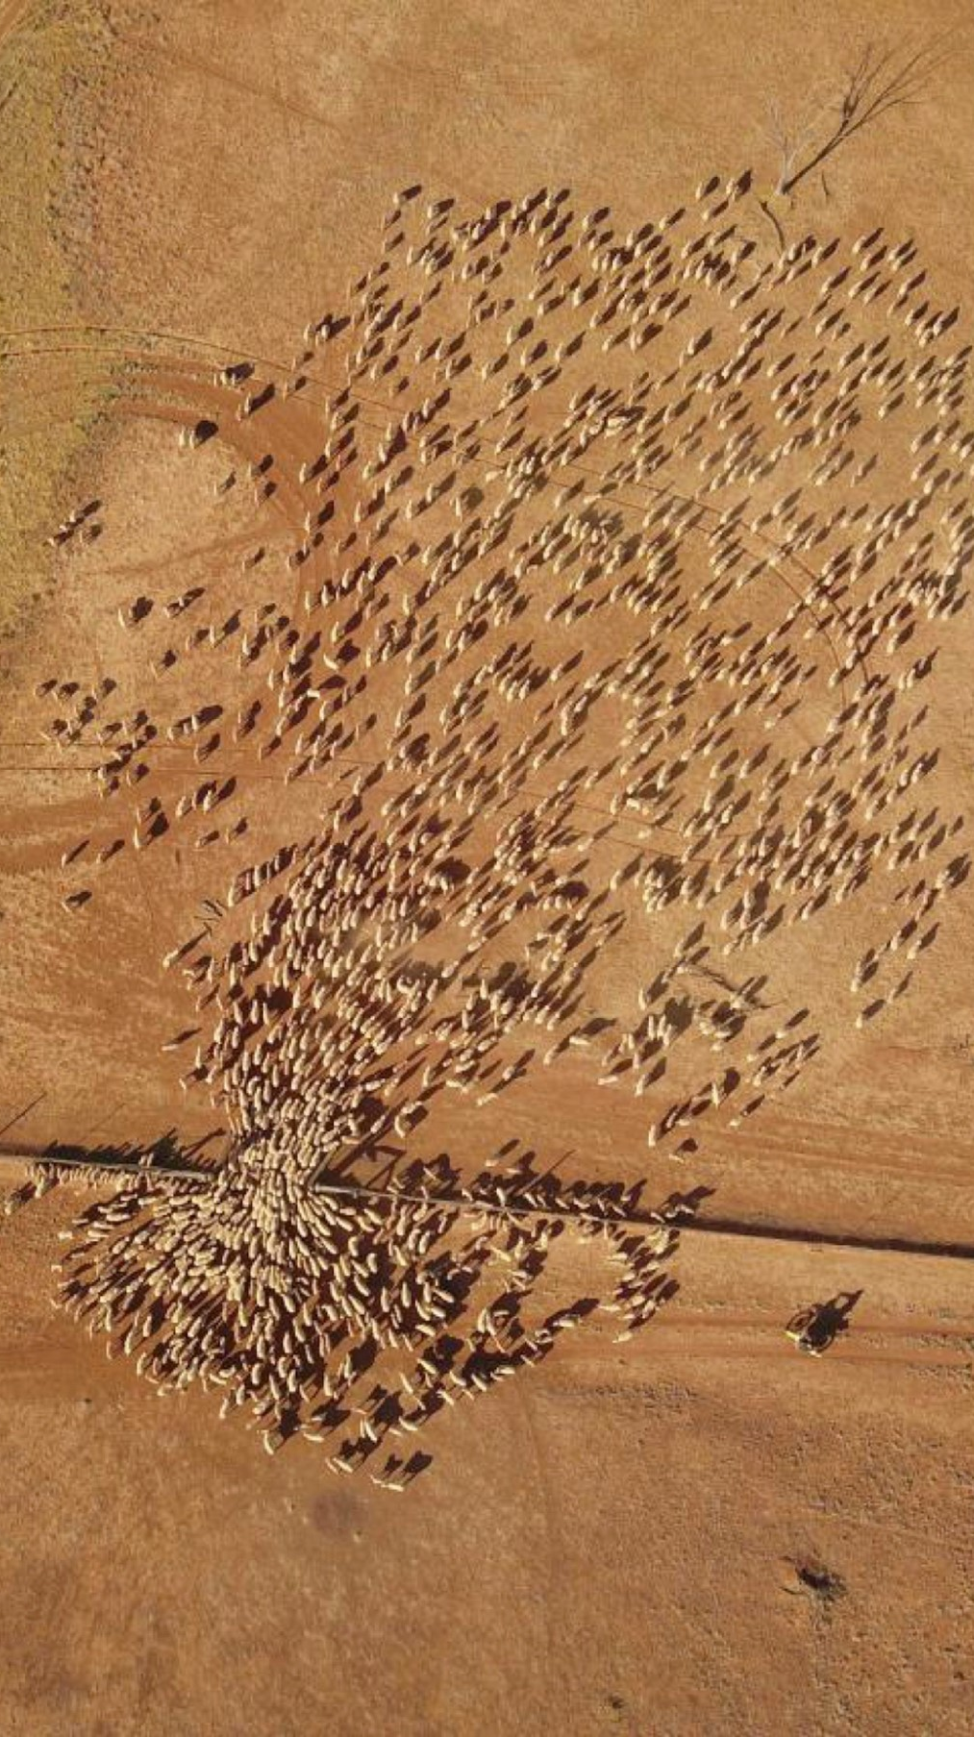
Working groups agreed to date
Afforestation in Rangelands
Mountain Pastoralism
Pastoralism & Gender
Pastoralism & Water
Rangelands & Land Degradation Neutrality
Rangelands & Biodiversity
Economics of Pastoralism
Pastoralist Youth

Slide 6
Possible tasks of Working Groups (WGs) related to their respective themes:
Collate and analyse existing research results (science review)
Identify knowledge & information gaps – and new opportunities
Stimulate and engage in participatory research to fill gaps & explore opportunities
Analyse existing international policy related to the theme
Identify “targets” (international bodies, conventions, events etc.) for science- and experience-based advocacy
Strategise on right messages for these targets, including identifying spokespersons or “ambassadors” to bring them across
Engage with pastoralists and others in IYRP network (including other WGs) in disseminating these messages, also for public awareness

Slide 7
Updates on activities of the WGs
Group 1: Afforestation in Rangelands
Coordinators: David Briske (USA) and Susi Vetter (South Africa)
“Rangeland afforestation is not a natural climate solution” state-of-the-science evidence-based paper submitted for publication
Key message: Rangelands are valuable ecosystems and afforestation efforts, driven by a climate change mitigation agenda, present a serious risk.
Group 2: Mountain Pastoralism
Coordinators: Igshaan Samuels (IYRP) and Eric Chavez (FAO)
Policy brief on Sustainable Mountain Pastoralism under development

Slide 8
Updates on activities of the WGs (cont’d)
Group 3: Pastoralism & Gender
Coordinator: Nitya Ghotge (India)
Highlight the advantages of bringing a gender lens to pastoralist policy & development
Disseminate key information around gender & pastoralism and generate discussions on this topic with a view to raise/increase awareness
Identify gaps in research on gender & pastoralism
Support the other IYRP WGs in their efforts to incorporate a gender lens into their work
Make sure gender issues receive adequate attention in the IYRP 2026
Concept note posted on the IYRP website

Slide 9
Updates on activities of the WGs (cont’d)
Group 4: Pastoralism & Water
Launched after webinar on pastoralism & water held in June 2022 by RWSN (Rural Water Supply Network), CELEP (Coalition of European Lobbies for Eastern African Pastoralism), IWMI (International Water Management Institute), SIMVI Foundation & Skat Foundation
Coordinators: Michael Odhiambo (Kenya) & Adrian Cullis (UK) with support from Kerstin Danert (UK)
Focus on water governance as well as water-related ecosystem services and rangeland land & water management
Concept note posted on the IYRP website

Slide 10
Updates on activities of the WGs (cont’d)
Group 5: Rangelands & Land Degradation Neutrality (LDN)
Coordinated by Bora Masumbuko (IUCN) and Mounir Louhaichi (ICARDA)
Focus on UN Convention to Combat Desertification with two critical issues for raising awareness within the UNCCD process:
Value of rangelands and pastoralism
Conversion of rangelands
The WG will undertake research & analysis, conduct case studies and disseminate knowledge products in form of policy briefs, animated videos, webinars etc.
Concept note posted on the IYRP website
Science review “Global action for sustainable rangelands and pastoralism to achieve Land Degradation Neutrality” under completion

Slide 11
Updates on activities of the WGs (cont’d)
Group 6: Rangelands & Biodiversity
Initiated Dec 2022 by Igshaan Samuels; co-chairs Rashmi Singh (India) & Matthew Luizza (USA)
Focus on “Biodiversity and Ecosystem Services”
Concept note on website & shared in IYRP network to stimulate creation of WG
Group 7: Economics of Pastoralism (being developed; concept note on website)
Coordinator Serena Ferrari (France/Senegal)
Initial focus:
Valuing pastoralism (contribution to GDP, imports and exports of pastoral products, etc.)
Competition at national level between pastoral products and industrial-sourced products
Constraints that pastoralists face in marketing their products
Sustainable production and consumption
Group 8: Pastoralist Youth (suggested by Fiona Flintan)
High interest among others in IYRP network – waiting for progress

Slide 12
Thank you

