Slide 1
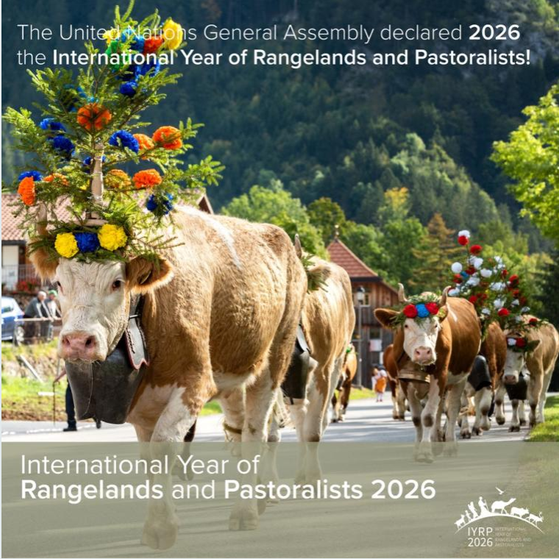
Introduction to the symposium and reflections on action planning for increasing awareness and knowledge on sustainable global rangelands
Igshaan Samuels and Maryam Niamir-Fuller
Co-chairs of the IYRP ISP
Society for Range Management – IYRP Symposium, 07 Feb 2023

Slide 2
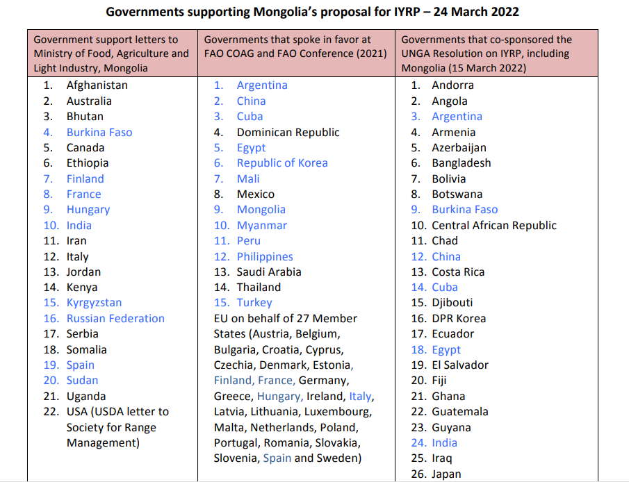
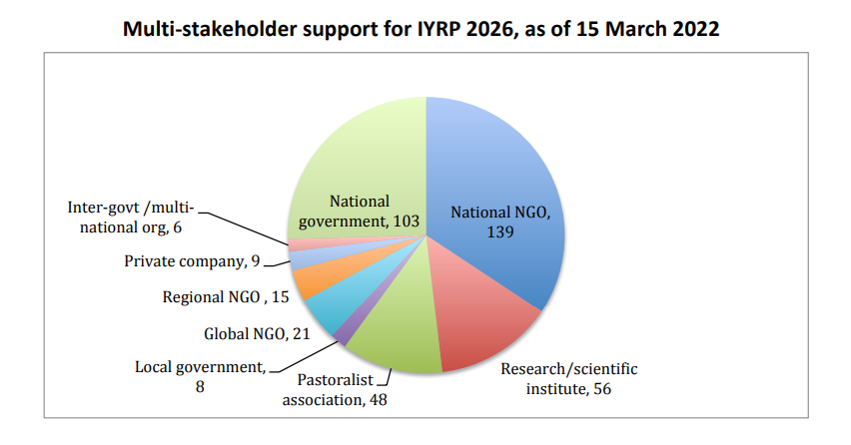
Who is the IYRP?
Coalition of 327 organizations from around the world representing pastoralists, NGOs, academia, media, private sector, multinational organizations, etc. )

Slide 3
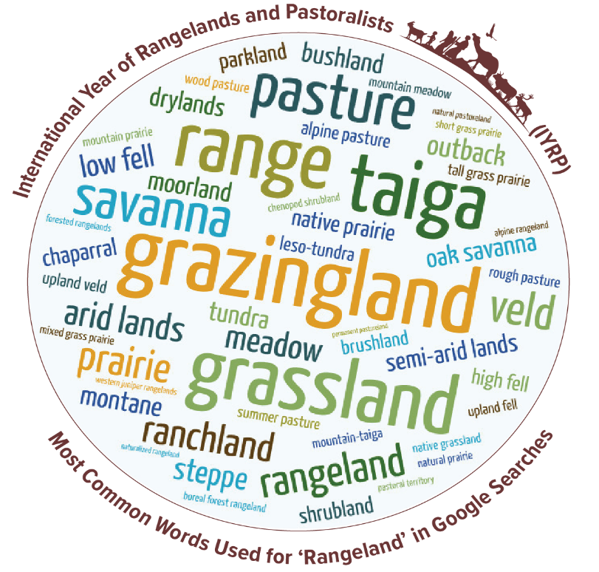
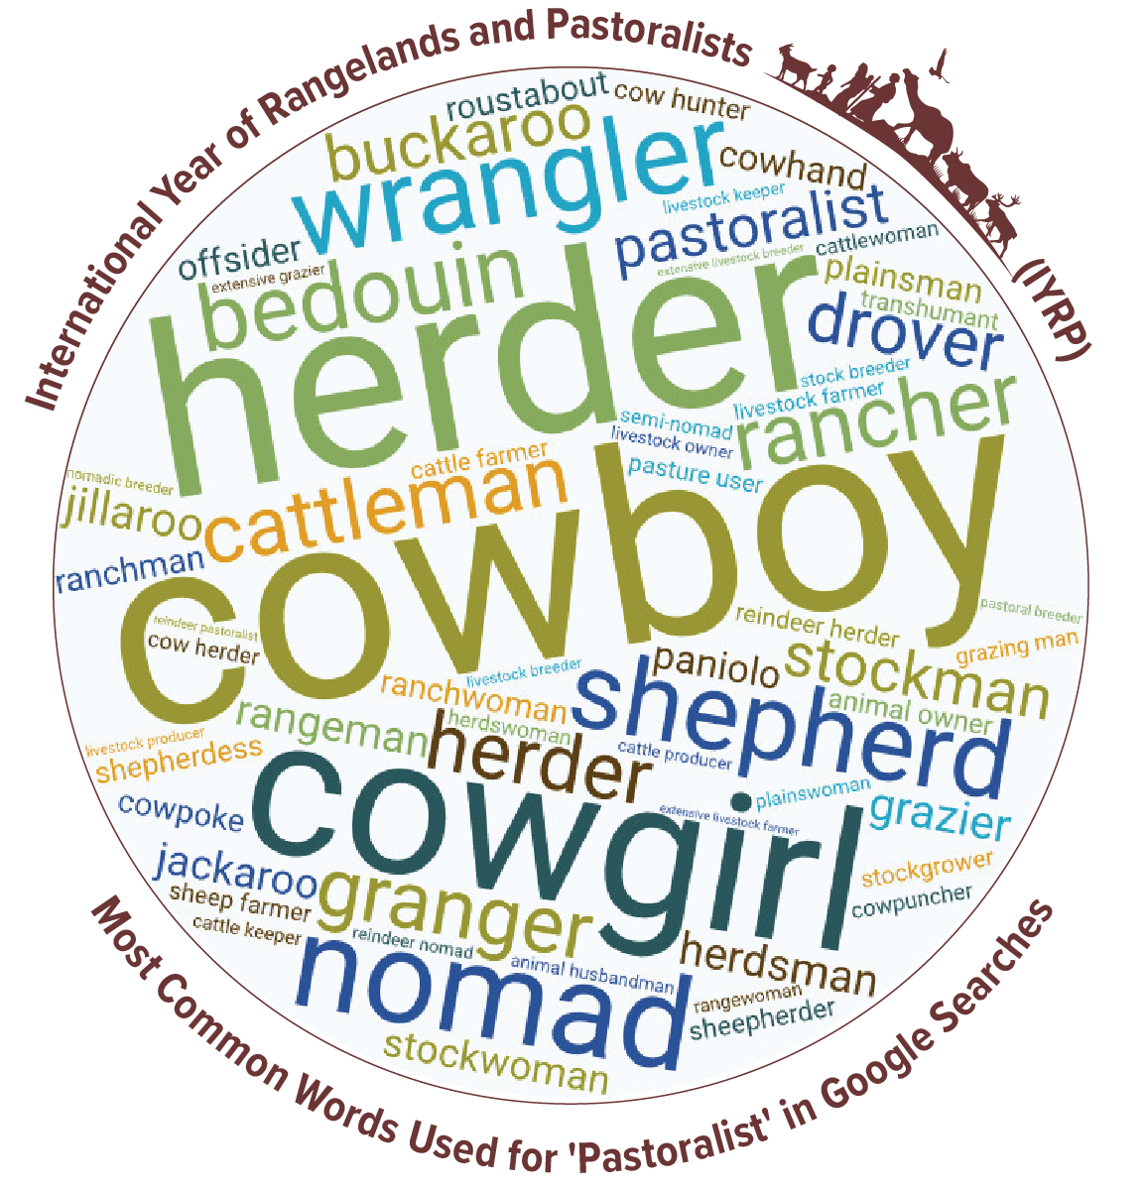
What are rangelands?
Who are pastoralists?

Slide 4
What does the IYRP seek to achieve?
Create awareness on the critical contributions of rangelands & pastoralists for food security, the economy and the environment
Break myths and misunderstandings of rangelands and pastoralism
Fill knowledge gaps with more participatory research and engagements
Promote evidence-based policies and legislation throughout the world in support of sustainable rangelands and pastoralism
Increase sustainable and ethical investment in rangelands

Slide 5
How will we achieve our goals?
Involvement of diverse stakeholders
Stakeholders will be involved in different processes, action plans, IYRP structures, events.
Institutional partnerships e.g. IYC, MPS, FAO COFO
IYRP representation on different platforms e.g. global events

Slide 6
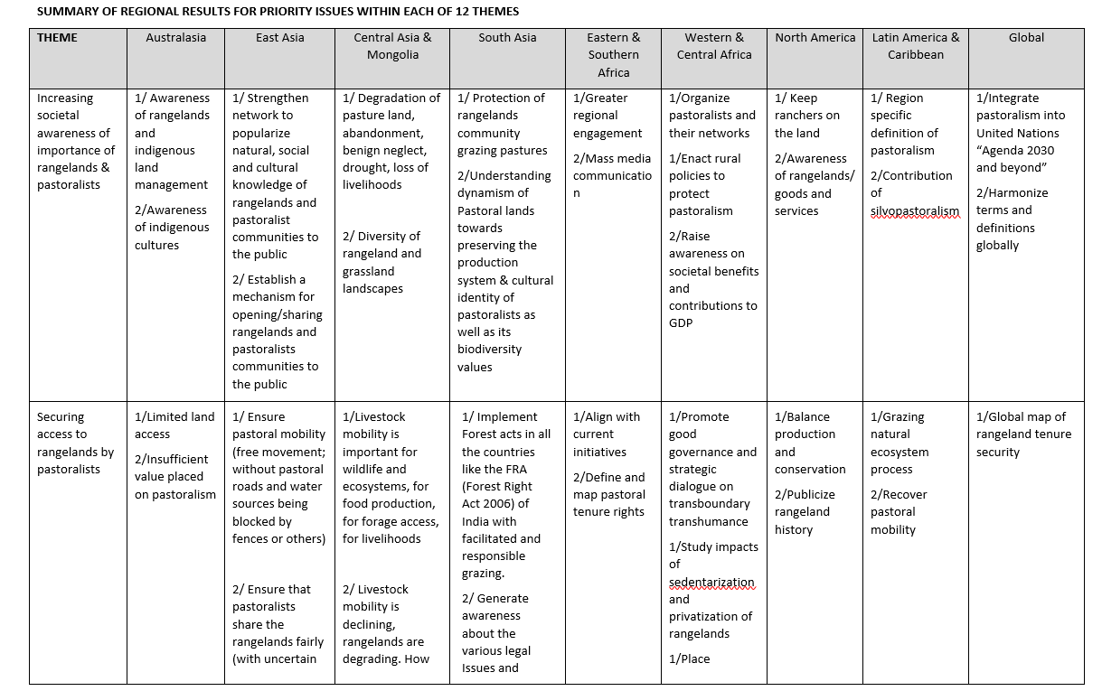
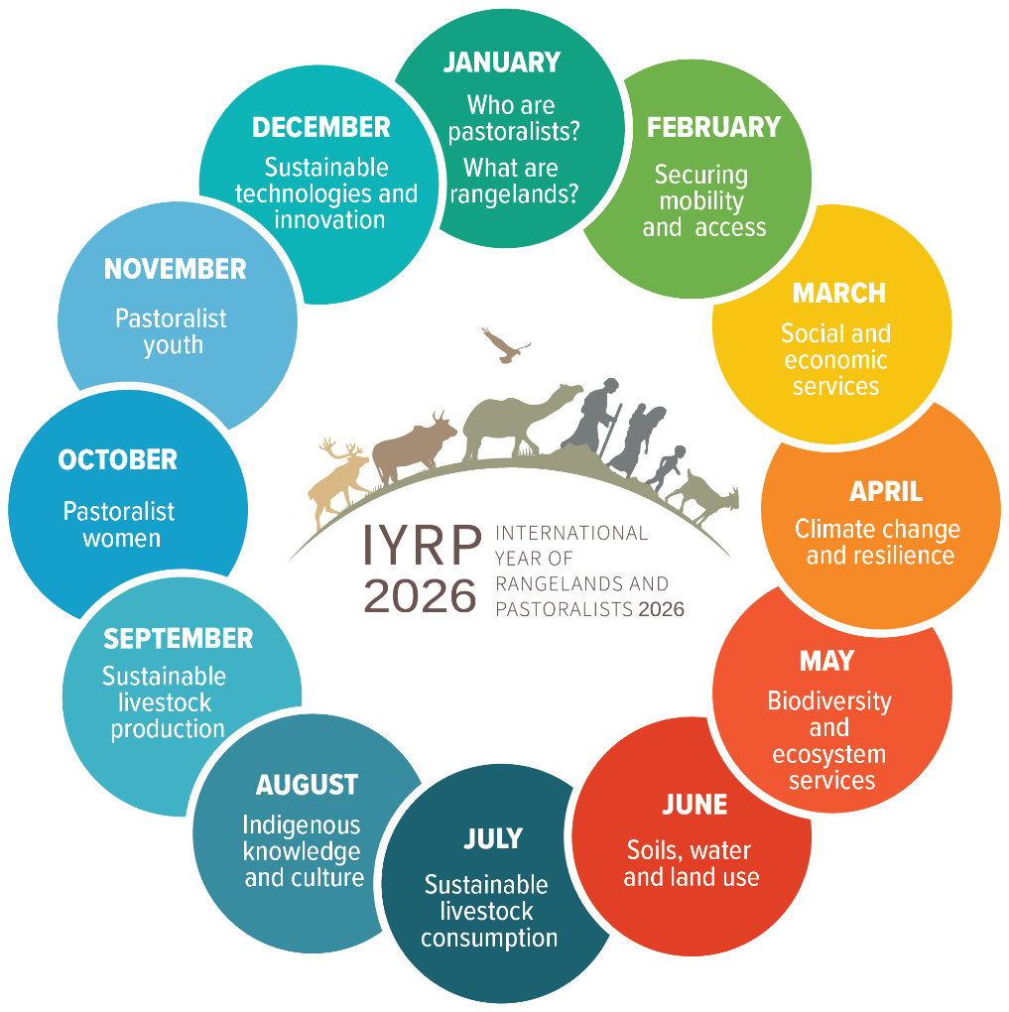
Action plans
12 themes

Slide 7
Further Actions to Achieve IYRP Goals
SRM IYRP Symposium
Strategic overview of global rangeland stewardship and how can the IYRP can be the catalyst for transformational change towards sustainability
Plans for establishing a global system for certification of rangeland-friendly products
WG on Afforestation in rangelands highlighting the challenges for meeting national climate goals
WG on Equitable Water Governance for pastoralists
WG LDN will present how countries can achieve Land Degradation Neutrality targets through rangeland restoration and empowerment of pastoralists.
There will be exchanges of experiences of Regional IYRP Support Groups relating to their activities.
We will hear the voices of some pastoralists at the global stage
The Symposium will draw conclusions on how the preparations for IYRP 2026 can reach all regions, including pastoralists and other members of society.

Slide 8
What would we consider success?
FAO Rangelands Partnership Secretariat, to continue to raise awareness for governments
Pastoralists are looking for platforms for pastoralists to speak and have their voice heard, at national, regional and global levels
Resolutions taken by UN Entities in support of rangelands and pastoralism, including UNFCCC and the Post-2030 SDGs
Global data base of rangelands and pastoralists
Changes in national, regional, global policies promoting the protection and sustainability of rangelands and pastoralists, fair and equitable benefits and upliftment
A fully funded and representative global gathering of pastoralists in 2026
More projects and programs dedicated to rangelands and pastoralists through global funds such as GEF, GCF, LDN, VCM – and growing portfolio of rangeland friendly certified products

