Slide 1
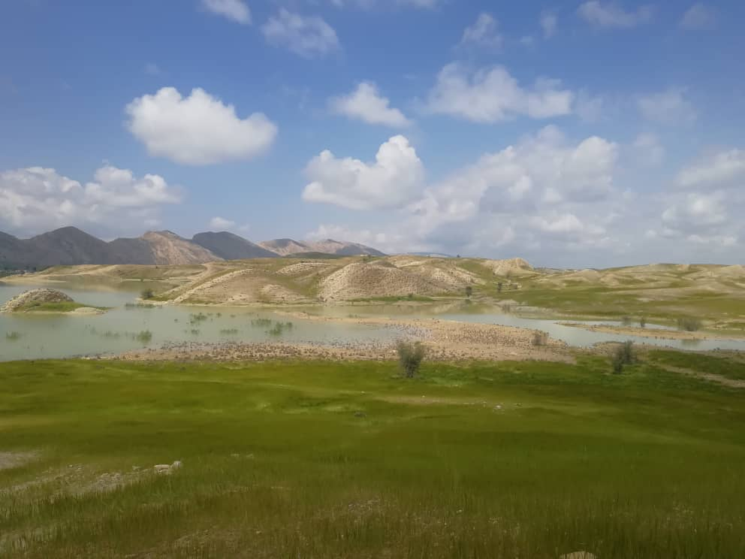
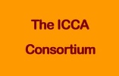
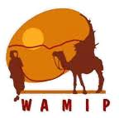
Importance of Mobility and Nomadic People in Managing Biodiversity and Food Systems
Side Event in the Frame of the 28th Session of the FAO COAG28 on “Transforming Agri-food Systems: From strategy to Action”
Nahid Naghizadeh, CENESTA
Small traditional dam in Wintering territory of Qashqai Tribal Confederacy, Farsimadan Tribe, Sheybani sub-tribe

Slide 2
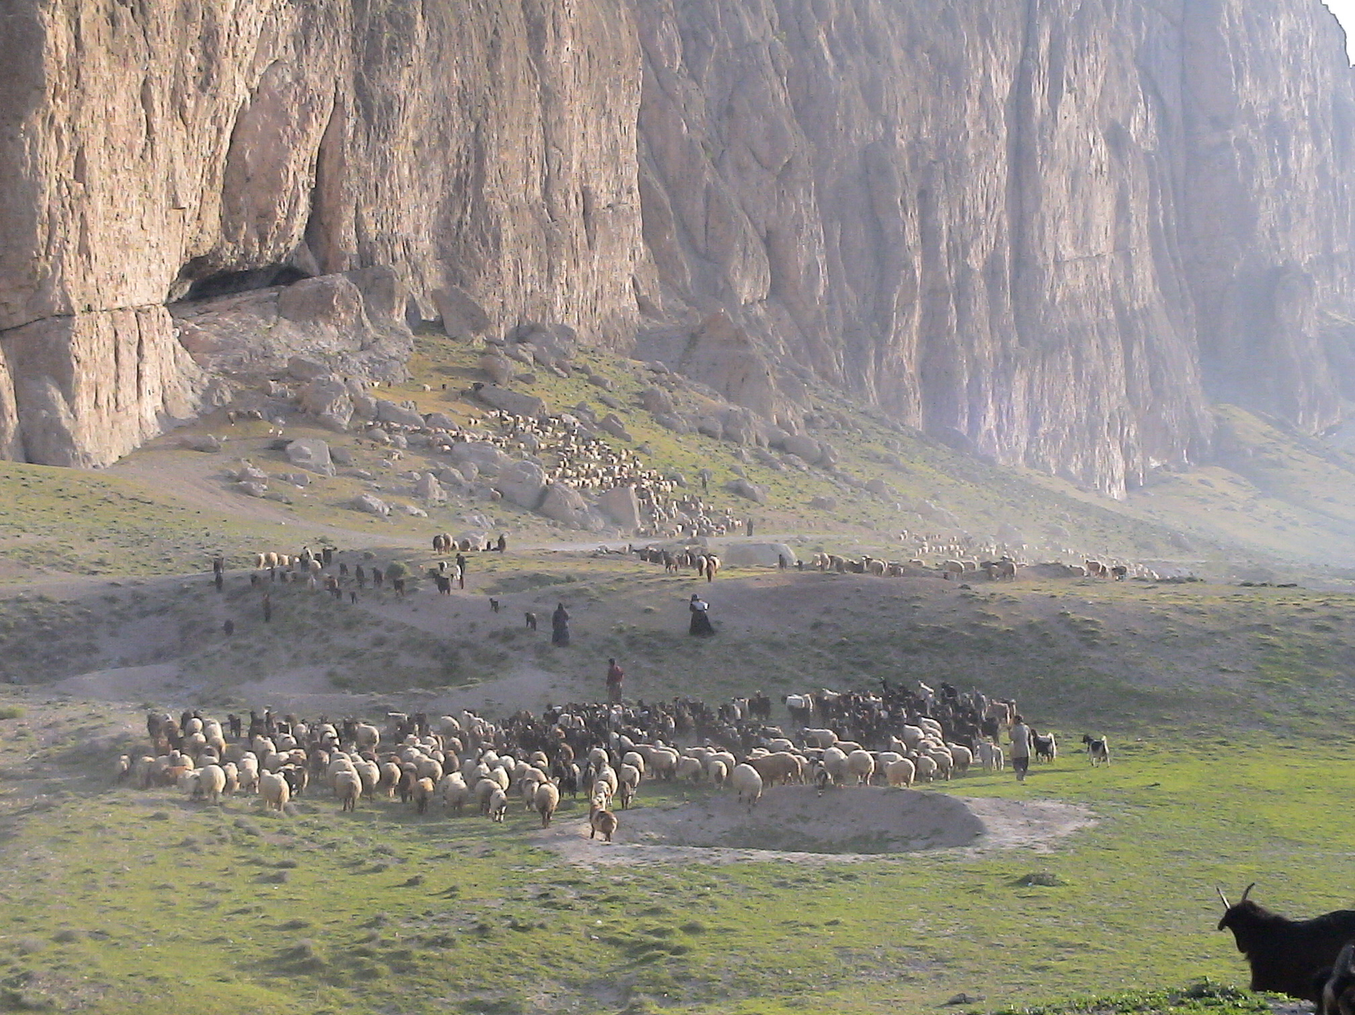
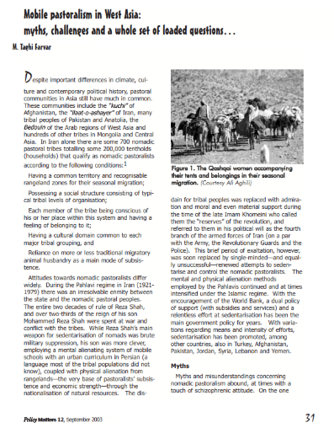
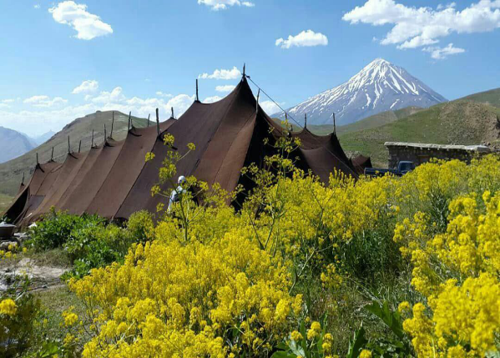
Pastoralism, the Backbone and Invisible Assets of the World’s Drylands

Slide 3
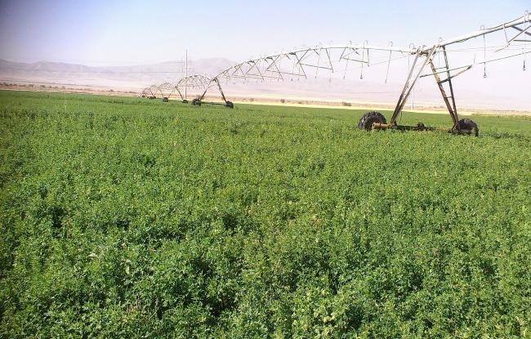
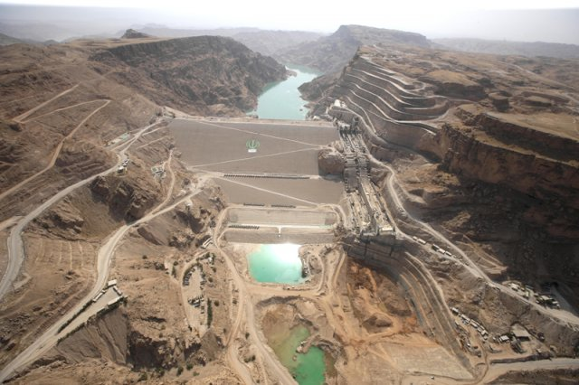
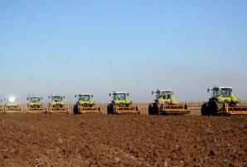
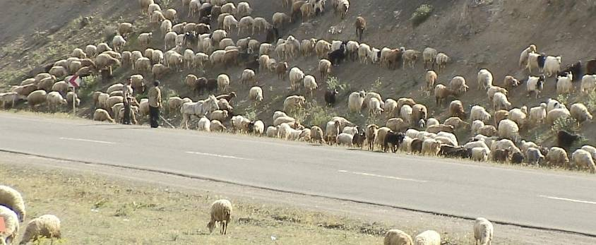
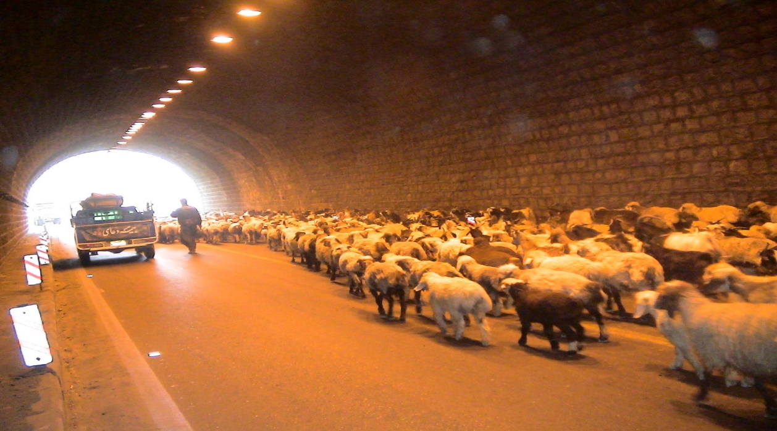
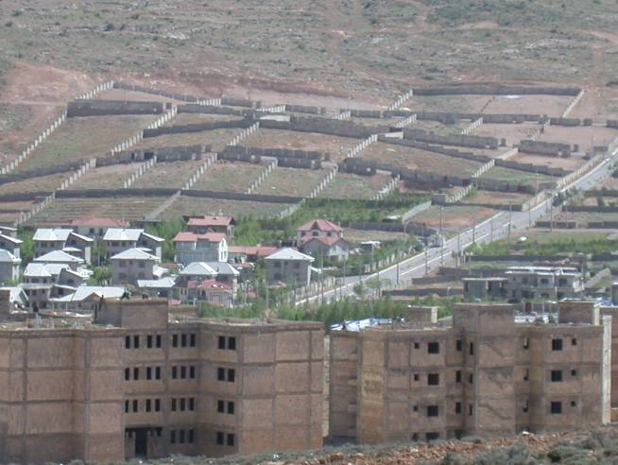
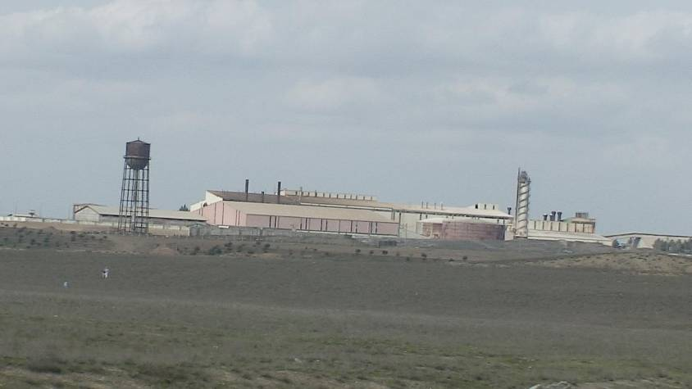
Policy and Social Issues

Slide 4
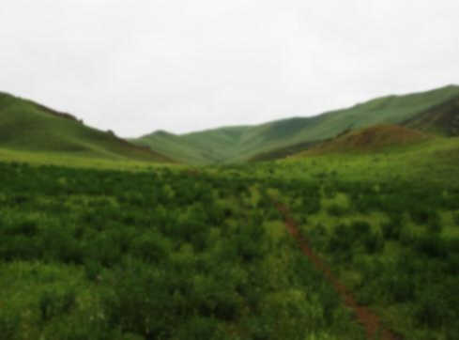
Loss of income & loss of youth motivation
Insecure property rights & right to land/ degradation
Weakening customary NRs management
Weakening socio-ecological cohesion
Increased pressure of livestock & degradation
Endangered livelihoods & production system
Migration & marginalization in big cities
Multilevel disputes and conflict
Weakening customary governance & social structure
Loss of: grazing lands, biodiversity & local breeds & degradation
Blocked Migratory routes, loss of indigenous knowledge
Social & Policy Issues
Fragmentation of Pastoralists territories—undermining mobility and survival of pastoralists
In search of job, education, …
Land allocation to Large scale development projects
Forced & induced sedentarisation
nationalization of rangelands
Social inequality and unbalance subsidies & development works
Lack of legal systems to legalize common property and mobility
Ignoring indigenous knowledge and Socio & ecological values
Poor delivery of mobile services in veterinary, health, education, …
Poor & Inappropriate Policies
& Programs at various levels

Slide 5
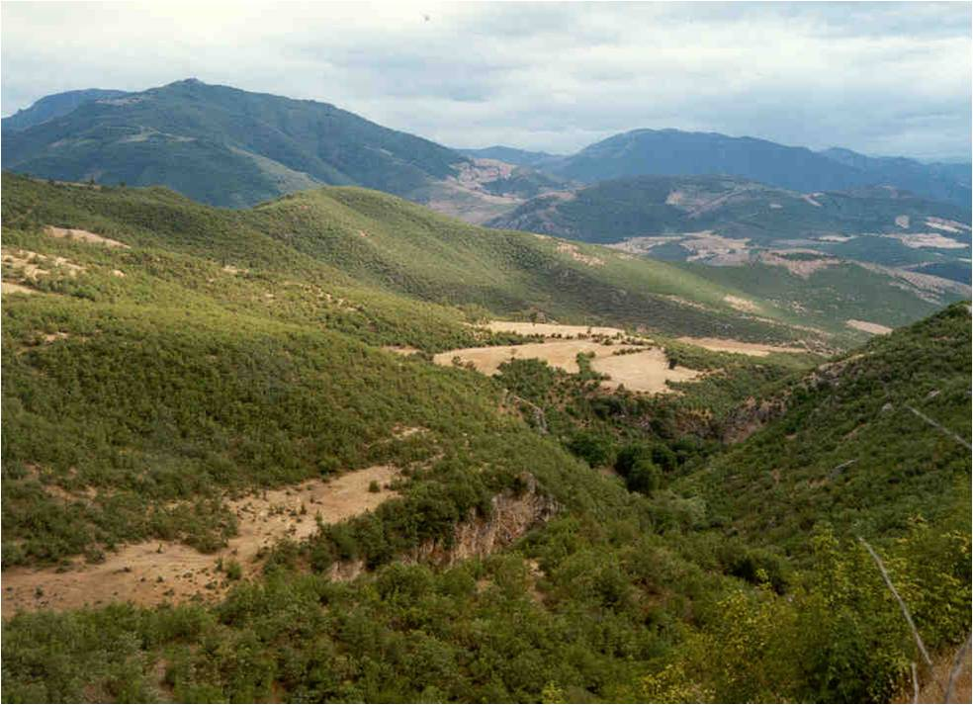
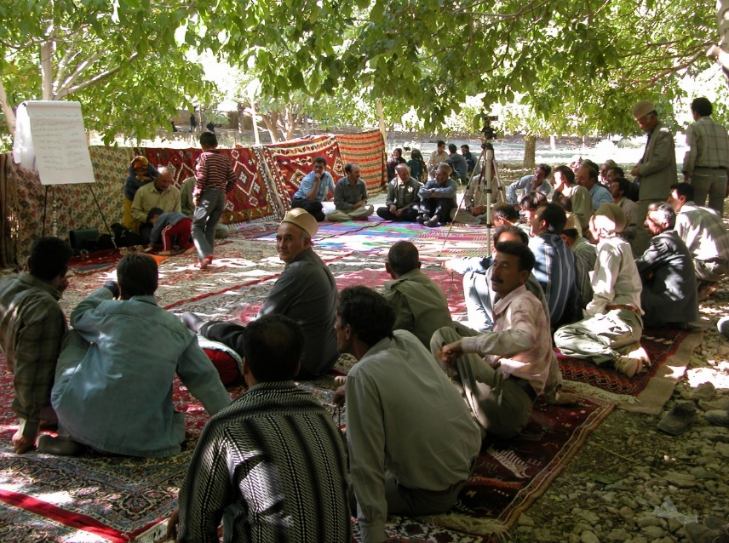
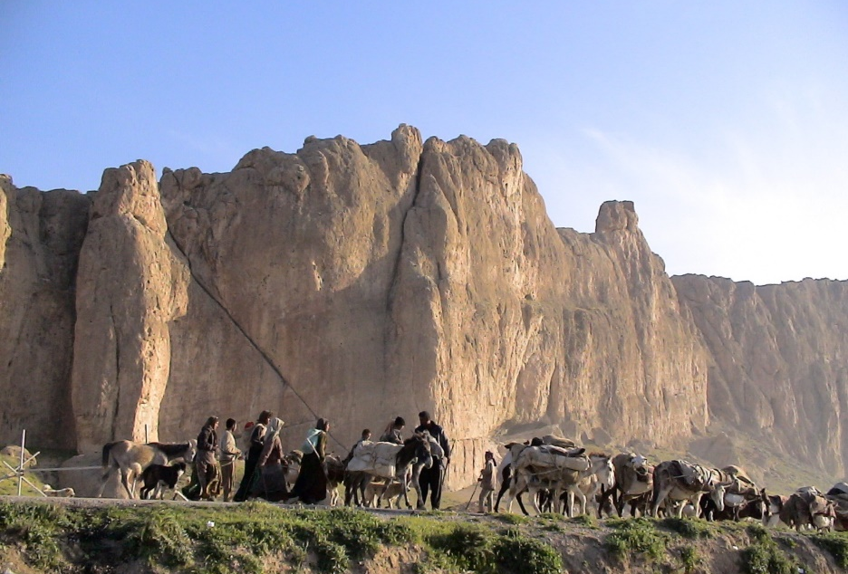
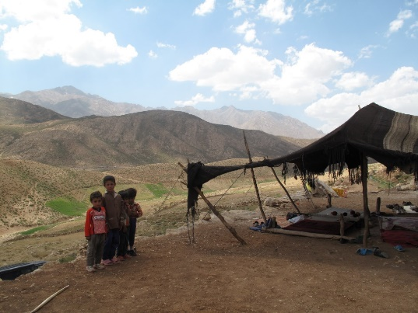
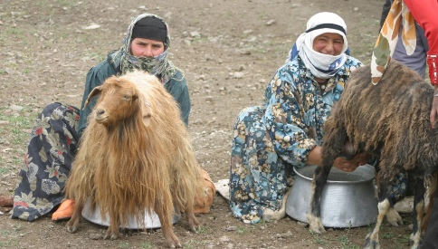
Key Messages
Recognition of the pastoralist's "Territories of Life“ and customary governance systems and, provision of the secure and sustainable right to land and its resources;
Establish binding strong supporting policies and resources to enhance the resilience and mobility features of pastoralists on environmental tensions and take immediate urgent actions to save the endangered livelihoods of pastoralists through relevant international policy platforms (the three Rio Conventions, UNDRIP, IYRP, Dana Declaration, and other international instruments);
Support and encourage pastoralists youth to take responsibility for preserving, sustainable use, and restoration of their territories and promoting their indigenous food systems

Slide 6
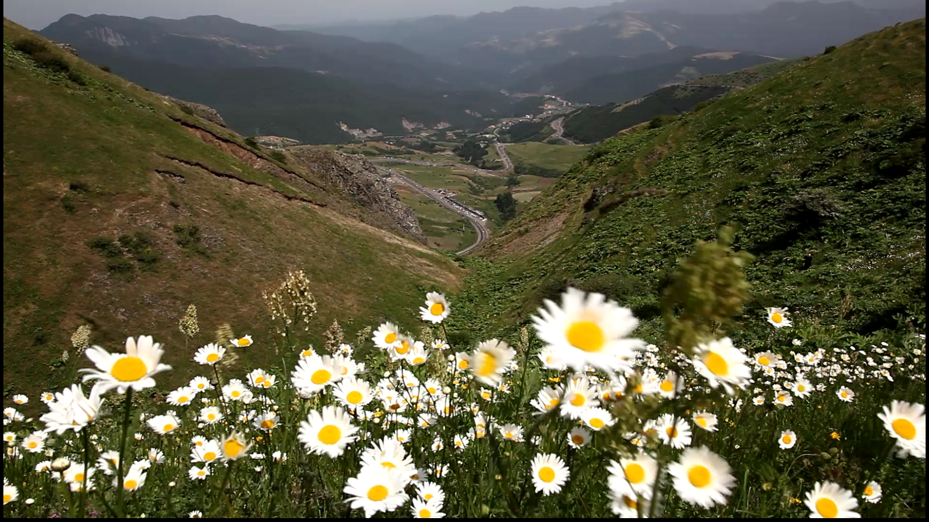
Nahid Naghizadeh, CENESTA, Iran
www.cenesta.org

