Slide 1
UN International Year of Rangelands & Pastoralists (IYRP) 2026
Overview of IYRP Working Groups
www.iyrp.info

Slide 2
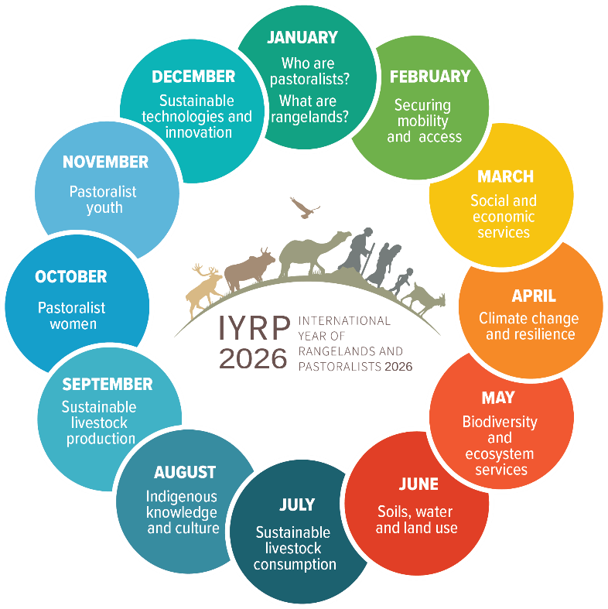
Outputs of the Working Groups will feed into the 12 themes that actors shall engage with during the IYRP (one theme per month).

Slide 3
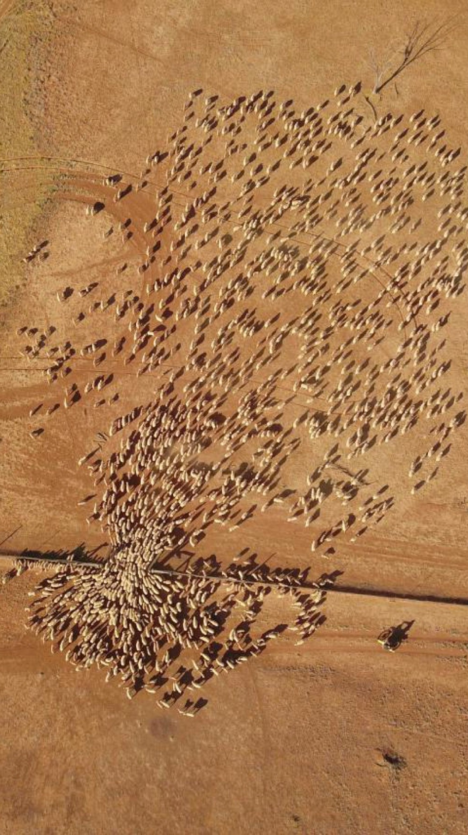
Working groups agreed to date
Afforestation in Rangelands
Mountain Pastoralism
Pastoralism & Gender
Pastoralism & Water
Rangelands & Land Degradation Neutrality
Rangelands & Biodiversity
Economics of Pastoralism
Pastoralist Youth
Pastoralist Land Tenure & Commons

Slide 4
What does the IYRP initiative seek to achieve through the Working Groups?
Greater awareness in science & society about how rangelands & pastoralists contribute to food security, economy, environment & cultural heritage
Resolutions taken by UN and other international entities in support of rangelands & pastoralists
Changes in national, regional & global policies in favour of sustainable management of rangeland resources by pastoralists & other stakeholders
Increase sustainable & ethical investment in rangelands & pastoralist livelihoods

Slide 5
Possible tasks of Working Groups (WGs) related to their respective themes:
Collate and analyse existing research results (science review)
Identify knowledge & information gaps – and new opportunities
Stimulate and engage in participatory research to fill gaps and explore opportunities
Analyse existing international policy related to the theme
Identify “targets” (international bodies, conventions, events etc.) for science- and experience-based advocacy
Strategise on right messages for these targets, including identification of spokespersons or “ambassadors” to bring them across
Engage with pastoralists and others in IYRP network (including other WGs) in disseminating these messages, also for public awareness

Slide 6
Group 1: Afforestation in Rangelands
Coordinators: David Briske (Texas A&M University, USA) and Susi Vetter (Rhodes University, South Africa)
Status: “Rangeland afforestation is not a natural climate solution” state-of-the-science evidence-based paper submitted for publication
Headline message: Rangelands are valuable ecosystems and afforestation efforts, driven by a climate change mitigation agenda, present a serious risk.
Group 2: Mountain Pastoralism
Coordinators: Igshaan Samuels (IYRP) and Eric Chavez (FAO)
Status: Policy brief on Sustainable Mountain Pastoralism under development

Slide 7
Group 3: Pastoralism & Gender
Coordinator: Nitya Ghotge (ANTHRA, India)
Status: WG has convened several times and recruited additional members
Activities:
Highlight the advantages of bringing a gender lens to pastoralist policy & development
Disseminate key information around gender & pastoralism and generate discussions on this topic with a view to raise/increase awareness
Identify gaps in research on gender & pastoralism
Support the other WGs in their efforts to incorporate a gender lens into their work
Make sure gender issues receive adequate attention in the IYRP 2026
Concept note posted on the IYRP website.

Slide 8
Group 4: Pastoralism & Water
Coordinators: Adrian Cullis, Michael Odhiambo & Kerstin Danert
Status: Launched after webinar on pastoralism & water held in June 2022 by RWSN (Rural Water Supply Network), CELEP (Coalition of European Lobbies for Eastern African Pastoralism), IWMI (International Water Management Institute), SIMVI Foundation & Skat Foundation
Focus on water governance as well as water-related ecosystem services and rangeland land & water management
A concept note is posted on the IYRP website.

Slide 9
Group 5: Rangelands & Land Degradation Neutrality (LDN)
Coordinators: Bora Masumbuko (IUCN) & Mounir Louhaichi (ICARDA)
Status: Science review “Global action for sustainable rangelands and pastoralism to achieve Land Degradation Neutrality” is under final editing.
Focus on the UN Convention to Combat Desertification (UNCCD) with two critical issues for raising awareness within the UNCCD process:
The value of rangelands and pastoralism
Conversion of rangelands
The WG will undertake research and analysis, conduct case studies and disseminate knowledge products in the form of policy briefs, animated videos, webinars etc.
A concept note is posted on the IYRP website.

Slide 10
Group 6: Rangelands & Biodiversity (under development)
Coordinators: Rashmi Singh & Matthew Luizza
Status: Concept note developed and to be shared with the network to stimulate the creation of a WG
Focus on “Biodiversity and Ecosystem Services”
Group 7: Economics of Pastoralism (under development)
Coordinator: Serena Ferrari (CIRAD, France)
Valuing pastoralism (contribution to GDP, imports & exports of pastoral products, etc.)
Competition at national level between pastoral products and industry-sourced products
Constraints that pastoralists face in marketing their products
Sustainable production & consumption

Slide 11
Group 8: Pastoralist Youth (under development)
Coordinator Caroline Ruto (Kansas State University)
Draft concept note has been developed and is under review with the WG
Group 9: Pastoralist Land Tenure & Commons (under development)
Coordinator/Facilitator: Natasha Maru (International Land Coalition)
Preliminary group meetings convened and a concept note for the group is under development.

Slide 12
Thank you

