Slide 1
IYRP initiative: where does it come from and where are we going?
Pastoralist Knowledge Hub Partners’ Meeting
8–10 December 2020
Notes:
1) Hello - My name is Barbara Hutchinson. I work at the University of Arizona in the United States and have been involved in the North American Rangelands Partnership since its beginning nearly 20 years ago. It is my pleasure to give this presentation on behalf of the International Year of Rangelands and Pastoralists (IYRP) Support Group. This group includes representatives of organizations and institutions from around the world who have strong interests in pastoralist and rangelands issues and who have worked for the past five years to gain a United Nations designation for an International Year of Rangelands and Pastoralists. In this presentation, I will focus on three topics: (1) the background on the history of the International Year initiative; (2) the current status of the initiative; and (3) how you can become involved.

Slide 2
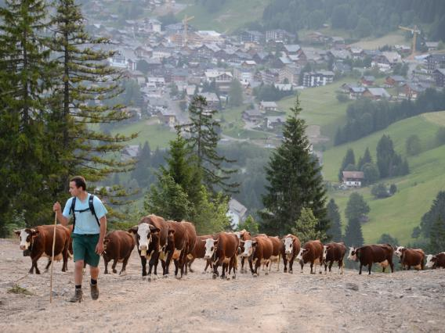
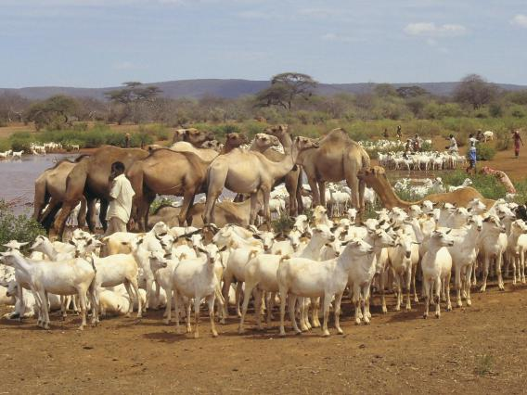
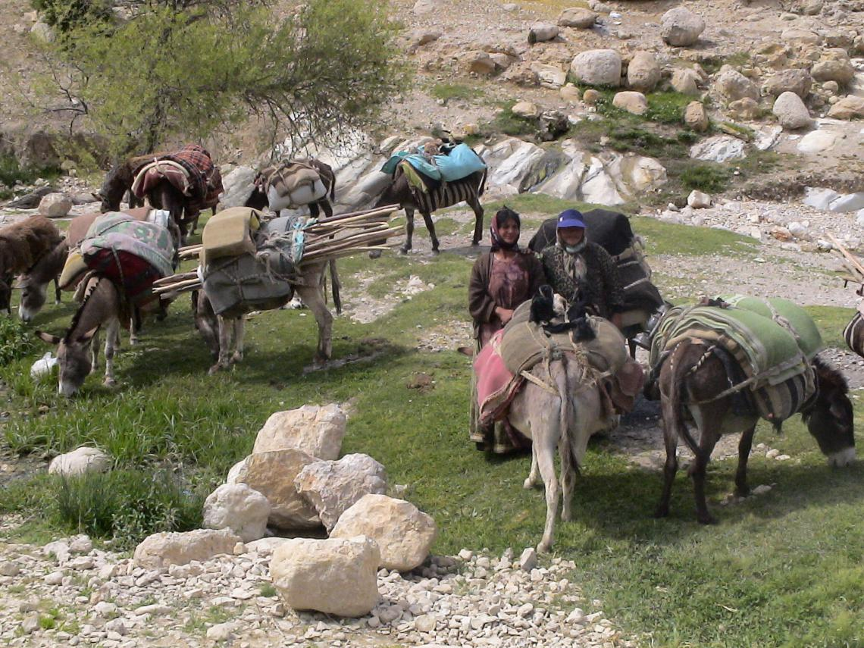
Why an IYRP?
To increase worldwide understanding of importance of rangelands & pastoralists for food security and environmental services
To inform decision-making at all levels, calling for enlightened policy to benefit current & future generations
To mobilize people worldwide to address today’s challenges and to grasp new opportunities in rangelands & pastoralism
To boost efforts for creating new knowledge and sharing experiences and practices related to rangelands & pastoralism
Photo: Veronique Magnin
Photo: Wolfgang Bayer
Photo: CENESTA
Source: IYRP Global Flyer Nov 2020
Photo: CENESTA
Notes:
2) As you see here, the reasons for an IYRP are numerous:
To increase worldwide understanding of importance of rangelands & pastoralists for food security and environmental services
To inform decision-making at all levels, calling for enlightened policy to benefit current & future generations
To mobilize people worldwide to address today’s challenges (such as climate change ad food insecurity) and to grasp new opportunities in rangelands & pastoralism
To boost efforts for creating new knowledge and sharing experiences and practices related to rangelands & pastoralism

Slide 3
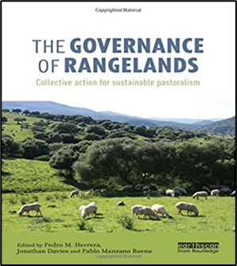
First Attempts & Joining Efforts
IRC/IGC 2008 Inner Mongolia, PRC: idea arose
IRC 2011 Argentina: Resolutions calling for IY of Rangelands and Global Rangelands Assessment
SRM and Rangeland Partnership 2015: reinvigorate efforts for IYRP
State of the World’s Rangelands working group
International Union for the Conservation of Nature (IUCN)
United Nations Environment Programme (UNEP)
Simultaneous effort by pastoralist groups for an International Year of Pastoralists
Notes:
3) However, the road for gaining support for the idea has been a long one. The first discussions for an International Year of Rangelands were held informally at the Eighth International Rangeland Congress (IRC) in 2008 and more formally at FAO afterwards. Then, at the Ninth IRC held in Rosario, Argentina in 2011 two related Resolutions were passed: a) the first calling for the UN General Assembly to launch an International Year of Rangelands, and b) the second requesting support for a Global Rangeland Assessment.
For various reasons these early attempts did not lead to further action and it was not until 2015 that the current effort began in earnest. ­­­­­­­­­­­­­­­­­­­­­Drawing on the successful example of the 2015 International Year of Soils, members of the Rangelands Partnership (RP) and the Society for Range Management (SRM) in the United States began exploring how such an International Year could be achieved. At the same time, members of the IUCN and UNEP were cultivating a group of like-minded people to begin working on an overview of the “state of the world’s rangelands”. This group quickly expanded and several critical discussions and actions took place as a result.
Members of the group with strong pastoralist ties discovered there was also a movement for pursuing an International Year of Pastoralists. While there were differing opinions among the groups about what were the most important intersections of land and people issues, in the end, there was agreement that significant commonalities existed. Thus, the International Year of Rangelands and Pastoralists (IYRP) was born!

Slide 4
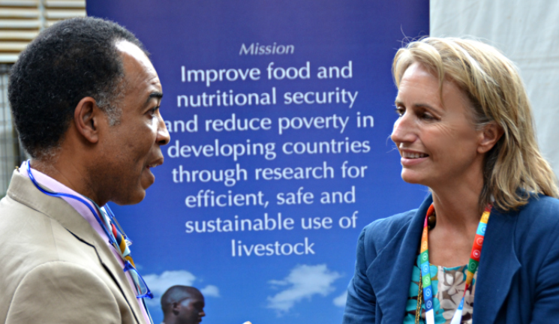
First action and early results
United Nations Environment Assembly (UNEA-2, Nairobi, 2016)
Side Event on pastoralists & pastoralist issues
Discussion of rangelands issues related to SDGs
Mongolia, Kenya, Ethiopia and Sudan presented resolution:
“Combating Desertification, Land Degradation and Drought, and Promoting Pastoralism and Rangelands” (26 May 2016)
Agreed to: “raising awareness”; “strengthening science–policy interface”; and called for a “worldwide gap analysis”
IRC 2016 Canada: Agreement on action plan to promote IYRP and form “International Steering Group” (ISG)
IYRP website: https://globalrangelands.org/international-year-rangelands-and-pastoralists-initiative
Notes:
4) In 2016, attention turned to the United Nations Environment Assembly where countries were debating how to implement the Sustainable Development Goals (SDG). At the meeting several countries worked on a last-minute Resolution that was ultimately approved in May 2016. Titled: “Combating desertification, land degradation, and drought and promoting pastoralism and rangelands”, the resolution was passed by more than 100 countries. While it did not include language for an IYRP, the resolution did call for:
raising “global awareness of sustainable pastoralism and rangelands”; strengthening “the science-policy interface” and conducting a worldwide gap analysis on pastoralist and rangelands issues.
To begin implementing the UNEA-2 resolution, a meeting was later held at the 2016 International Rangeland Congress. More than 50 representatives from around the world committed to an action plan of next steps in the International Year process.
By early 2017, a more formal “steering committee” had been organized including a secretariat that established a website for the effort. Now the IYRP “archive”, the website includes background documents, outreach materials, and meeting minutes among other related resources.

Slide 5
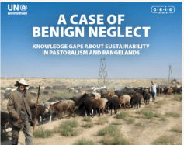
Further actions & dashed hopes
IYRP Steering Committee outreach efforts (2016–18)
Side Event, Convention on Biological Diversity (Cancun, Mexico)
Numerous resolutions by various groups around the world
UNEP funds a Gap Analysis (Johnsen et al. 2018)
Calls for global engagement to address complex issues of pastoralism & rangelands
Effort to go directly to the UNGA (2018) with a Kenyan Government resolution is unsuccessful
Need to work through FAO / UN approval processes
Notes:
5) Between the years 2016 to 2018, the Steering Committee promoted the International Year in multiple fora. For example, in December 2016, a side event was held at the Convention on Biological Diversity in Cancun, Mexico. At the meeting, the importance of sustainable pastoralism and healthy rangelands for biodiversity conservation was captured in a formal statement.
Also during this period, the Gap Analysis was compiled. It indicated a lack of understanding of the critical issues in pastoralism and rangelands management and recommended a globally coordinated assessment. It also highlighted the lack of balanced, integrated approaches to understanding the complex social, economic, environmental and political facets of rangelands and pastoralism.
At the same time, the Steering Committee was also exploring options for gaining UN approval. By the end of 2018, it became clear that such a proposal would need to first be presented and approved by FAO and that there were numerous steps to be taken in this process.

Slide 6
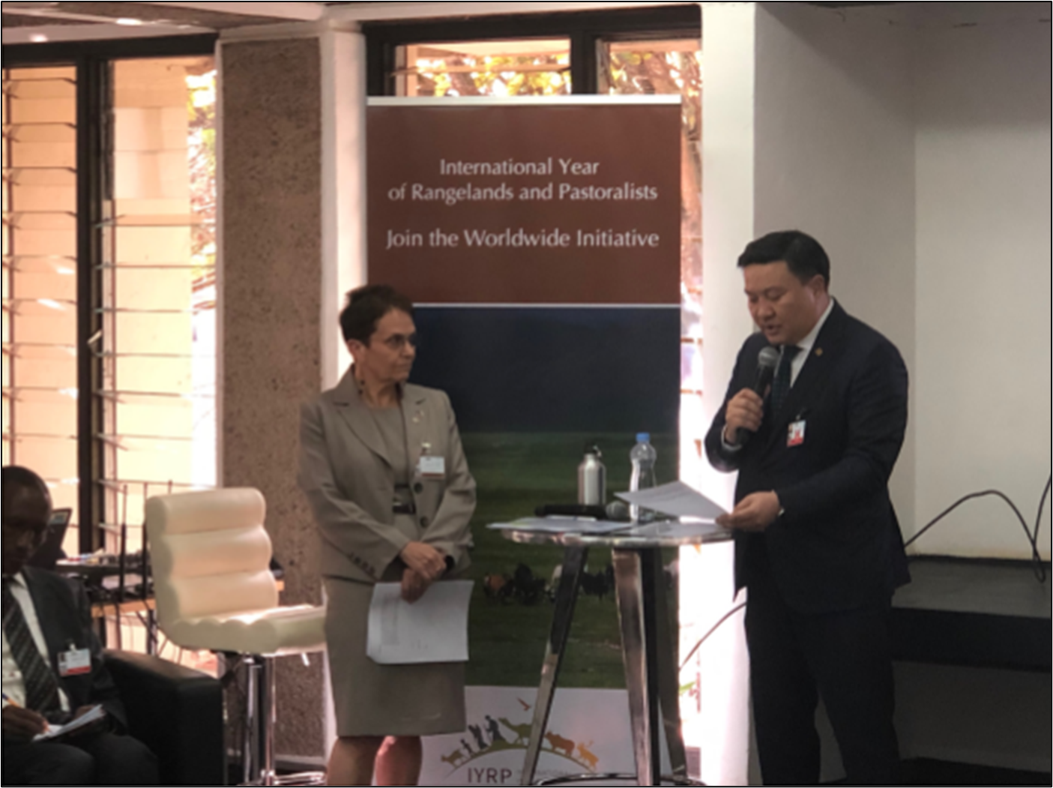
UNEA-4 2019
Ministerial Breakfast held with support from ILRI and UNEP
Africa Group follows resolution calls for recognition and support of sustainable rangelands and pastoralism
Acknowledged findings of Gap Analysis
Called for regional assessments
Recognized IYRP effort
Aug 2019: Mongolian Government proposed IYRP to UN; ISG became “International Support Group” to Mongolian team
Photo: ILRI/Sarah Kasyoka
Notes:
6) To this end, at the UNEA-4 meeting in March 2019, a "Ministerial Breakfast" event was held with significant support from international agencies. This resulted in the adoption of a resolution that, for the first time, explicitly called for recognition and support of sustainable rangelands and pastoralism. It acknowledged the findings of the Gap Analysis and recommended countries to carry out regional assessments. In addition, it recognized the “ongoing global efforts to introduce a proposal for an International Year of Rangelands and Pastoralism to FAO’s Committee on Agriculture”.
A key result of the Ministerial Breakfast was the commitment of the Minister of Environment from the Government of Mongolia to obtaining inter-ministerial support for Mongolia to take the lead on an International Year proposal to FAO. In July 2019, the Ministry for Food, Agriculture and Light Industries in Mongolia presented its formal intention to FAO and by October 2019 a full proposal for the IYRP had been submitted to COAG. By early 2020, letters of support from 4 countries and 29 non-governmental organizations had also been submitted. To provide ongoing leadership to the process, a National Working Group was established in Mongolia, and the IYRP Steering Committee then changed its name and nature to the IYRP Support Group.

Slide 7
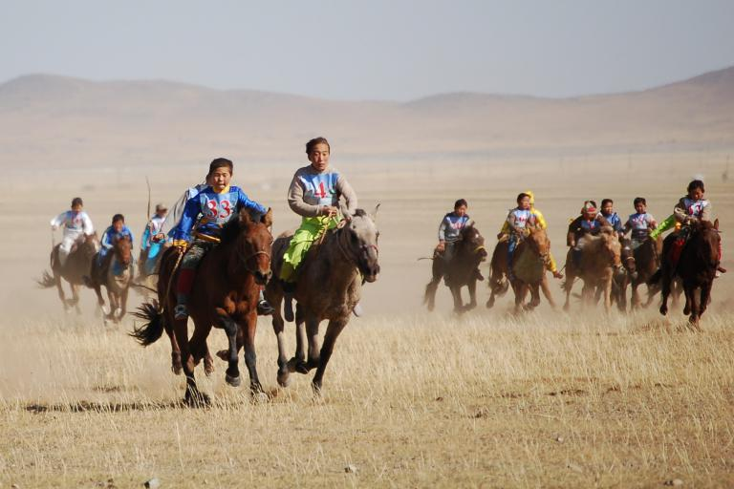
Process for approval as United Nations International Year
Photo: Marc Foggin
Oct 2020: FAO Committee on Agriculture (COAG) endorsed Mongolian Government’s proposal for IYRP in 2026
Proposal supported by over 150 organisations and over 50 national governments
Next hurdles in UN process: - FAO Council Dec 2020 - FAO Conference June 2021 - United Nations General Assembly (UNGA) Sept 2021
Notes:
7) Prior to the current pandemic, it was expected that the final proposal and letters of support would be presented “in person” to FAO’s Committee on Agriculture for discussion in October 2020, and that a side event and displays would need to be organized for the meeting. However, when the meeting was moved to a virtual environment, the Mongolian officials and members of the ISG quickly developed an electronic outreach plan which I will discuss in more detail in the next slide. We believe these efforts greatly helped gain the successful endorsement of COAG for the proposal for an IYRP in 2026. In the end, more than 150 organizations and more than 50 national governments expressed their approval of the proposal. As you see on this slide, the next hurdles include further reviews at FAO and, if successful, a final vote at the next UN General Assembly meeting in September 2021.

Slide 8
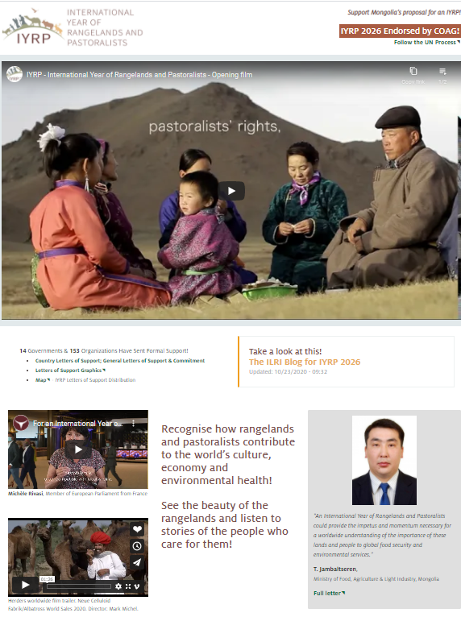
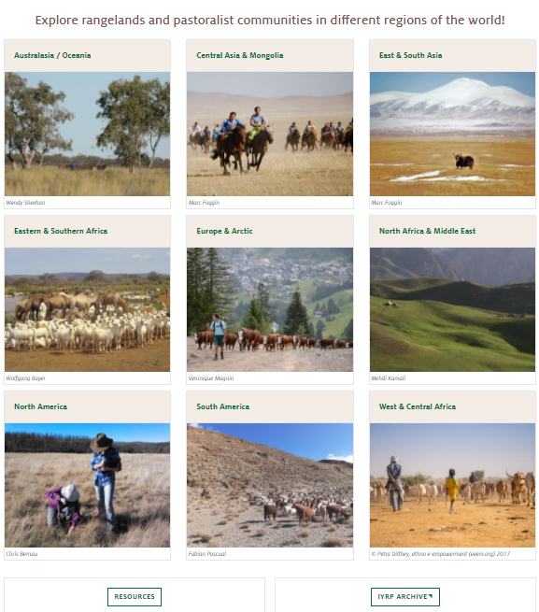
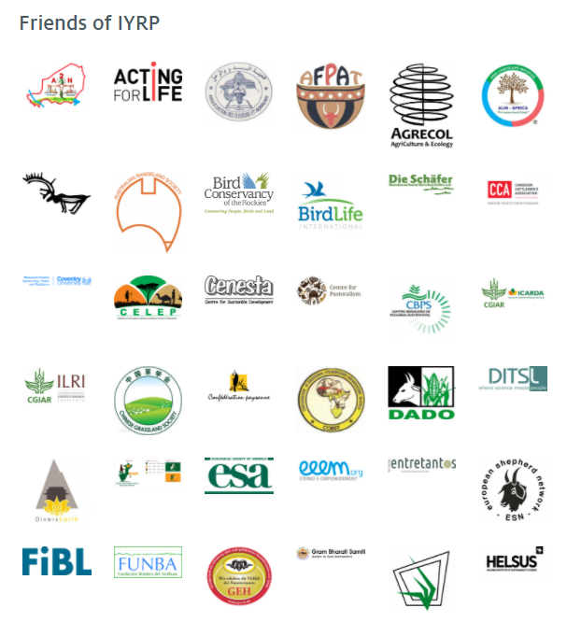
IYRP “Online Booth” (www.IYRP.info)
Notes:
8) A key component of the outreach program leading up to COAG was the development and launch of the “promotional” website you see on this slide. This was a monumental effort that was put together in less than a month. It involved the creation of original documentary videos as well as collecting videos and photos from all over the world to represent pastoralist groups and rangelands everywhere. As you see, there are nine regional groupings on the home page and behind each are videos of the “voices” of pastoralist peoples as well as more general featured videos. In addition, on each page is a rotating list of logos from the organizations who have supported the effort up to now. At the same time as the launch of the website, a targeted social media campaign was also organized and implemented by Engin Yilmaz at Yolda. This largely involved the use of twitter messages directed at the COAG Ambassadors and it was clearly highly successful. We hope you will want to explore the website and consider supporting this ongoing effort by submitting your own organizational videos or photos as well as logos!

Slide 9
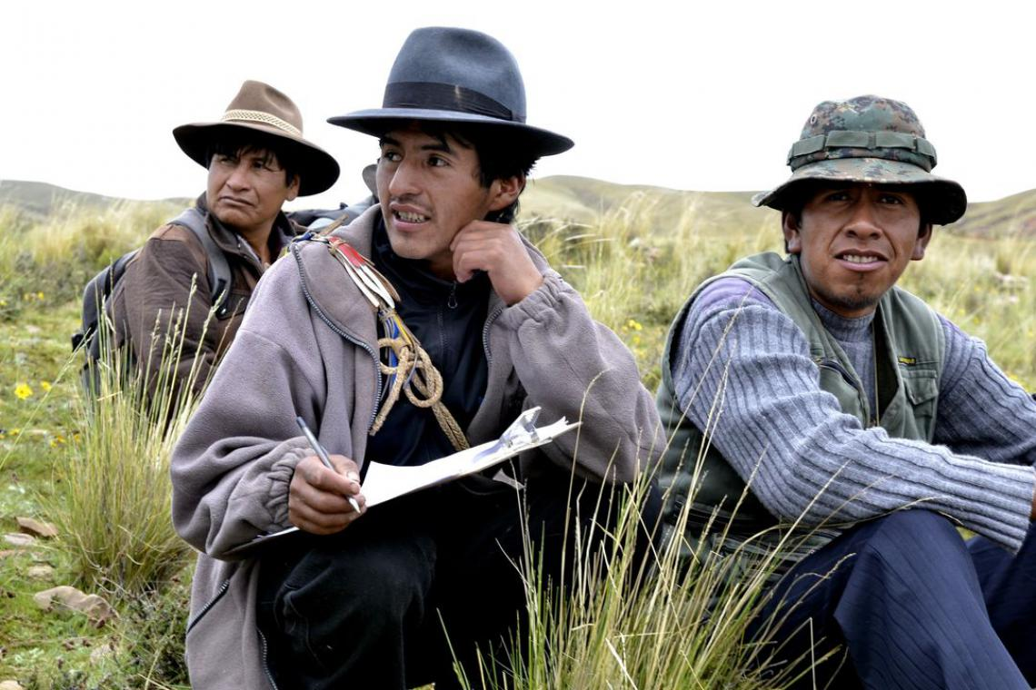
ISG Organizing Regional IYRP Support Groups (RISGs)
ISG Structure
Coalition of partners open to all interested who are committed to who are committed to spreading awareness about the IYRP and filling knowledge gaps on rangelands and pastoralists
Multi-stakeholder RISGs being created to generate more support and partnership:
expand network of supporting organizations and governments in 10 regions of the world
work with Government of Mongolia and ISG to plan and implement IYRP activities in these regions
Central role for pastoralist organizations in these activities
Photo: J.Dillan/MercyCorps
Notes:
9) Before moving on, I would like to provide a few more details about the ISG. This is a group of volunteers from a variety of organizations including international and regional affiliations, NGOs, and academia. There is no membership fee, only a commitment to spreading awareness about IYRP and filling knowledge gaps on rangelands and pastoralists. Basically, anyone can join as long as they commit to being proactive.
The ISG is now taking steps to organize regional Support Groups to generate more support and opportunities for partnership. As with the ISG, the Regional Support Groups consist of multiple stakeholders including representatives from international organizations and UN agencies; academic and research organizations; large and small NGOs; professional associations; and, of course, pastoralist associations. The membership spans a wide and integrated set of sectors including environmental, social, economic, & political interests. At this time, there are 10 regional groupings in the process of holding their first meetings. Their preliminary charge is to raise awareness and increase knowledge about rangelands & pastoralists before and during the IYRP.

Slide 10
Immediate action = Self-organization of RISGs
East Asia
South Asia
Central Asia & Mongolia
Australasia
North Africa & Middle East
Eastern & Southern Africa
West & Central Africa
Europe & Arctic
North America
Latin America & Caribbean
Selection of Chair of RISG
Selection of RISG representative to ISG
Selection of RISG representative to global Communications Team
Confirmation of geographical composition of RISG
Notes:
10) Here you see the current Regional groupings and the immediate actions to be taken. A Regional Group can decide to split into smaller groups if there are enough members and if language or other factors require it. For example, Europe and the Arctic or North Africa and the Middle East may decide to group separately. If Mexico wishes to be in both the North American and South American RISGs, then it will appoint a representative to both RISGs.

Slide 11
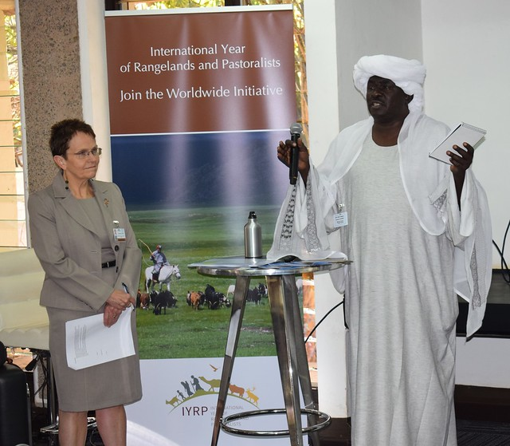
Priority action: ISG and RISGs generate more support for IYRP
Convince governments in home countries/ regions to support the IYRP:
Approach Ministries of Agriculture (in time for FAO Conference) and Foreign Affairs (in time for UNGA)
Generate and share IYRP flyers
Invite governments to co-sponsor Mongolian Government resolution
letters of support
Photo: ILRI/Sarah Kasyoka
Raise attention at international meetings (e.g. side events, ministerial meetings) and insert IYRP into official resolutions
Further populate “online booth” (www.iyrp.info) and launch well-targeted social media campaigns
Notes:
11) Co-sponsorship” of a resolution at the United Nations means that one or more countries agree to submit the proposal along with the lead country (in our case, Mongolia). It also means that these countries will be willing to commit some financing for the process (e.g. funds for side events, briefing meetings for Ambassadors prior to a decision, promotional publications, etc.). To this end, gaining letters of support from governmental agencies and NGOs is a high priority, as well as bringing the effort to the attention of others through relevant meetings. And, as mentioned before, we hope the RISG members will continue to help populate the “online booth” and conduct their own social media campaigns.

Slide 12
Countries that supported IYRP at COAG
East Asia:
China
South Korea
West & Central Africa: Burkina Faso, Mali
Australasia: Australia
Central Asia & Mongolia: Kyrgyzstan, Mongolia
North Africa & Middle East: Egypt, Iran, Jordan, Saudi Arabia
Latin America & Caribbean: Argentina, Cuba, Dominican Republic, Peru
Europe & Arctic: European Union (27 countries), with also individual country support from Finland, Hungary, Italy, Serbia*, Spain and Turkey*
(*not part of EU)
South & Southeast Asia: Afghanistan, Myanmar, Philippines, Thailand
Eastern & Southern Africa: Ethiopia, Kenya, Sudan
North America: Canada, Mexico
Notes:
12) This slide shows the countries who have expressed some type of support for the IYRP during COAG. We are hoping the Regional Committees will be able to gain concrete letters of support from more of these governments prior to the UN General Assembly meeting.

Slide 13
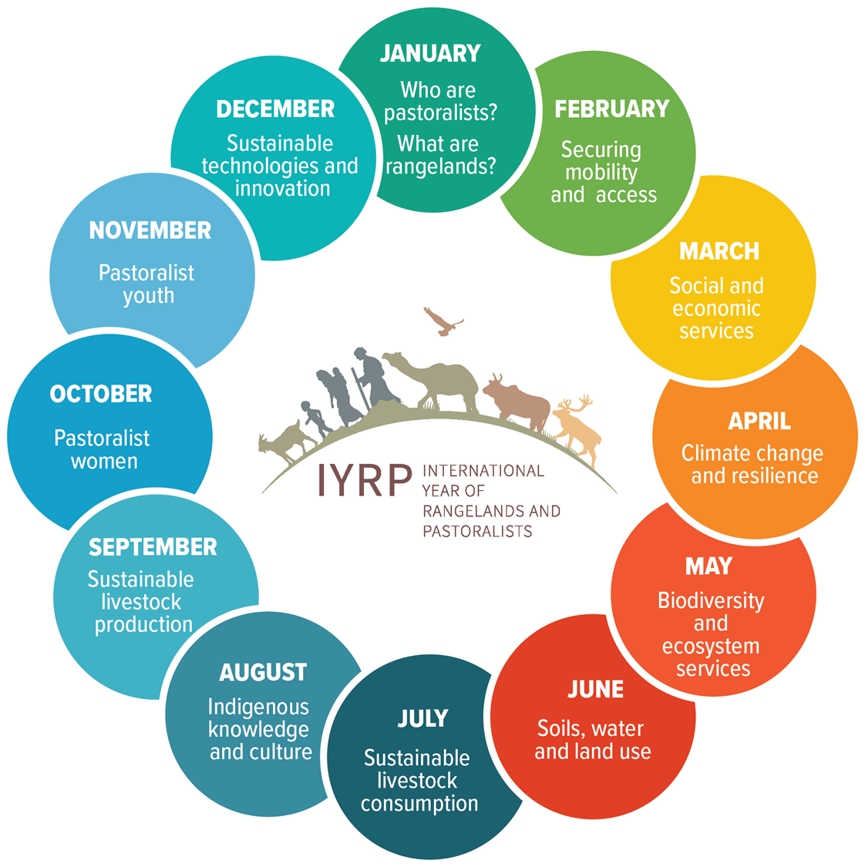
Priority action: Prepare monthly themes in each region
Expanding awareness of complexity & diversity of rangelands & pastoralism
Revealing new insights
Highlighting priority issues of pastoralists
Balancing coverage of environmental, social, economic & policy issues
…to be refined and finalized together with RISGs
Notes:
13) Often partners want to know what priority issues will be included under the IYRP banner. A document specifying “12 monthly themes” was put together in an attempt to find a global common ground. This now will be adapted to the specific interests and languages of each region. Regional Groups may also consider how to engage regional, national, and local groups to plan and conduct activities prior to and during the IYRP around these themes. This might include expos, awards, fairs, educational materials, national awareness days, social media campaigns and video documentaries. Through the efforts of the ISG and Regional Groups, it is hoped that international organizations and other global partners will also consider “hosting” a theme throughout the IYRP and implementing a variety of outreach and awareness raising activities.

Slide 14
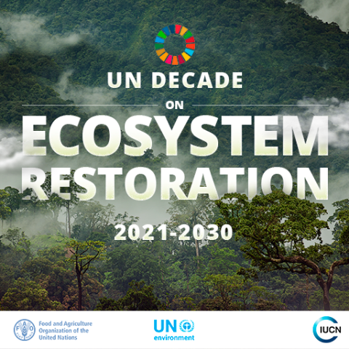
Other potential actions:
Generate support among non-governmental partners
Recognize common interests & combine efforts of rangelands & pastoralism communities of science & practice
Use personal and professional networks
Find supporting partner organizations involved with:
Sustainable Development Goals (SDGs) by 2030
UN Decade of Family Farming (2019–28)
UN Decade on Ecosystem Restoration (2021–30)
Notes:
14) Other potential actions for the Regional Groups include generating additional support among NGOs. Currently, 153 partner organizations provided letters of support and/or logos for the website. We are hoping the Regional Groups will help greatly expand this network. By combining efforts and reaching out to our local networks, we feel we will gain even broader support. At the same time, FAO COAG acknowledged importance of IYRP initiative for the SDGs, UN Decade of Family Farming and UN Decade on Ecosystem Restoration. The hope is to link up with the partner organizations supporting these complementary efforts.

Slide 15
Important contacts Please Consider Joining this Effort
ISG Chair = Jim O’Rourke (jorourke@csc.edu)
ISG Vice Chair = Maryam Niamir-Fuller (mniafull2@gmail.com)
ISG Communications Team =
Barbara Hutchinson (barbaraH@cals.arizona.edu)
Ann Waters-Bayer (waters-bayer@web.de)
Engin Yilmaz (engin@bican.net)
IYRP archives =
https://globalrangelands.org/international-year-rangelands-and-pastoralists-initiative
IYRP online booth = www.iyrp.info
Notes:
15) Thank you for your time and attention. If you have questions or suggestions about IYRP activities or plans, or if you would be interested in joining a Regional Group, please feel free to contact me or any of the other contact persons at the email addresses listed here. And, finally, a very special thank you to the PKH for providing this opportunity to share our progress in supporting the Government of Mongolia’s IYRP proposal!

