Slide 1
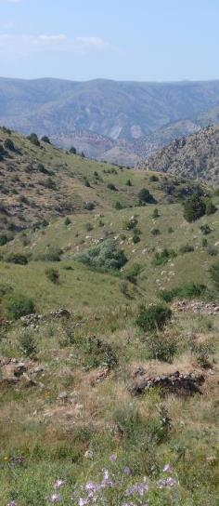
Global Grasslands & Savannahs Dialogue Platform Spotlight: North America
23 January, 2024

Slide 2
Agenda
Opening and welcome
Updates and Announcements: COP reflections, publications, etc
Central Grasslands Roadmap: Christian Artuso, Environment Canada
Great Plains Plowprint Report 2023: Dr. Patrick Lendrum, WWF-US
Grazing the Malpaís: Bildo Saravia, CEO, Rancho El Ojo and Founding Partner, Internacional Ganadera

Slide 3
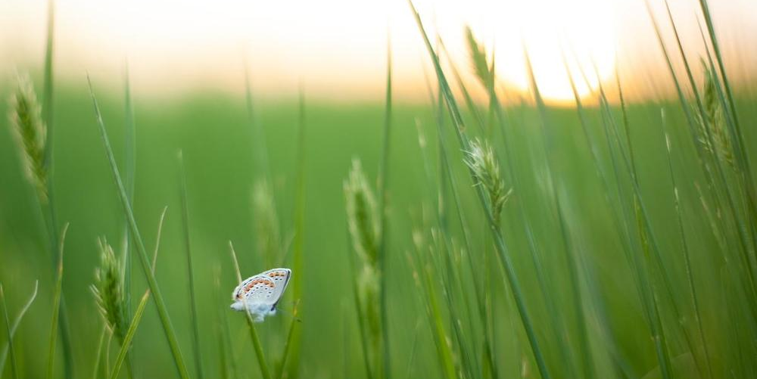
NEW PUBLICATIONS Integrating Grasslands and Savannahs into National Biodiversity and Climate Commitments Plantlife, WWF, Equilibrium Research Valuing Grasslands: Critical Ecosystems for Nature, Climate and People Grasslands, Rangelands, Savannahs and Shrublands (GRaSS) Alliance
Food Practice - March 2022
© Sarah Black / WWF

