Slide 1
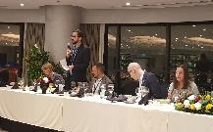
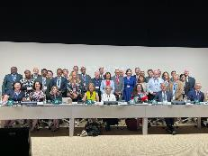
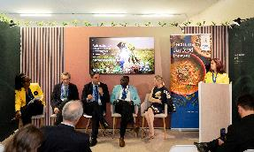
Agriculture and Food Systems at CoP28
Negotiations
Sharm el-Sheikh Joint Work on Agriculture: Negotiations with no results, decision postpone to June.
Global Stocktake: Food Systems strong in the adaptation section, but no consensus on food systems as global approach
Presidency Program
COP 28UAE Declaration on Sustainable Agriculture, resilient food systems and climate action (signed by 162 Member states)
Non-State Actors
Non State Actor call to Action (signed by over 200 organisations)
Dinner with negotiator
Ministerial roundtable
Successful strengthening NDC for Food Systems and national implementation:
Launch of NDC Guidance for food systems / Food Forward NDCS
Joint report with UAE COP 28, CGIAR and FAO COP 28 Agriculture, Food & Climate National Action Toolkit
New final financial commitments for Agriculture and Food Systems 25 bn US$
Side Events

Slide 2
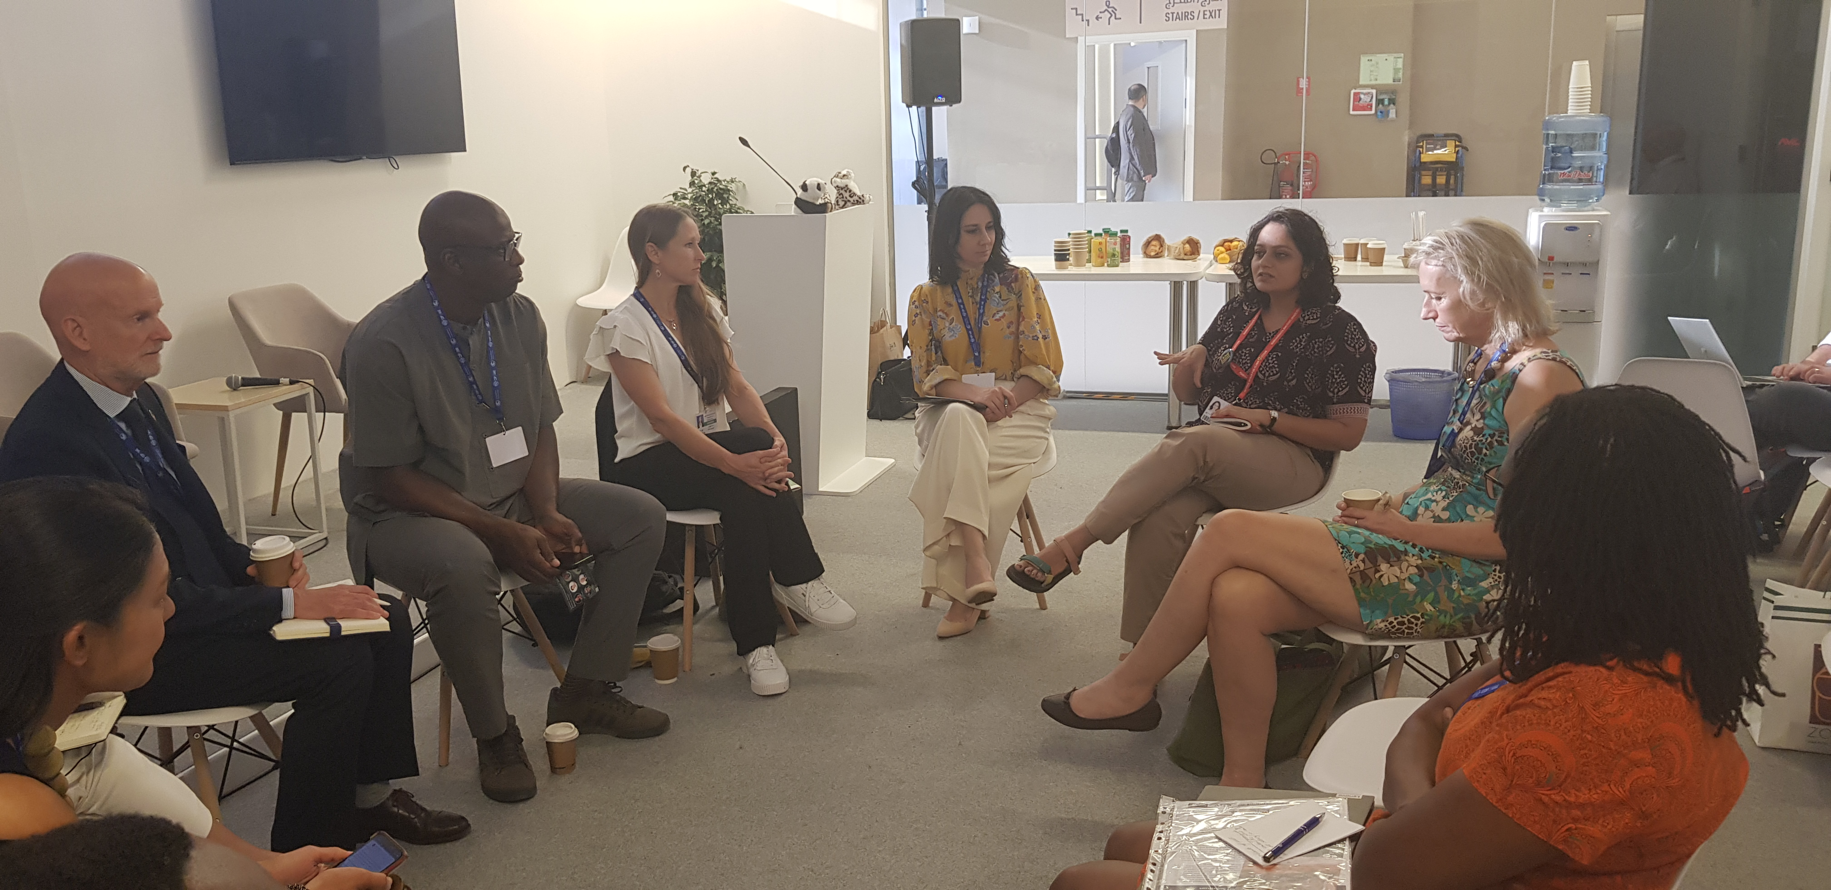
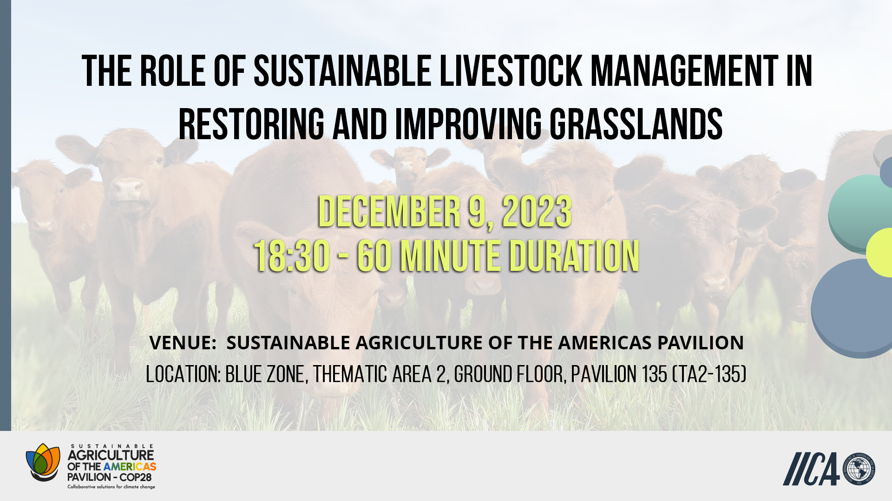
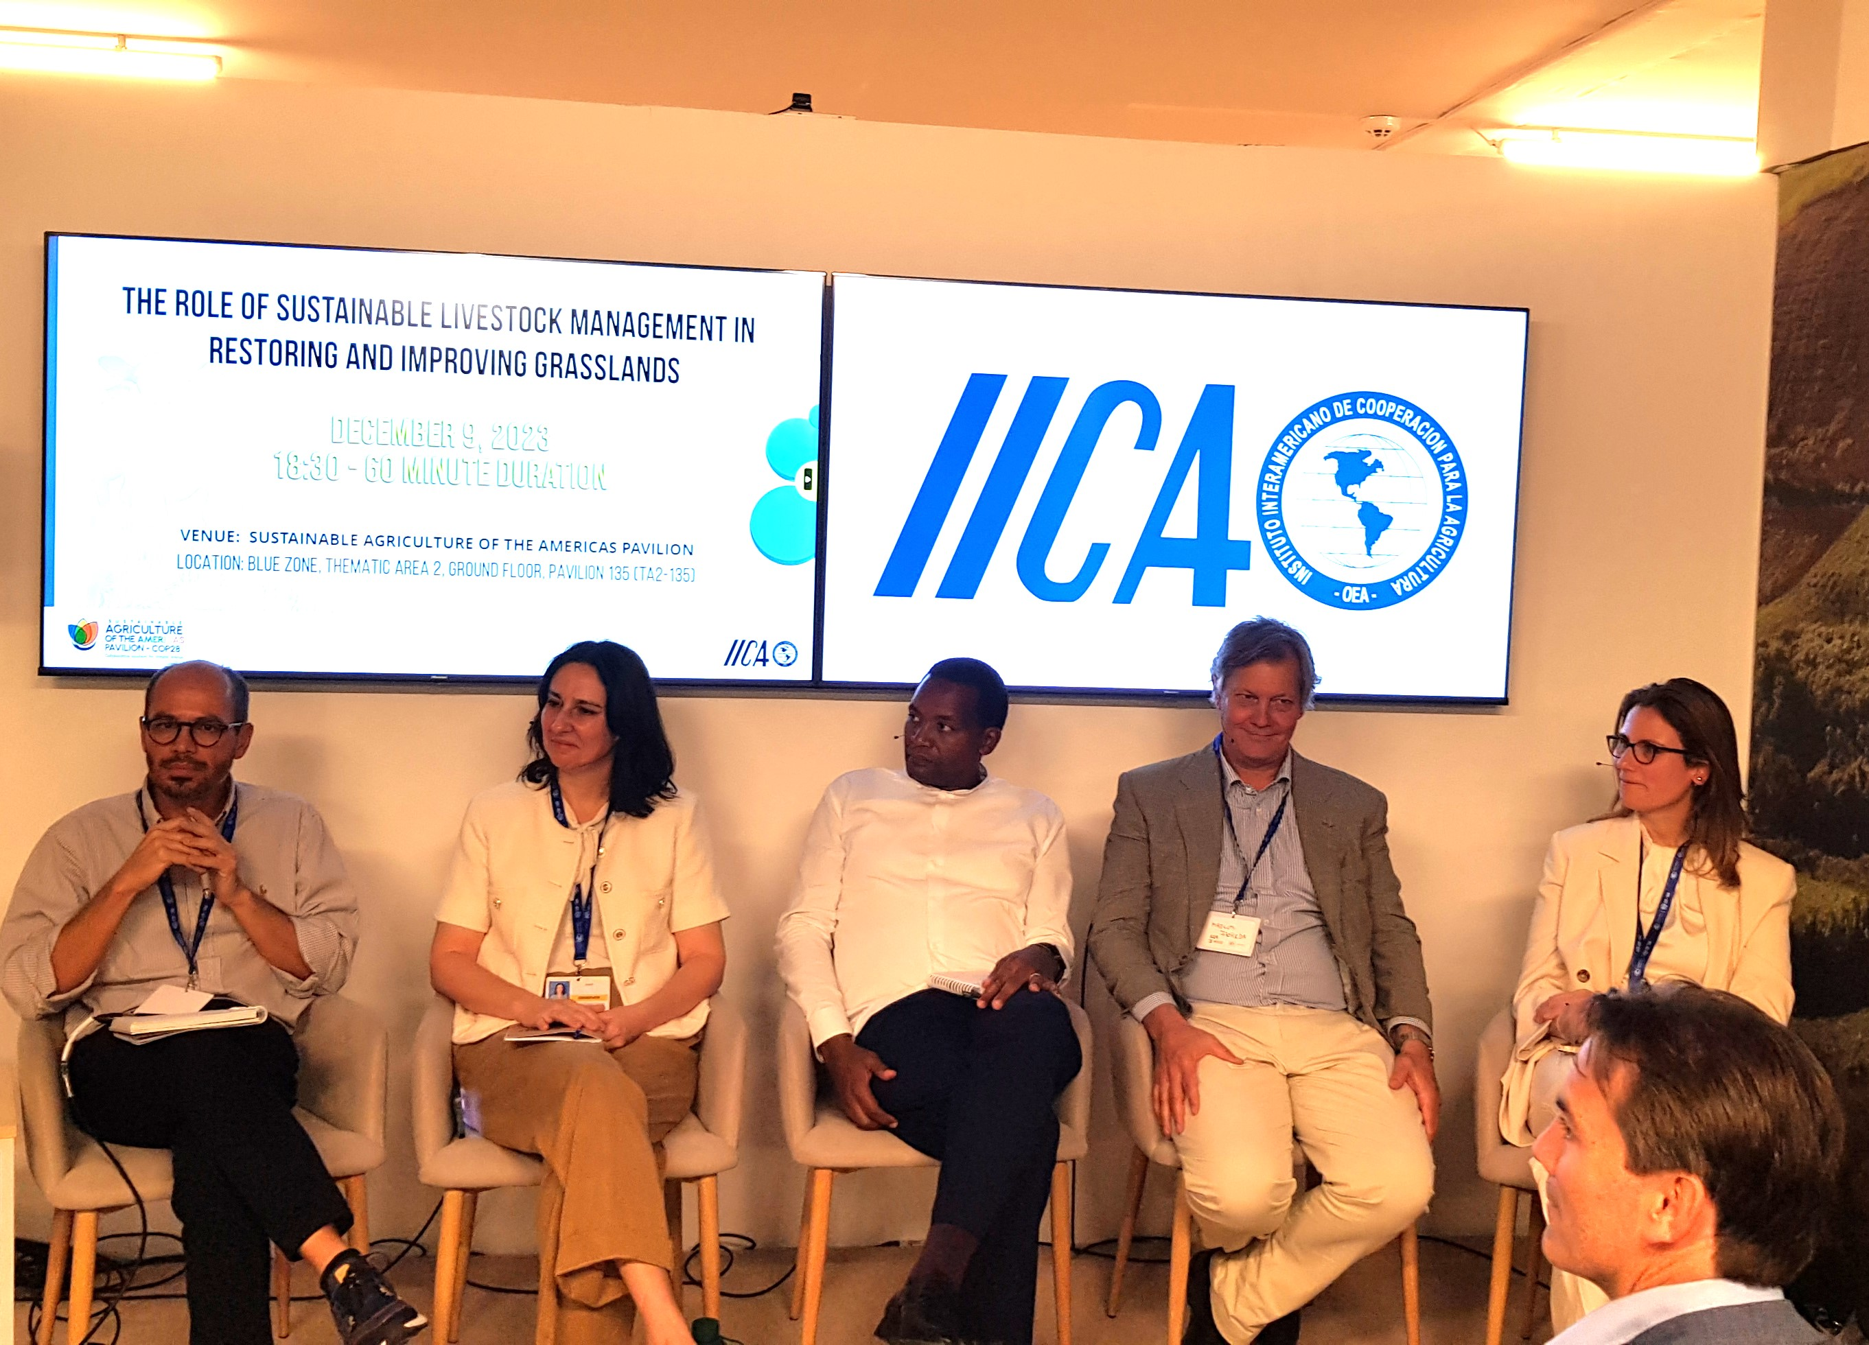
Grasslands & Savannahs at COP 28
Breakfast Event: Grasslands & Savannahs: An integral climate solution
Side-Events with linkage to grasslands and livestock
Publication calling to integrate “Grassland and Savannahs into national biodiversity and climate commitments”
NDC Guidance Tool for Agriculture and Food Systems with concrete policy measures (“Implementing improved management practices of grasslands”)

Slide 3
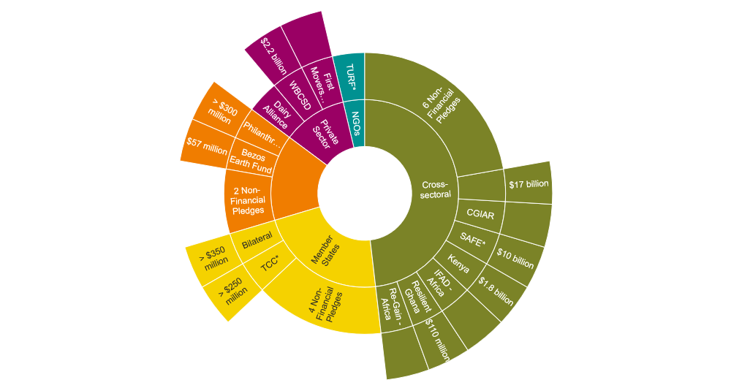
Financial Commitments for Agriculture and Food Systems of about 25 Bn US$
17 Commitments without concrete financial promises
18 Commitments with financial promises
*TCC: National Food Systems Technical Cooperation Collaborative
*SAFE: Scale-up Agriculture and Food systems for Economic development in Africa and the Middle East
*TURF: Transforming Urban-Rural Food Systems
* WWF assessment, 2024

