Slide 1
Introducing the Rangelands Gateway
Virtual Range Livestock Workshop
March 10, 2021
Notes:
Thank you for the opportunity to introduce to you a new web portal from the Rangelands Partnership that has been two years in the making. Besides a tour of this new website, I will also give a little background on the Partnership and its history.

Slide 2
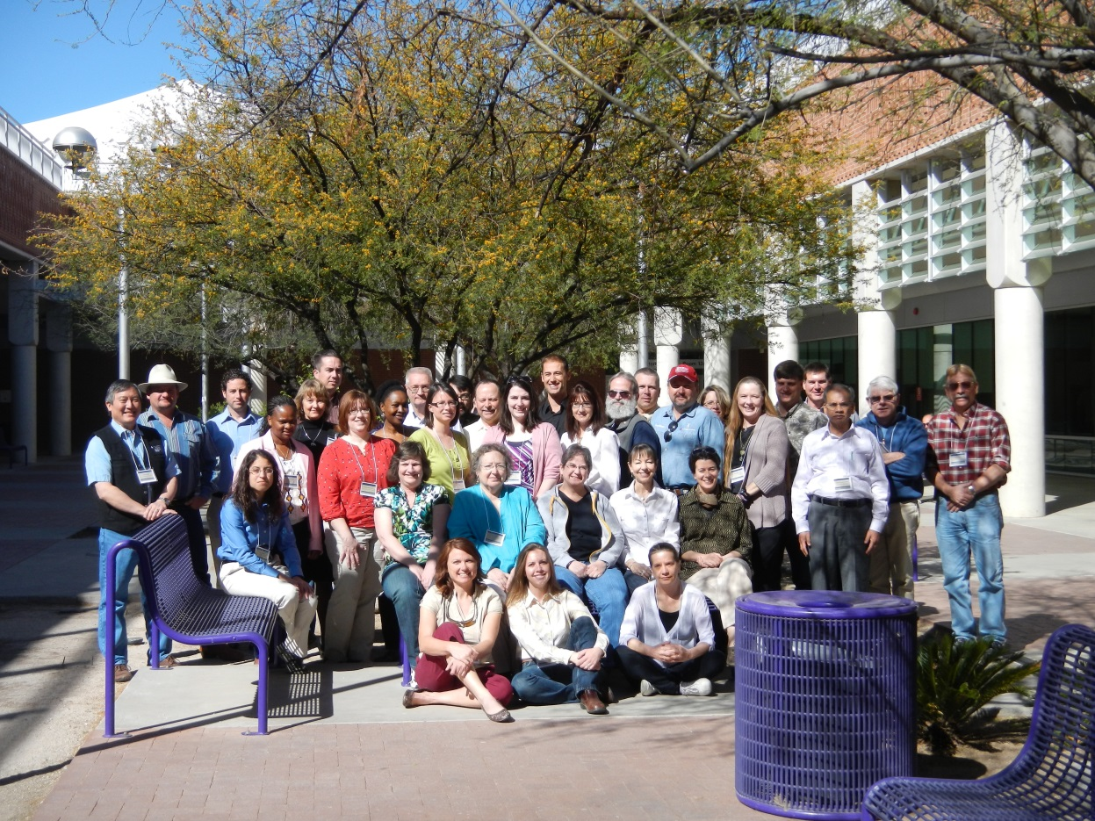
Members from 19 Western Land Grant Universities
Notes:
Slide Two: Began in 1995 as University of Arizona Library project partnering with the National Agriculture Library initiative and the Rangelands program at the UA that ended up developing the first Managing Rangelands website - at the beginning of the WWW.
After about five years of successfully building the site and gaining competitive grants, we invited other western Land Grant Universities (LGUs) to join in what was first called the ”Western Rangelands Partnership” largely because the issues surrounding rangelands do not stop at political boundaries and we recognized we needed help if we were to cover them all. With the support of many people and taking both a top down and bottom up approach, the first meeting was held successfully in Tucson in 2002 and for ten years after until other institutions started hosting the meeting – something we hope to start again in 2022 at Colorado State.
Some of the Partnership’s unique features: largely a collaboration of range extension specialists and librarians/technologists; essentially volunteers who believe we can accomplish more working together. However, the Partnership has evolved also into more of a Community of Practice with a focus on networking and professional development. In addition, members have become involved in a level of international engagement especially around the effort to gain an International Year of Rangelands and Pastoralists.

Slide 3
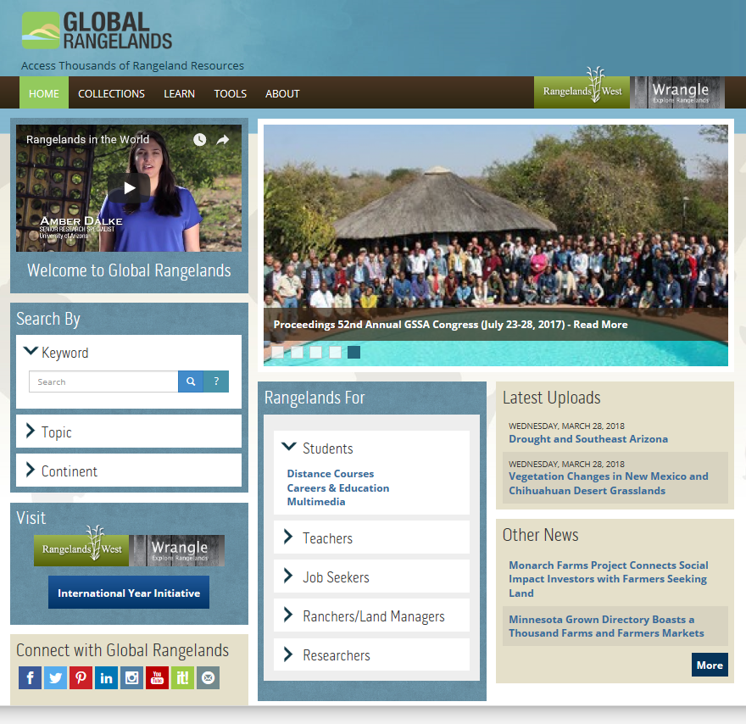
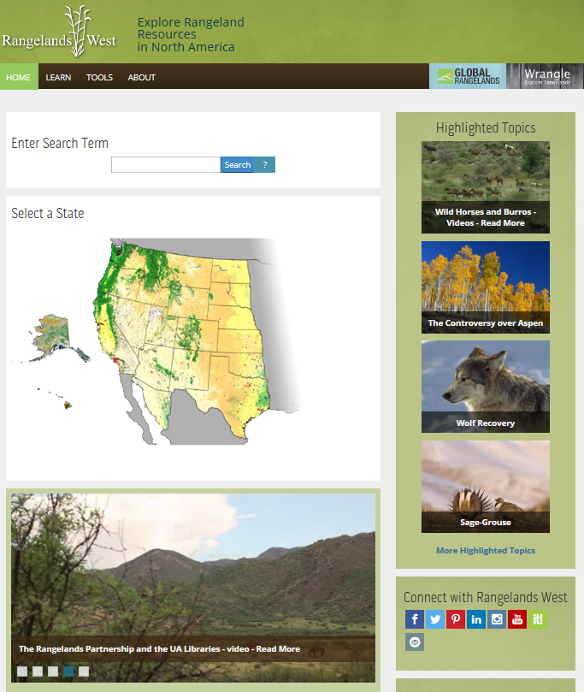
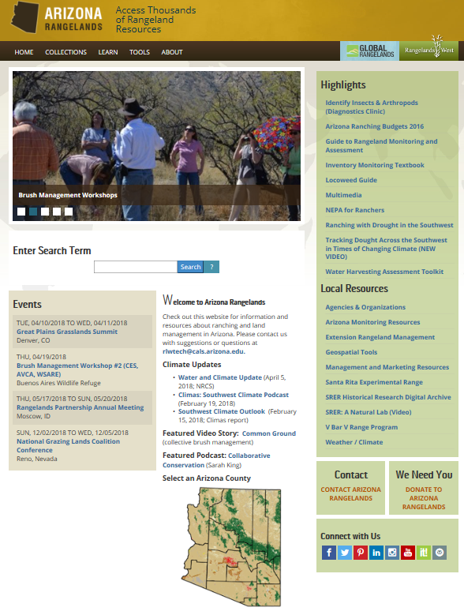
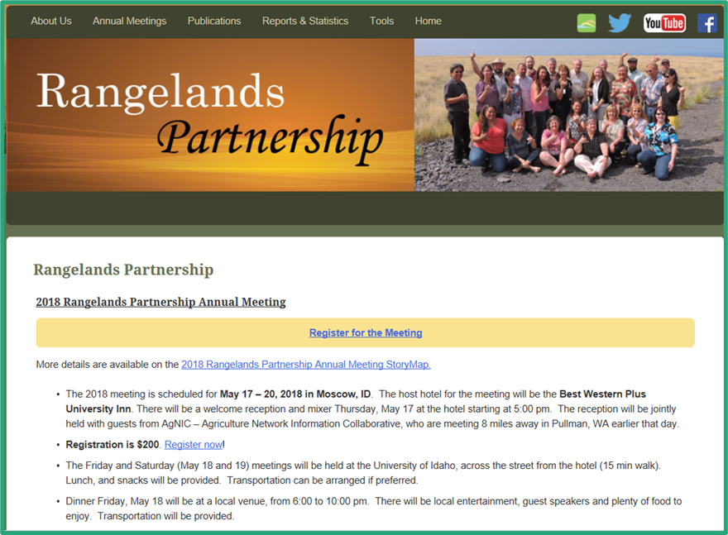
The Previous Rangelands Partnership Web Portals:
Global, Rangelands West, State and Member Sites
Notes:
Slide Three: The RG combines four levels of websites as they evolved during the first 15+ years of the Rangelands Partnership: Global Rangelands, Rangelands West, and state specific rangelands websites, as well as a Member Site managed by the University of Wyoming for organizational materials. This system became unwieldy and was not as user-friendly as we had hoped so we began an intensive redesign process that went through many stages with our IT unit as well as gaining feedback from stakeholders at various points.

Slide 4
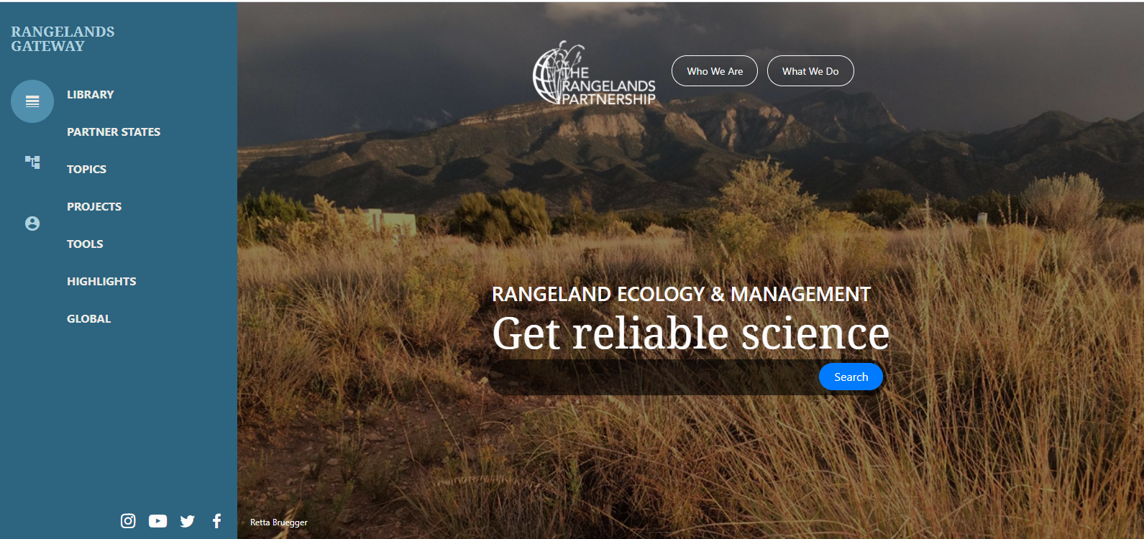
Launching March 2021
https://rangelandsgateway.org/
Database with more than 25,000 resources from 11 collections
Notes:
Slide Four: Note the homepage and navigation panel on the left that stays visible no matter where you are in the website; you can scroll down through all the major sections or navigate by clicking on the topics in the navigation panel.
Search capability: the main action you can take on the homepage is to search the database of more than 25,000 resources including collections emanating from JRM, Rangelands (SRM), Rangelands West, RSIS, Australian Rangelands, FAODocs, AVCA, Global Rangelands. The SRM journals make up the largest percentage of database records.

Slide 5
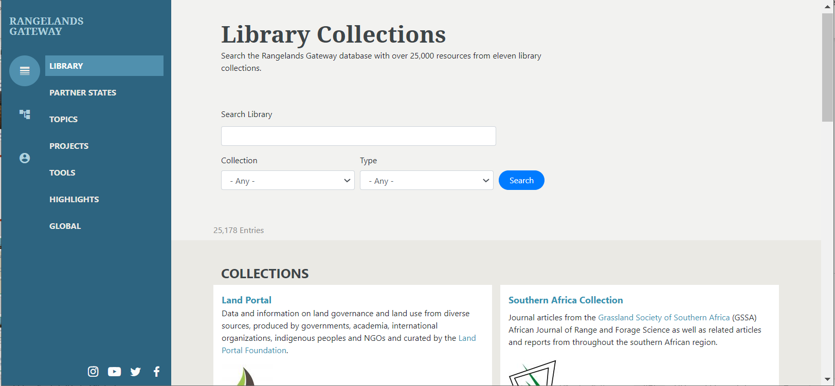
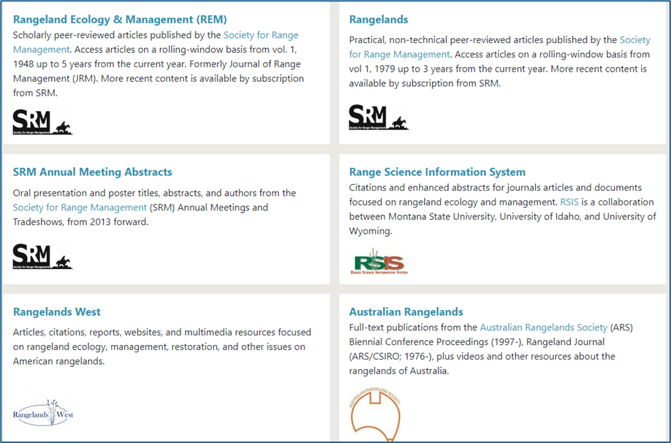
Navigation of the RG is always viewable in left panel
Library Database Collections can be searched individually or as a group or as a whole
Notes:
Slide Five: Left navigation panel highlights where you are moving around the website. When you click on “Library” you will see a list of the eleven collections and a description of them. Collections include journal articles, reports, and multimedia resources. From the home page search box, you will also be able to search the Collections as well as the content from UA hosted state sites and Topics.

Slide 6
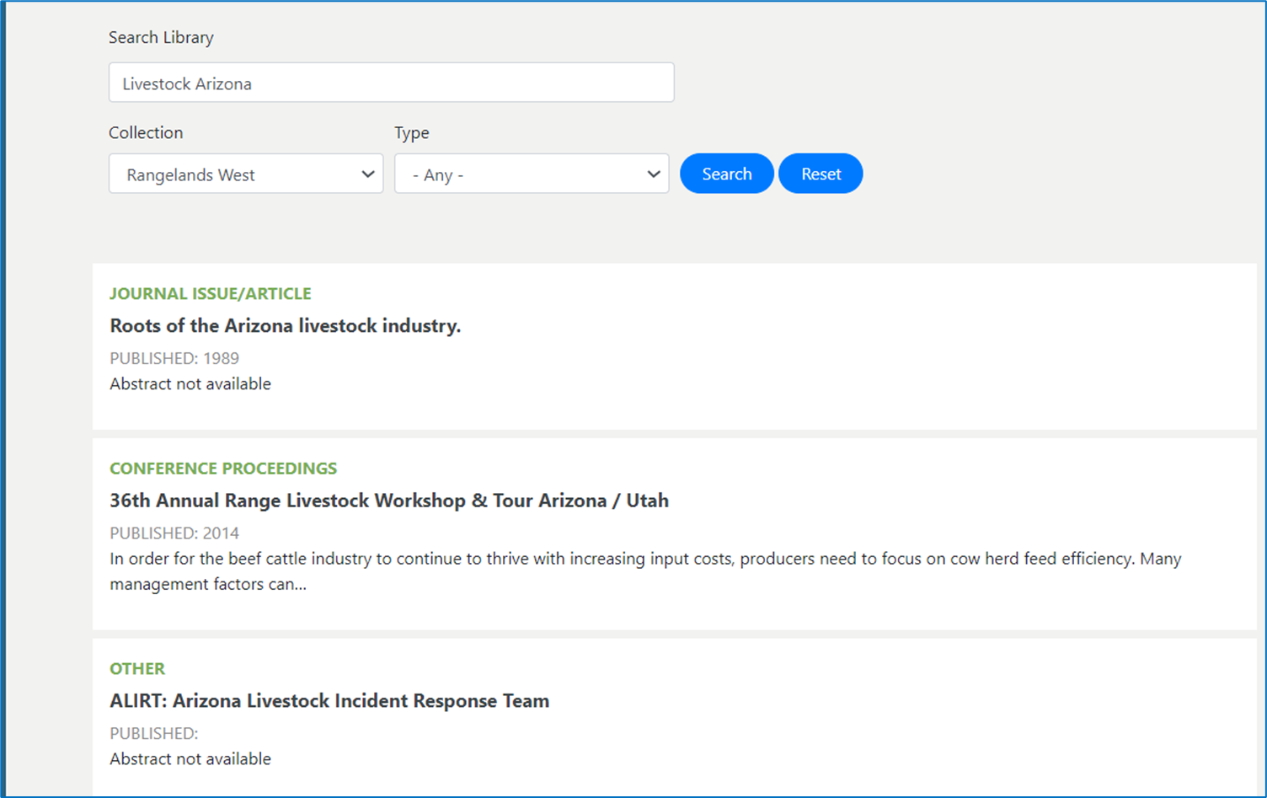
Notes:
Slide Six: Here is an example of what the search results look like when you run a search from the “Library” collections page. I put in the terms “livestock’ and “Arizona” not knowing what I would find as we are still tweaking the search function, but as you see here, the results included one of the proceedings from the 36th Range Livestock Workshop in 2014. These were provided to us by Doug Tolleson. We do rely on members and all of you to let us know about content you would like to have included in the database. Now that the RG is up, the focus in the next few years will be on content development. We welcome your suggestions.

Slide 7
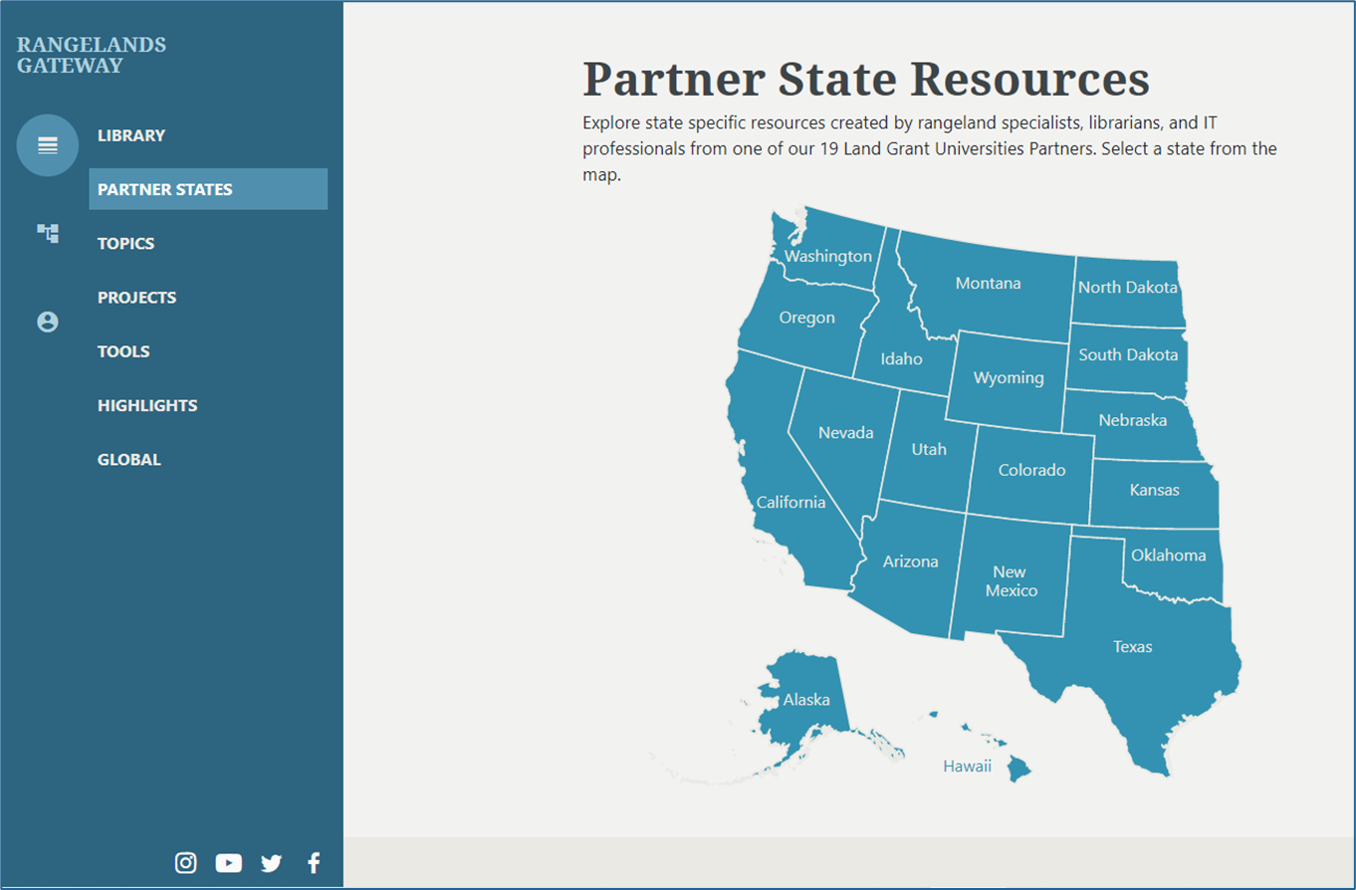
Notes:
Slide Seven: The next major section provides access to state level rangelands websites that used to be called “Rangelands West”. More than half of the state sites are hosted by the Arizona technical team and use the same template as a result. Most of the states have members who maintain these state sites, but there are a few that the Arizona team is managing until new partners are identified. The Partnership is an old enough organization that we have retirements and job changes that do not always have someone to take their place immediately so we are always open to new membership.

Slide 8
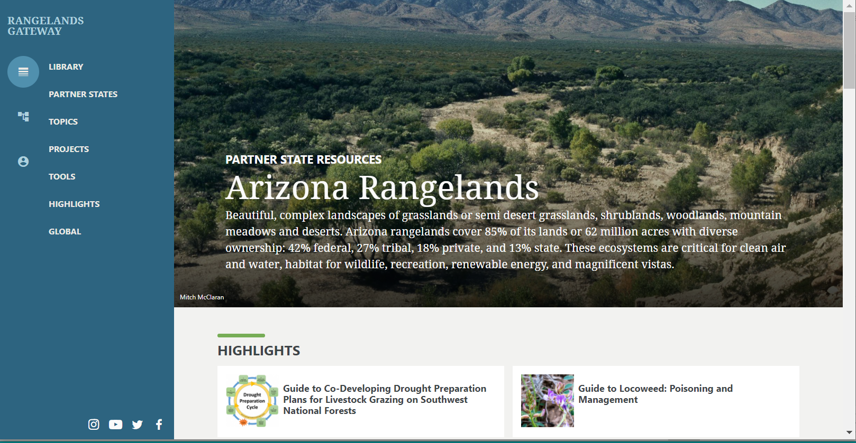
Notes:
Slide Eight: An example of a UA state-hosted website looks like the Arizona Rangelands website. Home pages state with a pretty image and are followed by sections of content as you will see in the next slide. (PARTNER STATES NOT HIGHLIGHTED – ask Craig)

Slide 9
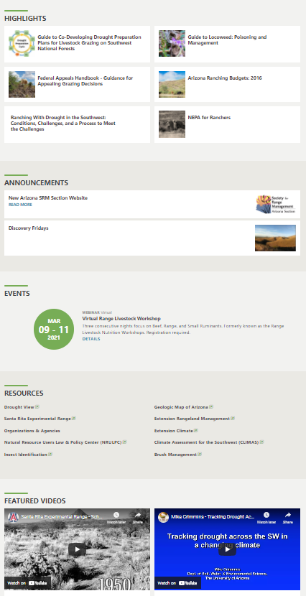
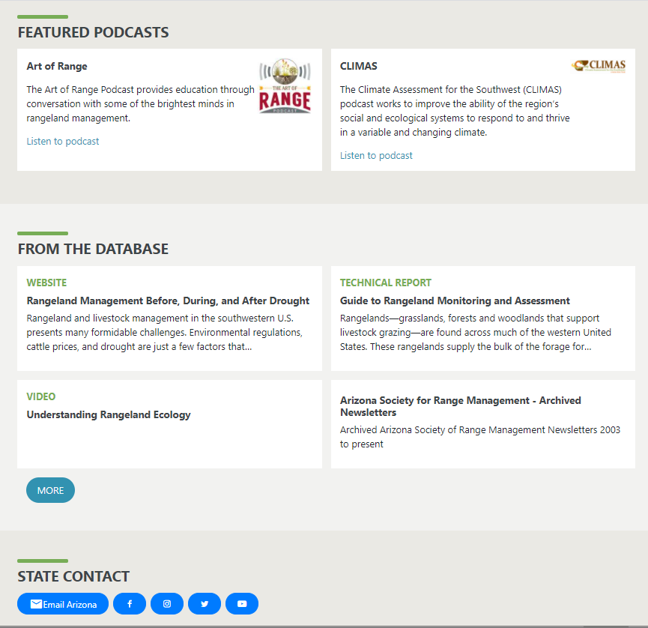
Notes:
Slide Nine: All the UA state hosted sites have the possibility of featuring Highlights to new or important resources you want to bring to the attention of users. Also, you can include announcements and events as well as a list of more general resources and other web links. In addition, there are featured videos, podcast feeds and a selection of key items from the database and quick access to searching the database. Finally, there are links back to the Partnership’s social media outlets which I will mention more about later.

Slide 10
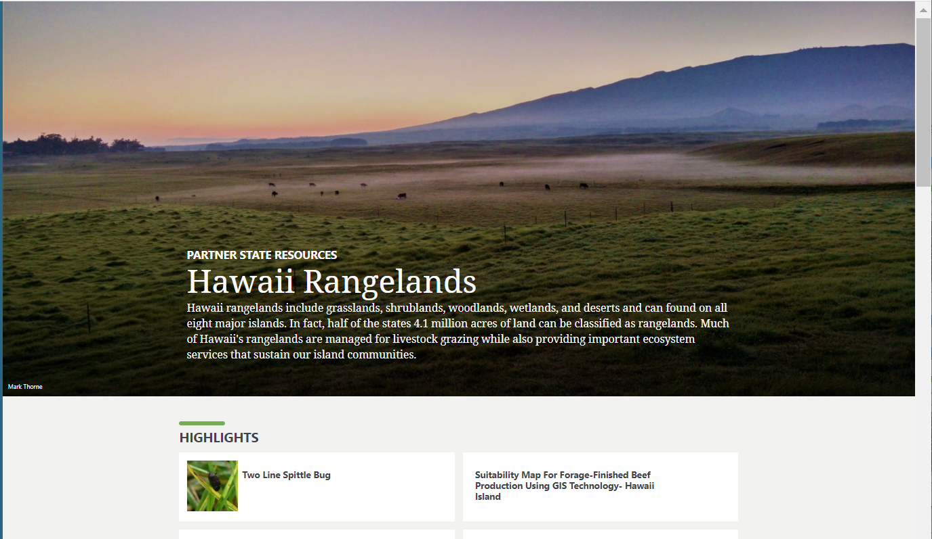
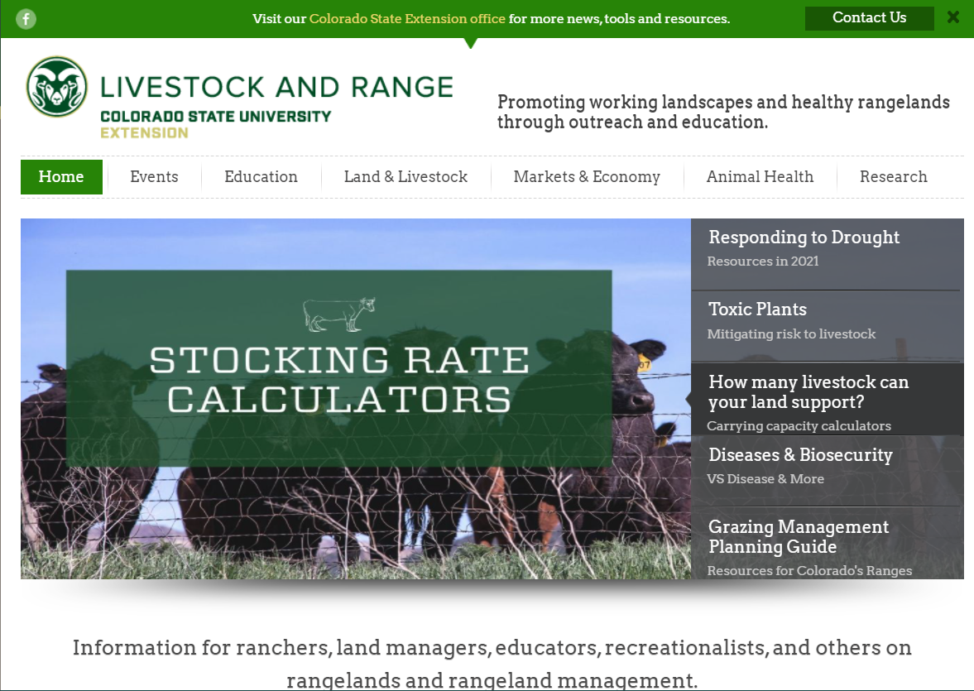
Notes:
Slide Ten: Examples of other state websites…the top two are examples of those following the UA hosted template format. However, non-hosted sites come in many different versions. As you will see, Colorado elected to manage just one rangelands site through Extension so we just link to those websites as selected by the member from that state. For California we had to do something different because there are partners from different institutions so we have an interim page that gives links to all of their range programs and major rangelands information websites.

Slide 11
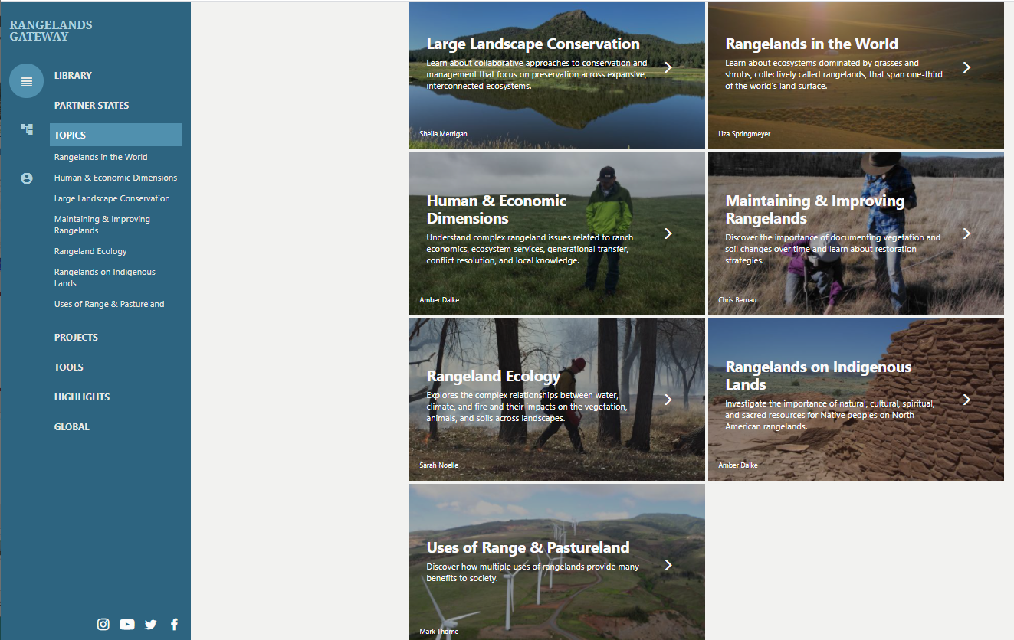
Seven Major Topics – many sub-topics with variety of resources
Notes:
Slide Eleven: The next section on the Rangelands Gateway has been developed over the past ten years through a number of externally funded projects. The idea has been to provide summary information on topics that inform the full discipline of rangelands management. Besides an overview introduction to rangelands in the world, there are six major topics each with multiple sub-topics that were defined by the members with rangeland specializations. Aaron will be showing you a new sub-topic that has been developed to a higher level than previous versions and that is our new template for updating each topic and sub-topic. In the next slide, you will see how some of the topics are organized.

Slide 12
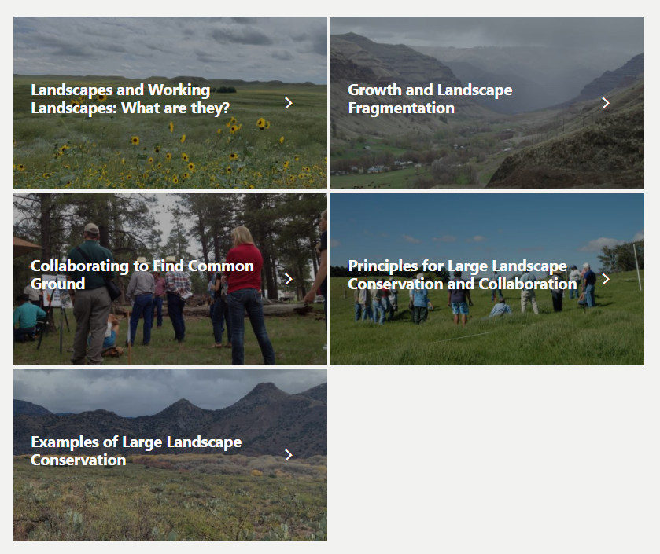
Notes:
Slide Twelve: This is the section on Large Landscape Conservation that was compiled for the website by Aaron Lien. This is more similar to earlier versions where there is generally summary text following by further reading or links to other resources. The newer topic pages focus also on multimedia content, including interviews and videos made by the Partnership.

Slide 13
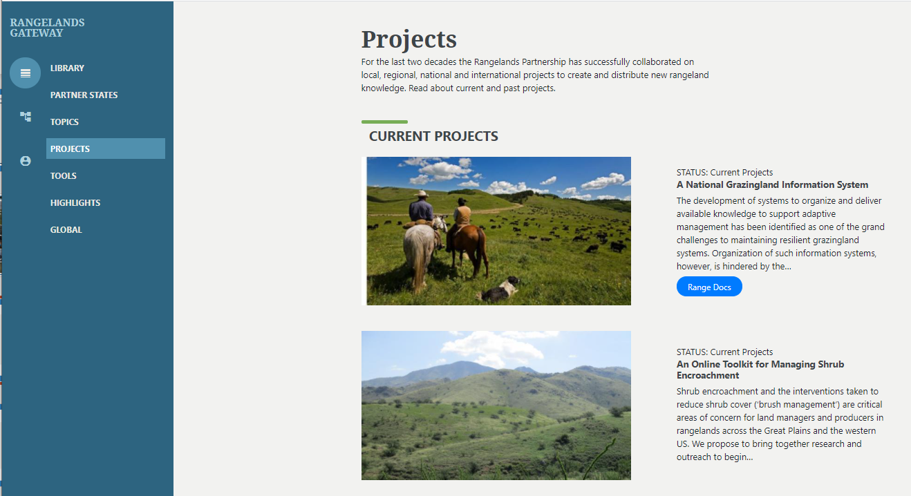
Notes:
Slide Thirteen: This section has information about and links to web pages about current and past projects funded in large part through competitive grants. As you see here, there is link to a new tool called “RangeDocs” that has been developed through an NRCS Conservation Innovation Grant. This tool includes about 70 key documents that are indexed at the paragraph level for extremely targeted results to identify very specific information. Also here is a new project that was funded by an RREA NFF grant to develop a brush management toolkit. Other projects are included on this page as well as a link to an archive list of all projects received since the Partnership began.

Slide 14
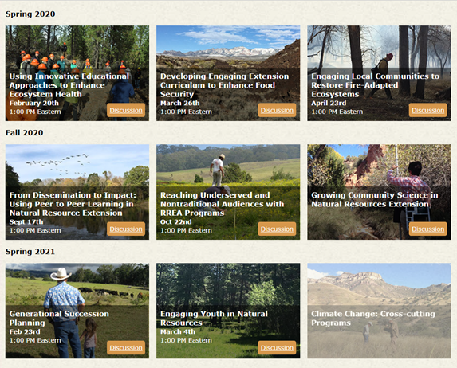
Notes:
Slide Fourteen: One project that is close to finishing is the RREA-NFF project that has offered a series of nine webinars on topics related to the current RREA strategic plan. The website provides access to the one hour webinar recordings each with three speakers from across the country, plus additional handouts, links for more information and a discussion board.

Slide 15
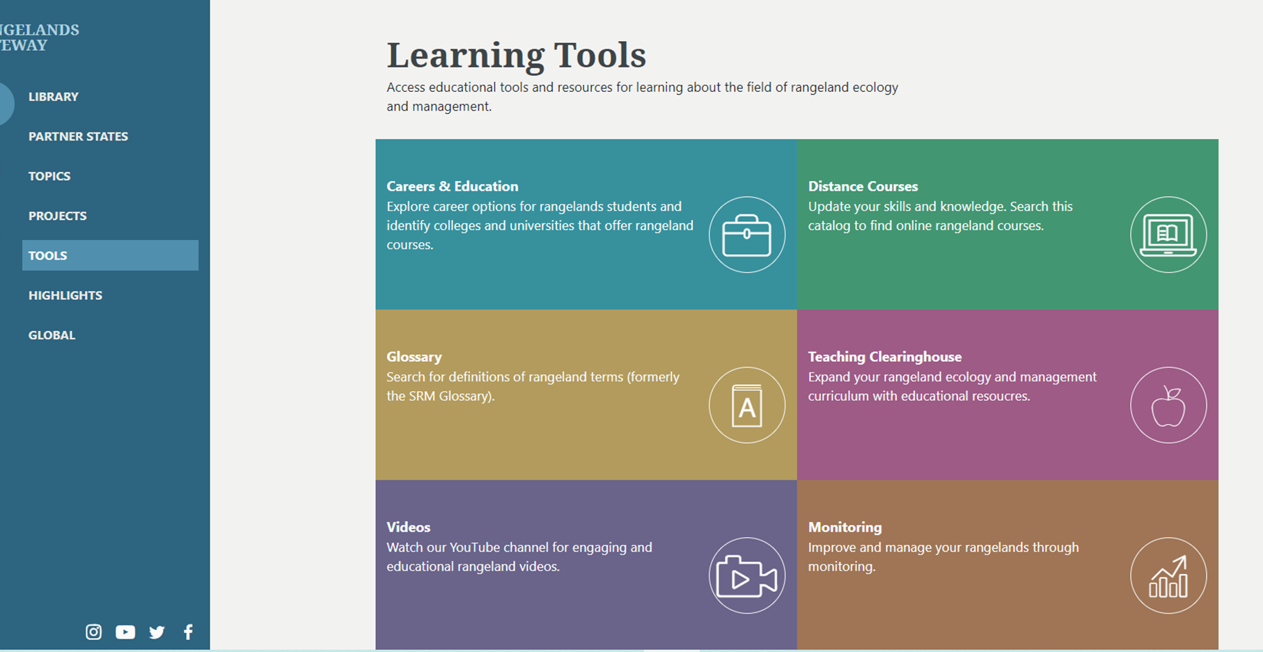
Notes:
Slide Fifteen: The Tools section links the user to three websites that were developed as part of a USDA Higher Education Challenge grant. The RP technical and IT team created the websites, but the grant was implemented by members of the Range Science Education Council (RSEC) affiliated with SRM. These include a Teaching Clearinghouse of PPTs and other resources that can be used for teaching, a list of distance courses from various universities, and a Careers and Education website. Also here is a link to the SRM glossary of rangeland terminology and to the RP’s YouTube videos. Finally, there will be a new Monitoring resource soon, but right now it is a work in progress.

Slide 16
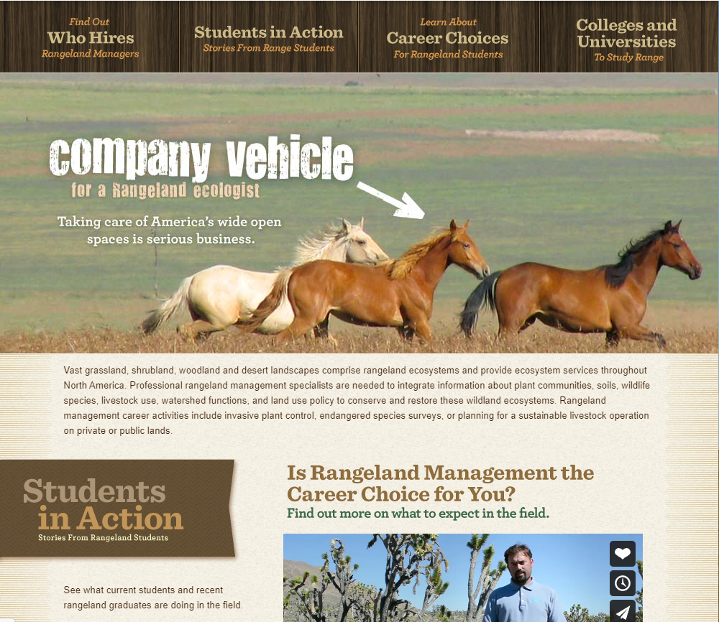
Notes:
Slide Sixteen: Here is the Careers and Education website that was developed primarily by Susan Marshall at Humboldt State. There are some useful videos here about career opportunities, plus information about where to look for jobs etc.

Slide 17
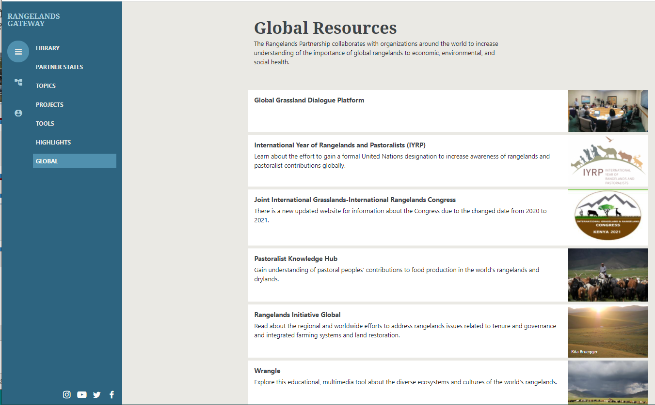
Notes:
Slide Seventeen: Reflecting the Partnership’s growing interest in international collaboration, we also have a section with links to the major initiatives that are currently ongoing. This includes the recently initiated Global Grasslands Dialogue Platform, the upcoming combined International Rangelands and Grasslands Congress this coming October, and other international collaborators. In particular, there are two IYRP websites that the UA RP Tech team manages, an archive site with documents from the past five years of working toward a vote at the UNGA this coming September, and the “online booth” webinar that we developed since in-person events were not possible this past year. The next slide will give you an overview of that website.

Slide 18
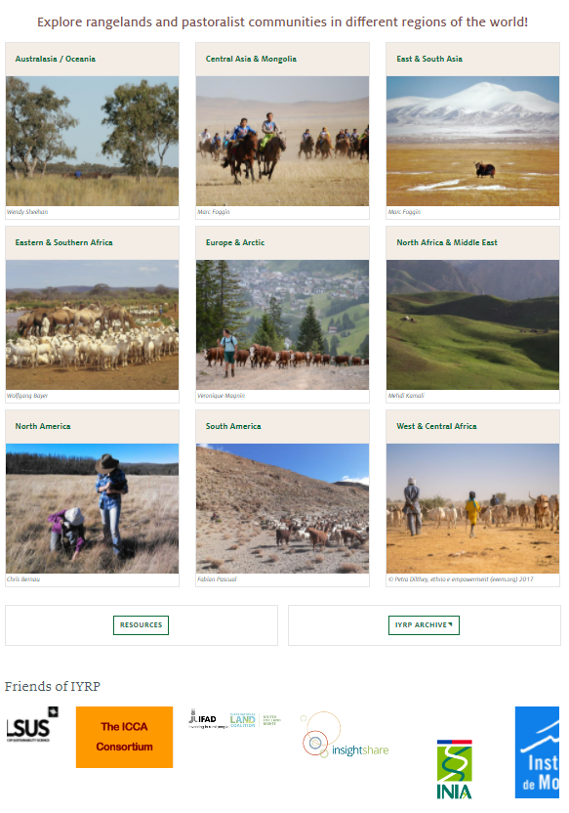
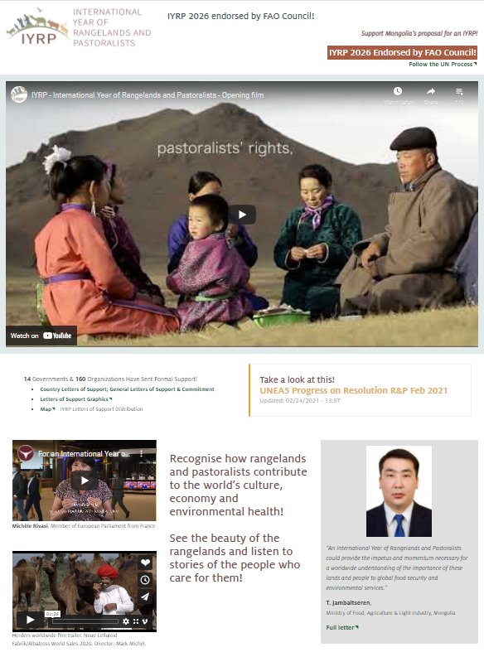
Notes:
Slide Eighteen: On the right is the top of the home page and the left is the bottom section as you scroll down. If you haven’t viewed the opening video, it is a wonderful short piece made by a German film producer in collaboration with a Mongolian NGO. As you see, the world is represented by contributed photos and videos from all over, with sections for nine regional groupings. There are also “Resource” sections for each region where minutes from Regional Support Groups meetings are available. These groups have only recently formed, with many of them meeting once a month for the purpose of gaining additional support for the IYRP proposal to the UN. If successful, these groups will then continue to develop educational programming and other activities at national and regional levels until and through the actual IYRP in 2026.

Slide 19
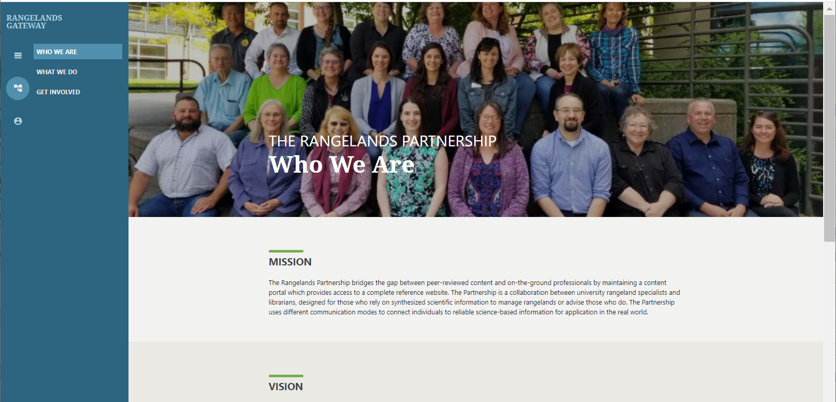
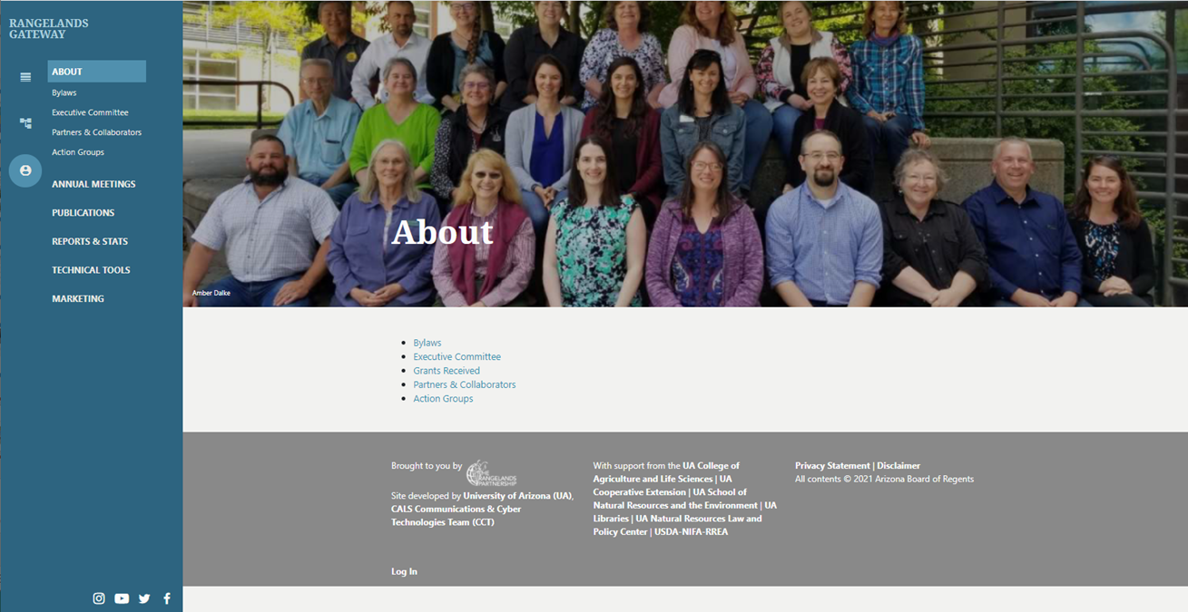
Notes:
Slide Nineteen: For information about the Rangelands Partnership including mission, vision, technology, collaborators, and operational documents, there are icons further to the left that provide access to this information. The previous “Member Site” has not been brought over in totality yet but will be located here as you see the links in the dropdown in the left navigation panel. Soon there will be links to the annual meeting presentations and handouts, lists of publications about the Partnership and its projects, as well as technical guides and marketing materials.

Slide 20
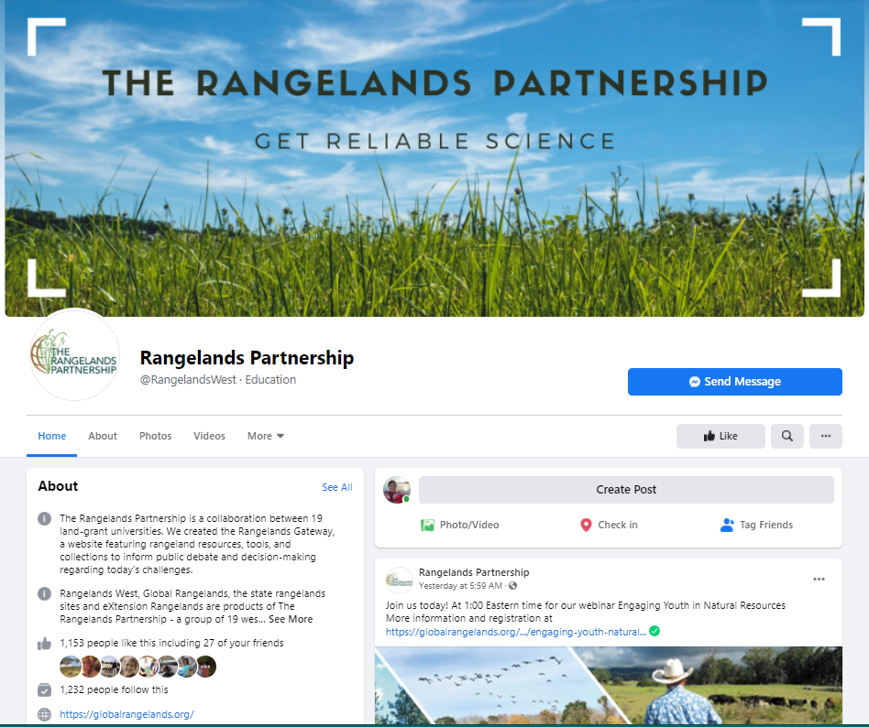
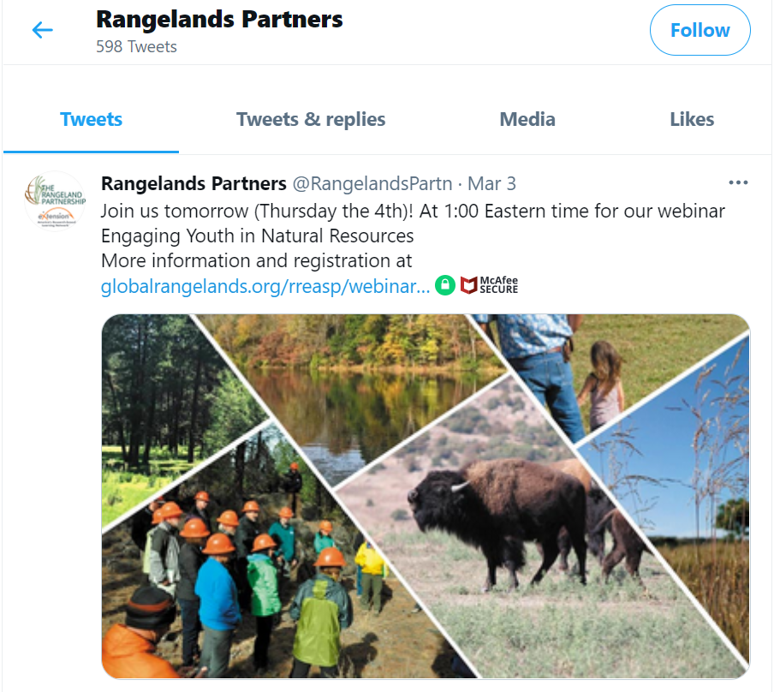
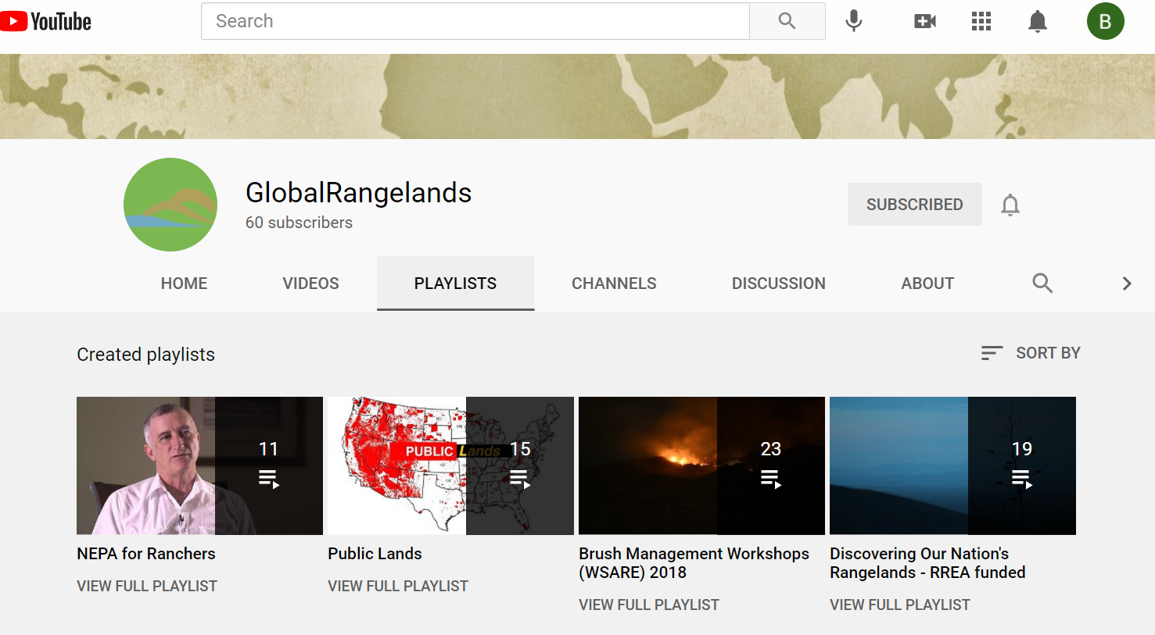
Social Media Outlets
Notes:
Slide Twenty: Finally, as mentioned above, the Partnership largely under the direction of the Arizona Tech Team, offers several social media outlets. The most active are the Facebook page and the YouTube Global Rangelands Channel. However, there is a Twitter account too. We hope you will go to these outlets and like us sometime soon…if you haven’t already!

Slide 21
Thank you! Questions?
Arizona RP Tech Team
Amber Dalke
Barb Hutchinson
Jeanne Pfander
Sheila Merrigan
Sarah Noelle
And Friends
George Ruyle
Anne Gondor
Aaron Lien
Many others
barbarah@cals.Arizona.edu
Notes:
Slide Twenty-One: The most important feature of the Rangelands Partnership is its high level of collaboration. On behalf of all of us on the Arizona RP Tech Team, I thank you for your attention. At the same time, this website and its many off-shoot projects would not happen without many people working together in a cooperative process. If you would like to know more about the RP or have content you would like added to the database or you would like to subscribe to our monthly e-newsletter you see on the slide, please contact me at this email address barbarah@cals.Arizona.edu. There are contact forms on the website, too.

