Slide 1
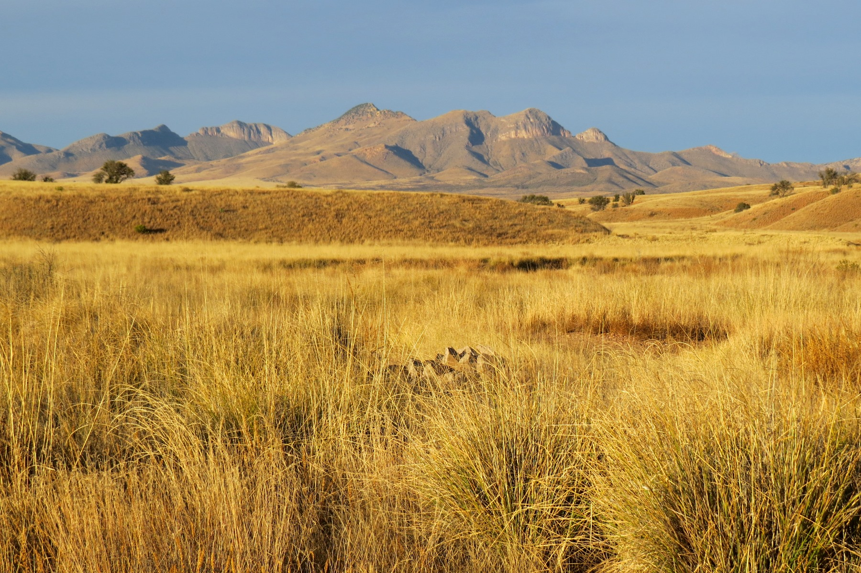
Vegetation Change on SE Arizona Grasslands
Robinett – AVCA, Elkhorn Ranch 12-2-15

Slide 2
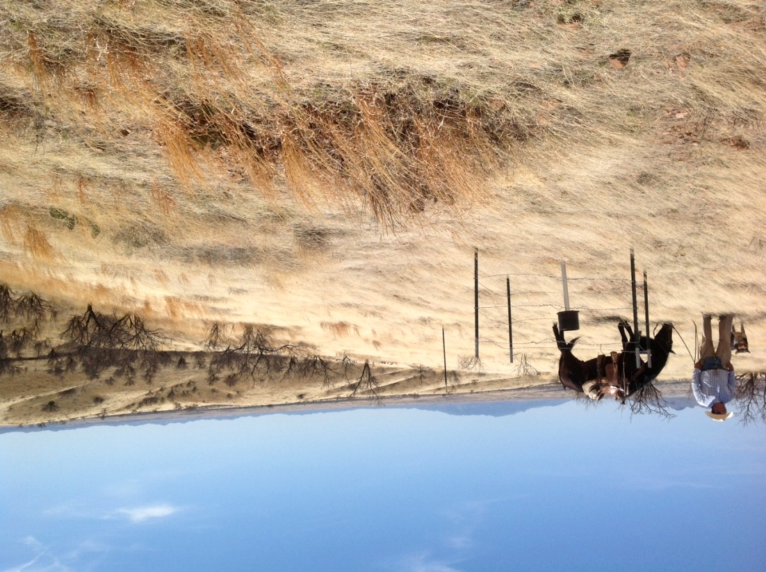
Objectives
Changes in SE AZ grasslands
  Winter drought
  Perennial grass cover
Monitoring data and research information
Implications for management

Slide 3
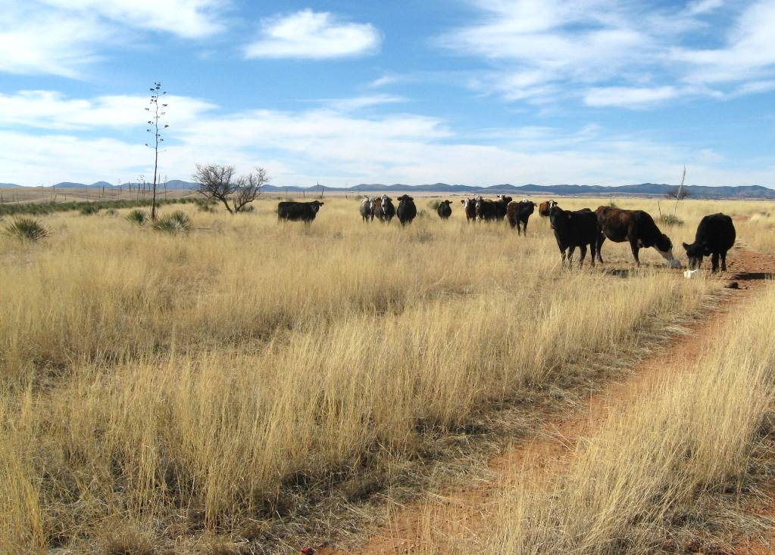
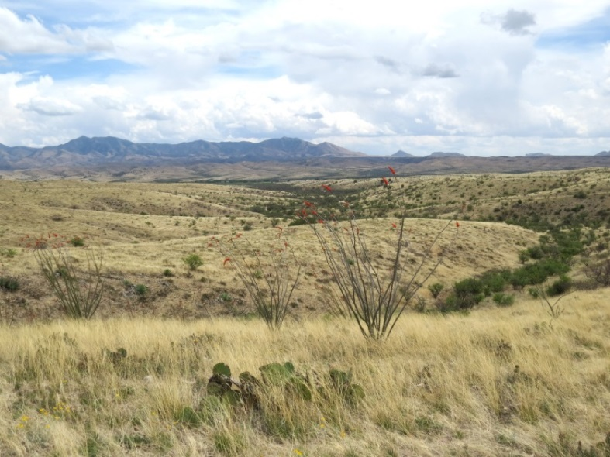
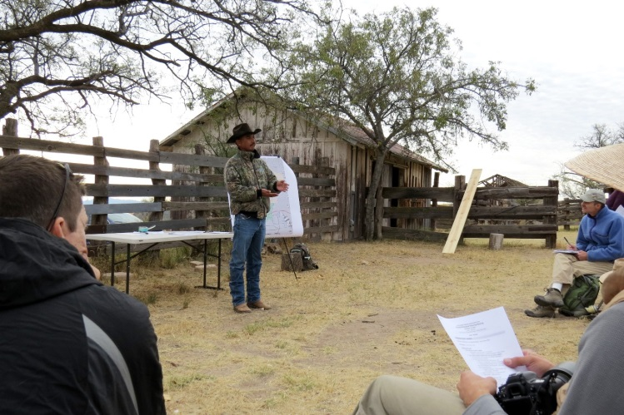
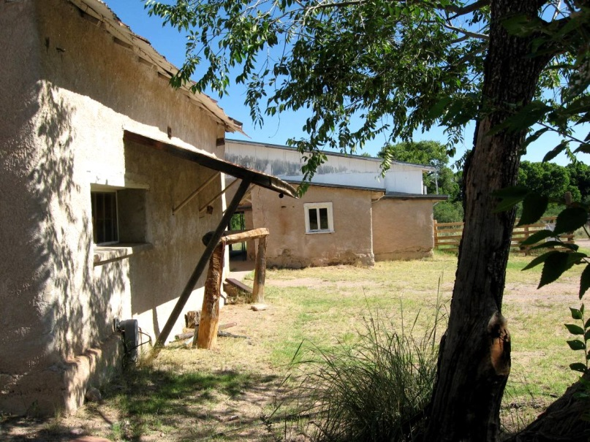
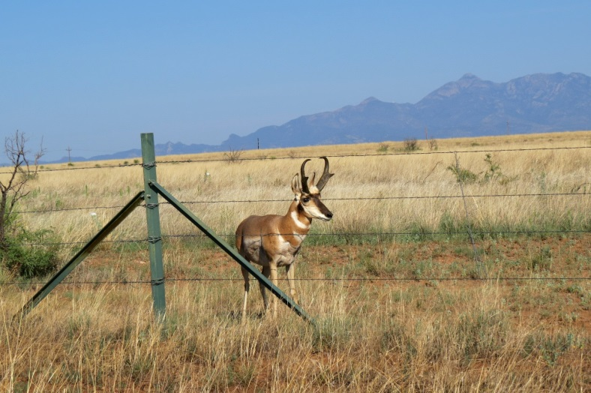
Las Cienegas National Conservation Area, Empire Ranch
Various ranches since 1870
BLM since 1988
Las Cienegas NCA in 2000
Active management, multiple land uses
Monitoring veg, wildlife, climate, water, arch and historic resources

Slide 4
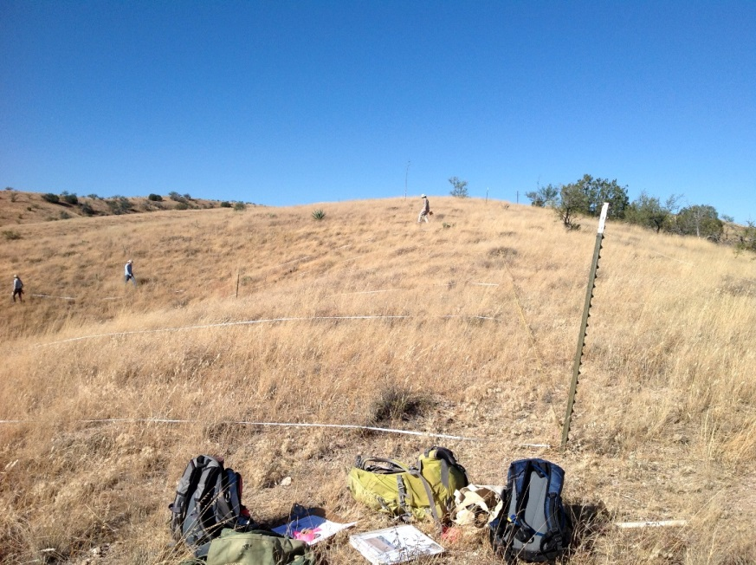
Empire Ranch Monitoring
44 upland veg transects
7 paired (grazed-ungrazed)
77000 acres
MLRA 41-3, 12-16”pz
Monitor
  Photos
  Vegetation cover
  Precipitation
  Grazing utilization
  Other
Empire, North Pas. KA 2

Slide 5
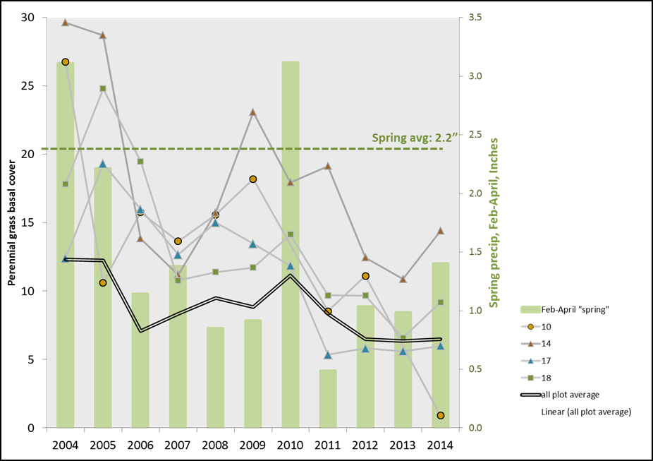

Empire Ranch Trends 2003-2014
Basal cover declining
Litter cover increasing
Lehmann lovegrass increasing
Similar trends grazed-ungrazed
G. Bodner, 2014 TNC

Slide 6
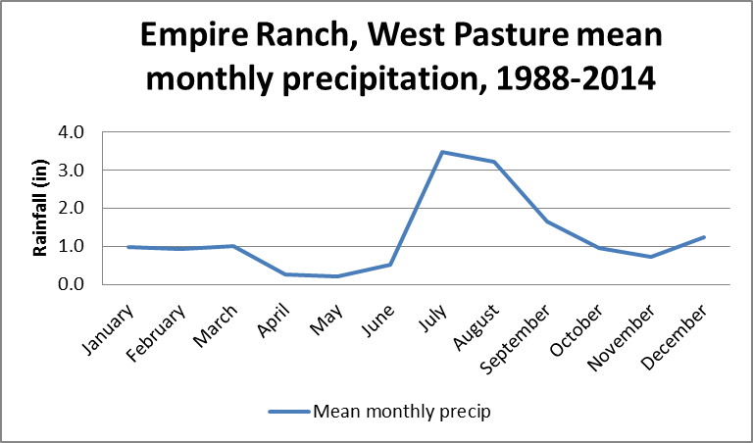
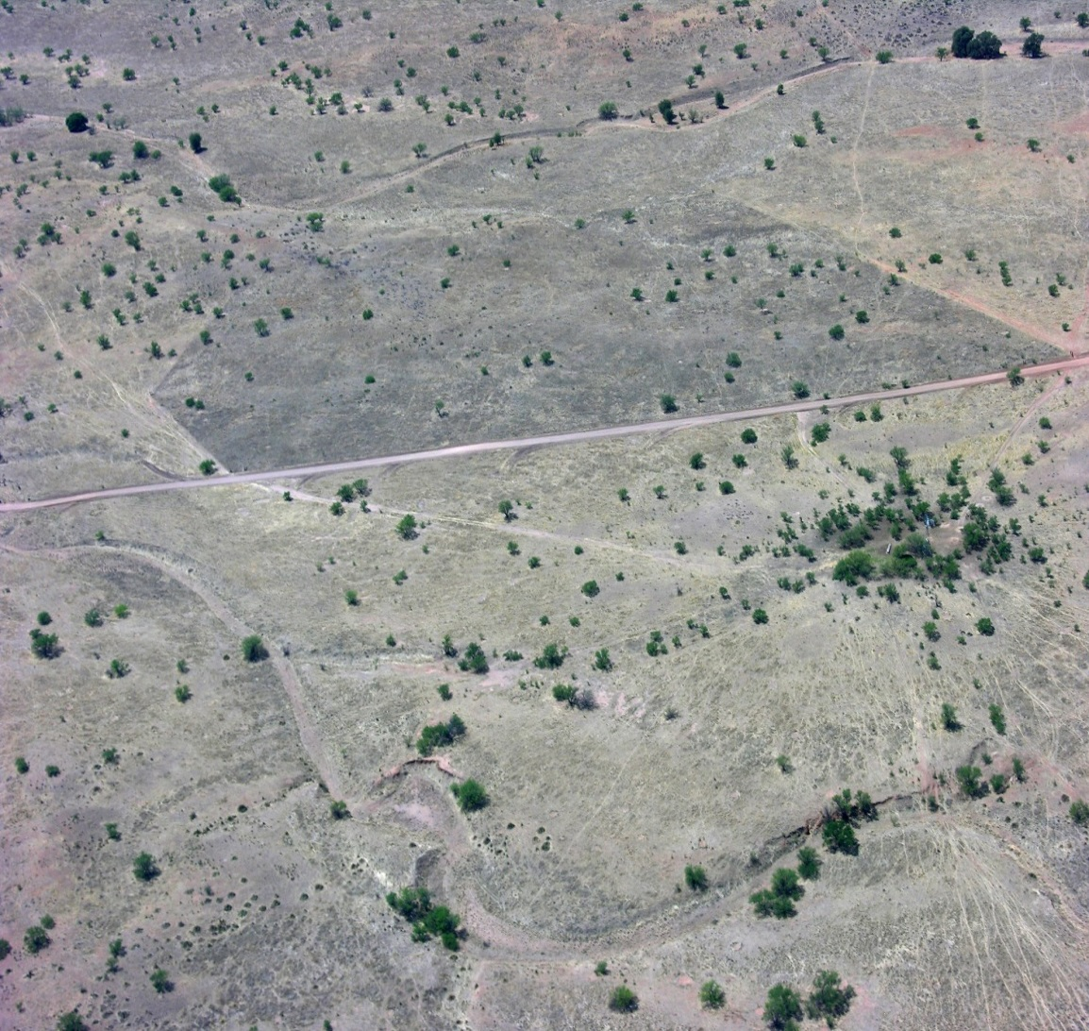
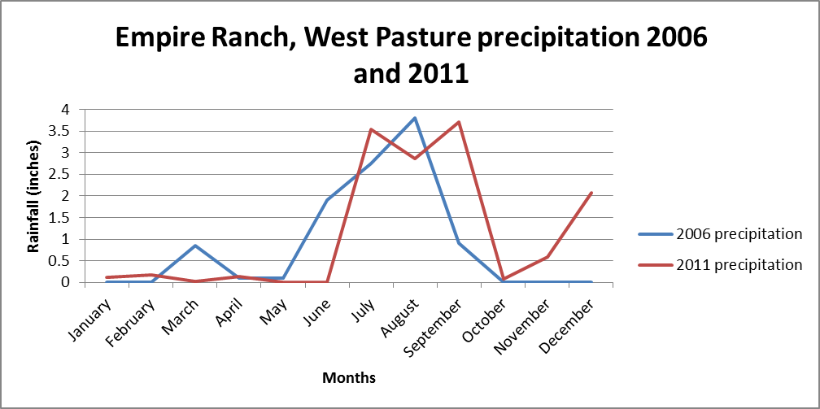
Empire Ranch, West Pasture
Emmerich, 2002
Mean annual precip 14.75”

Slide 7
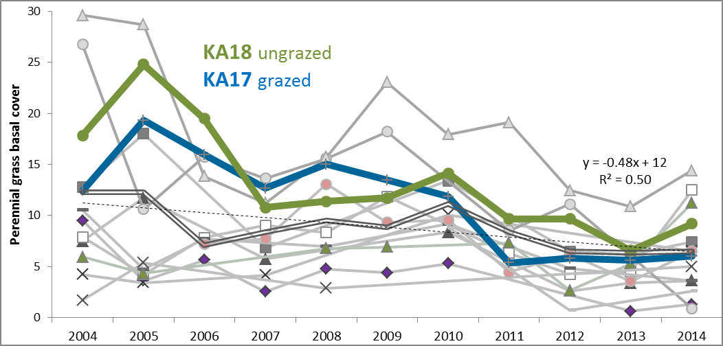
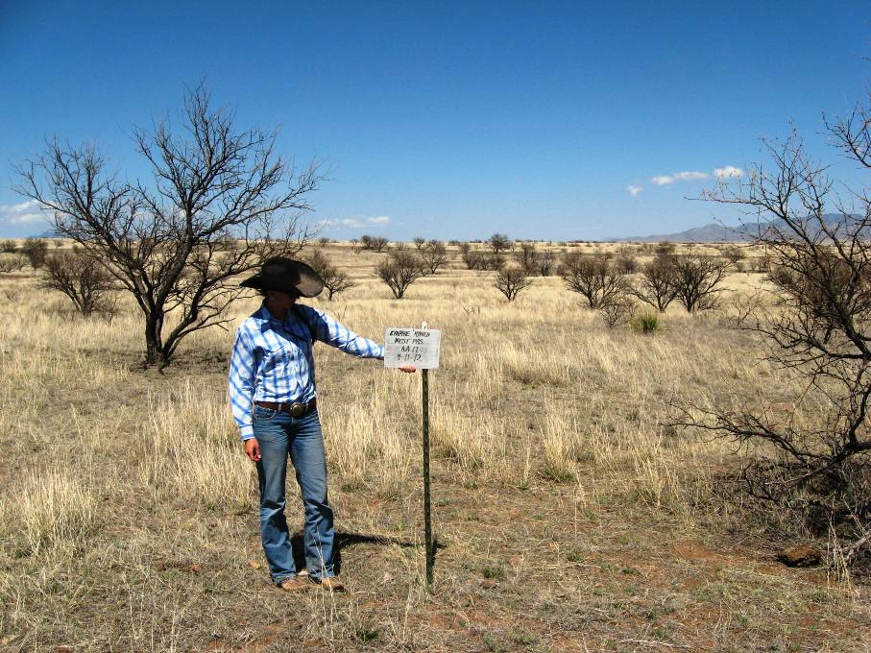
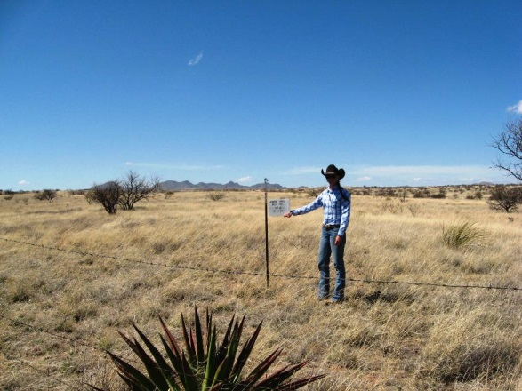
Empire Ranch, West Pasture KA 17 & 18
Outside
Inside
4-11-12

Slide 8
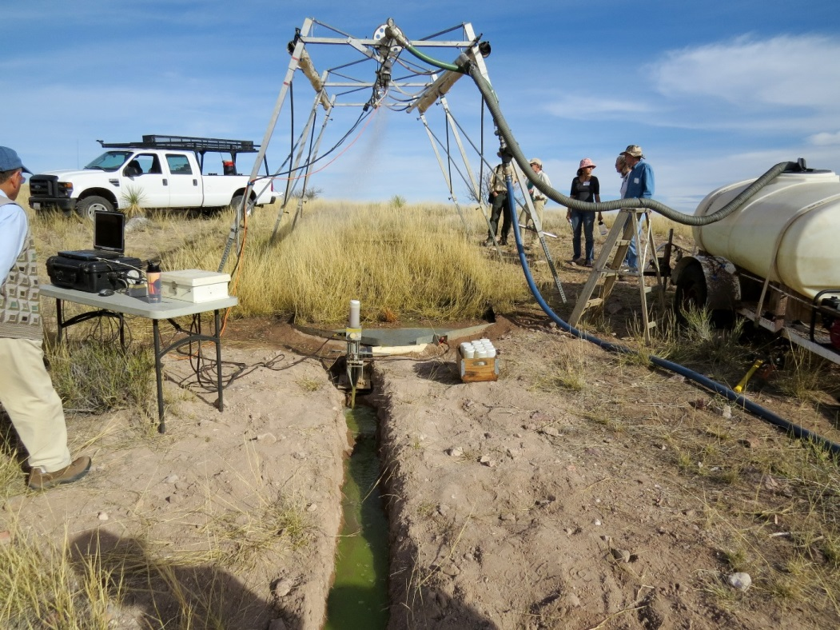
Agricultural Research Service, Walnut Gulch Experimental Watershed
WGEW in 1956
  150 km2
  Tombstone
SW Watershed Research Center in 1971
Instrumented
  precipitation
  runoff
  sediment
  vegetation
  meteorological
  atmospheric
  soil moisture

Slide 9
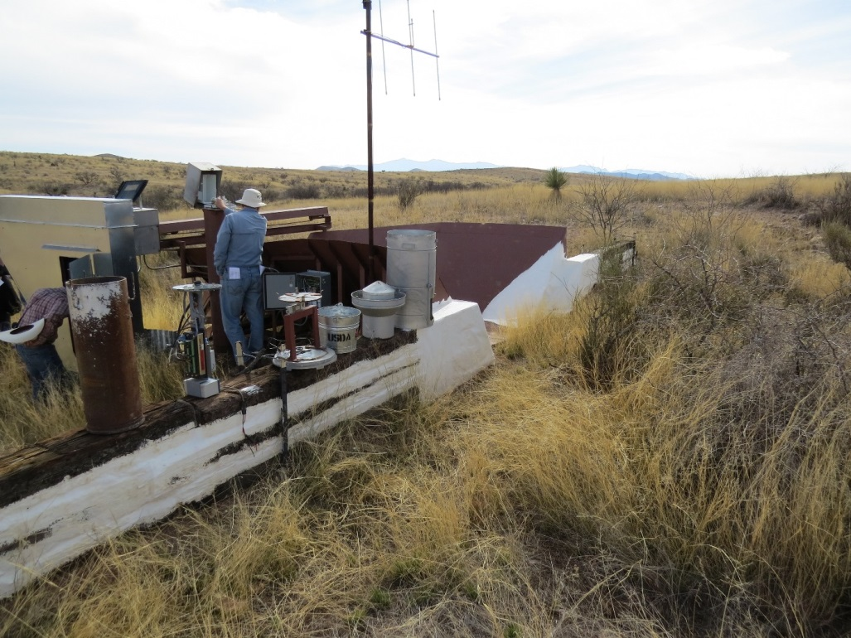
Kendall watershed
Grassland
5000’ elev.
13.6” ann. precip
MLRA 41-3
1990-2014

Slide 10
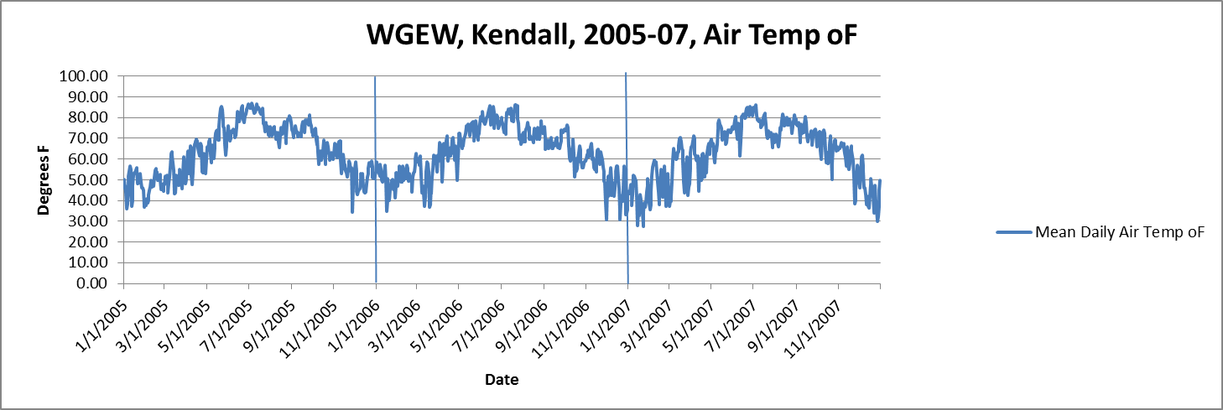
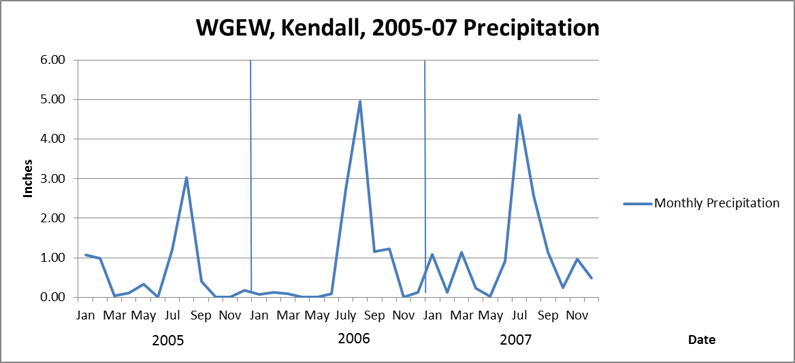
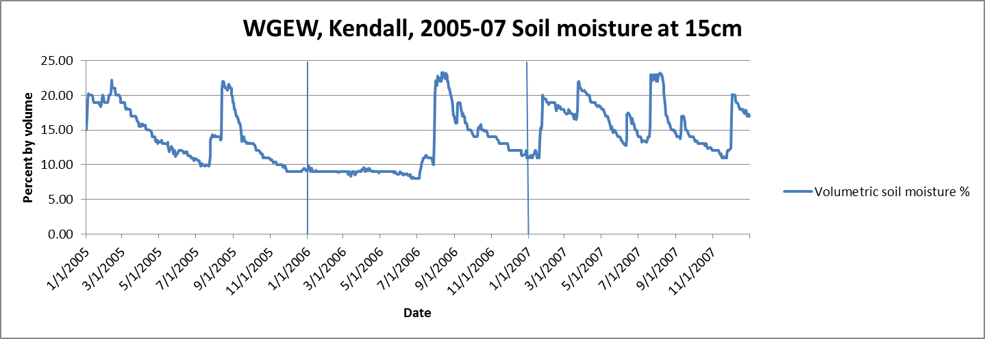
Kendall Watershed 2006 drought
50 F (10 C)mean daily air temp. green-up, warm season grasses
2005 green-up & growth until August
2006 little green-up/growth grass mortality
2007 green-up & growth until July

Slide 11
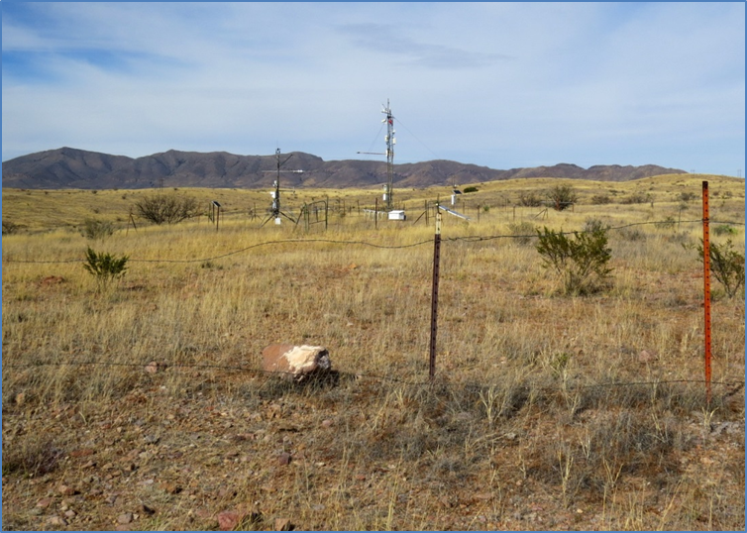
Kendall 2006 drought
Native grass cover declined
Shrub cover crashed
Lehmann lovegrass increased
Polyakov ET AL, 2010

Slide 12
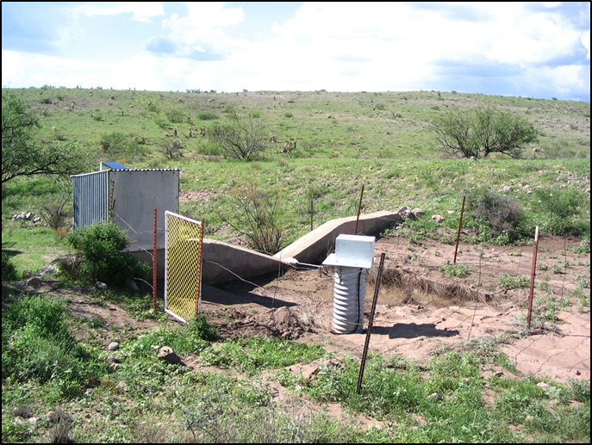
Kendall 2006 drought
Sediment yield
  23 times pre drought levels
  recovered to pre drought levels 2007-09.
2006 sediment
  56% of the total from the watershed
  In 19 years of monitoring.
Russ Scott, Aug. 2006
Polyakov ET AL, 2010

Slide 13
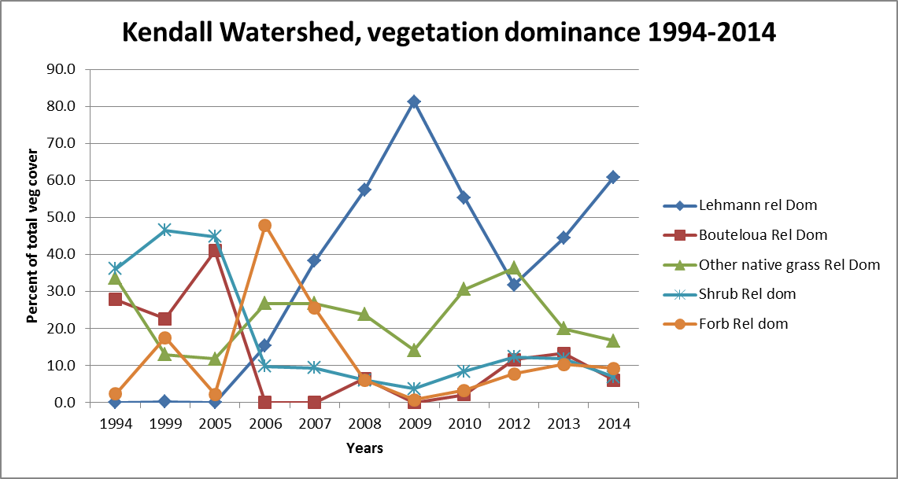
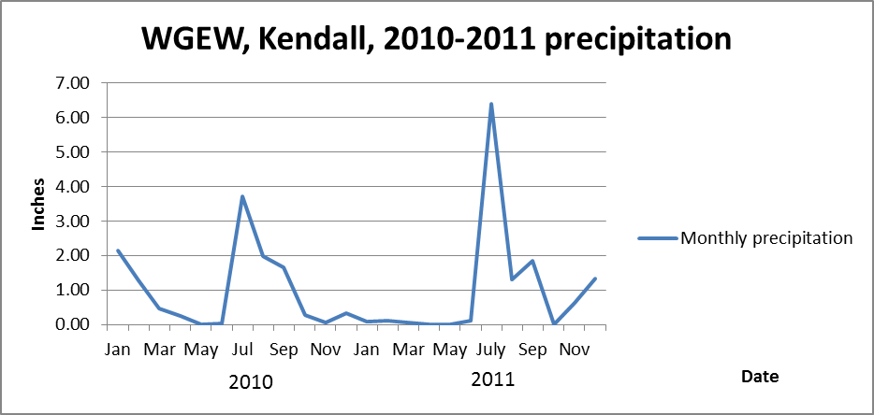
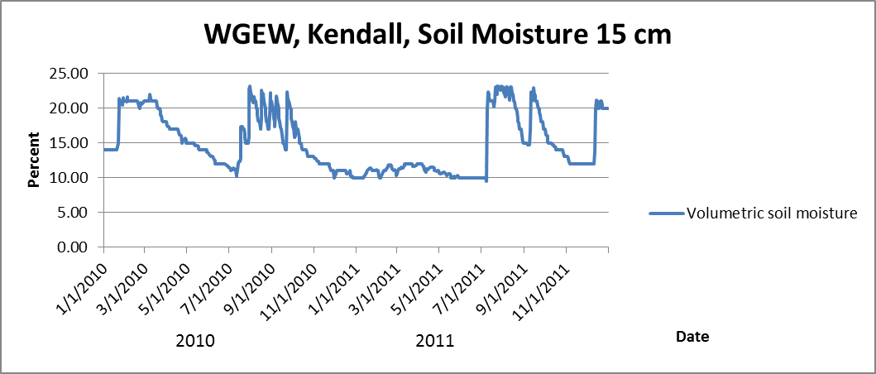
Kendall Drought 2011
Feb –Apr precip
  .20 inches in 2011
Extreme freeze
  Feb. 2-4, 2011
  14 to -3 degrees F
Grass mortality
  65%
  Lehmann lovegrass
Hamerlynck, Scott and Barron-Gafford, 2013

Slide 14
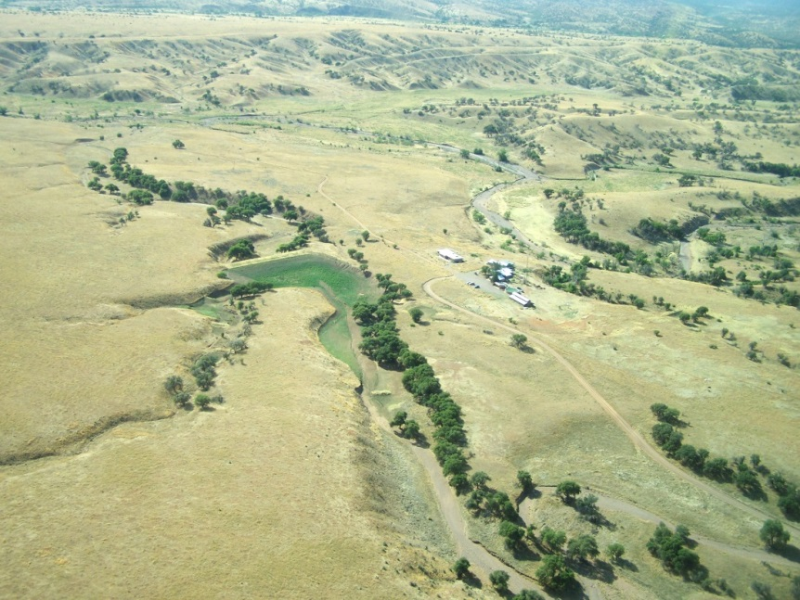
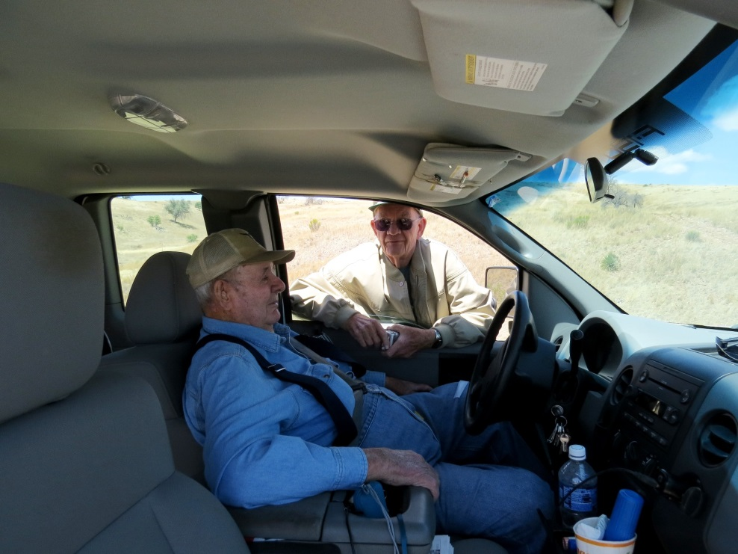
Appleton-Whittell Research Ranch of the National Audubon Society
Appleton family, Elgin Hereford ranch 1955-67
Research facility 1969 (un-grazed)
Grassland research, plants, animals, soil, climate, water, etc.
Reference area for MLRA 41-1, 16-20” precip zone,
L. Kennedy
Bill Piper, Phil Ogden, 5-7-14

Slide 15
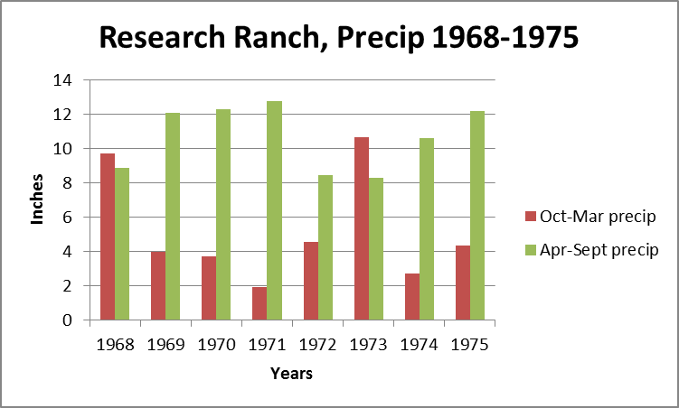
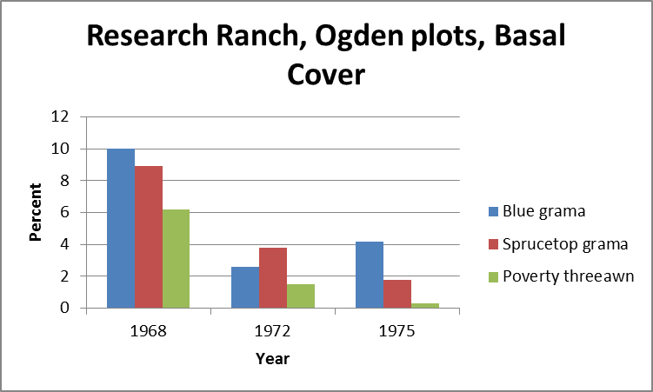
Audubon Research Ranch 1965-1975
Phil Ogden, Jack Stroehlein, Jerry Schickedanz plots
Winter-spring drought 1971
Basal cover perennial grasses
  25% in 1968
  8% in 1972
  6% in 1975

Slide 16
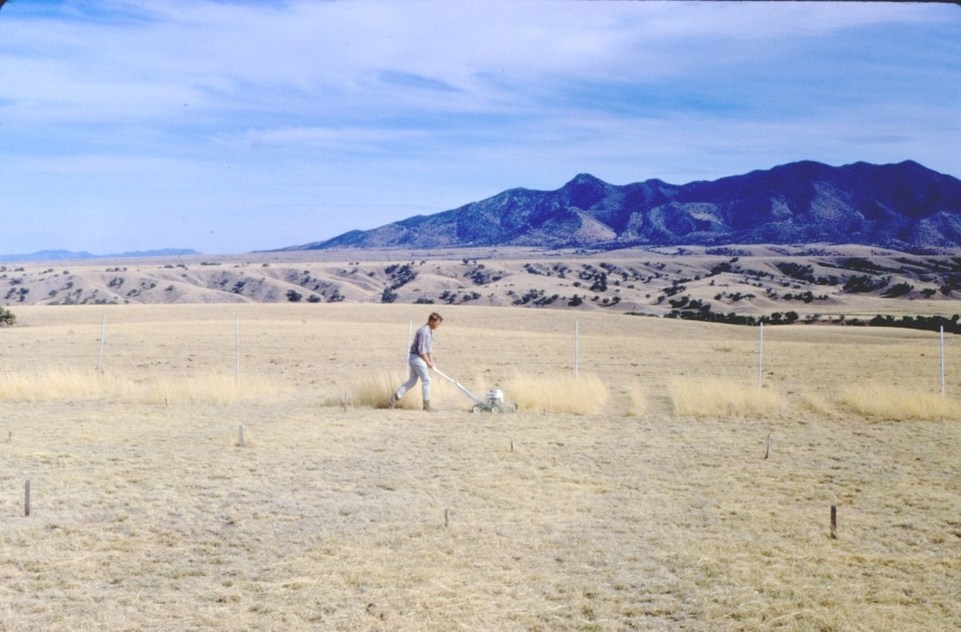
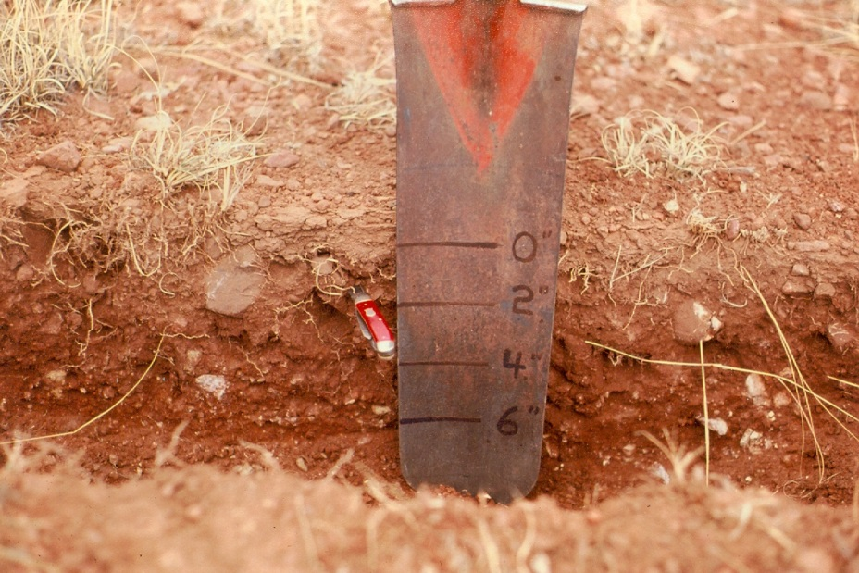
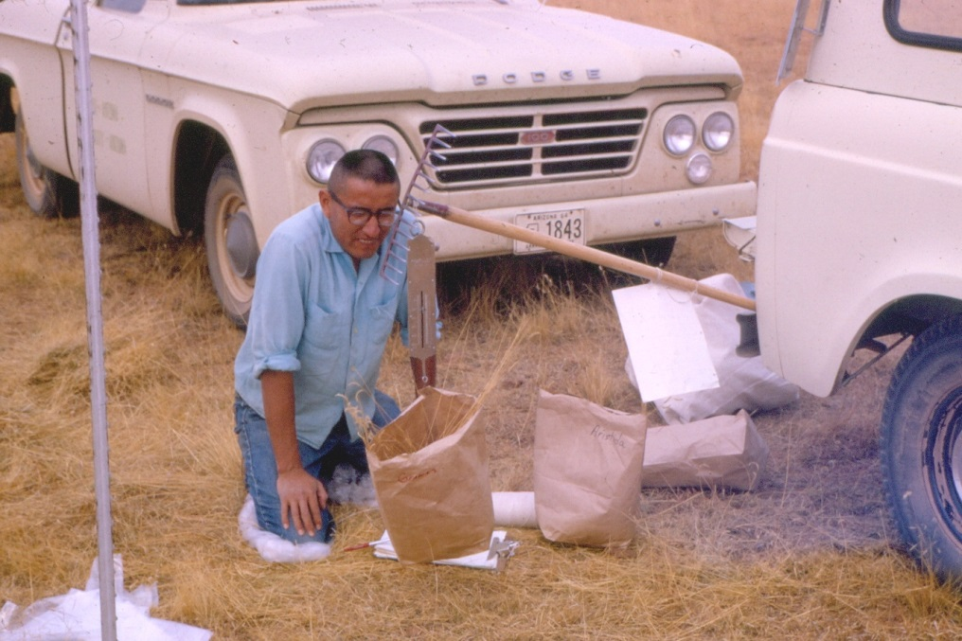
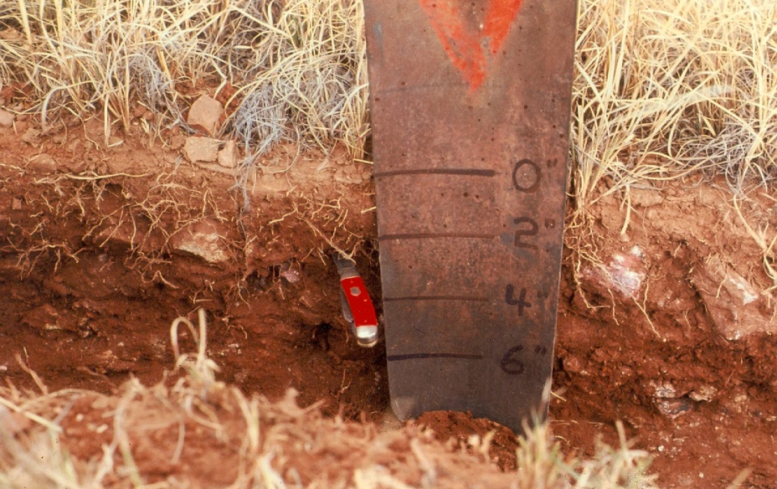
Audubon Research Ranch 1965-1975

Slide 17
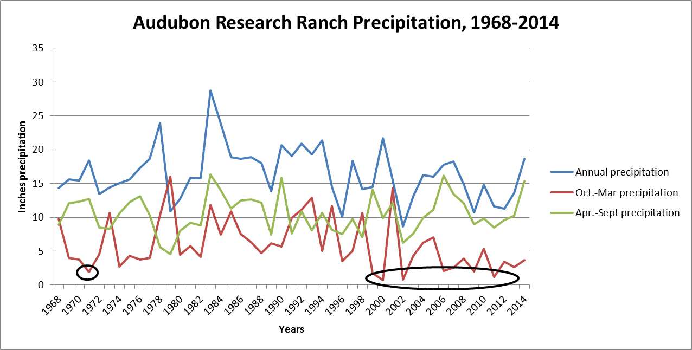
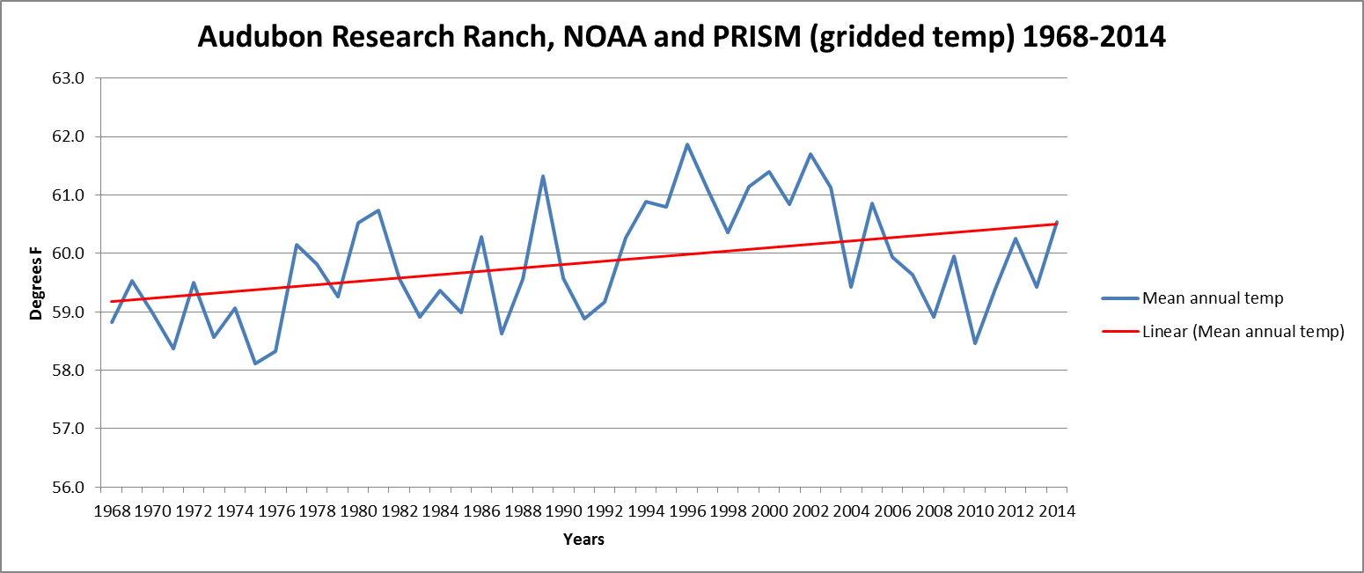
Mean ann. precip full record - 16.5”
Mean ann. precip last 18 years -14.8”
Warm season mean full record 10.5” CV is .27
Warm season mean last 18 years 10.5” CV .23
Cool season mean full record - 5.9” CV is .64
Cool season mean last 18 years - 4.3” CV .80

Slide 18
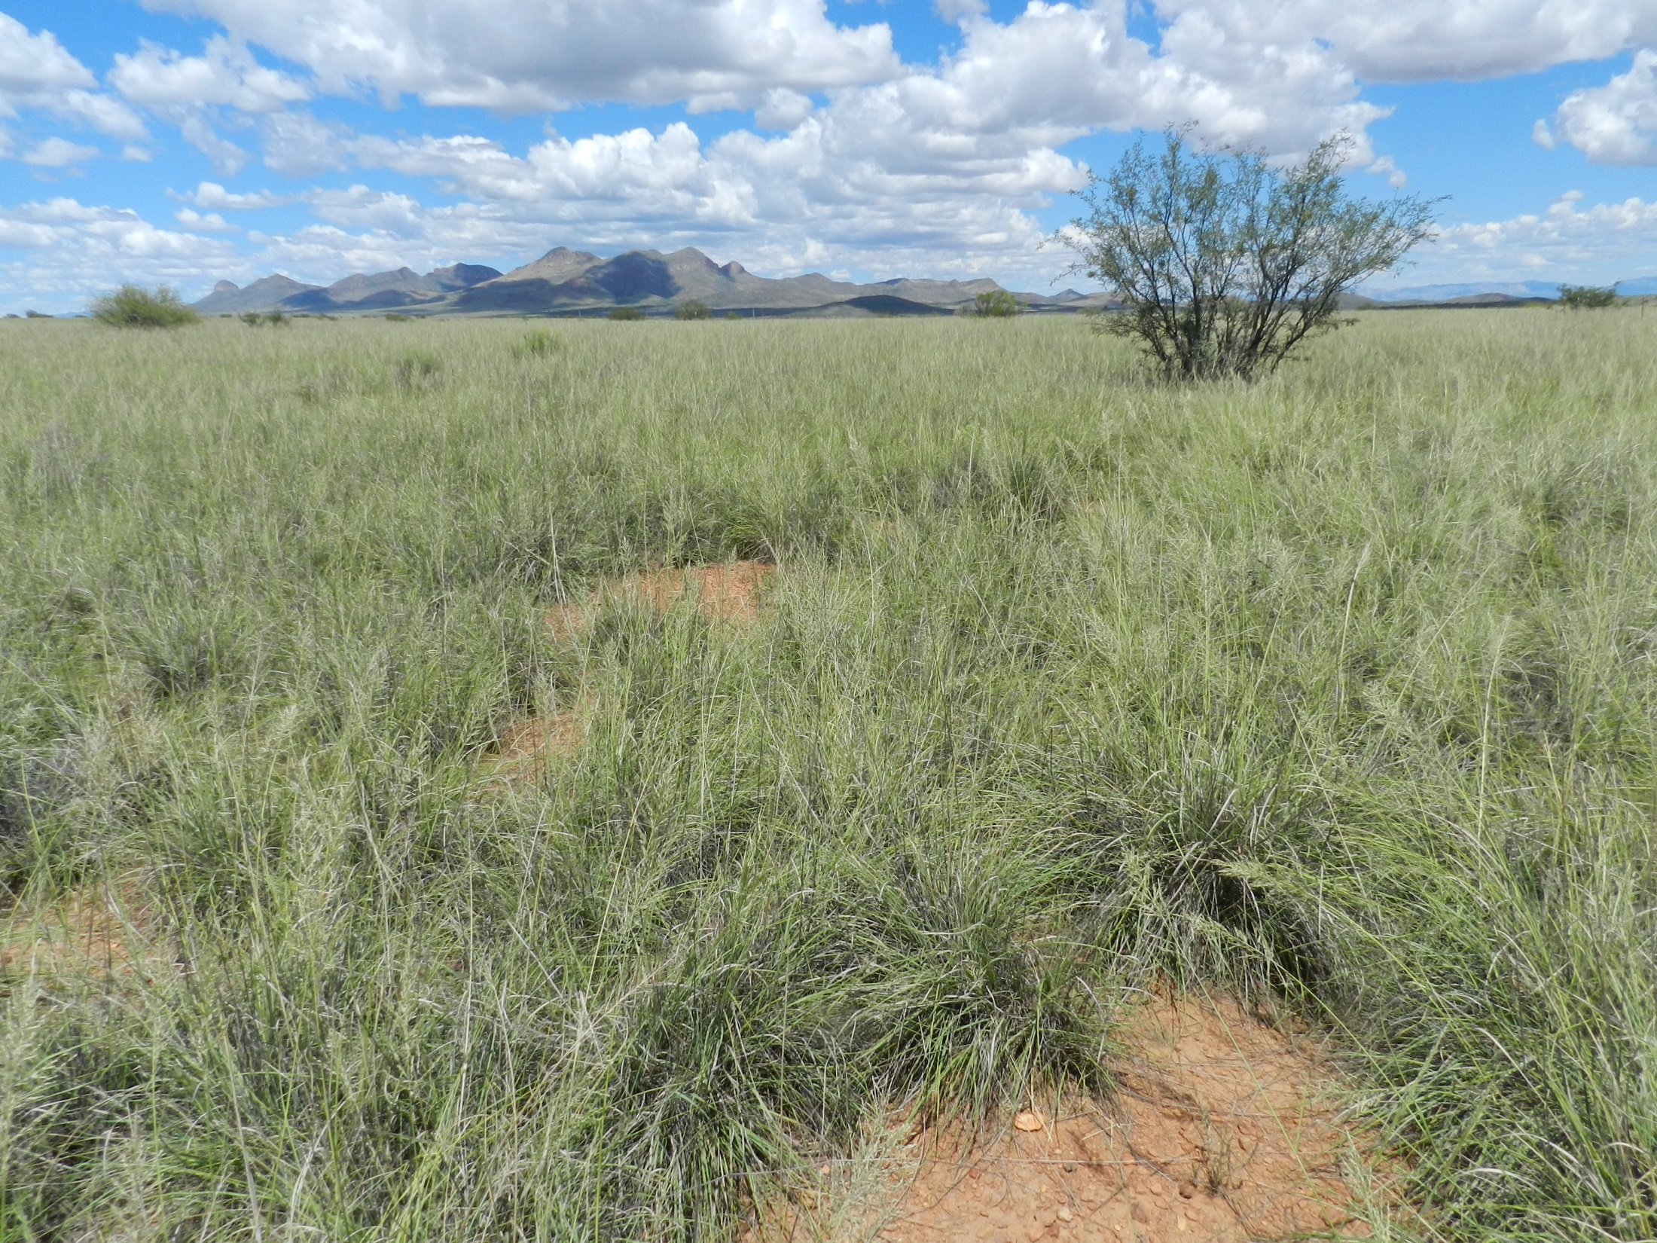
Audubon RR, 18 Upland Monitoring Transects
Monitoring began after drought – fire combination in 2002
8 Loamy Upland
  Two - native grasses continue to dominate since 2002
  Four - Lehmann / Boer lovegrass increasing to dominate since 2002
  One with Lehmann increasing, declining in 2011 drought followed by natives increasing
  One Boer lovegrass monoculture since 2002 (only 43 plant species recorded since 2003)

Slide 19
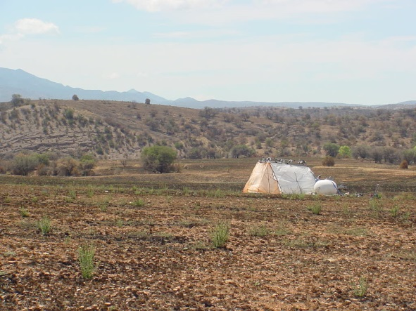
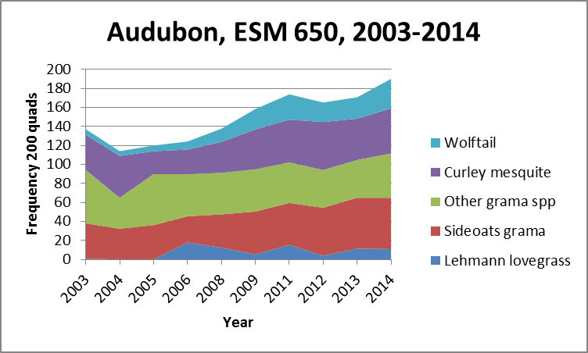
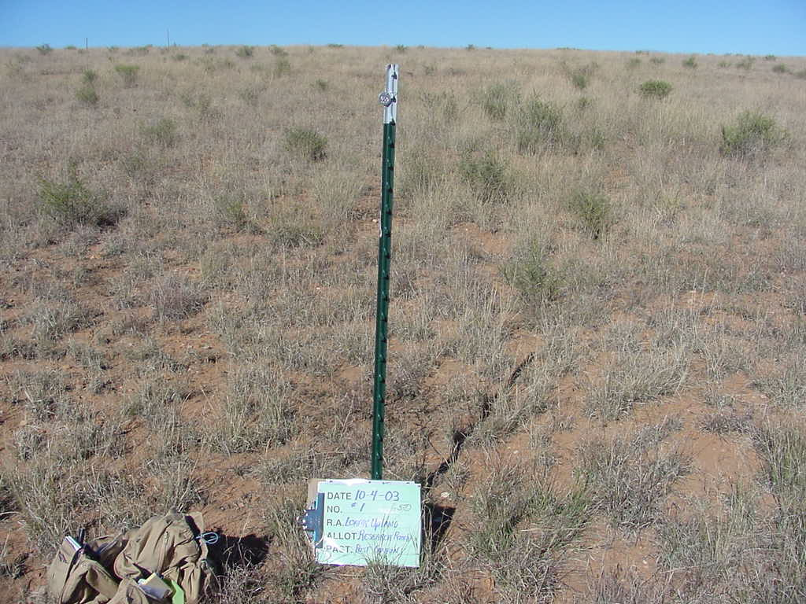
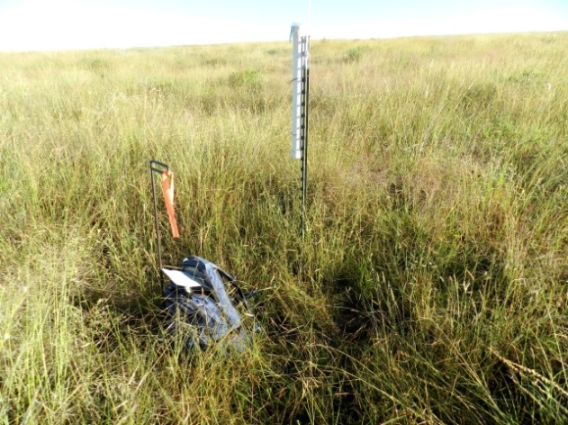
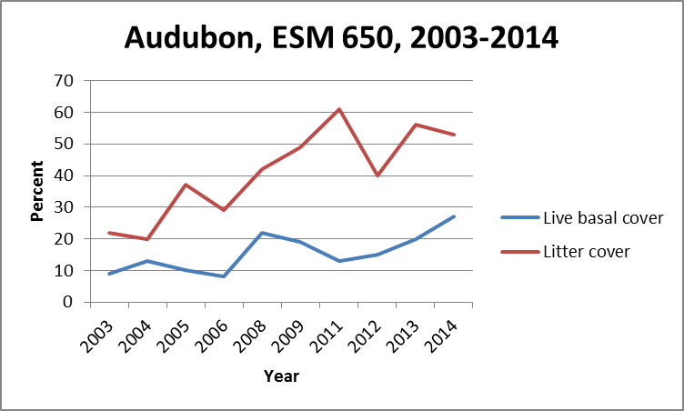
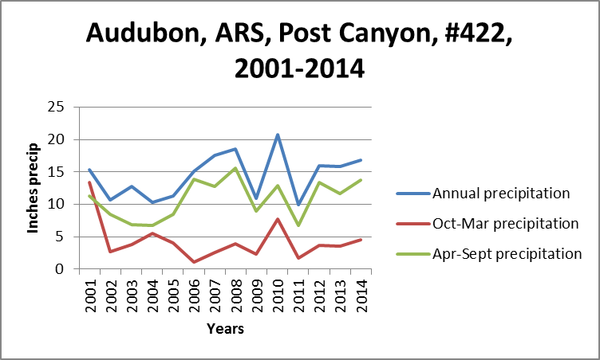
Ryan Fire, drought April-2002
ARS, 7-9-02
11-2003
9-2014
113 total species recorded in 10 years

Slide 20
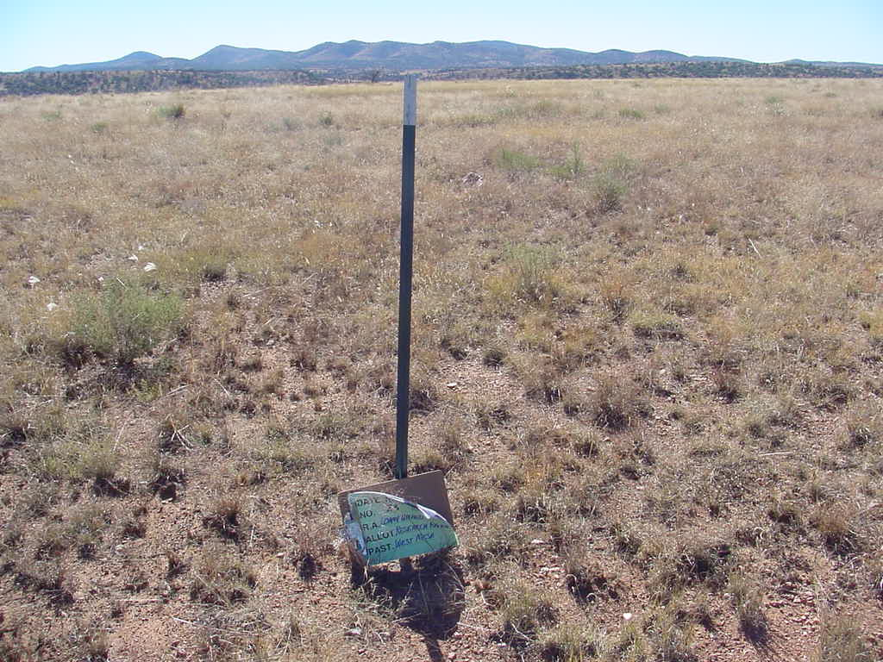
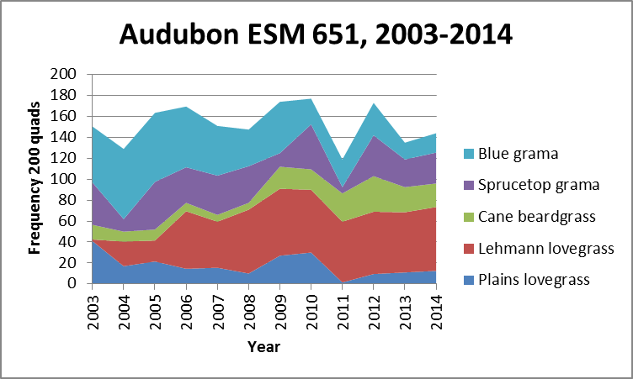
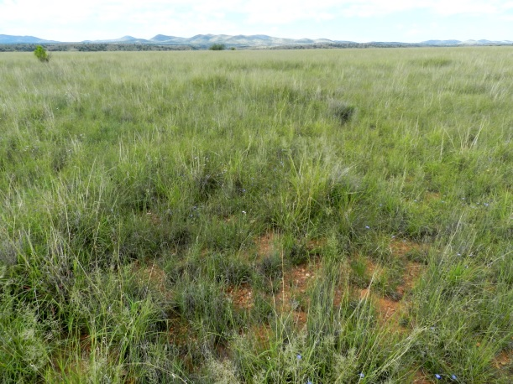
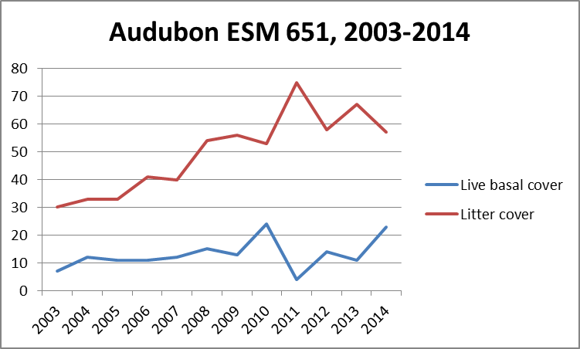
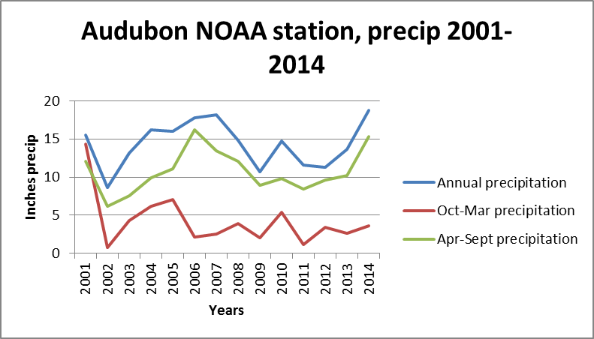
11-2003
9-2014
101 total plant species recorded in 12 years

Slide 21
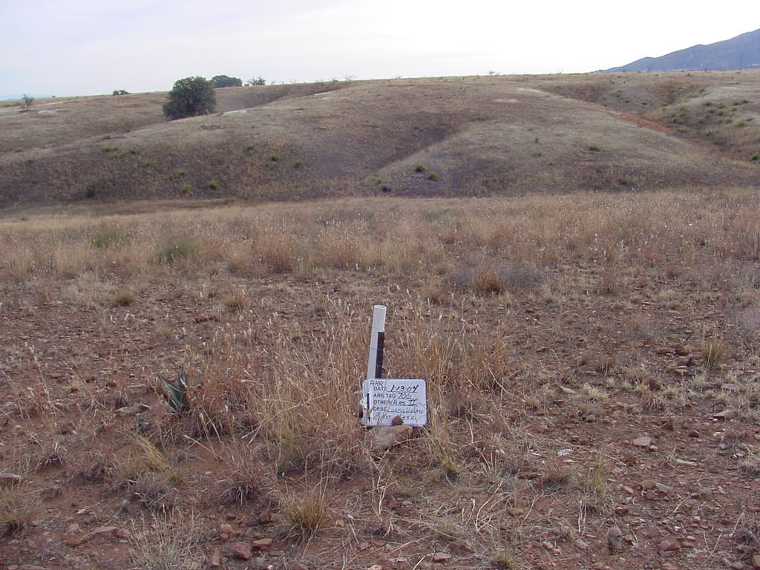
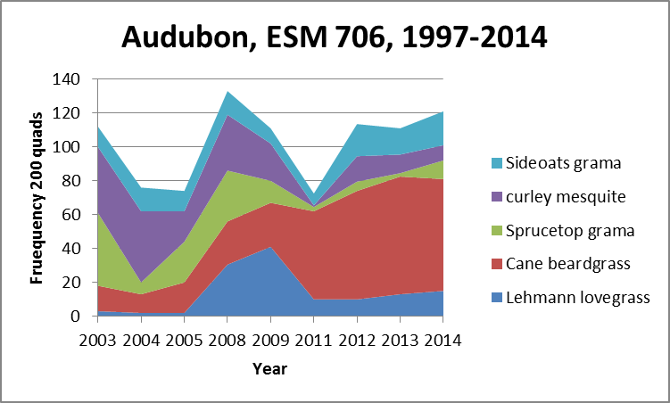
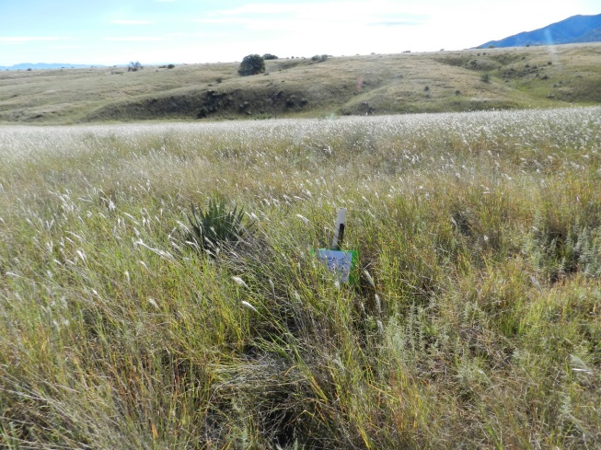


1-2004
9-2013
112 total plant species recorded in 10 years

Slide 22

Audubon Research Ranch Trends 2003-2014
Blue grama, plains lovegrass decreasing
Lehmann lovegrass increasing
Live basal cover steady or increasing
Litter cover increasing

Slide 23


Temperature
  Fore summer (Apr-June) drought longer and hotter ?
Growing season
  Earlier in spring
  Later in fall

Slide 24


Altar Valley (Anvil Ranch) precipitation

Slide 25

What does this mean for Range/Ranch Management?
Drought planning:
We use indicators throughout the year to make management decisions like;
Water availability
Previous year summer precipitation
Current year precipitation
If cool season (Jan - June) precip is:
  < 2 inches = fair chance of loss of grass cover and production
If cool season (Jan - June) precip. is:
< 1 inch = very high chance of loss
of grass cover and production

Slide 26



Other Vegetative Changes
M. James 10-20-50
5-9-14
Oak species declining

Slide 27
Acknowledgement
Ian Tomlinson
Dr. Linda Kennedy
Dr. Gita Bodner
Dr. Mary Nichols
Dr. Phil Ogden

Slide 28
Bibliography
Chasey, Richard, 2010. LEHMANN LOVEGRASS (ERAGROSTIS LEHMANNIANA NEES.) ANNOTATED BIBLIOGRAPHY. http://researchranch.audubon.org/PDFs/E_lehmanniana_annotated_bibliography_rc_6-3-10.pdf
Frank, A.B. 1996. Evaluating Grass Development for Grazing Management. RANGELANDS 18(3), June.
Goodrich, D.C., T.O. Keefer, C.L. Unkrich, M.H.Nichols, H.B. Osborn, J.J. Stone, and J.R. Smith. 2008. Long-term precipitation database, Walnut Gulch Experimental Watershed, Arizona, United States. Water Resources Research 44:W05S04
Hamerlynck EP, Scott RL, Barron-Gafford GA, Cavanaugh ML, Moran MS, Huxman TE. 2012b. Cool-season whole-plant gas exchange of exotic and native semiarid bunchgrasses. Plant Ecol 213:1229–39.
Hamerlynck EP, Scott RL, Moran MS, Keefer TO, Huxman TE. 2010. Growing season ecosystem- and leaf-level gas exchange of an exotic and native semiarid bunchgrass. Oecologia 163:561–70.
Hamerlynck, Erik P., Russell L. Scott, and Greg A. Barron-Gafford. 2013. Consequences of cool-season drought-induced plant mortality to Chihuahuan desert grassland ecosystem and soil respiration dynamics. Ecosystems 16.7 : 1178-1191.
Hamerlynck EP, Scott RL, Stone JJ. 2012a. Soil moisture and ecosystem function responses of desert grassland varying in vegetative cover to a saturating precipitation pulse. Ecohydrology 5:297–305. doi:10.1002/eco.128.
Keefer, T.O., M.S. Moran, and G.B. Paige. 2008. Long term meteorological and soil hydrology database, Walnut Gulch Experimental Watershed, Arizona, United States. Water Resources Research 44:W05S07.
King, D., S. Skirvin, C. Holifield Collins, M.S. Moran, S. Biedenbender, M. Kidwell, M.A. Weltz, and A. Diaz-Guiterrez. 2008. Assessing vegetation change temporally and spatially in southeastern Arizona. WaterResources Research 44:W05S15.
McAuliffe JR, Hamerlynck EP. 2010. Perennial plant mortality in the Sonoran and Mojave Deserts in response to severe, multiyear drought. J Arid Environ 74:885–96.
McClaran, Mitch and H. Wei. 2014. Recent drought phase in a 73 year record at two spatial scales: implications for livestock production on rangelands in the southwestern United States. Agricultural and Forest Meteorology, 197:40-51.
Moran, M.S., E.P. Hamerlynck, R.L. Scott, W.E. Emmerich, C.D. Holifield Collins. 2008. Soil Evaporative Response to Lehmann Lovegrass, Eragrostis lehmanniana, Invasion in a Semiarid Watershed. The Third Interagency Conference on Research in the Watersheds, 8-11 September 2008, Estes Park, CO.
Polyakov,V.O., M. A. Nearing, J. J. Stone, E. P. Hamerlynck, M. H. Nichols, C. D. Holifield Collins, and R. L. Scott. 2010. Runoff and erosional responses to a drought‐induced shift in a desert grassland community composition. JOURNAL OF GEOPHYSICAL RESEARCH, VOL. 115, G04027
Scott, Russ, 2014. ARS, personal communication
Scott RL, Hamerlynck EP, Jenerette GD, Moran MS, Barron-Gafford GA. 2010. Carbon dioxide exchange in semidesert grassland through drought-induced vegetation change. J Geophys Res 115:G030326.

