Slide 1
Greenbush Draw,
Naco, AZ
Drop Structure Photos
Photos from Dan Robinett
Altar Valley Watershed Restoration Retreat
December 3 – 5, 2015

Slide 2
The bridge on Greenbush draw at Naco, Az was built in 1974 and incorporates a drop structure to protect the floodplain above from head-cutting in the main channel below the bridge. The channel below is 20 feet deeper than the floodplain above. The pipe discharging water seen in some of the pictures is a recent addition in the 2000s. It is the discharge of the Bisbee waste water system's treated effluent not used for irrigation on the Naco golf course. It enters below the bridge and has created some nice riparian vegetation that otherwise would not be present.

Slide 3
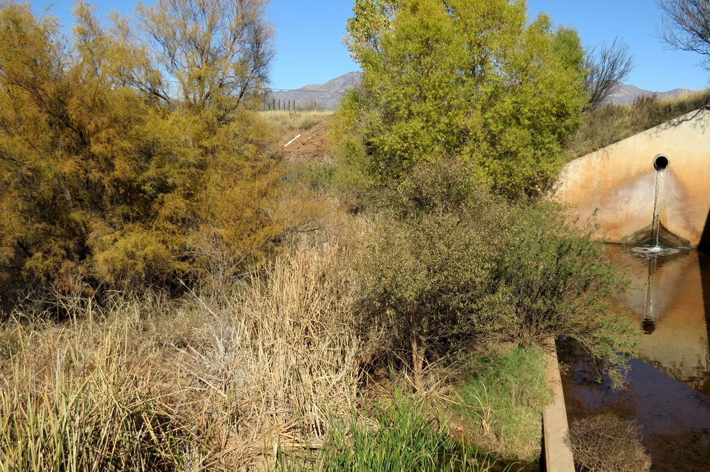
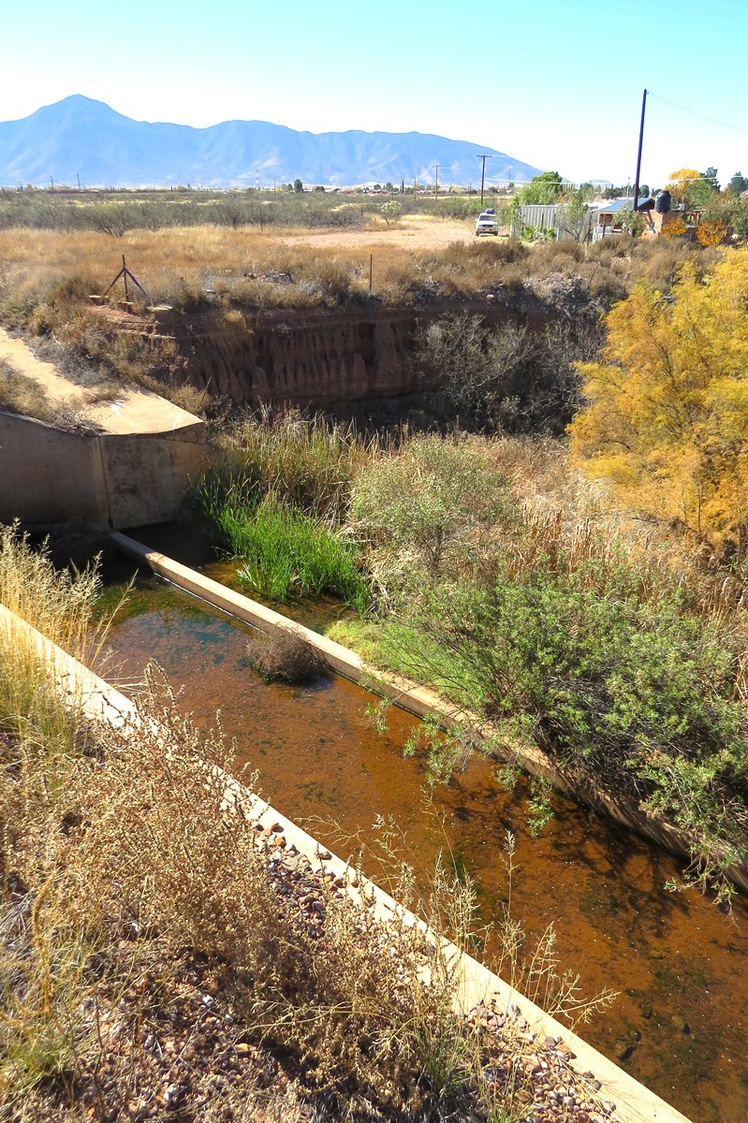
L: Naco-Don Luis bridge on Greenbush Draw, Bisbee waste water efluent pipe outlet and vegetation, 11-23-15.jpg
R: Naco-Don Luis bridge on Greenbush Draw, downstream drop structure, 11-23-15.jpg

Slide 4
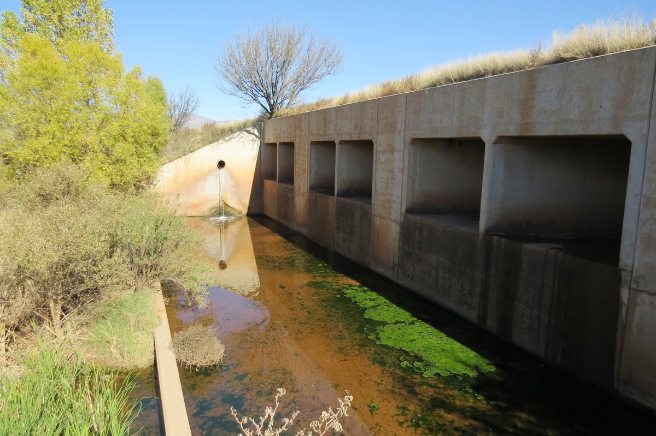
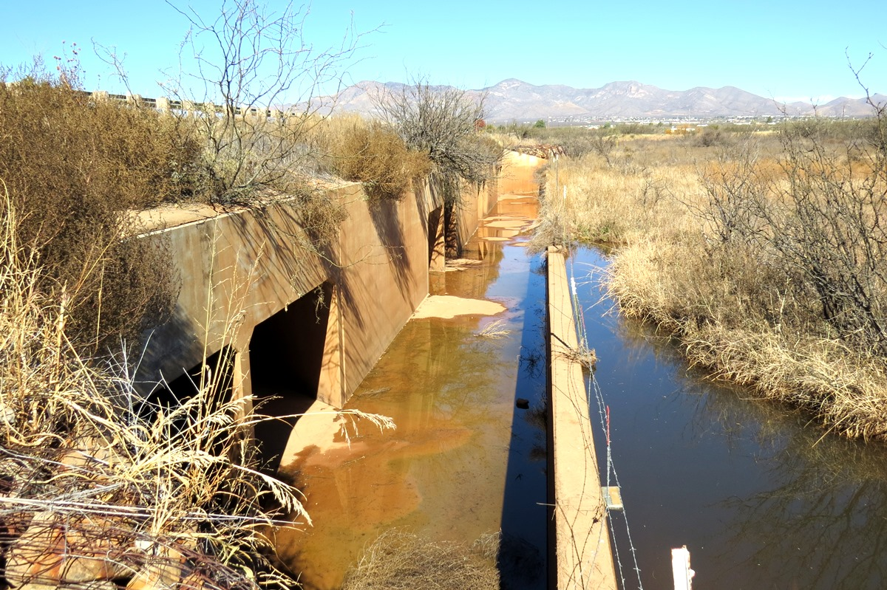
L: Naco-Don Luis bridge on Greenbush Draw, downstream drop structure, Bisbee waste water effluent pipe outlet, 11-23-15.jpg
R: Naco-Don Luis bridge on Greenbush Draw, upstream drop structure, 11-23-15.jpg

Slide 5
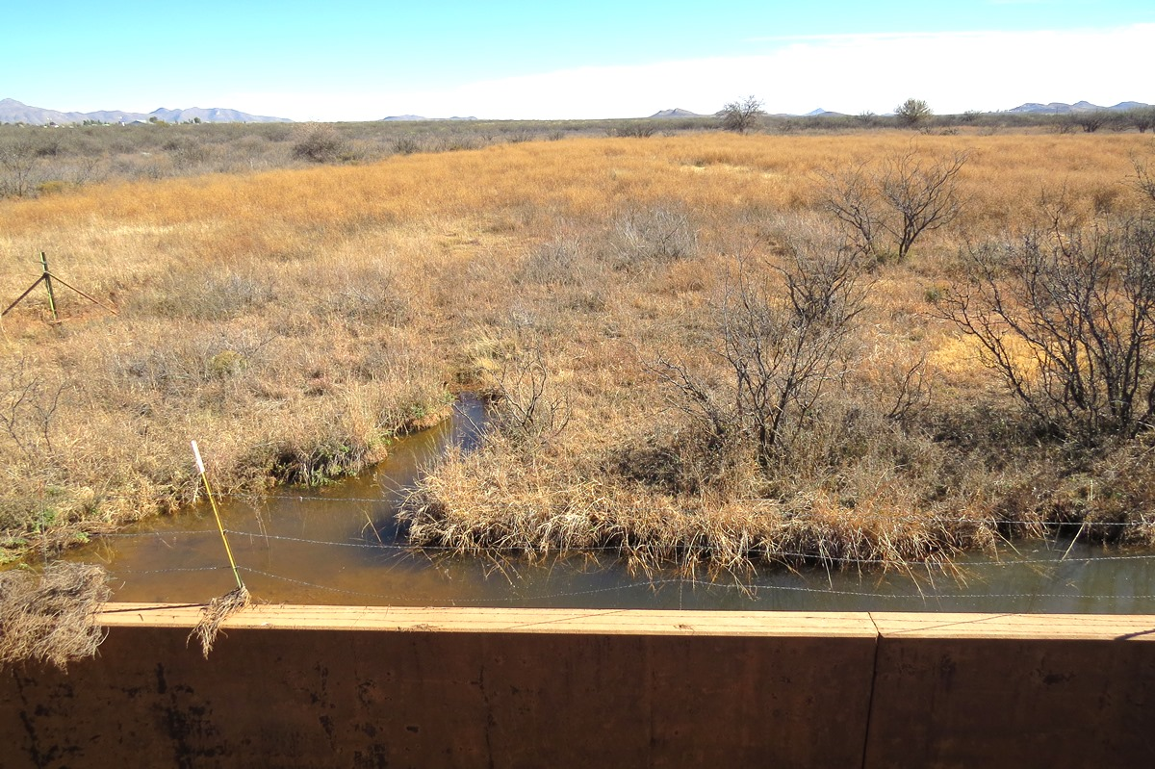
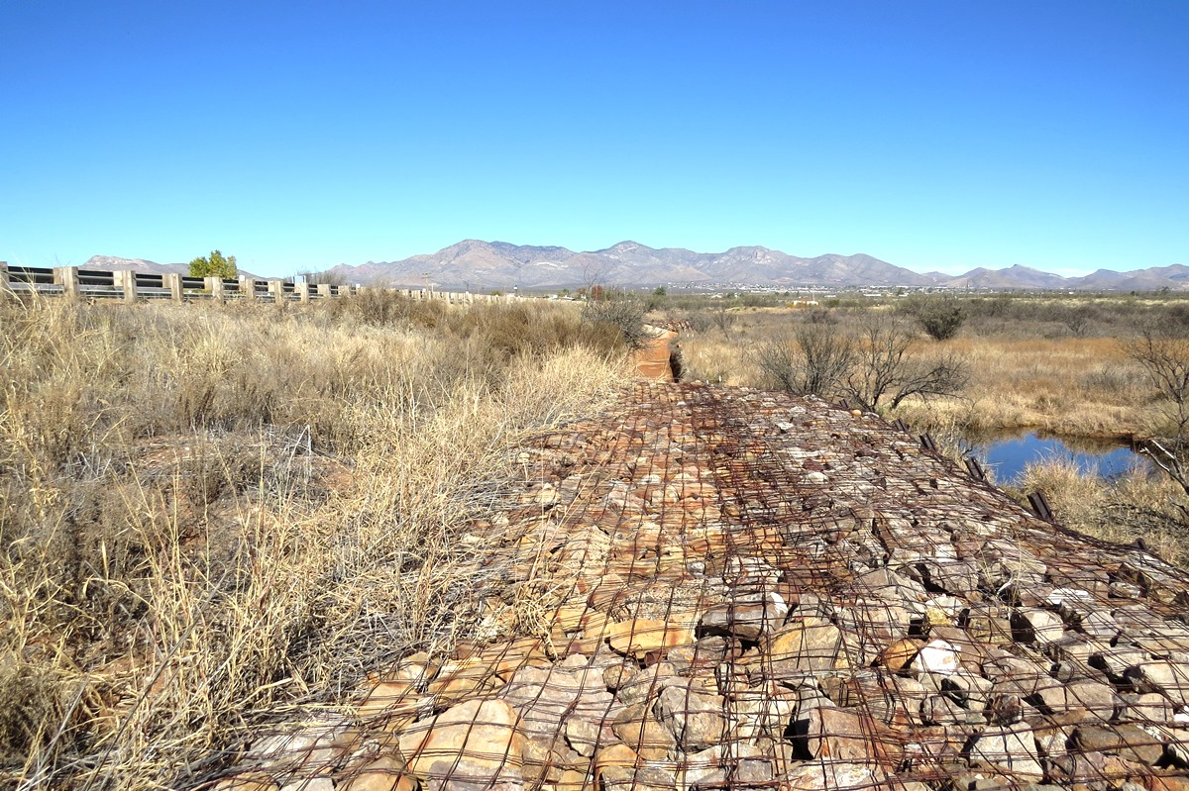
L: Naco-Don Luis bridge on Greenbush Draw, upstream floodplain, 11-23-15.jpg
R: Naco-Don Luis bridge on Greenbush Draw, upstream revetment, 11-23-15.jpg

Slide 6
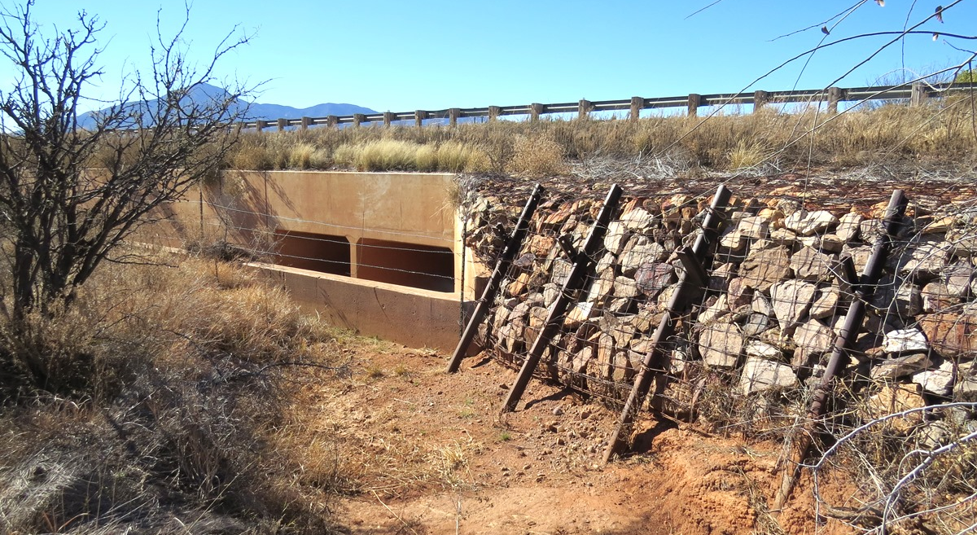
Naco-Don Luis bridge on Greenbush Draw, upstream revetment, north side, 11-23-15.jpg

