Slide 1
RAIN DATA
Altar Valley Watershed Restoration Retreat
December 3 – 5, 2015

Slide 2
Los Encinos Ranch

Slide 3
Elkhorn Ranch Data

Slide 4
Noon Ranch

Slide 5
Noon Ranch temperatures

Slide 6
Noon Ranch precipitation

Slide 7
Buenos Aires NWR rain

Slide 8
Noon Ranch precipitation

Slide 9
Anvil Ranch

Slide 10
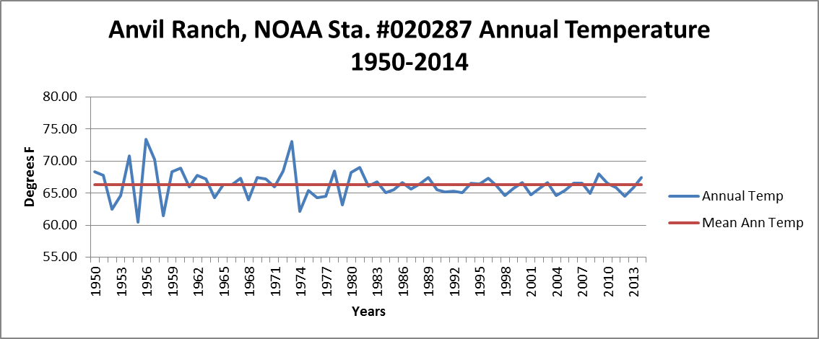

Slide 11
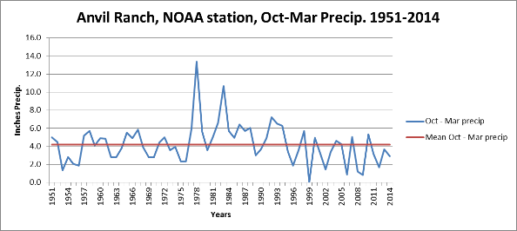
Anvil Ranch cont…

Slide 12
Anvil Ranch cont …

