Slide 1
Buenos Aires National Wildlife Refuge Gabions
Altar Valley Watershed Retreat
December 3 – 5, 2015

Slide 2
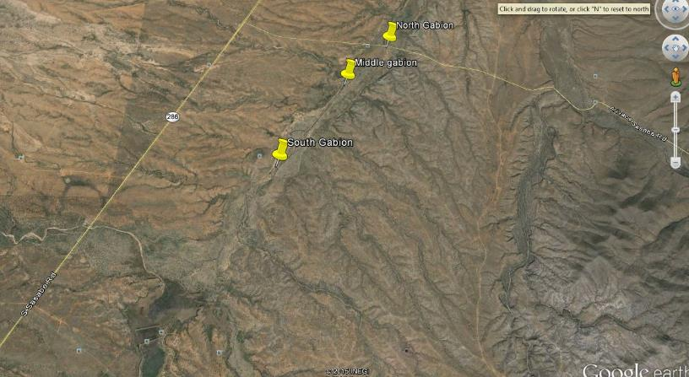
Gabion locations

Slide 3
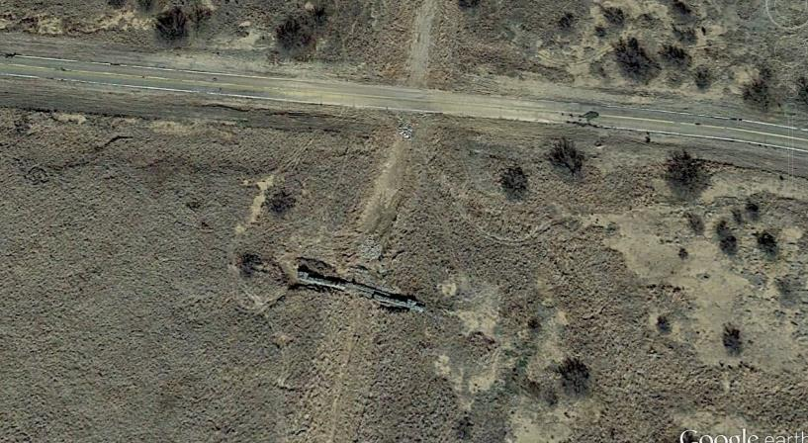
North Gabion

Slide 4
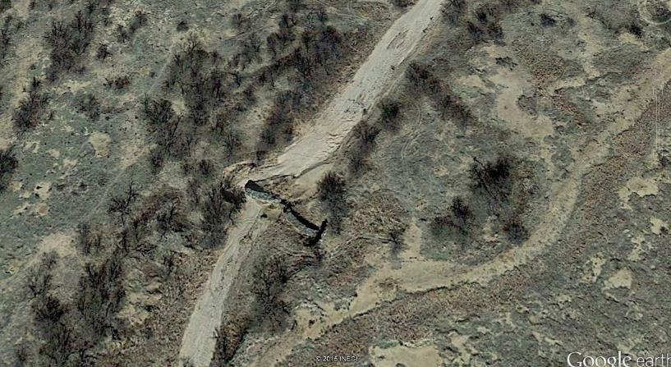
Middle Gabion

Slide 5
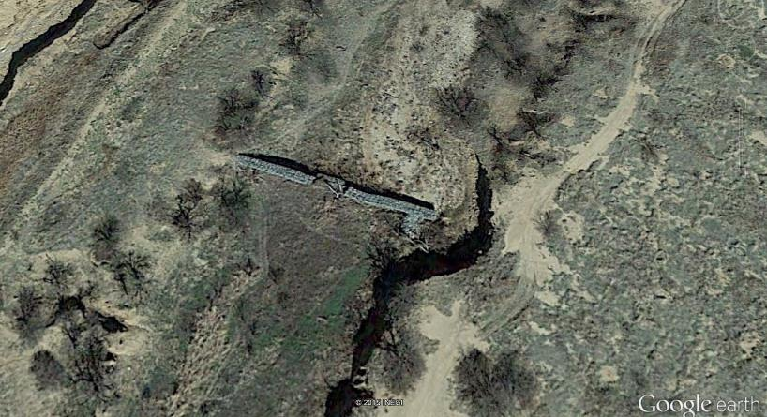
South Gabion

Slide 6
South Gabion 1999

Slide 7
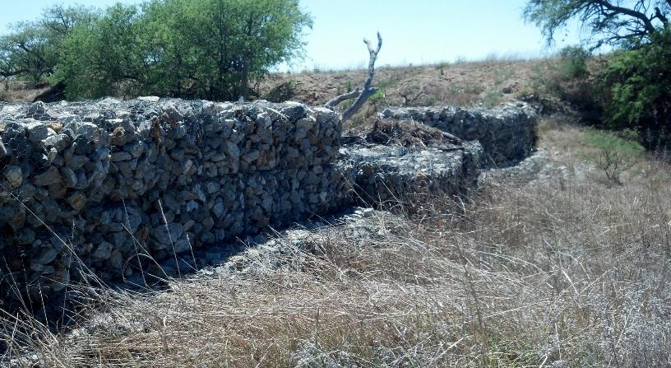
South Gabion, north side

Slide 8
South Gabion

