Slide 1
Altar Wash Photos Taken by King Family November 2015
Altar Valley Watershed Restoration Retreat
December 3 – 5, 2015

Slide 2
Vicinity of Hwy 86 Bridge and South

Slide 3
L: Anvil crossing looking south R: Bridge at Highway 86 / Ajo Highway

Slide 4
L: Looking south from Hwy 86 Bridge R: Looking south from Hwy 86 Bridge … bend in stream is location of BLM land offered to Pima NRCS in 70s/80s as potential location for soil retention structure

Slide 5
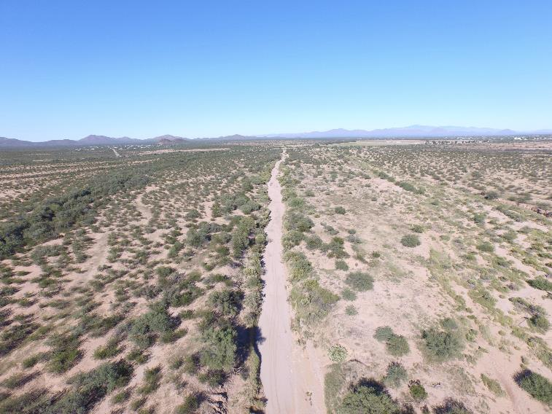
Looking north towards Hwy 86 Bridge

Slide 6
L: Vicinity of BLM land proposed for sediment retention structure looking west R: Same vicinity looking east

Slide 7
Vicinity of BLM land proposed for structure looking south

Slide 8
Anvil Headquarters Area

Slide 9
L: Looking south towards Anvil HQ area crossing R: Looking north with Anvil crossing in center

Slide 10
Pozo Nuevo Area

Slide 11
Pozo Nuevo looking south

Slide 12
Pozo Nuevo to south cont..

Slide 13
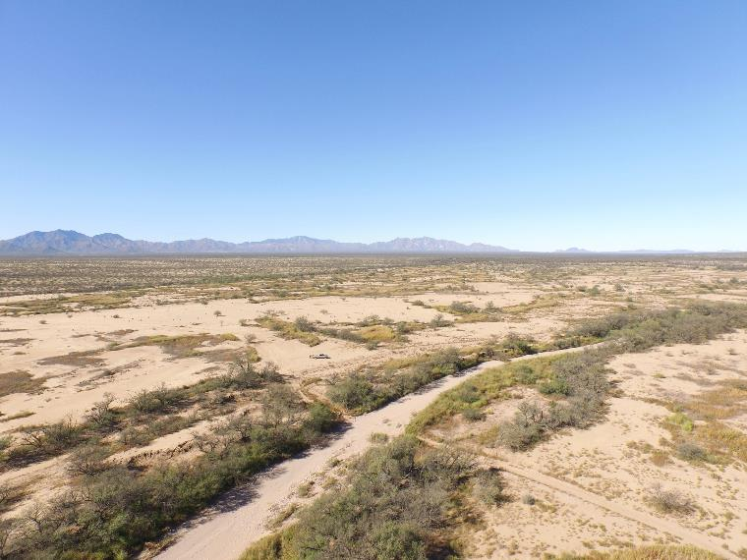
Road into Pozo Nuevo

Slide 14
Pozo Nuevo looking north …

Slide 16
Pozo Nuevo to north …

Slide 17
Cazador Area

Slide 18
L: Cazador looking south R: Cazador looking east

Slide 19
Cazador area

Slide 20
Cazador area

Slide 21
Cazador area

