Slide 1
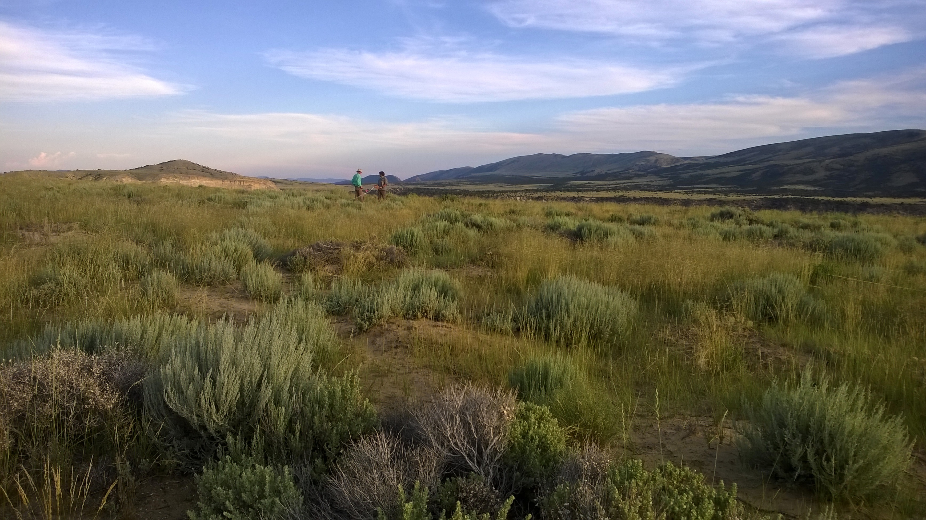
2017 Colorado State University – Rangeland Partnership Site Report
Presented by Retta Bruegger, Regional Extension Specialist for the Western Region, CSU Extension
OLD SITE: http://lib.colostate.edu/research/corange/index.html
NEW SITE: http://rangemanagement.extension.colostate.edu/

Slide 2
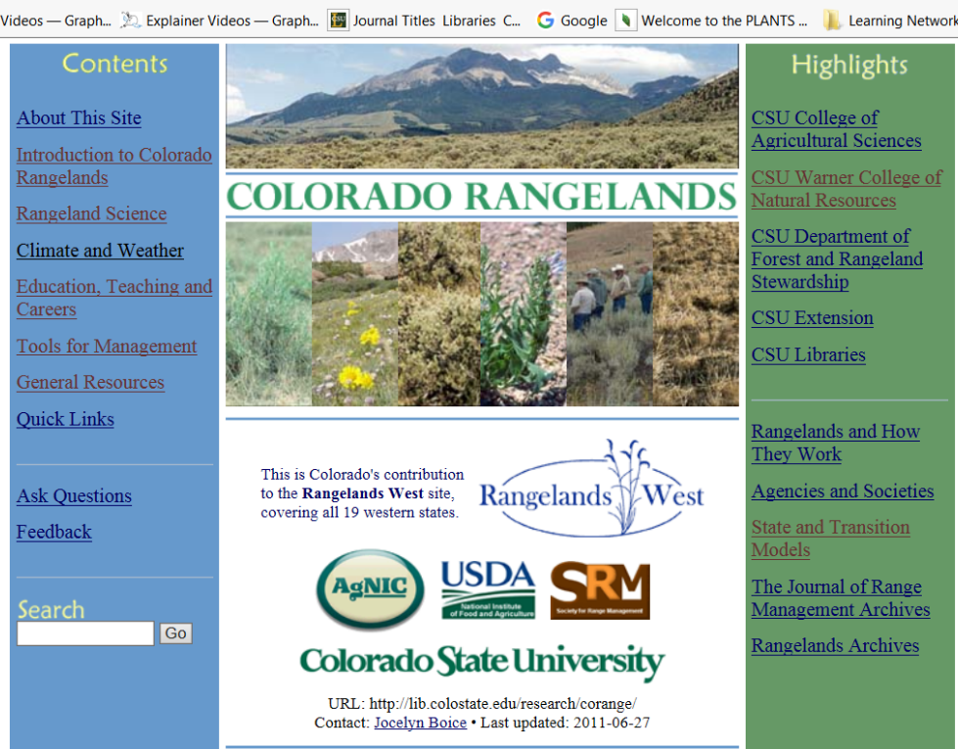
Colorado (Current but soon to retire)State Site Usage Statistics
Minimal maintenance
  Fixed broken links
Used categories to inform new organization
Deleted outdated resources
Notes:
Current website statistics for 1/1/16 – 12/31/16:
Methods used to reach the website
~48% of sessions reached site via search engine
~30% came directly to the website (i.e. typed the URL into the browser)
~22% came from another website that linked to Colorado Rangelands

Slide 3
Accessed most frequently from the US (76% of users)
Use statistics
Number of users: 363
Number of sessions - 453
Number of page views – 884

Slide 4
Current Website Continued
Accessed most frequently from computers (81%)
48% search engines to find site
30% typed the URL into the browser
22% from another website that linked to Colorado Rangelands
Notes:
Nearly 19% of sessions were on a mobile device or tablet
~48% of sessions reached site via search engine
~30% came directly to the website (i.e. typed the URL into the browser)
~22% came from another website that linked to Colorado Rangelands

Slide 5
But, we have a new site!
2016 Goals
Migrate to new platform → Done
Update links and information → Done
  Update resources on Learning from the Land → not done
Develop new content/ link to resources → Done
Work with Colorado Section for Society for Range Management

Slide 6
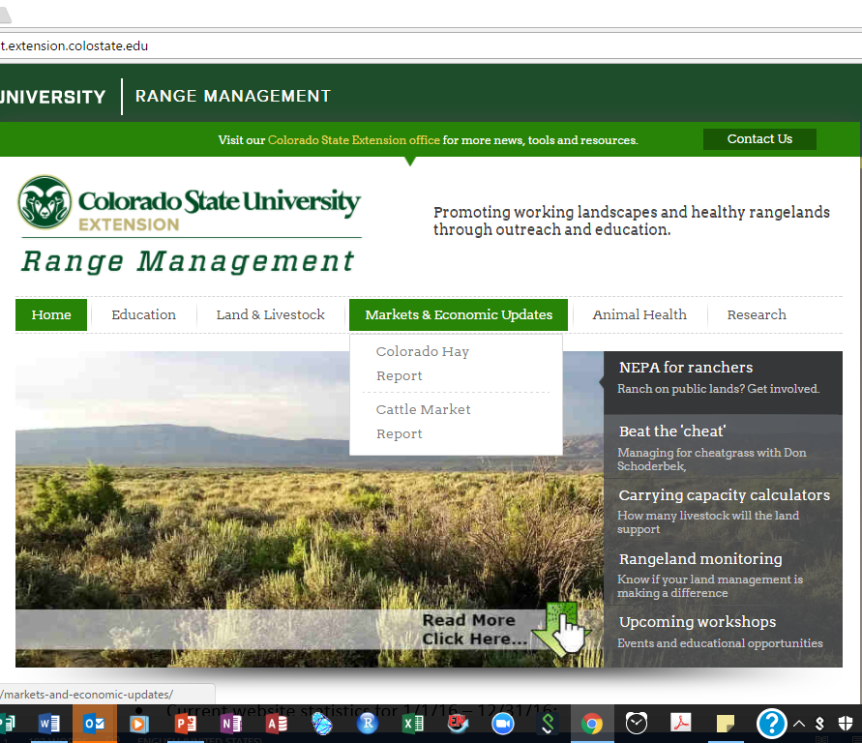
Notes:
Working on creating a new, updated CO Rangelands website that is combined with the Colorado State University Range Extension website
An undergraduate CSU student helped with initial redesign stages in the fall
Conducted interviews with potential stakeholders (12 interviews –what is most important to include, what’s unique to Colorado that we should include, who are the end users, etc).
Reviewed literature on information needs of ranchers and examined existing resources
Information gathered by the student will inform website content and design
Hope to have the new site up and running by early fall, then will retire current site
Streamline to drop dow menu
Included priority links from old site
Still working on this
Jocelyn Boyce and I have calls every other week and set goals

Slide 7
But, we have a new site!
Hosted by CSU Extension
Long list of things that are “in progress”
Need to be strategic about the content we have up there
End- User testing!

Slide 8
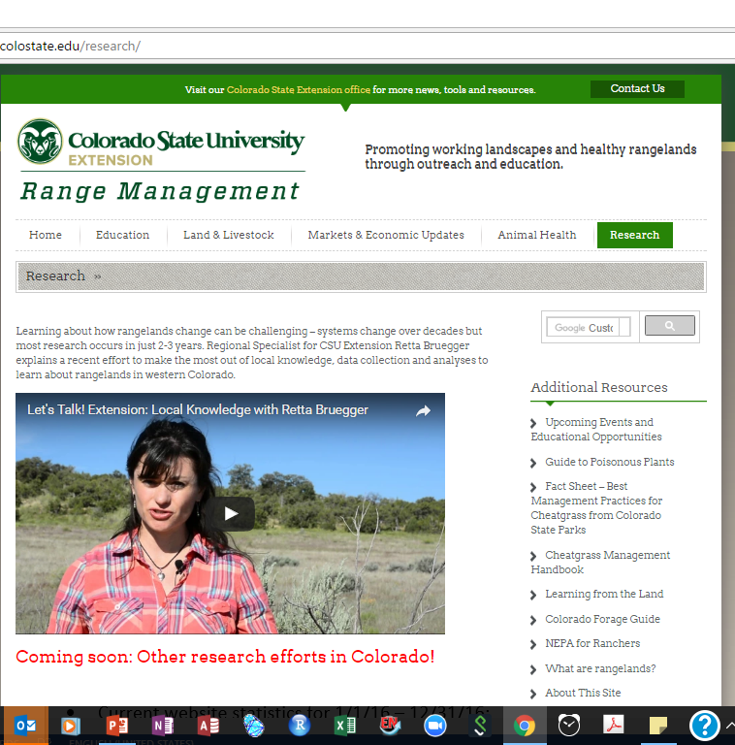
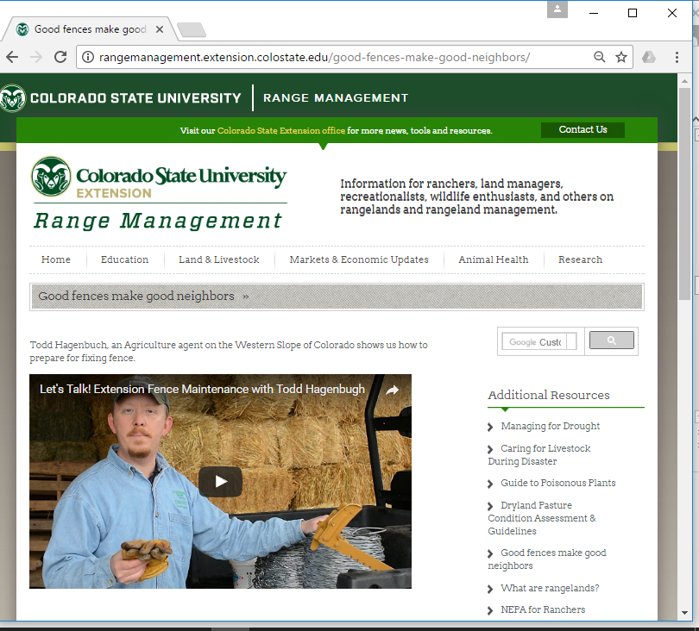
A few videos……
Notes:
Climate hub grant
What to do if you see a cow video
Other videos from Extension agents

Slide 9
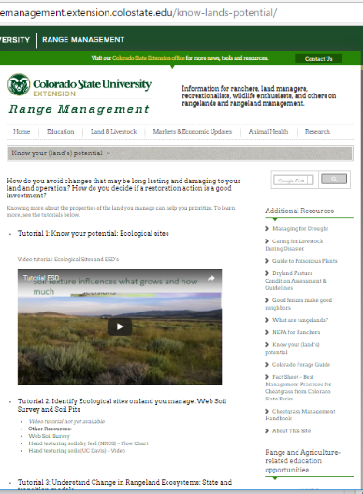
Trying out the “tutorial” approach

Slide 10
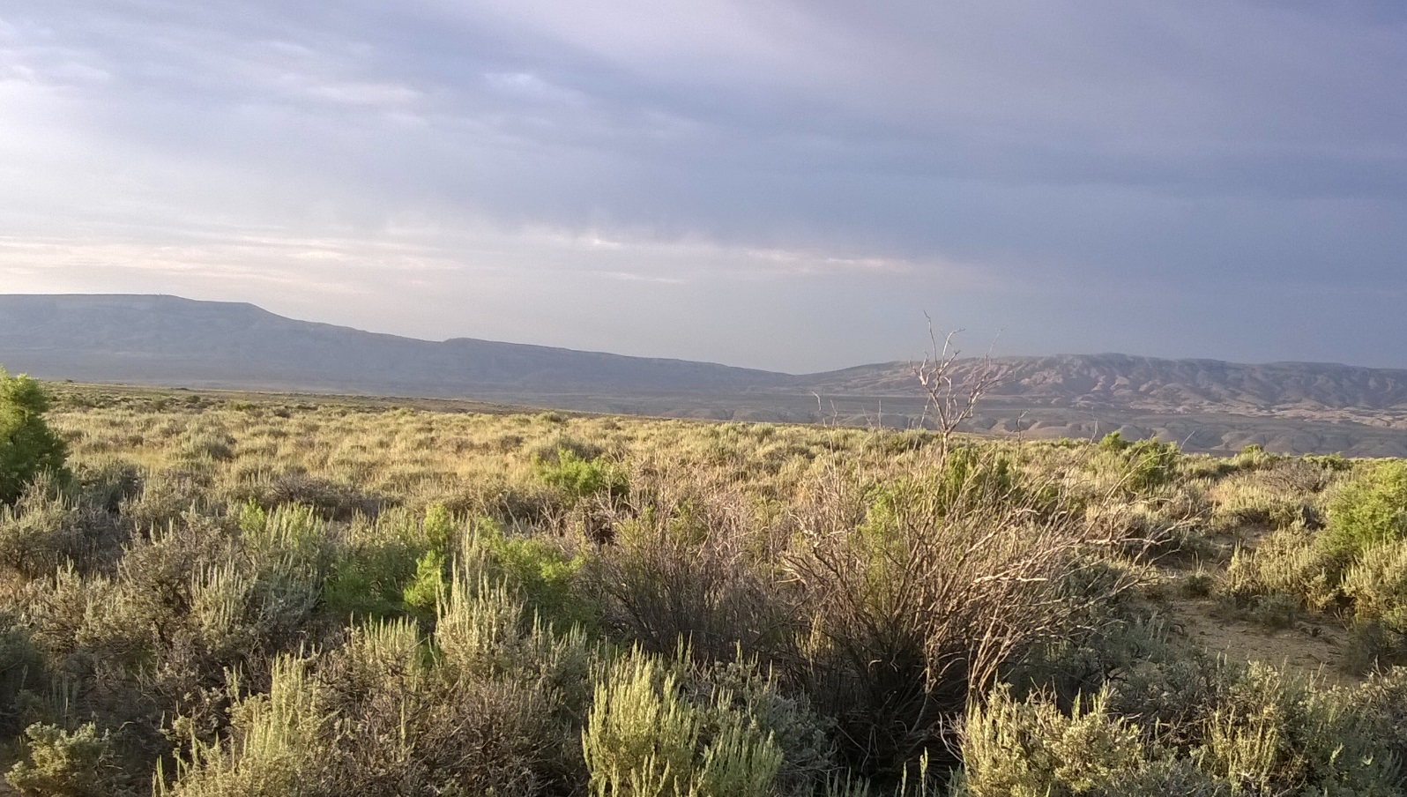
Updates from current CSU extension and research

Slide 11
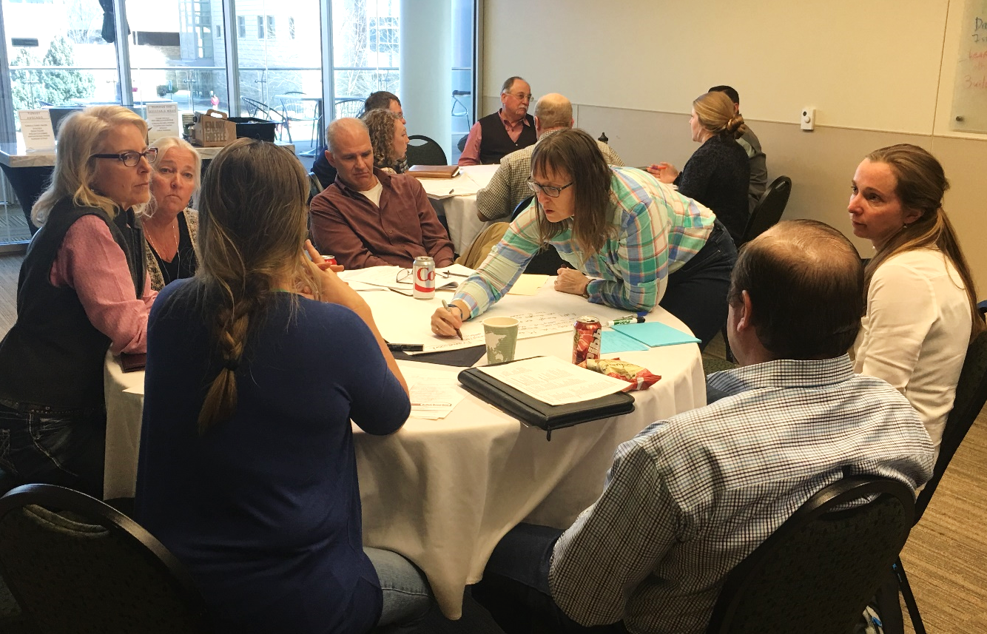
Retta’s projects
Ladies day on the range
Range Schools and Rangeland Technical Team
Need $$$ for monitoring and analyses of past FS data
Notes:
New Hire Don Schoderbeck
Range schools revival (include photo

Slide 12
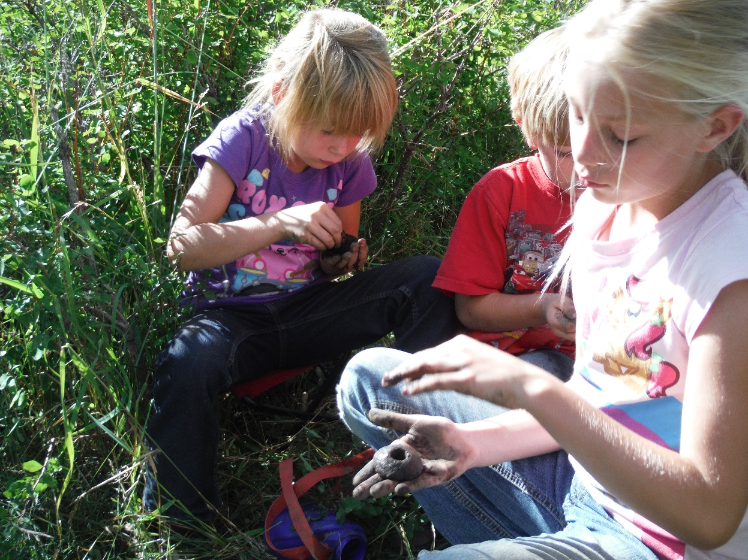
Other CSU happenings
New Regional Specialist in Range for the Eastern Plains – Donald Schoderbek!
Learning from the Land finished → several different project and students
Other

Slide 13

Thank you!
Questions?

